Slide 1
Weather Forecast Cutouts

Slide 2
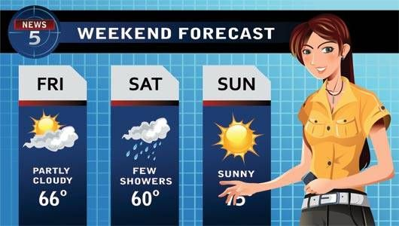

Slide 3
Prepare:
Print, Laminate, and affix Velcro tape to the following weather symbols.
Obtain a large felt board and draw a weather forecast chart on it.
I did Monday to Friday
Cut out roles:
Meteorologist
Monday
Tuesday
etc.

Slide 4
Make a forecast:
First, hand out the role cards to volunteers.
The meteorologist will come to the front.
Starting with Monday, the days of the week will make a statement. “It’s Sunny.”, “It’s rainy.”
The meteorologist must memorize the forecast and reproduce it correctly. The days of the week will check the answers.

Slide 5
Get Harder
After a few round like this, you can make things a bit more difficult.
Change the order of the days.
Allow students to make more than one statement.
Do not allow repeat statements.

Slide 14
Meteorologist
Monday

Slide 15
Tuesday
Wednesday

Slide 16
Thursday
Friday

Slide 17
Saturday
Sunday

