Slide 1
Simon Says
https://www.youtube.com/watch?v=t9WAGkQUUL0

Slide 2
Stand up / Sit down

Slide 3
Turn Around

Slide 4
Classroom Rules
Clean up
Be quiet
Listen to the teacher
Pick up your pencil
Raise your hand

Slide 5
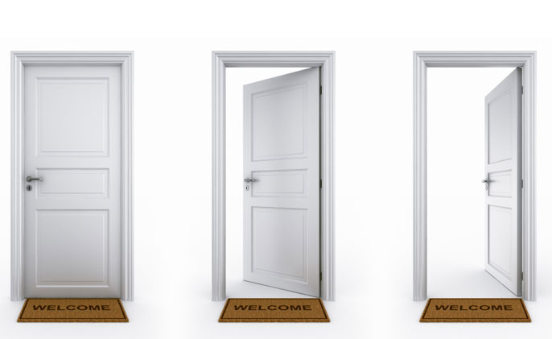
Open / Close
Book
Window
Door

Slide 6
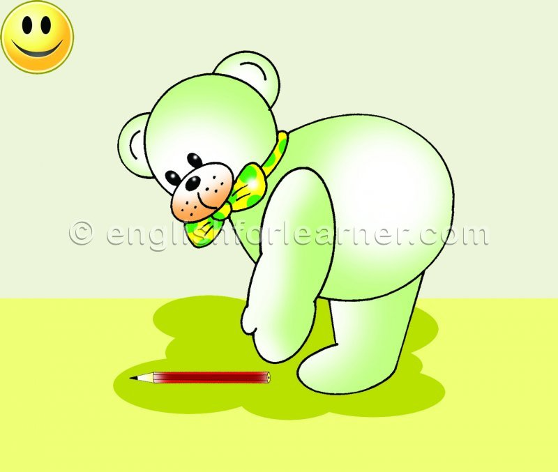
Pick up / Put down
Pencil
Book

Slide 7
Simon Says…
Listen carefully
If the teacher says, “please.” You should do the action.
If the teacher doesn’t say, “please,” don’t do it.

