Slide 1
Angry Teacher
Where is the ball?

Slide 2
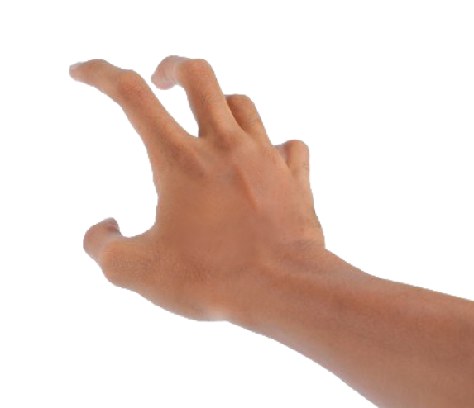

Slide 3
Where is my ball?

Slide 4
Rules
Don’t let the teacher catch you with the ball.
Whoever is holding the ball must answer the questions
If they are correct, choose a number (1,2,3) and pass the ball.
If they are incorrect, click the X button and the student is out of the game.
You can also make them stand or sit at the back of class if you’d like.
At the end of the game, whoever is still ‘in’ gets some kind of reward (or the class with the most students at the end is the winner)
To proceed to the next question, click the question box.

Slide 5
Question #1
Pass to your left
Pass to your right
Pass behind you

Slide 6
Question #2
Someone wearing red
Someone wearing blue
Someone wearing black

Slide 7
Question #3
Someone holding a pencil.
Someone NOT wearing glasses.
Someone wearing glasses

Slide 8
Question #4
A handsome boy
A pretty girl
A funny student

Slide 9
Question #5
Pass to anyone
Pass to a boy
Pass to a girl.

Slide 10
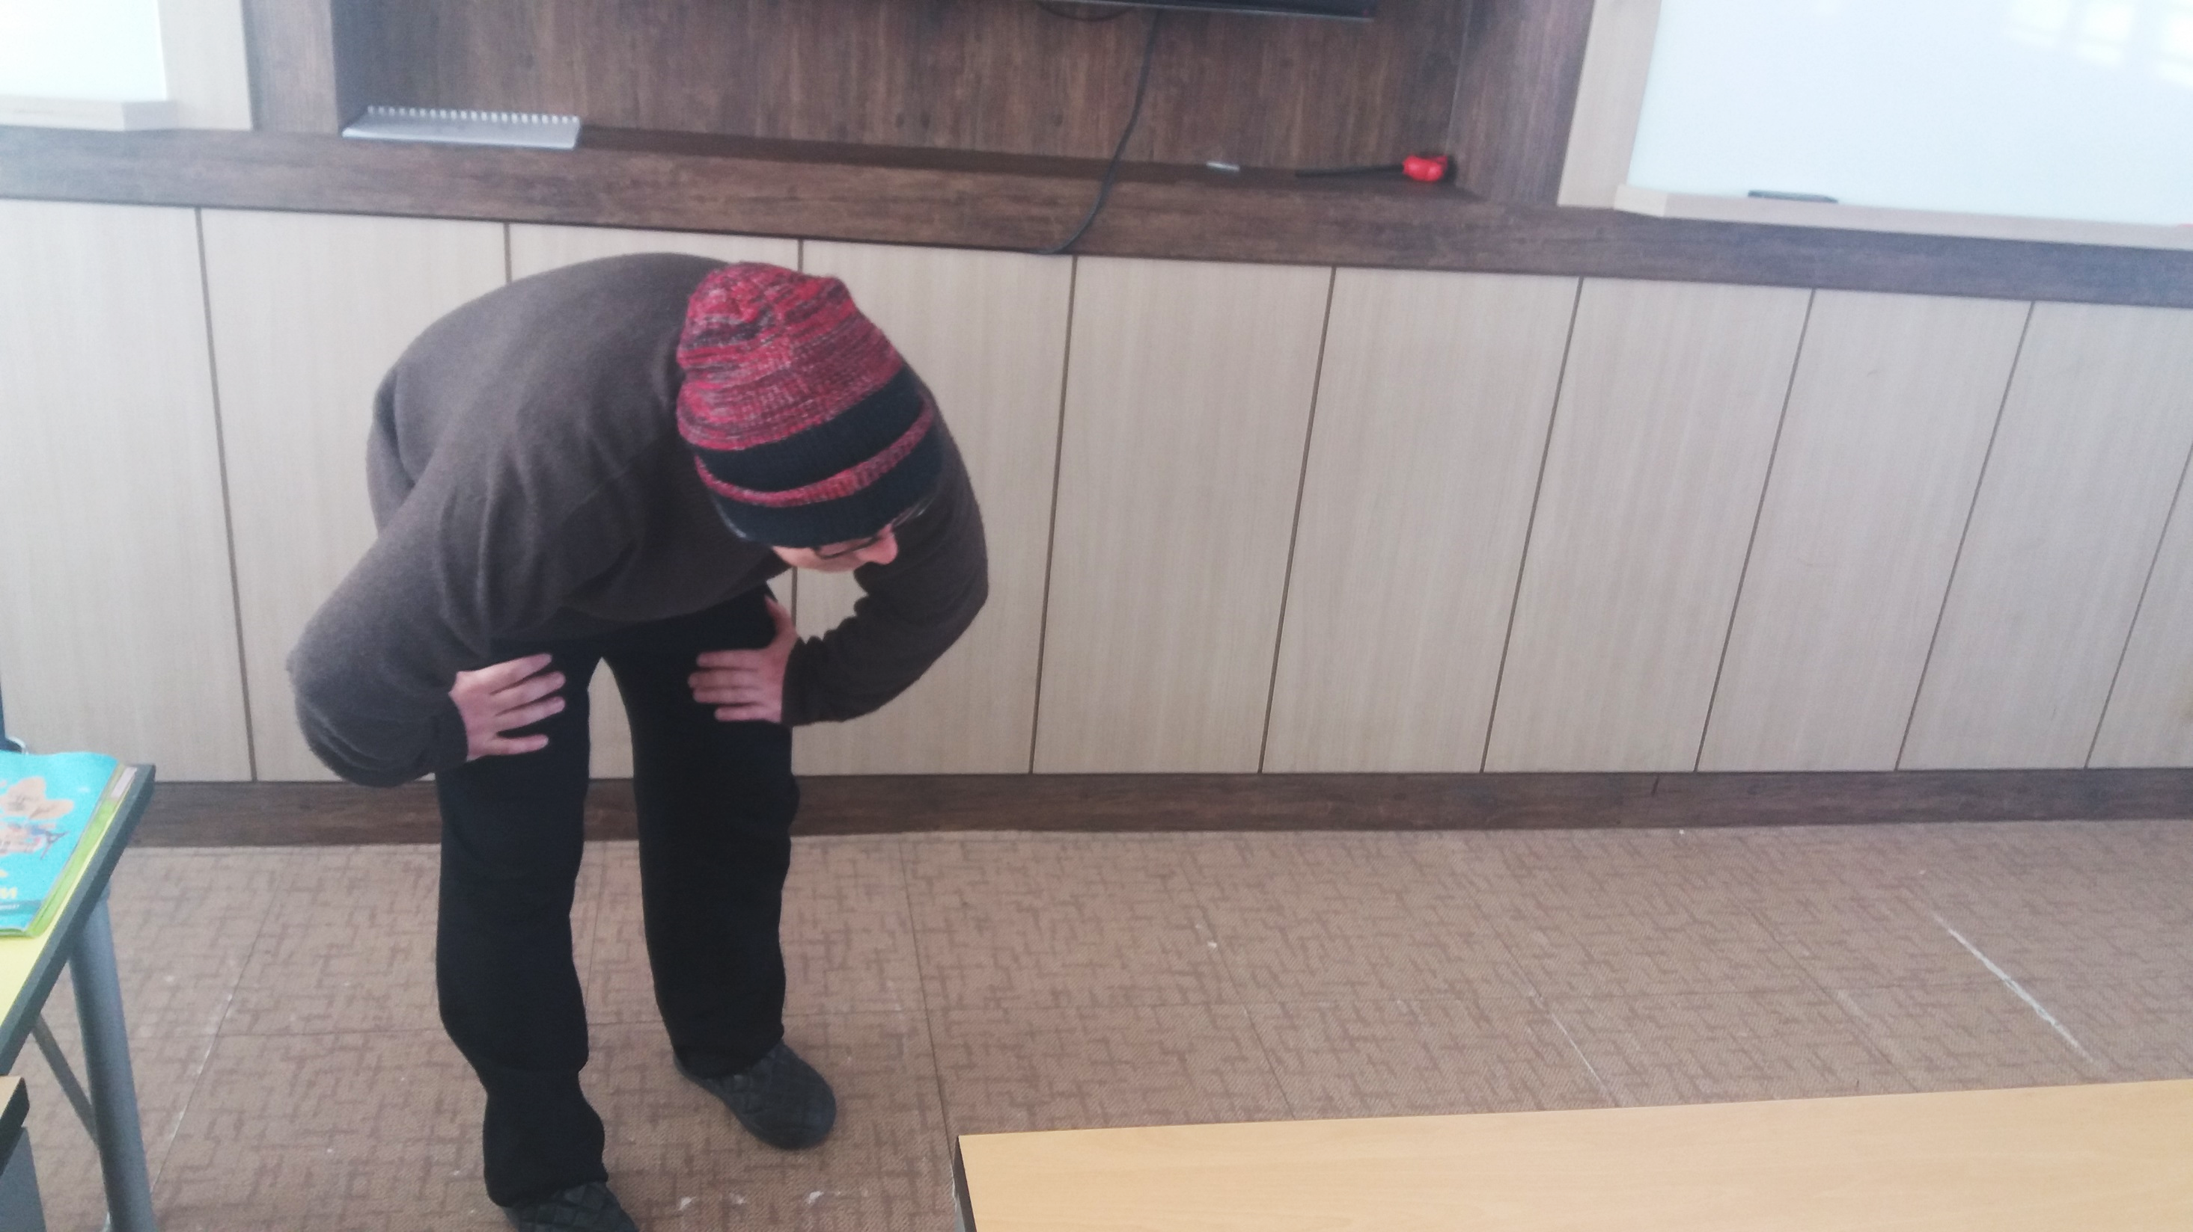
Click here

Slide 11
I caught you!

Slide 12
Question #6
Pass without standing
Pass without looking
Pass to anyone

Slide 13
Question #7
Someone wearing yellow
Someone wearing green
Someone wearing orange

Slide 14
Question #8
The nicest person
The happiest person
The slowest person

Slide 15
Question #9
Beside you
Behind you
In front of you

Slide 16
Question #10
Pass with your foot
Pass to with your head
Pass with your neck

Slide 17
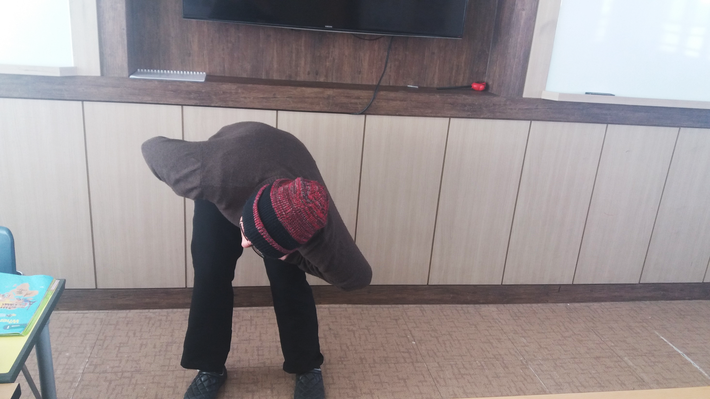
Click here

Slide 18
I caught you!

Slide 19
Question #11
Pass to your friend
Pass to a boy
Pass to a girl

Slide 20
Question #12
Someone wearing white
Someone wearing a watch
Someone wearing accessories

Slide 21
Question #13
Pass to any student
Pass to the teacher
Pass to any student

Slide 22
Question #14
Pass to the smartest student
Pass to shortest student
Pass to the tallest student

Slide 23
Question #15
Someone in your row
Someone in another row
The person beside you

Slide 24
Click here

Slide 25
I caught you!

Slide 26
Question #16
Pass to your left
Pass to your right
Pass behind you

Slide 27
Question #17
Someone with long hair
Someone with short hair
Someone with straight hair.

Slide 28
Question #18
A used eraser.
A short pencil
A cute pencil case

Slide 29
피구#19
A good soccer player
A good dodgeball (피구) player
A good computer game player

Slide 30
Question #20
Someone who likes to read.
Someone who likes to play sports.
Someone who likes to eat kimchi.

Slide 31
Click here

Slide 32
I caught you!

Slide 33
Question #21
Pass to your left
Pass to your right
Pass behind you

Slide 34
Question #22
Someone wearing red
Someone wearing blue
Someone wearing black

Slide 35
Question #23
Someone with a pencil.
Someone NOT wearing glasses.
Someone wearing glasses.

Slide 36
Question #24
A handsome boy
A pretty girl
A funny student

Slide 37
Question #25
A boy
A girl
Anyone

Slide 38
Click here

Slide 39
I caught you!

Slide 40
Question #26
Pass without standing up
Pass without looking
Pass to anyone

Slide 41
Question #27
Someone wearing green
Someone wearing orange
Someone wearing yellow

Slide 42
Question #28
A nice student.
A happy student
Someone who runs slowly.

Slide 43
Question #29
The student beside you.
The student behind you.
The student in front of you.

Slide 44
Question #30
Pass with your neck.
Pass with your head.
Pass with your foot.

Slide 45
Click here

Slide 46
I caught you!

Slide 47
Question #31
Pass to your friend
Pass to a boy
Pass to a girl

Slide 48
Question #32
Someone wearing white
Someone wearing a watch
Someone wearing accessories

Slide 49
Question #33
Pass to any student
Pass to the teacher
Pass to any student

Slide 50
Question #34
Pass to the smartest student
Pass to shortest student
Pass to the tallest student

Slide 51
Question #35
Someone in your row
Someone in another row
The person beside you

Slide 52
Click here

Slide 53
I caught you!

Slide 54
Question #36
Pass to your left
Pass to your right
Pass behind you

Slide 55
Question #37
Someone with long hair
Someone with short hair
Someone with straight hair.

Slide 56
Question #38
A used eraser.
A short pencil
A cute pencil case

Slide 57
피구#39
A good soccer player
A good dodgeball (피구) player
A good computer game player

Slide 58
Question #40
Someone who likes to read.
Someone who likes to play sports.
Someone who likes to eat kimchi.

Slide 59
Click here

Slide 60
I caught you!

Slide 61
The End

