Slide 1

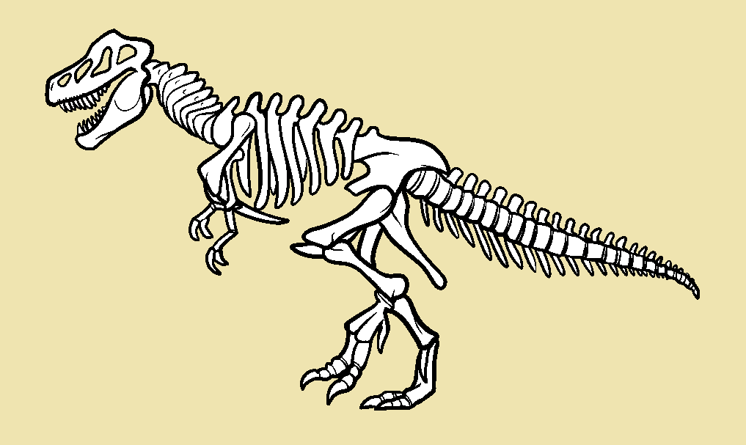
Digging Up Bones
Review Game

Slide 2
Prepare:
Print a copy of the bones for each team and cut them out.
Note that there are 4 sets hidden in each puzzle. There is a small chance that a skeleton can’t be completed based on how students guessed. In the simplest of terms, if 4 of any type of bone are revealed, move on to the next slide.
In this case, just move on to the next puzzle and allow the students to keep their puzzle pieces.

Slide 3

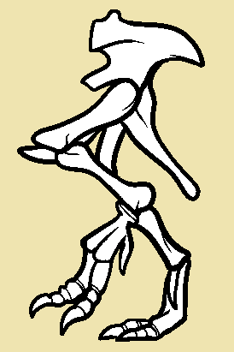
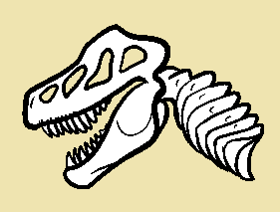
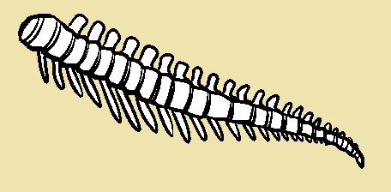
Rules:
Ask the students questions
When a student answers a question correctly, they may choose a number
Click the number
A team wins when they collect a whole skeleton (3 pieces)

Slide 5
1
6
11
16
21
2
7
12
17
22
Digging Up Bones
3
8
13
18
23
4
9
14
19
24
5
10
15
20
25

Slide 6
1
6
11
16
21
2
7
12
17
22
Digging Up Bones
3
8
13
18
23
4
9
14
19
24
5
10
15
20
25

Slide 7
1
6
11
16
21
2
7
12
17
22
Digging Up Bones
3
8
13
18
23
4
9
14
19
24
5
10
15
20
25

Slide 8
1
6
11
16
21
2
7
12
17
22
Digging Up Bones
3
8
13
18
23
4
9
14
19
24
5
10
15
20
25

Slide 9
1
6
11
16
21
2
7
12
17
22
Digging Up Bones
3
8
13
18
23
4
9
14
19
24
5
10
15
20
25

