Slide 1
Faces
Rules for Kid’s version

Slide 2
How to Play:
Separate students into groups
Pass out a small stack of cards (approx. 25) as randomly as possible to each group.
The students will spread all of their cards over the table so all players can see.
One student (the leader) will describe one of the faces.
Including the key phrases, “She / He has ______ ______.” and “She/ He looks like a __________”
Students must find a character matching the description.
They are only allowed to choose one card each round and can’t replace it after they hear other clues.
However, the longer they wait, the more description they hear.
The leader reveals which card they choose and that player gets the point.
Put all the cards back.
The winner becomes the new leader.

Slide 3
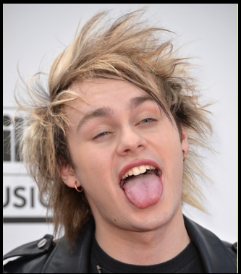
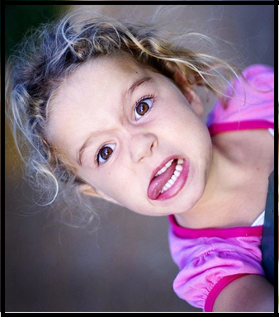
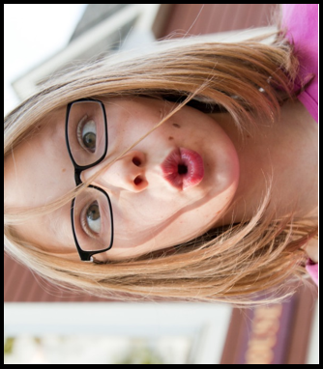
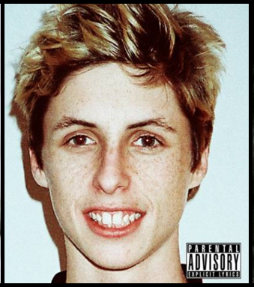
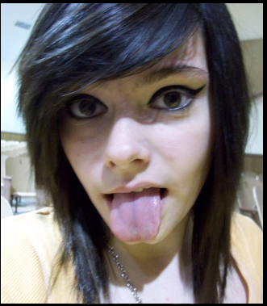
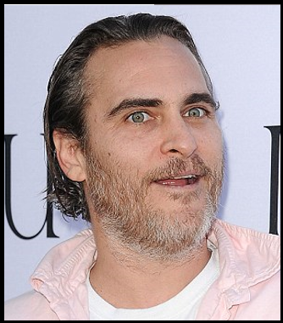
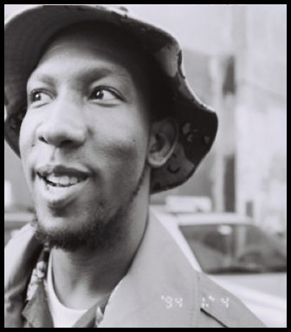
How to Play:
Put all the cards in the middle.

Slide 4
How to Play:
Choose a leader

Slide 5
How to Play:
The leader describes a face.
She has blonde hair.
She has big eyes.
She is wearing glasses.

Slide 6
How to Play:
The other students can choose one card.
(You can’t change it)

Slide 7
How to Play:
After everyone has a card, the leader tells the answer.

Slide 8
How to Play:
The winner becomes the new leader.

Slide 9
How to Play:
How many times did you win?

