Slide 1
Random Feeling

Slide 2
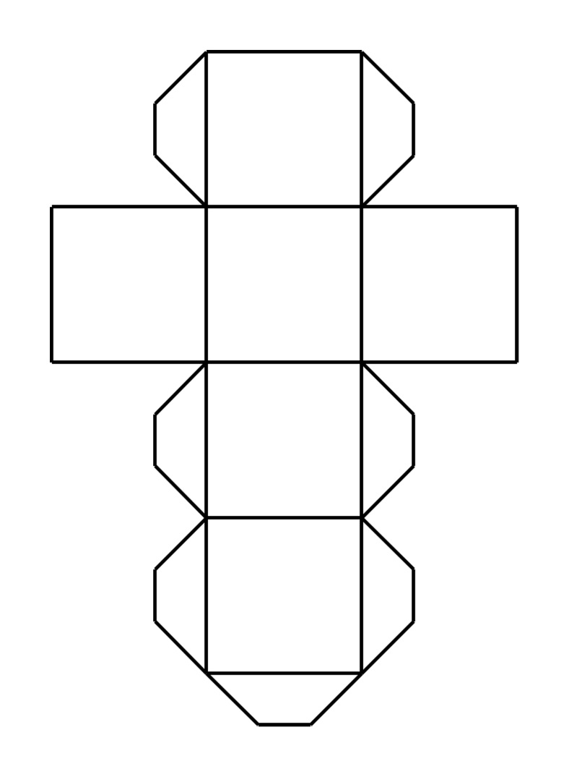
Create a dice:
Talk with your partner about the feelings you want to put on the dice.
You can use feelings from last class too!
Cut and paste to make the dice.

Slide 3
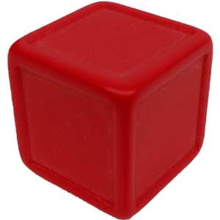
How to Play:
Why are you happy?
I’m happy because I got a new ball.
Happy

Slide 4
How to play:
A: Roll the dice and ask your partner: “Why are you _______?”
B: Answer the question:
“I’m _______ because _________.”
Pass the dice and repeat.
If a student can’t answer OR uses the same answer as before, they lose.
Pass the dice to the next group and play again.

