Slide 1
Ask and Draw Game

Slide 2
How to play:
Give each student a blank piece of paper (a good time to use scrap paper) and access to some coloring pencils.
Students can ask about the description using, “Does he / she have ____ _____?” or “Is he / she wearing ______?”
Click on the appropriate box to reveal the answer.
When the students are satisfied with their answers, click on the silhouette to see the answer.
The student with the picture closest to the answer is the winner.
You can play multiple times

Slide 3
Choose Your Suspect
Faces
Clothes

Slide 4
Black Hair
Big Eyes
Blonde Hair
Small Eyes
Brown Hair
Blue Eyes
Big Nose
Red Hair
Yes, she does.
No, she doesn’t.
Brown Eyes
Small Nose
Grey Hair
Green Eyes
Purple Hair
Big Mouth
Curly Hair
Long Hair
Small Mouth
Straight Hair
Average Hair
Wavy Hair
Short Hair

Slide 5
Start

Slide 6
Black Hair
Big Eyes
Blonde Hair
Small Eyes
Brown Hair
Blue Eyes
Big Nose
Red Hair
Brown Eyes
Small Nose
No, she doesn’t.
Yes, she does.
Grey Hair
Green Eyes
Purple Hair
Big Mouth
Curly Hair
Long Hair
Small Mouth
Straight Hair
Average Hair
Wavy Hair
Short Hair

Slide 7
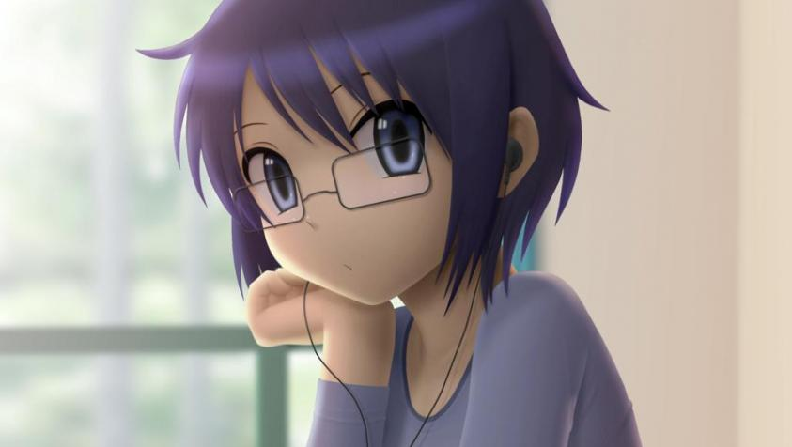
Start

Slide 8
Black Hair
Big Eyes
Blonde Hair
Small Eyes
Brown Hair
Blue Eyes
Big Nose
Red Hair
Brown Eyes
Small Nose
No, he doesn’t.
Yes, he does.
Grey Hair
Green Eyes
No Hair
Big Mouth
Curly Hair
Long Hair
Small Mouth
Straight Hair
Average Hair
Wavy Hair
Short Hair

Slide 9
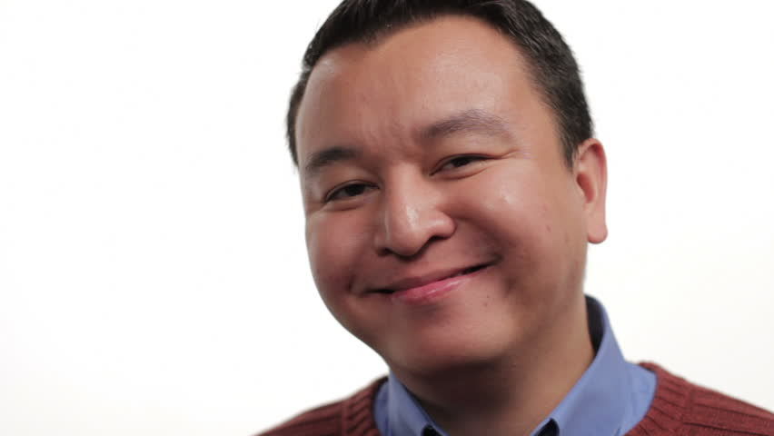
Start

Slide 10
Black Hair
Big Eyes
Blonde Hair
Small Eyes
Brown Hair
Blue Eyes
Big Nose
Red Hair
Brown Eyes
Small Nose
No, he doesn’t.
Yes, he does.
Grey Hair
Green Eyes
No Hair
Big Mouth
Curly Hair
Long Hair
Small Mouth
Straight Hair
Average Hair
Wavy Hair
Short Hair

Slide 11
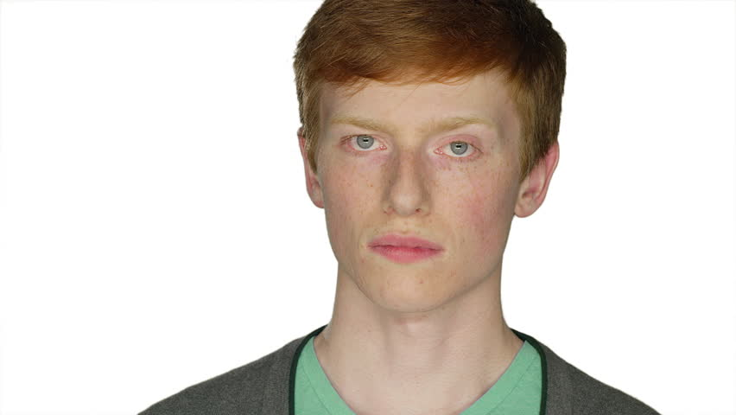
Start

Slide 12
A Hat
A Shirt
A Jacket
Pants
Shoes
Sunglasses
Black Hat
Black Shirt
Black Jacket
Black Pants
Black Shoes
Glasses
Blue Hat
Blue Shirt
Blue Jacket
Blue Pants
Blue Shoes
Earrings
No, she isn’t.
Brown Hat
Brown Shirt
Brown Jacket
Yes, she is.
Brown Shoes
Necklace
Brown Pants
Green Hat
Green Shirt
Green Jacket
Green Pants
Green Shoes
Hand Bag
Red Hat
Red Shirt
Red Jacket
Red Pants
Red Shoes
Watch
White Hat
White Shirt
White Jacket
White Pants
White Shoes
Scarf
Yellow Hat
Yellow Shirt
Yellow Jacket
Yellow Pants
Yellow Shoes
Belt

Slide 13
Start

Slide 14
A Hat
A Shirt
A Jacket
Pants
Shoes
Sunglasses
Black Hat
Black Shirt
Black Jacket
Black Pants
Black Shoes
Glasses
Blue Hat
Blue Shirt
Blue Jacket
Blue Pants
Blue Shoes
Earrings
Yes, she is.
Brown Hat
Brown Shirt
Brown Jacket
No, she isn’t.
Brown Pants
Brown Shoes
Necklace
Green Hat
Green Shirt
Green Jacket
Green Pants
Green Shoes
Hand Bag
Red Hat
Red Shirt
Red Jacket
Red Pants
Red Shoes
Watch
White Hat
White Shirt
White Jacket
White Pants
White Shoes
Scarf
Yellow Hat
Yellow Shirt
Yellow Jacket
Yellow Pants
Yellow Shoes
Belt

Slide 15
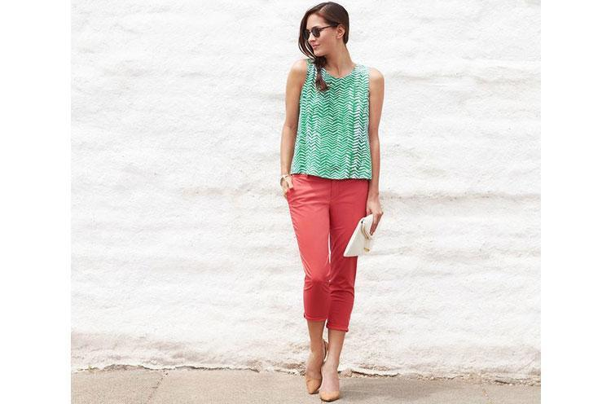
Start

Slide 16
A Hat
A Shirt
A Jacket
Pants
Shoes
Sunglasses
Black Hat
Black Shirt
Black Jacket
Black Pants
Black Shoes
Glasses
Blue Hat
Blue Shirt
Blue Jacket
Blue Pants
Blue Shoes
Earrings
Yes, he is.
Brown Hat
Brown Shirt
Brown Jacket
No, he isn’t.
Brown Pants
Brown Shoes
Necklace
Green Hat
Green Shirt
Green Jacket
Green Pants
Green Shoes
Hand Bag
Red Hat
Red Shirt
Red Jacket
Red Pants
Red Shoes
Watch
White Hat
White Shirt
White Jacket
White Pants
White Shoes
Scarf
Yellow Hat
Yellow Shirt
Yellow Jacket
Yellow Pants
Yellow Shoes
Belt

Slide 17
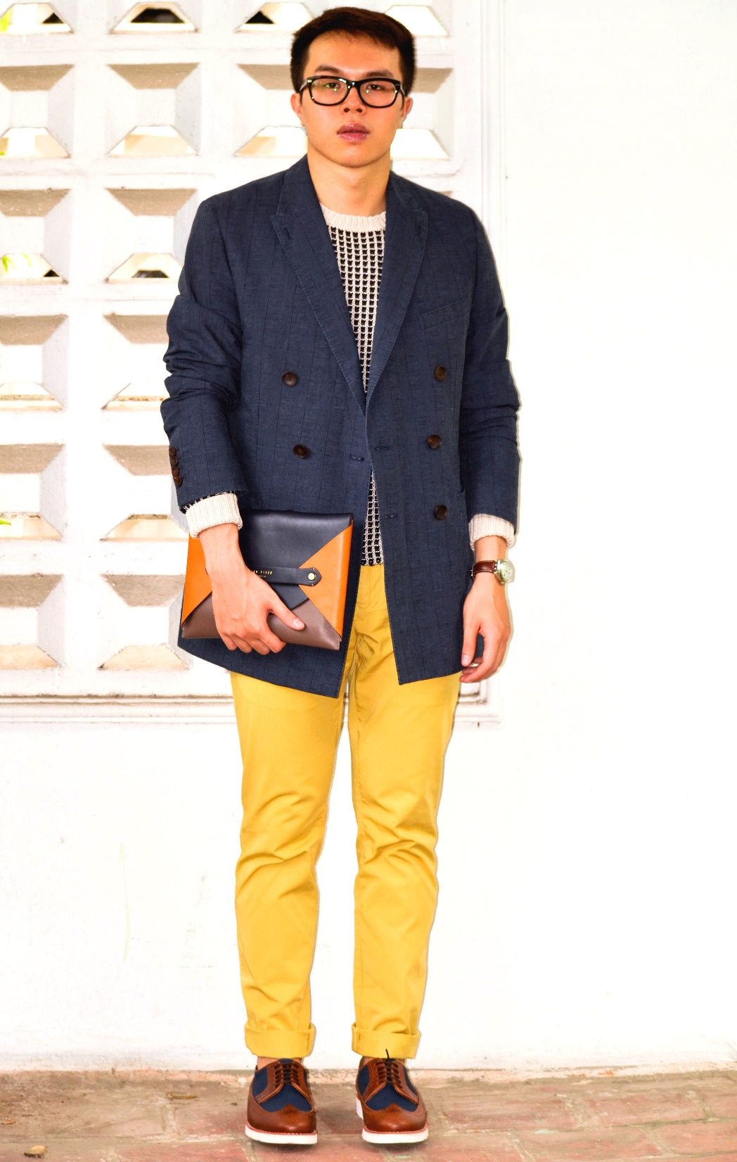
Start

Slide 18
A Hat
A Shirt
A Jacket
Pants
Shoes
Sunglasses
Black Hat
Black Shirt
Black Jacket
Black Pants
Black Shoes
Glasses
Blue Hat
Blue Shirt
Blue Jacket
Blue Pants
Blue Shoes
Earrings
No, he isn’t.
Brown Hat
Brown Shirt
Brown Jacket
Yes, he is.
Brown Shoes
Necklace
Brown Pants
Green Hat
Green Shirt
Green Jacket
Green Pants
Green Shoes
Hand Bag
Red Hat
Red Shirt
Red Jacket
Red Pants
Red Shoes
Watch
White Hat
White Shirt
White Jacket
White Pants
White Shoes
Scarf
Yellow Hat
Yellow Shirt
Yellow Jacket
Yellow Pants
Yellow Shoes
Belt

Slide 19
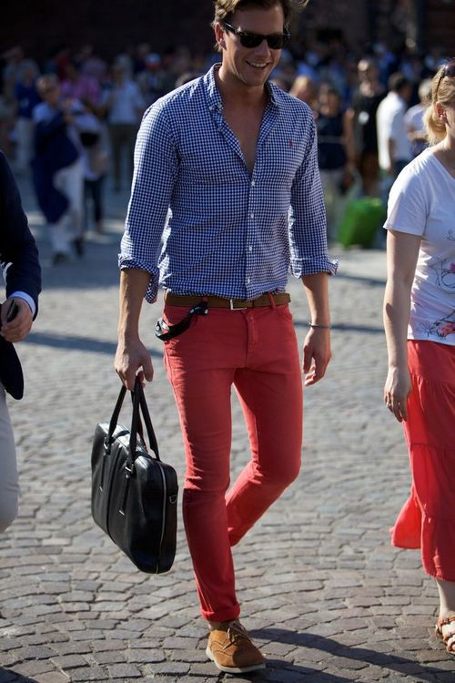
Start

