Slide 1
How do I get there?
Follow the clues to make the picture.

Slide 2








How to Play:
Read the clues and draw a line to the next location (vehicle icon).
Each location has many different way to get there as indicated by the picture.
Guess what the picture is

Slide 3

Take a taxi

Slide 4
Take a bus

Slide 5
Take a train

Slide 6

Take a subway

Slide 7

Take a plane

Slide 8

Take a boat

Slide 9
Walk

Slide 10

Ride my bike

Slide 11

Home

Slide 12
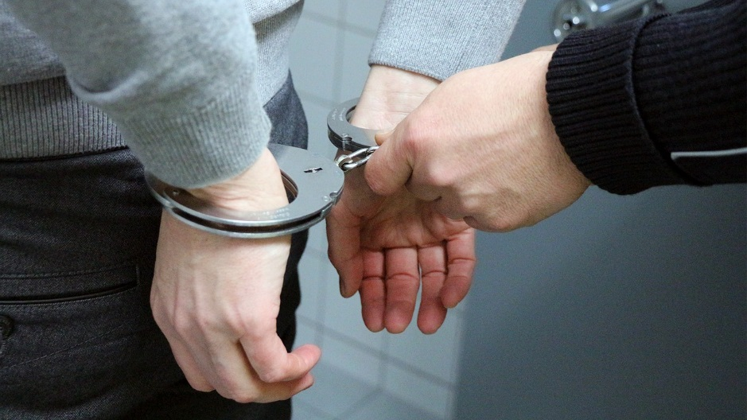
Police Station

Slide 13

Library

Slide 14
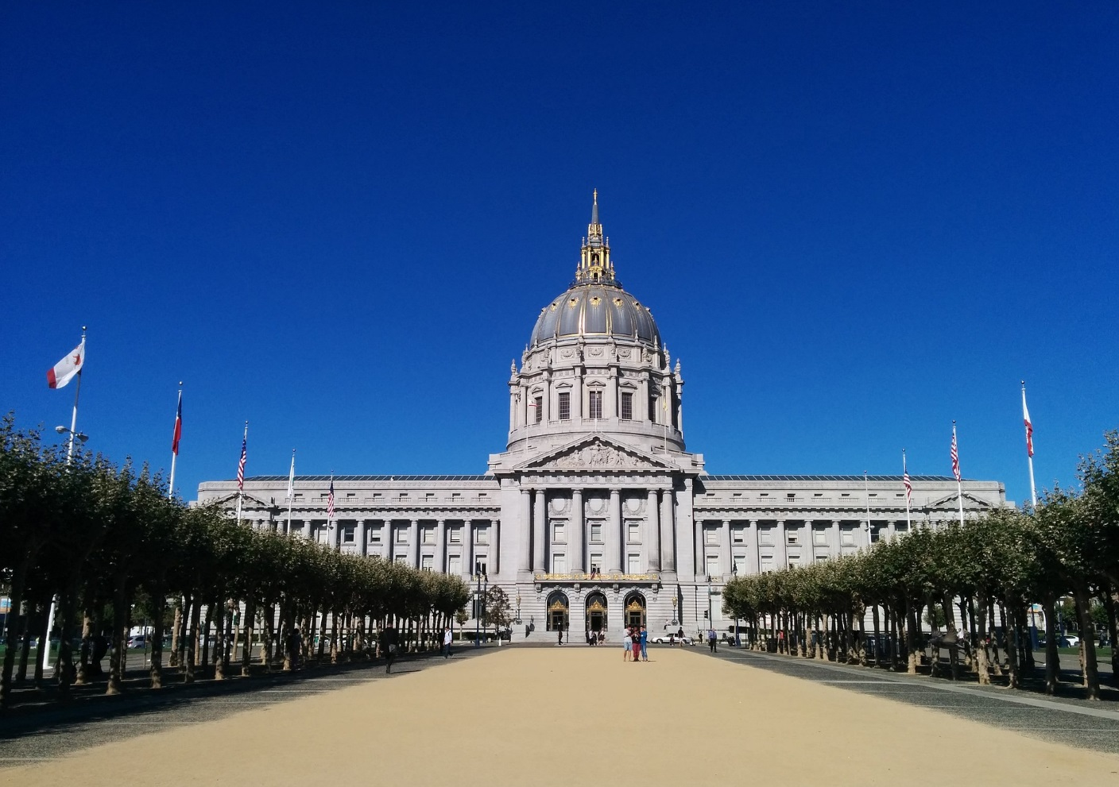
City Hall

Slide 15
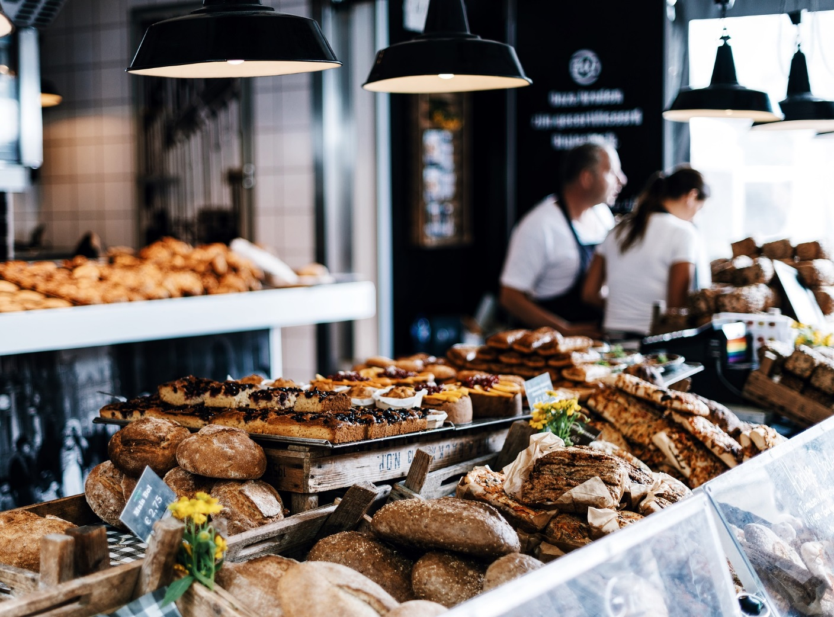
Bakery

Slide 16
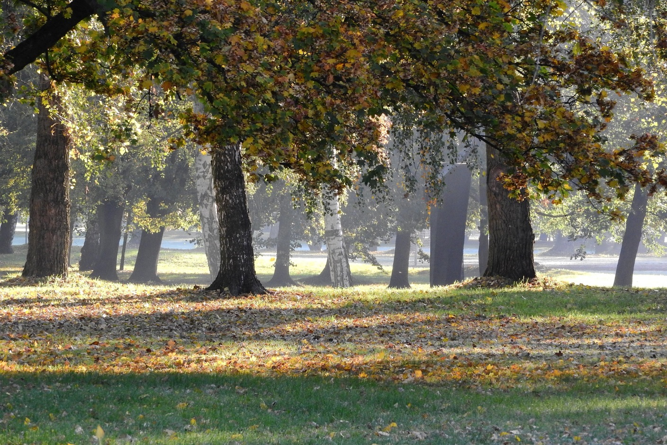
Park

Slide 17
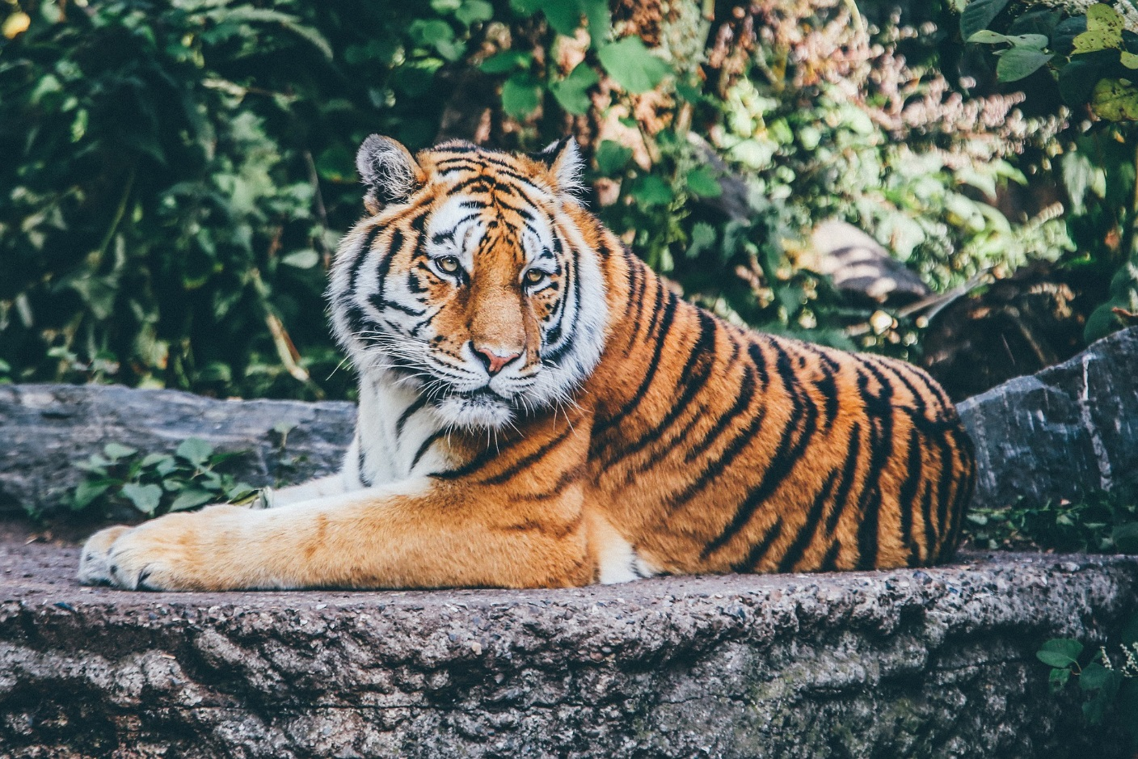
Zoo

Slide 18
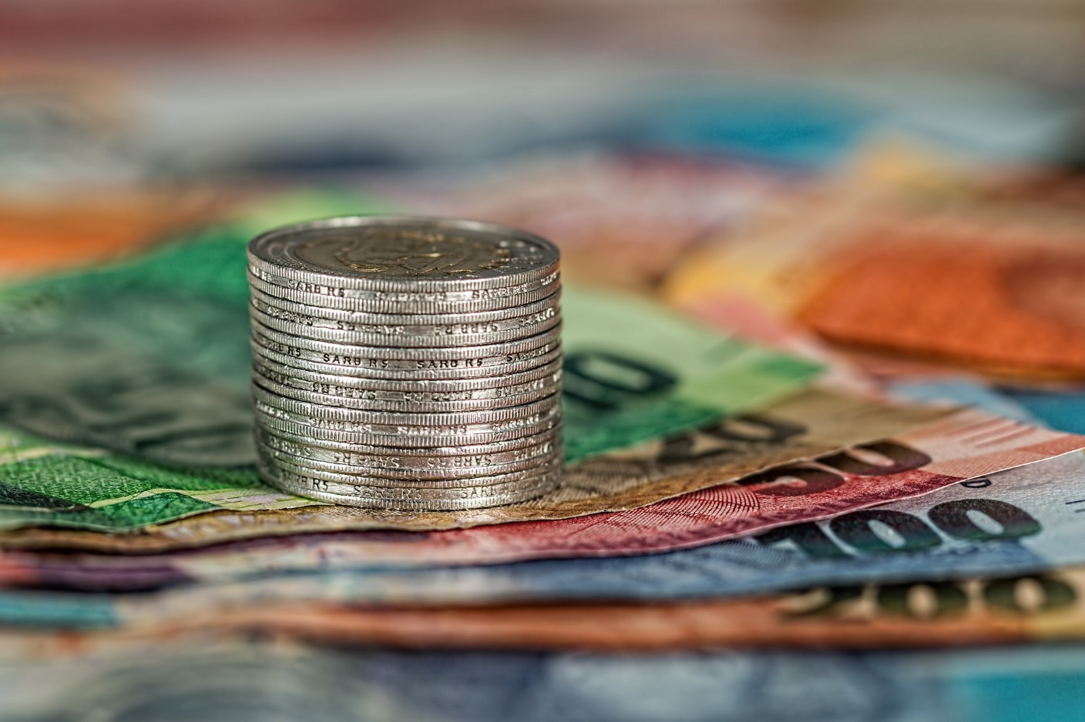
Bank

Slide 19
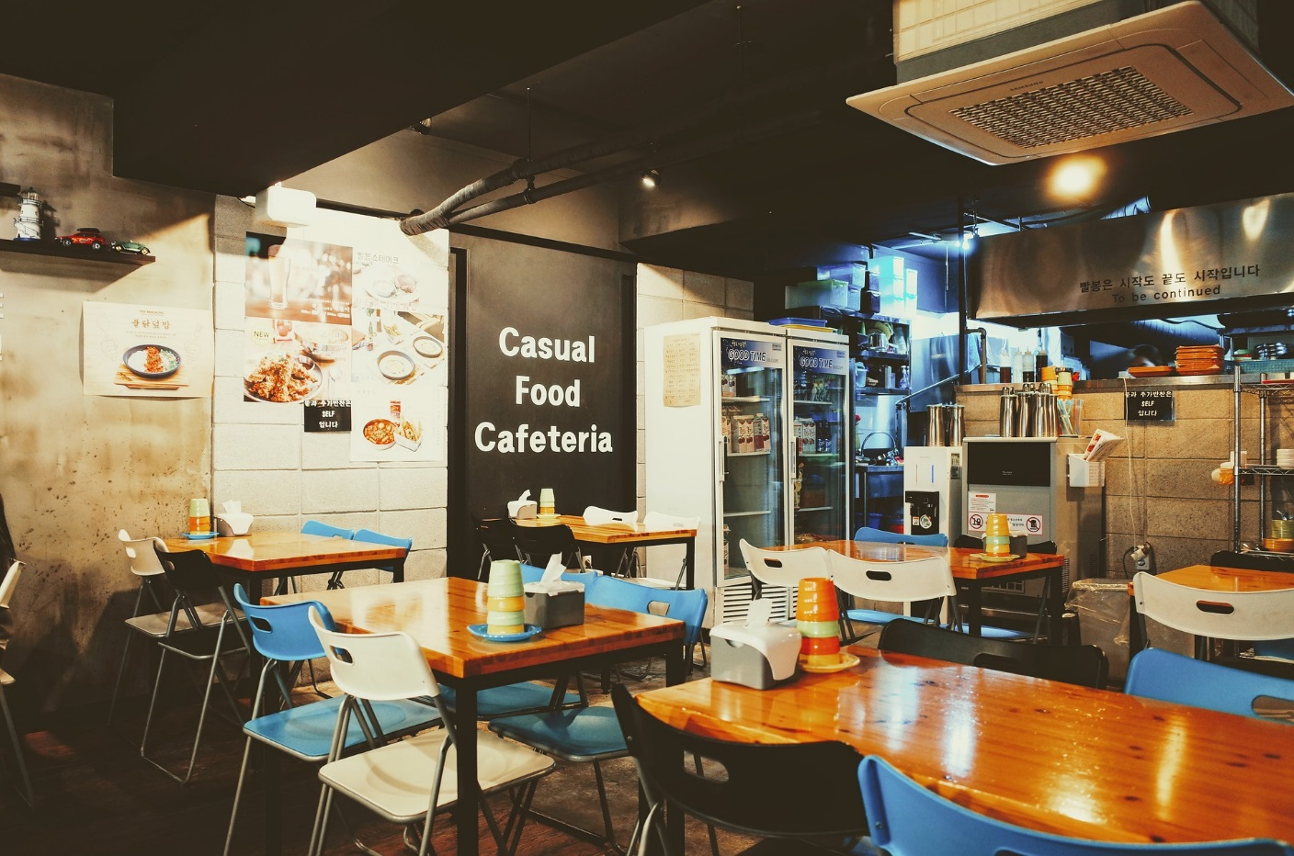
Restaurant

Slide 20
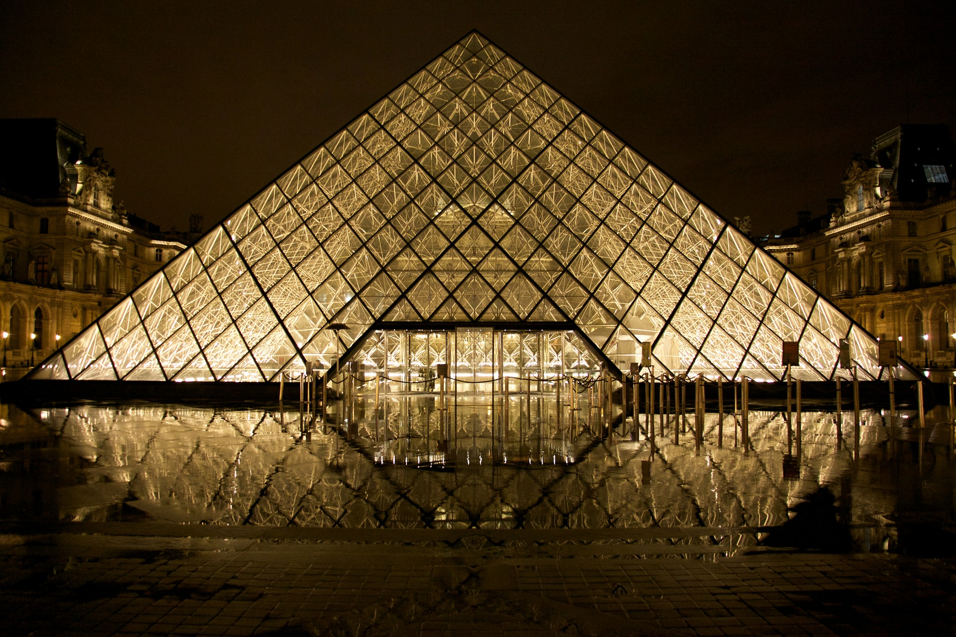
Museum

Slide 21

Cinema / Theater

Slide 22

School

Slide 23
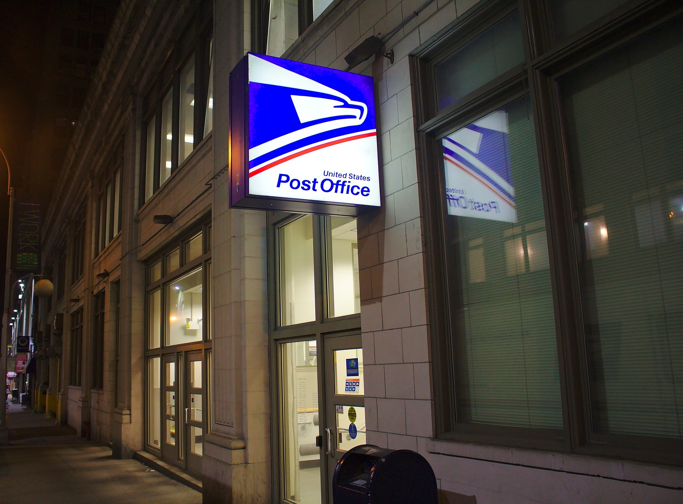
Post Office

Slide 24

Hospital

Slide 25

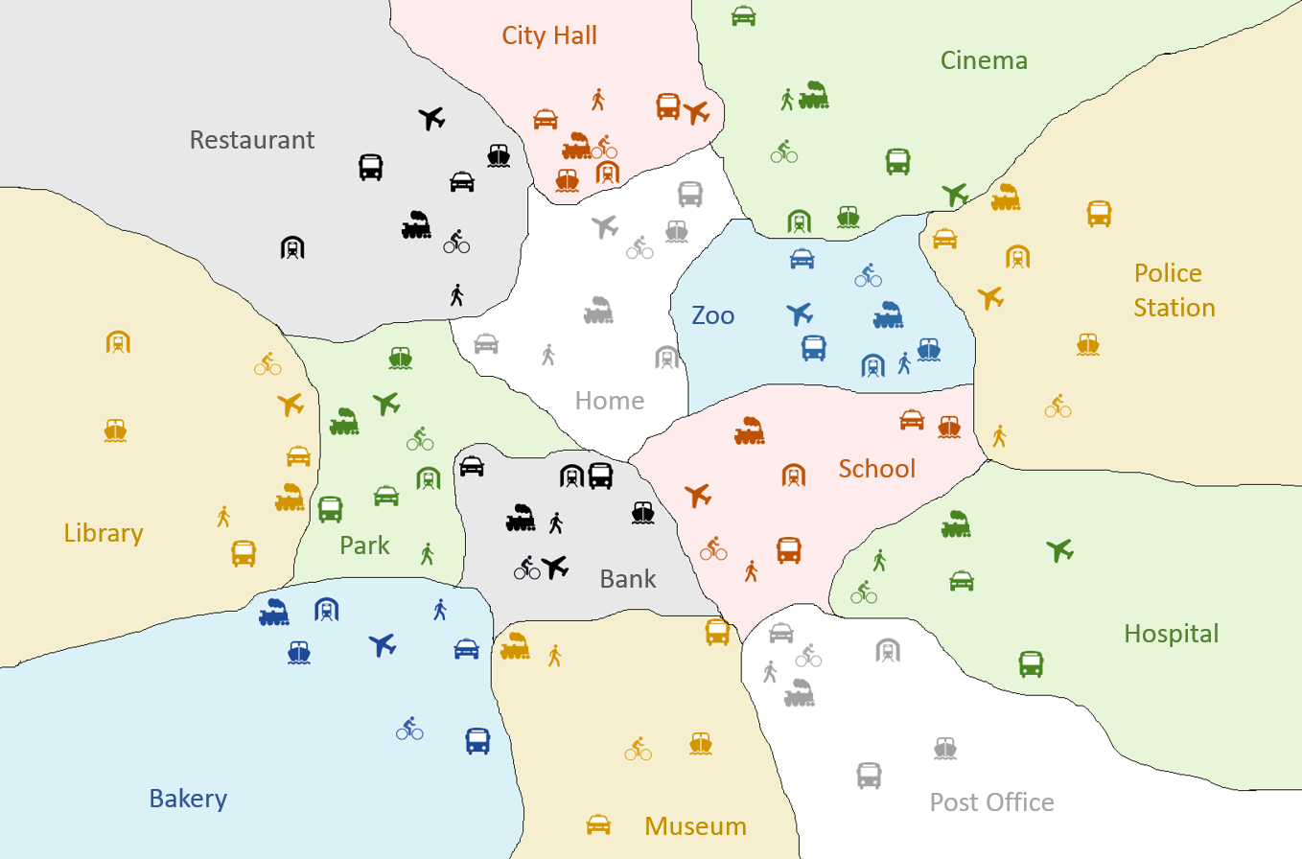

How to Play
Home + Bike
Find the start location.

Slide 26

How to Play
How do I go to the park?
Look at the picture and ask, “How do I go to ________?”

Slide 27
How to Play
I take a bus to the park.
The teacher will answer, “I _________ to _________”

Slide 28
How to Play
Draw a line to the new location.

Slide 29

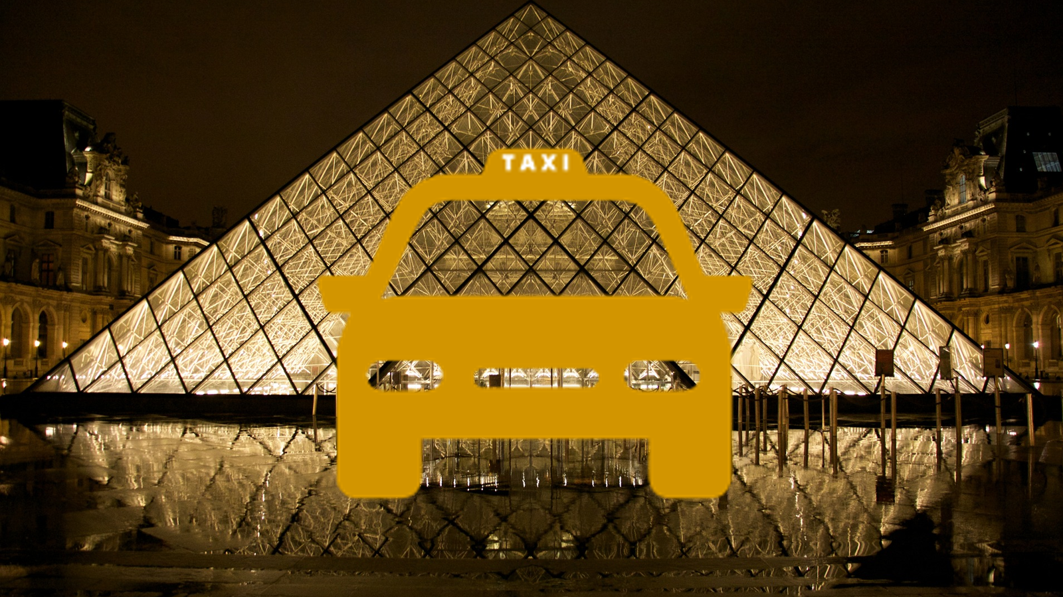
How to Play
Keep drawing location until you know the picture.

Slide 30
Choose a Picture
1
2
3
4
5
6
7
8

Slide 31
Picture 1

Slide 32
Show Answer

Slide 33
Show Answer

Slide 34
Show Answer

Slide 35
Show Answer

Slide 36
Show Answer

Slide 37
Show Answer

Slide 38
Show Answer

Slide 39
Show Answer

Slide 40
Show Answer

Slide 41
Show Answer

Slide 42
Show Answer

Slide 43
Show Answer

Slide 44
Show Answer

Slide 45
Show Answer

Slide 46
Show Answer

Slide 47
Show Answer

Slide 48
Show Answer

Slide 49
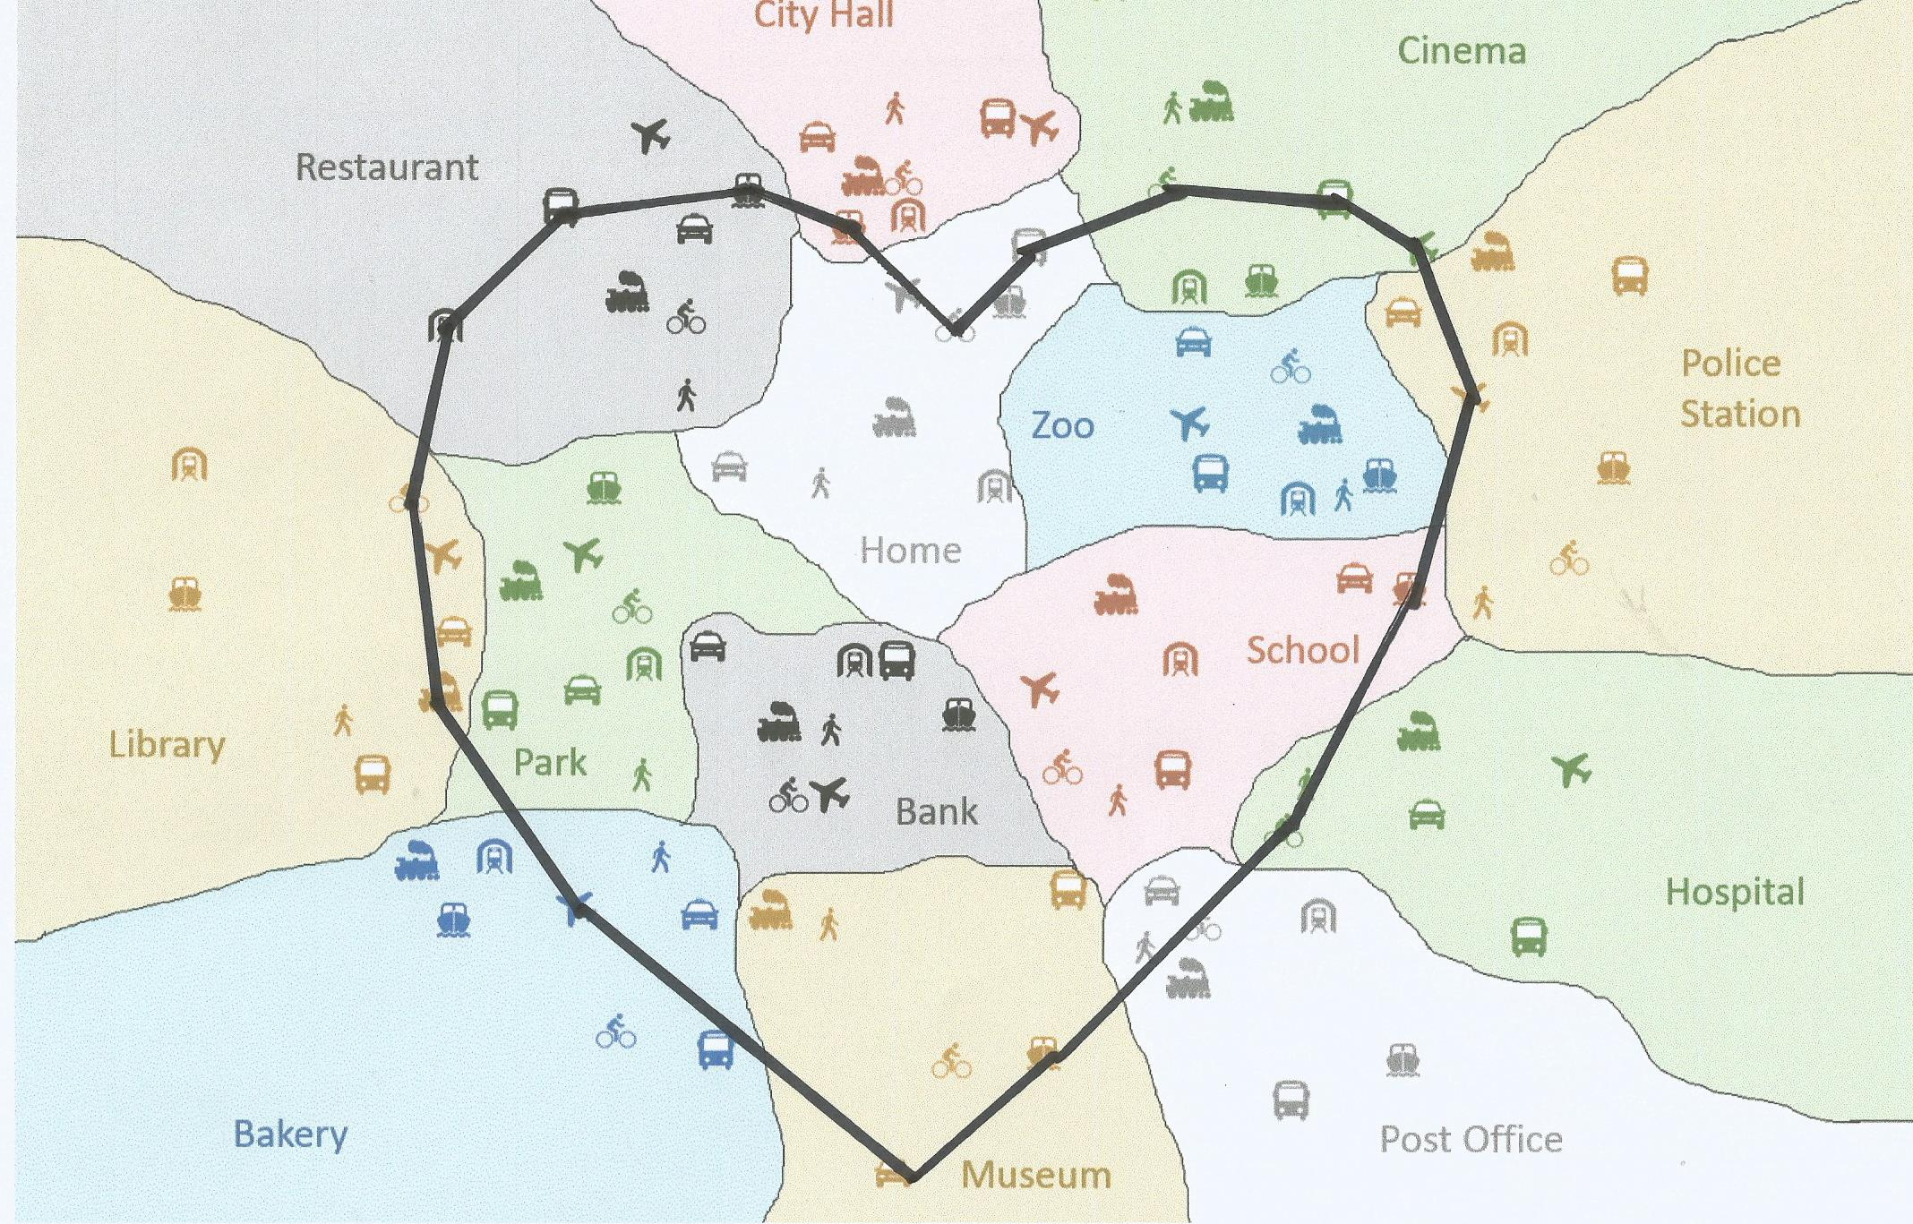
Play again

Slide 50

Picture 2

Slide 51
Show Answer

Slide 52
Show Answer

Slide 53
Show Answer

Slide 54
Show Answer

Slide 55
Show Answer

Slide 56
Show Answer

Slide 57
Show Answer

Slide 58
Show Answer

Slide 59
Show Answer

Slide 60
Show Answer

Slide 61
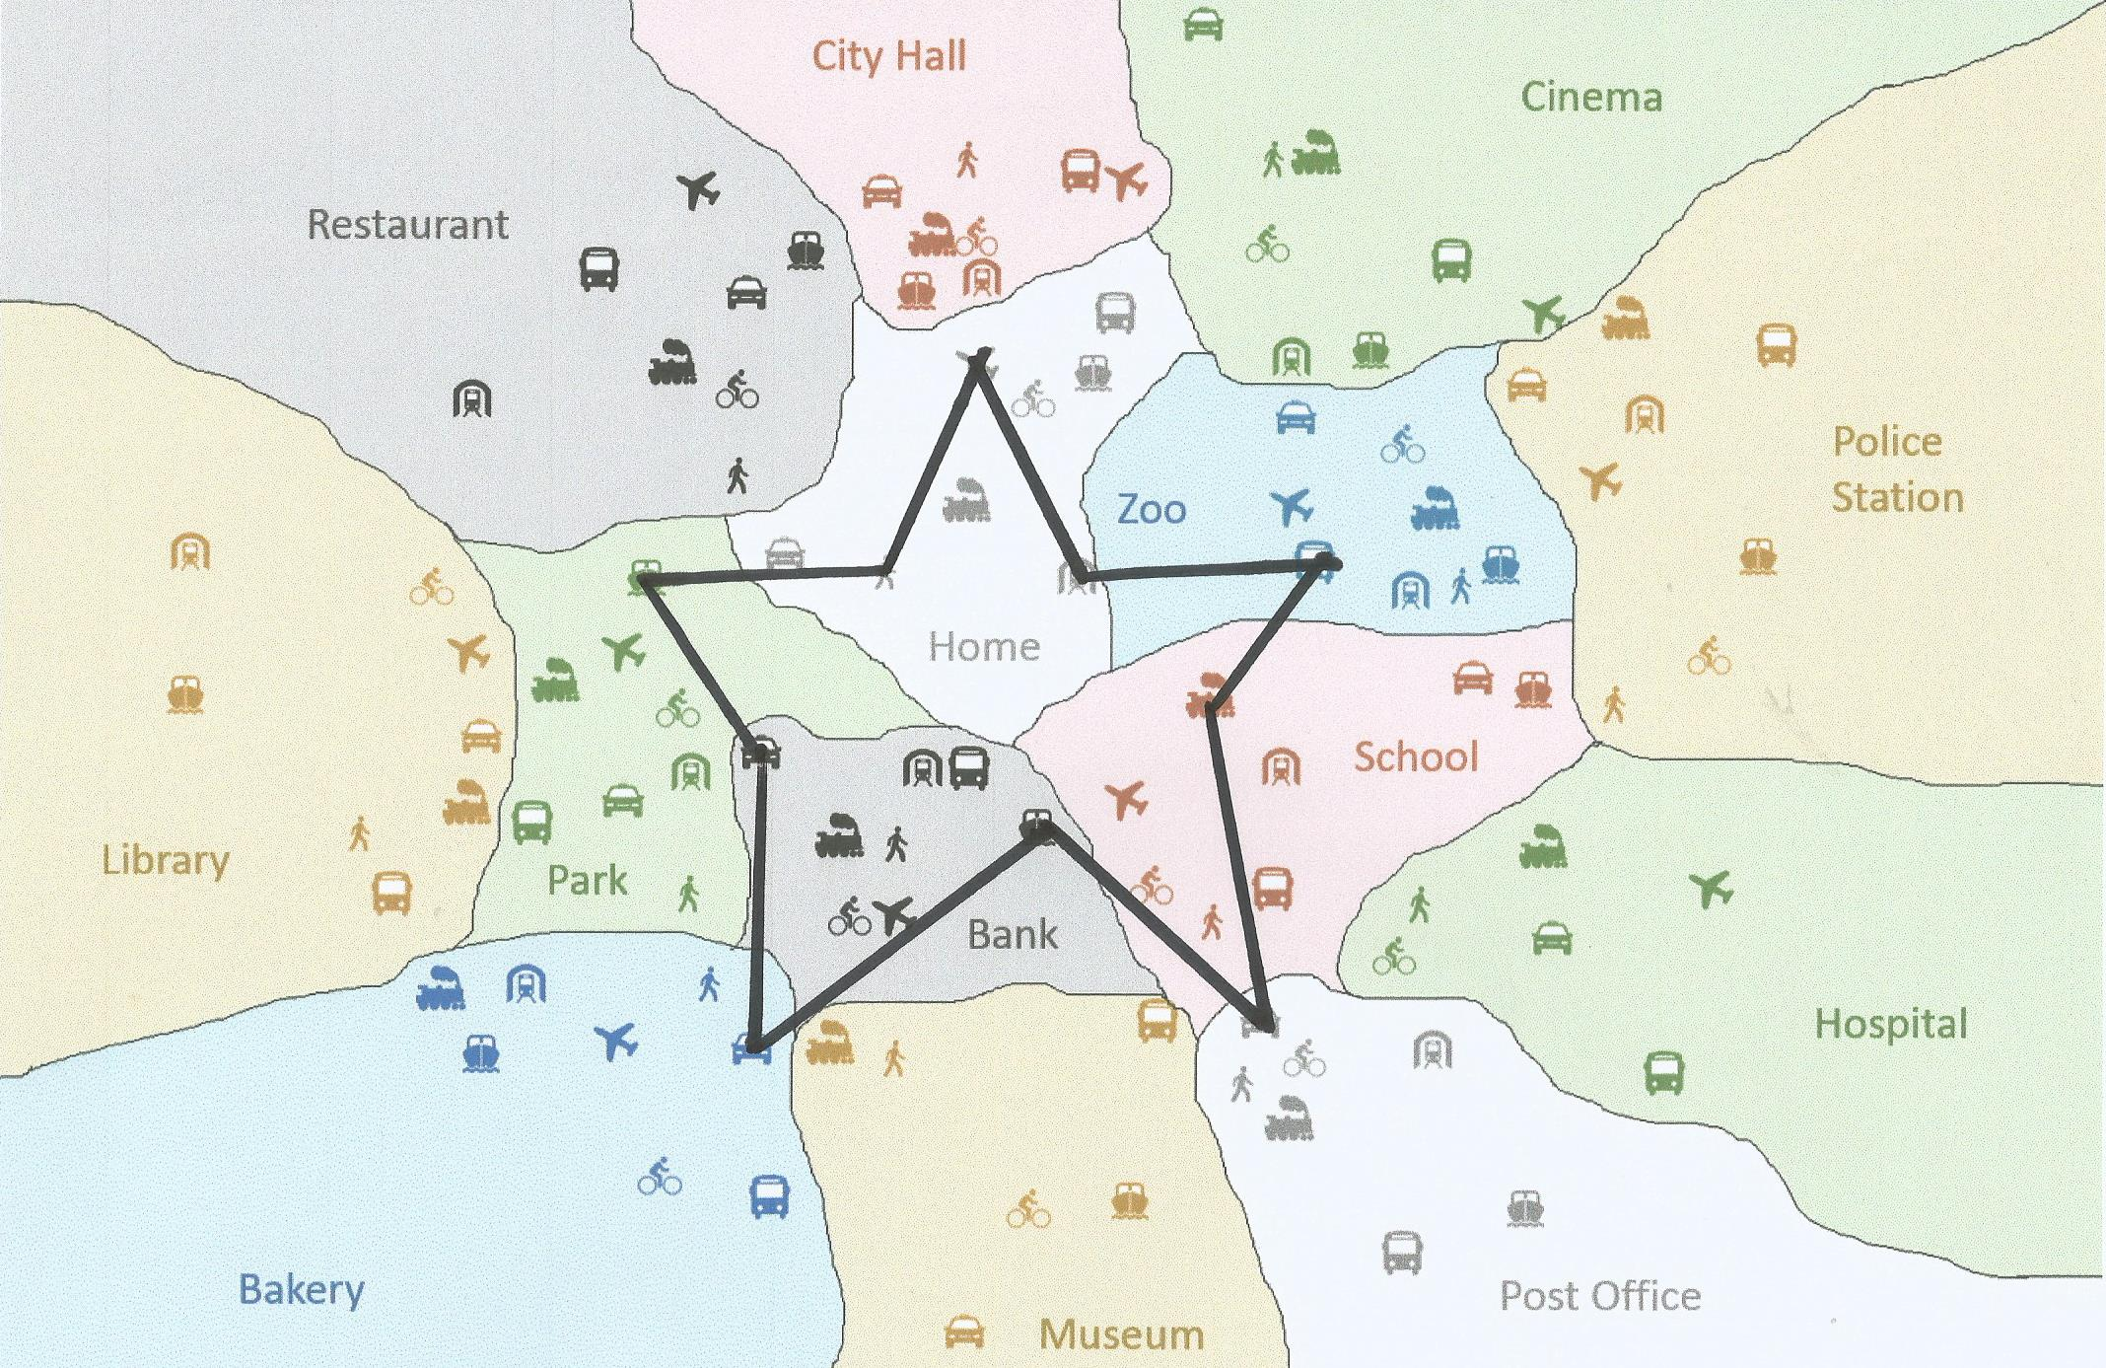
Play again

Slide 62

Picture 3

Slide 63
Show Answer

Slide 64
Show Answer

Slide 65
Show Answer

Slide 66
Show Answer

Slide 67
Show Answer

Slide 68
Show Answer

Slide 69
Show Answer

Slide 70
Show Answer

Slide 71
Show Answer

Slide 72
Show Answer

Slide 73
Show Answer

Slide 74
Show Answer

Slide 75
Show Answer

Slide 76
Show Answer

Slide 77
Show Answer

Slide 78
Show Answer

Slide 79
Show Answer

Slide 80
Show Answer

Slide 81
Show Answer

Slide 82
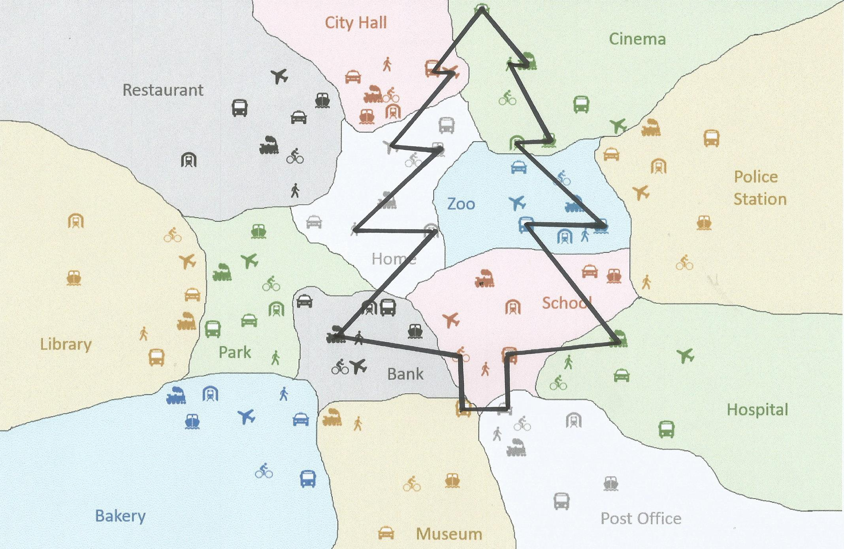
Play again

Slide 83

Picture 4

Slide 84
Show Answer

Slide 85
Show Answer

Slide 86
Show Answer

Slide 87
Show Answer

Slide 88
Show Answer

Slide 89
Show Answer

Slide 90
Show Answer

Slide 91
Show Answer

Slide 92
Show Answer

Slide 93
Show Answer

Slide 94
Show Answer

Slide 95
Show Answer

Slide 96
Show Answer

Slide 97
Show Answer

Slide 98
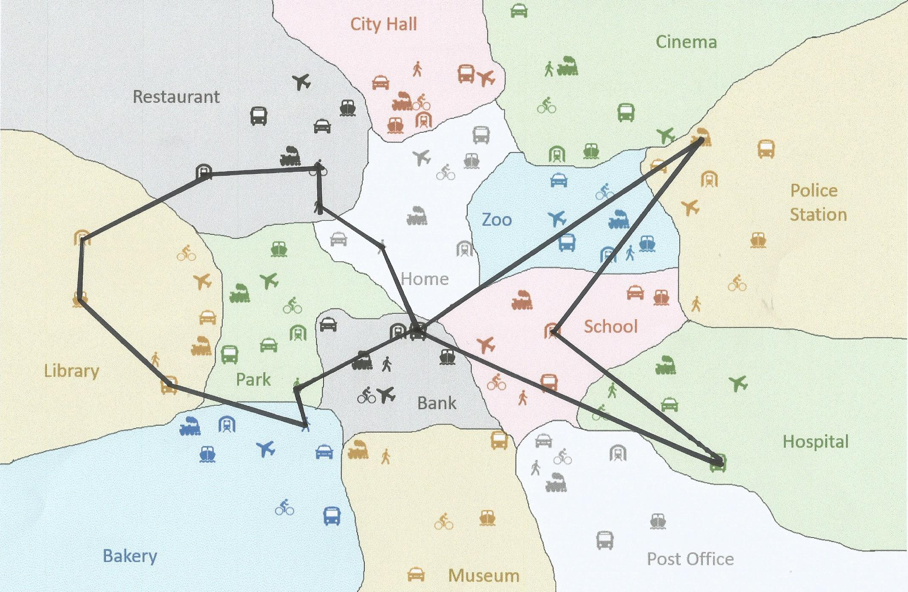
Play again

Slide 99

Picture 5

Slide 100
Show Answer

Slide 101
Show Answer

Slide 102
Show Answer

Slide 103
Show Answer

Slide 104
Show Answer

Slide 105
Show Answer

Slide 106
Show Answer

Slide 107
Show Answer

Slide 108
Show Answer

Slide 109
Show Answer

Slide 110
Show Answer

Slide 111
Show Answer

Slide 112
Show Answer

Slide 113
Show Answer

Slide 114
Show Answer

Slide 115
Show Answer

Slide 116
Show Answer

Slide 117
Show Answer

Slide 118
Show Answer

Slide 119
Show Answer

Slide 120
Show Answer

Slide 121
Show Answer

Slide 122
Show Answer

Slide 123
Show Answer

Slide 124
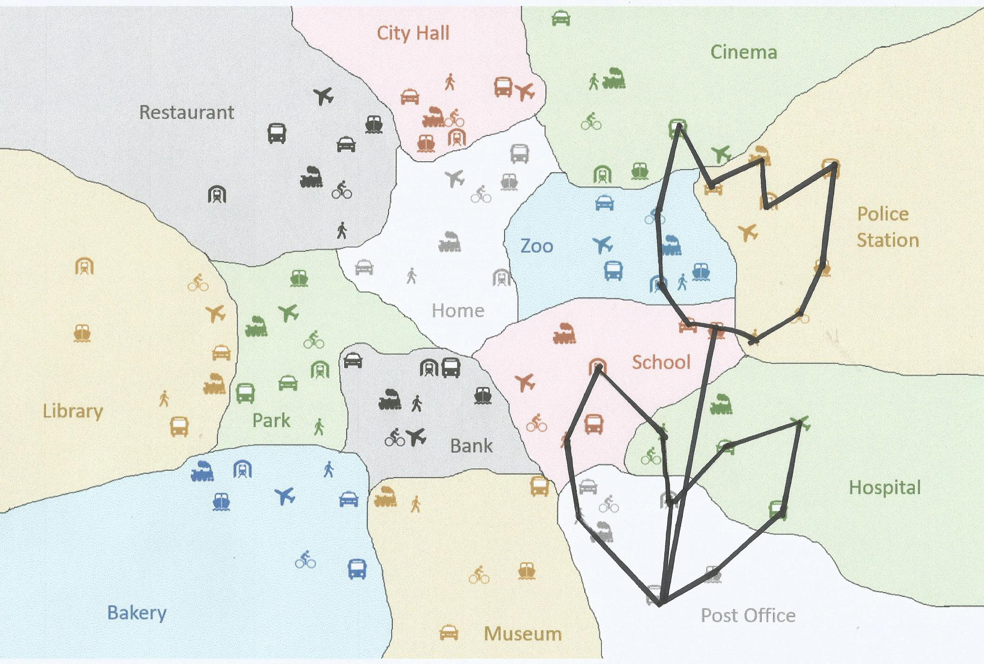
Play again

Slide 125

Picture 6

Slide 126
Show Answer

Slide 127
Show Answer

Slide 128
Show Answer

Slide 129
Show Answer

Slide 130
Show Answer

Slide 131
Show Answer

Slide 132
Show Answer

Slide 133
Show Answer

Slide 134
Show Answer

Slide 135
Show Answer

Slide 136
Show Answer

Slide 137
Show Answer

Slide 138
Show Answer

Slide 139
Show Answer

Slide 140
Show Answer

Slide 141
Show Answer

Slide 142
Show Answer

Slide 143
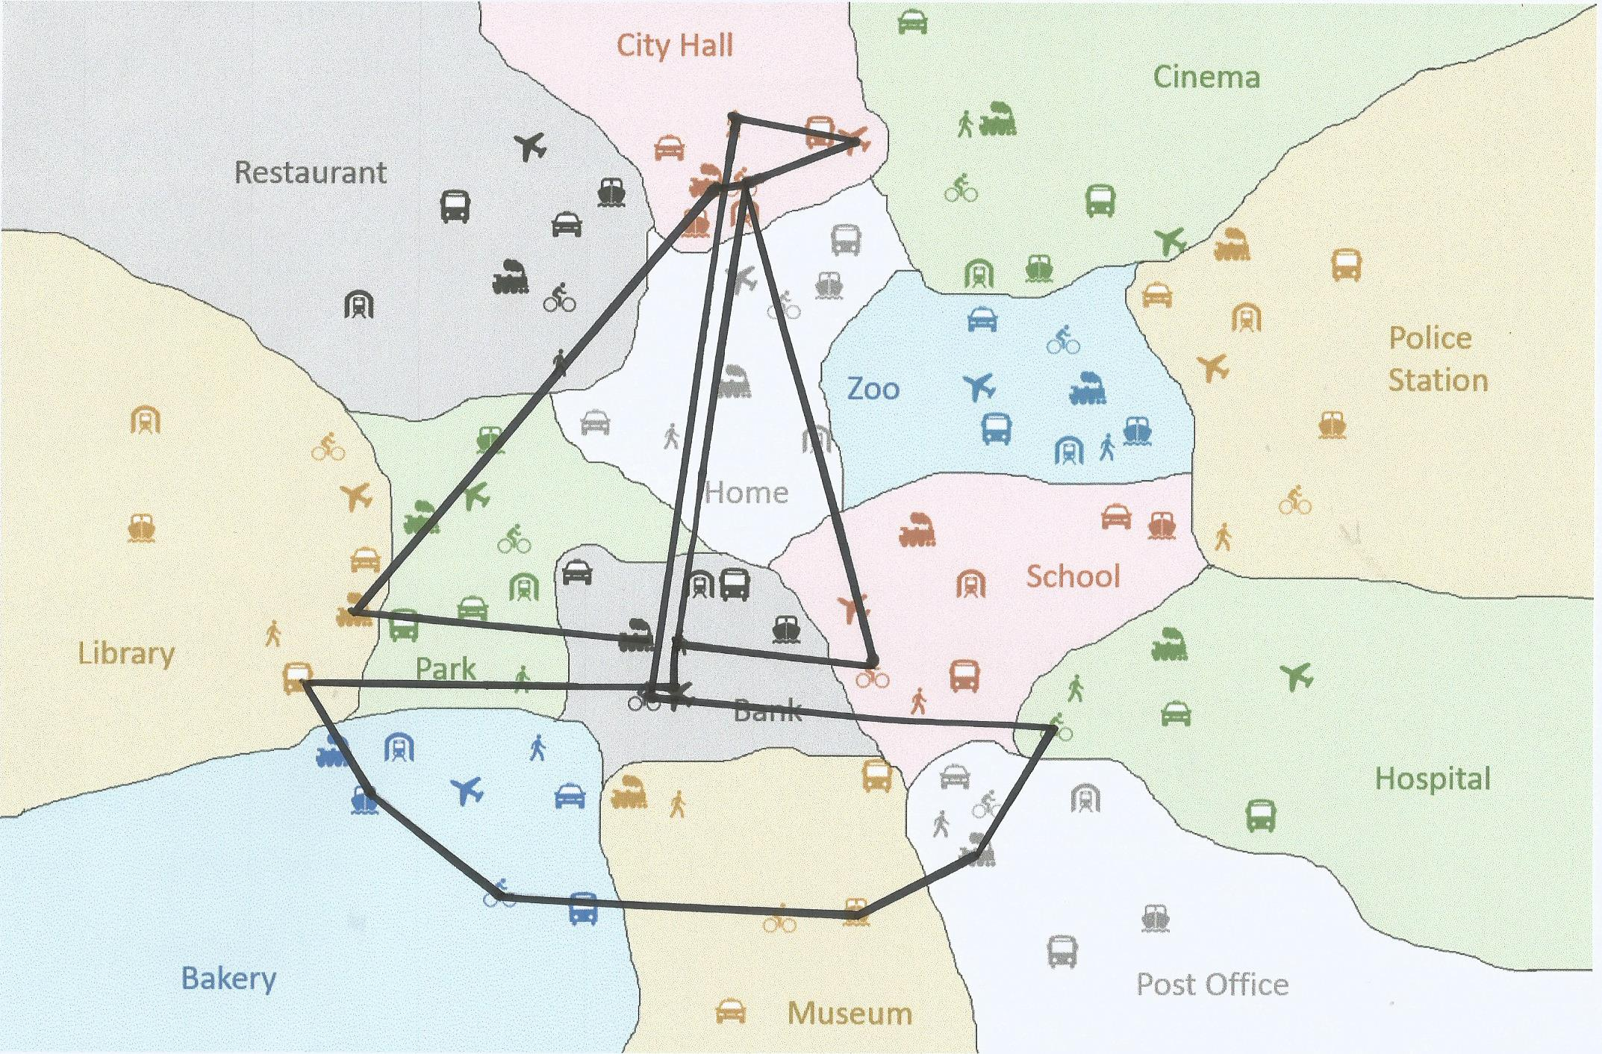
Play again

Slide 144

Picture 7

Slide 145
Show Answer

Slide 146
Show Answer

Slide 147
Show Answer

Slide 148
Show Answer

Slide 149
Show Answer

Slide 150
Show Answer

Slide 151
Show Answer

Slide 152
Show Answer

Slide 153
Show Answer

Slide 154
Show Answer

Slide 155
Show Answer

Slide 156
Show Answer

Slide 157
Show Answer

Slide 158
Show Answer

Slide 159
Show Answer

Slide 160
Show Answer

Slide 161
Show Answer

Slide 162
Show Answer

Slide 163
Show Answer

Slide 164
Show Answer

Slide 165
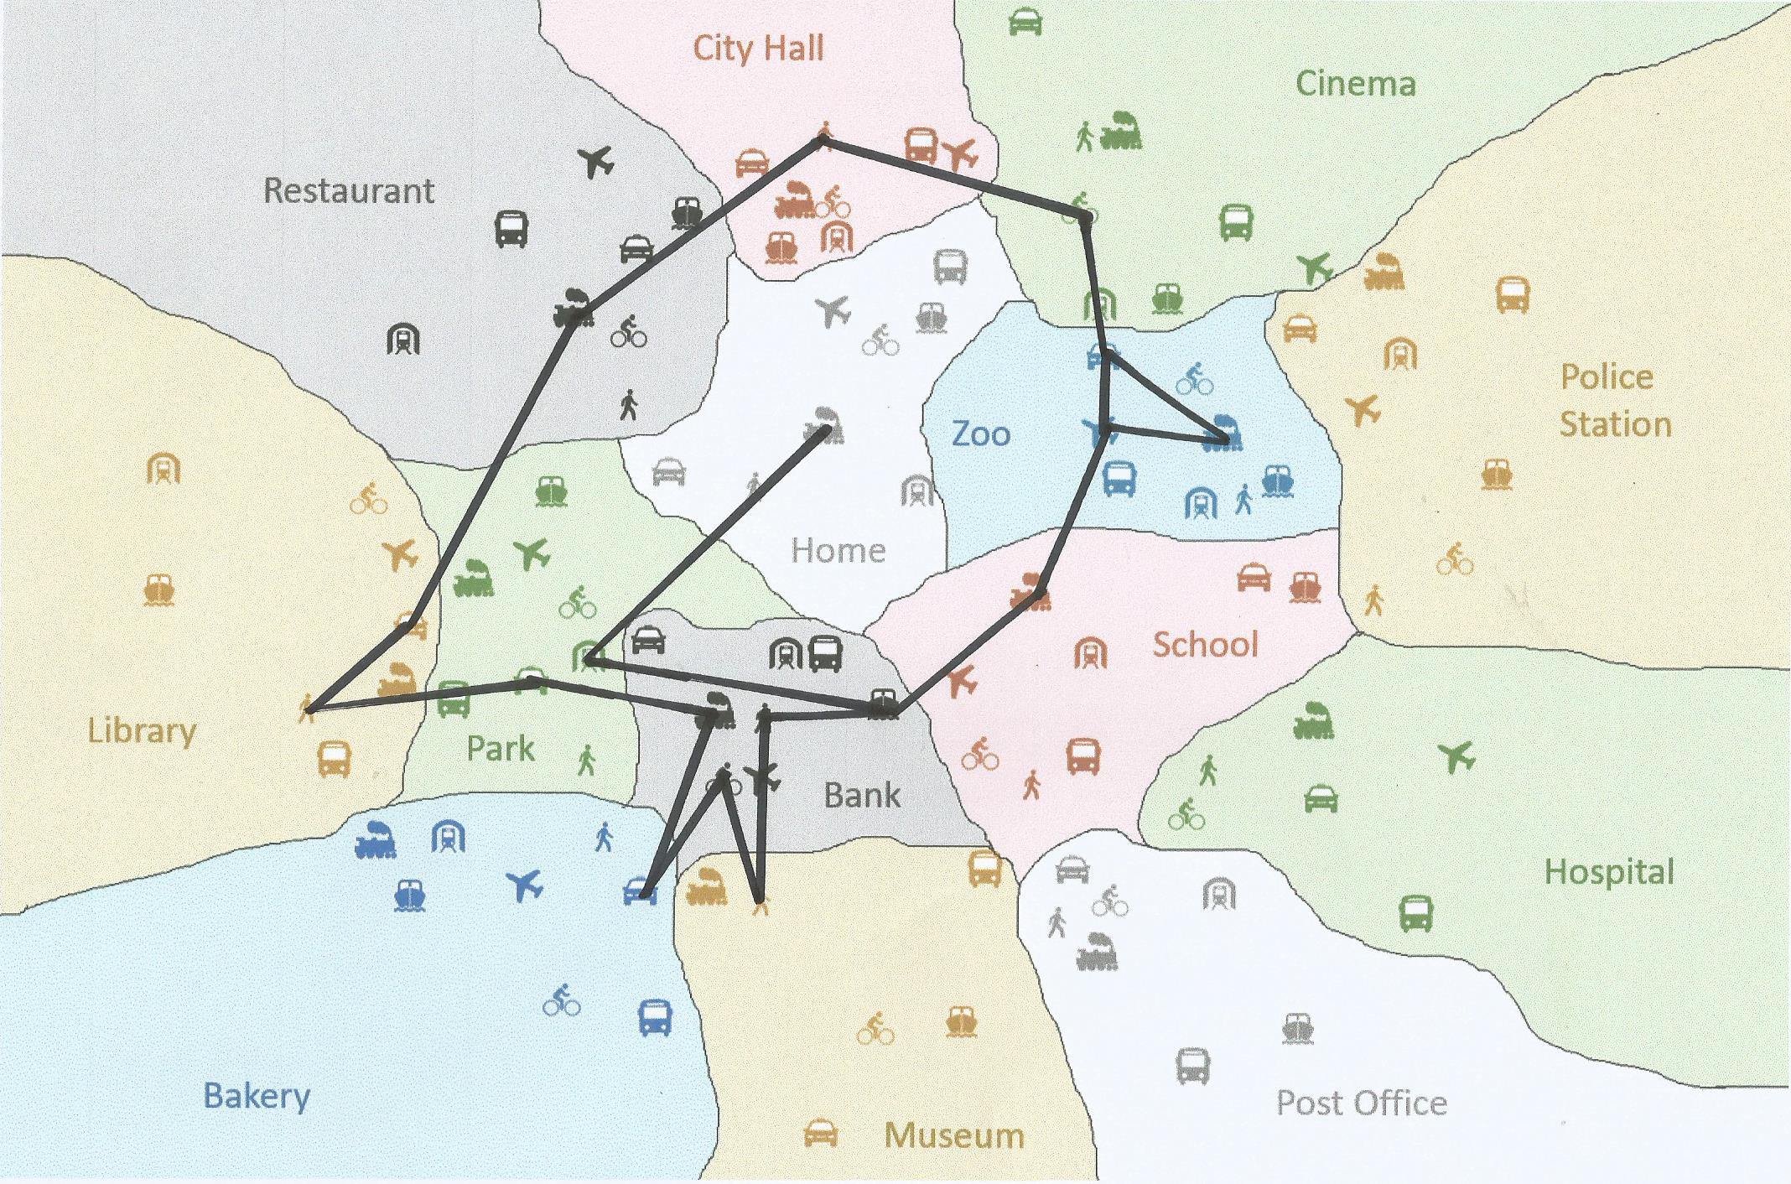
Play again

Slide 166

Picture 8

Slide 167
Show Answer

Slide 168
Show Answer

Slide 169
Show Answer

Slide 170
Show Answer

Slide 171
Show Answer

Slide 172
Show Answer

Slide 173
Show Answer

Slide 174
Show Answer

Slide 175
Show Answer

Slide 176
Show Answer

Slide 177
Show Answer

Slide 178
Show Answer

Slide 179
Show Answer

Slide 180
Show Answer

Slide 181
Show Answer

Slide 182
Show Answer

Slide 183
Show Answer

Slide 184
Show Answer

Slide 185
Show Answer

Slide 186
Show Answer

Slide 187
Show Answer

Slide 188
Show Answer

Slide 189
Show Answer

Slide 190
Show Answer

Slide 191
Show Answer

Slide 192
Show Answer

Slide 193
Show Answer

Slide 194
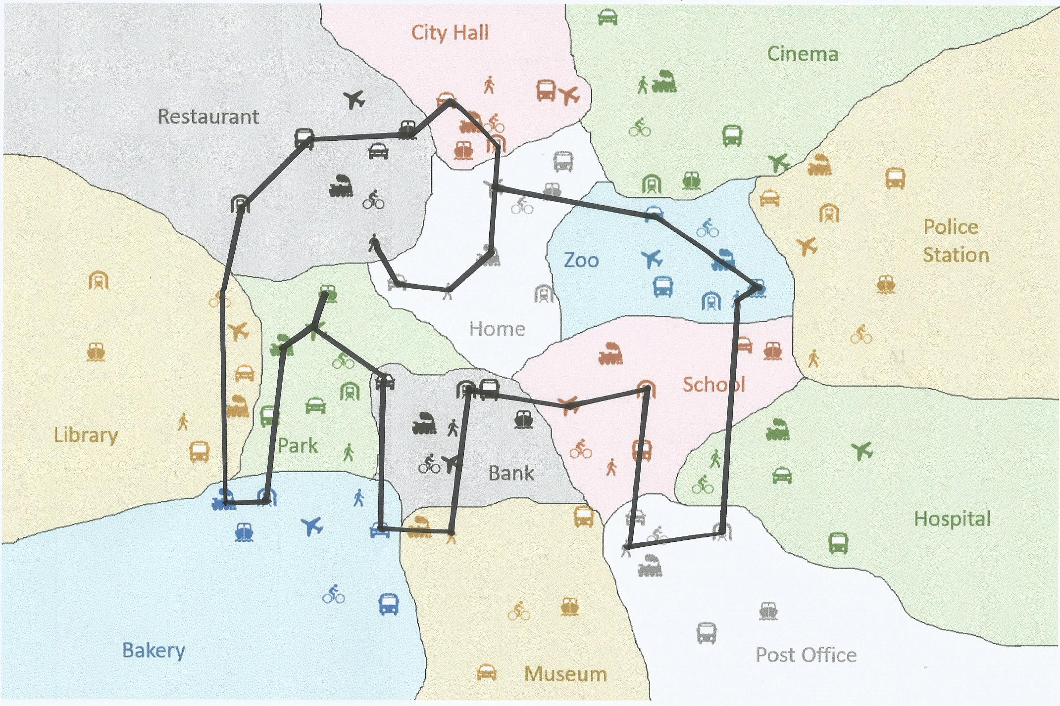
Play again

