Slide 1
My Schedule Game

Slide 2
How to Play (Part 1):
Make two stacks of cards (facedown)
Students will draw a card from each deck.
The group will ask, “What time do you _______?”
The student will answer with the information on the cards.
“I _______ at ___:___”
The student then write the sentence in one of the Bingo squares
Mix the cards and play again (until all the squares are filled)

Slide 3
How to Play (Part 2):
Play Bingo
Now the teacher will draw two cards
The whole class must make a question, “What time do you…”
The teacher will respond appropriately.
“I _______ at ___:___”

Slide 4
Part 1: Two Stacks of cards

Slide 5
Part 1: Take one card from each deck

Slide 6
Part 1: Look at the cards
Go to Bed
9:00

Slide 7
Part 1: Make a question and answer
What time do you go to bed?
I go to bed at 9:00.
Go to Bed
9:00

Slide 8
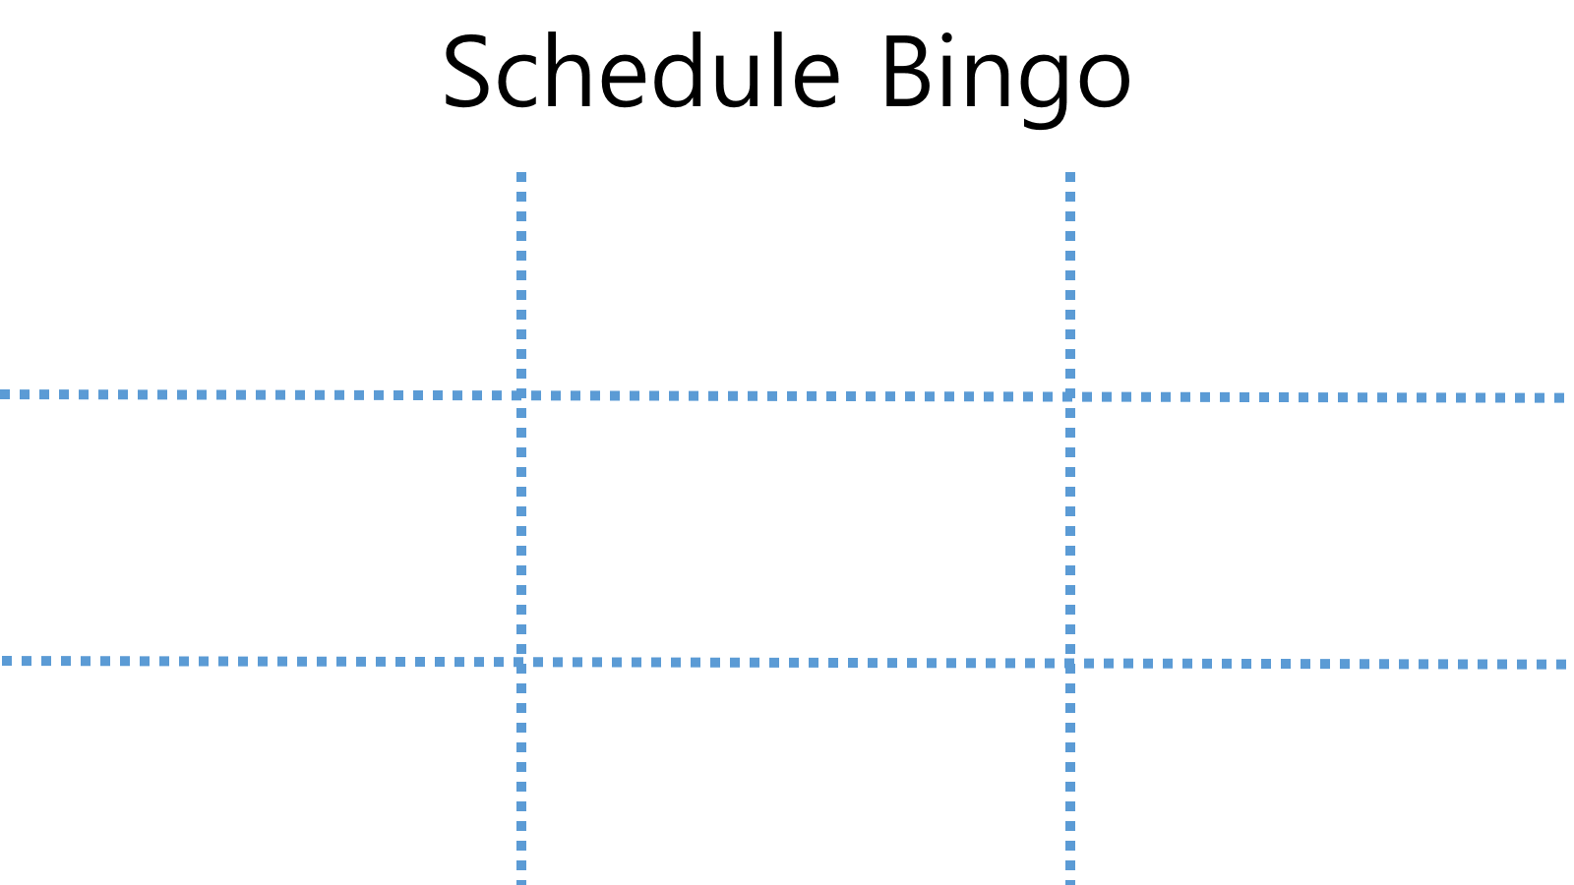
Part 1: Write it on the Bingo card
I go to bed at 9:00.

Slide 9
Part 2: The teacher will choose two cards
Have Breakfast
6:30

Slide 10
Part 2: Ask the teacher
What time do you have breakfast?
Have Breakfast
6:30

Slide 11
Part 2: The teacher will make a sentence.
What time do you have breakfast?
I have breakfast at 6:30.
Have Breakfast
6:30

Slide 12
Part 2: Cross it off of your Bingo card.
I brush my teeth at 7:00.
I go to bed at 8:15.
I have breakfast at 6:30.
I do my homework at 9:00.
I go to school at 7:30.
I wash my face at 8:30.
I wash my face at 8:15.
I go to bed at 8:00.
I go to school at 9:00.

Slide 13
Schedule Bingo

Slide 14
Go to school
Water the tree
8:15
7:30
Have breakfast
Do my homework
8:30
7:00
Go to bed
Brush my teeth
8:00
9:00
Get up
Wash my face
7:15
6:30

