Slide 1
Draw by Dates
Follow the instructions to make a picture.

Slide 2
How to Play
Use the printouts from the Connect 4 Game
Ask the teacher, “What’s the date today?”
The teacher will answer, “It’s ___________”.
Color in that square.
It will make a picture.

Slide 3
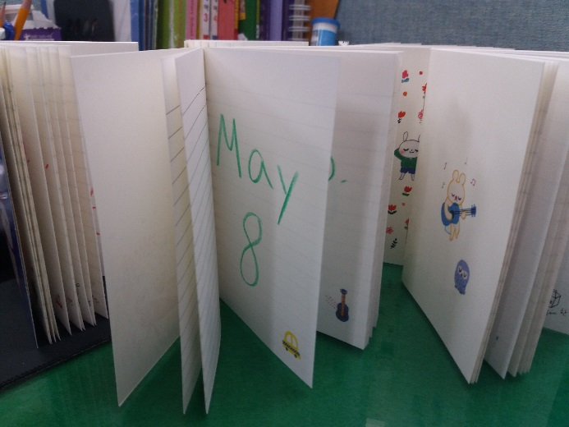
How to Play (Alternative Rules)
Prepare by writing out the days in little notebooks (you can buy at Daiso)
The students can ask, “What’s the date today?”
The teacher will show the answer to a student who will say, “It’s ___________”.
Click that square.
It will make a picture.
Easy
Medium
Difficult

Slide 4
May 5
June 9
Dec. 18
Apr. 1
Feb. 28
Sept. 2
Jan. 30
July 13
Feb. 14
Apr. 20
Aug. 16
Oct. 27
Nov. 12
Jan. 1
Mar. 31
Aug. 9
Feb. 13
May 26
May. 5
Jan. 27
Dec. 25
Mar. 3
May 21
Apr. 6
July 19
Mar. 1
Oct. 24
Sept. 25
Feb. 8
Dec. 16
Nov. 11
Jul. 09
Nov. 1
Jan. 30
Oct. 3
Aug. 17
Jun. 6
Oct. 31
May 19
Nov. 27
March 22
Feb. 6
Apr. 23
July 1
Dec. 31
Dec. 18
Jun. 30
Oct. 1
July 13
Aug. 14
May 8
Mar. 21
Nov. 5
Dec. 8
Nov. 30
July 22
May 18
May. 23
Jan. 29
Dec. 30
Feb. 02
Aug. 7
May. 18
Dec. 25
May 6
Aug. 4
Apr. 8
Nov. 9
July 14
Aug. 15
Apr. 23
Jan. 2
Restart
Oct. 5
June 17
Feb. 6
Oct. 9
Mar. 12
Oct. 10
May 9
Mar. 14
Feb. 24

Slide 5
National Foundation Day
June 9
Dec. 18
April Fools Day
Feb. 28
Sept. 2
Jan. 30
July 13
Valentine’s Day
Apr. 20
Aug. 16
Oct. 27
Nov. 12
New Year’s Day
Mar. 31
Aug. 9
Feb. 13
May 26
Children’s Day
Jan. 27
Christmas
Mar. 3
May 21
Apr. 6
July 19
Independence Movement Day
Oct. 24
Sept. 25
Feb. 8
Dec. 16
Peppero Day
Jul. 09
Nov. 1
Memorial Day
Oct. 3
Aug. 17
Jun. 6
Halloween
May 19
Nov. 27
March 22
Feb. 6
Apr. 23
July 1
New Year’s Eve
Dec. 18
Jun. 30
Oct. 1
July 13
Aug. 14
Parent’s Day
Mar. 21
Nov. 5
Dec. 8
Nov. 30
July 22
Teacher’s Day
May. 23
Jan. 29
Dec. 30
Feb. 02
Aug. 7
May. 18
Christmas Eve
May 6
Aug. 4
Apr. 8
Nov. 9
July 14
Liberation Day
Apr. 23
Jan. 2
Restart
Oct. 5
June 17
Feb. 6
Hangeul Day
Mar. 12
Oct. 10
May 9
White Day
Feb. 24

Slide 6
National Foundation Day
06.09
Dec. 18
April Fools Day
Feb. 28
09.02
Jan. 30
07.13
Valentine’s Day
04.20
Aug. 16
10.27
Nov. 12
New Year’s Day
Mar. 31
08.09
Feb. 13
05.26
Children’s Day
01.27
Christmas
03.03
May 21
04.06
July 19
Independence Movement Day
Oct. 24
09.25
Feb. 8
12.16
Peppero Day
07.09
Nov. 1
Memorial Day
Oct. 3
08.17
Jun. 6
Halloween
May 19
11.27
March 22
02.06
Apr. 23
07.01
New Year’s Eve
12.18
Jun. 30
10.01
July 13
08.14
Parent’s Day
03.21
Nov. 5
12.08
Nov. 30
07.22
Teacher’s Day
05.23
Jan. 29
12.30
Feb. 02
08.07
May. 18
Christmas Eve
May 6
08.04
Apr. 8
11.09
July 14
Liberation Day
Apr. 23
01.02
Restart
Oct. 5
06.17
Feb. 6
Hangeul Day
Mar. 12
Oct. 10
May 9
White Day
Feb. 24

