Slide 1
Let’s Play
Heads or Tails Game
(coins required)

Slide 2

1. Make a suggestion:
“Let’s ___________________”
1 2

Slide 3

2. The other player will flip the coin.

Slide 4
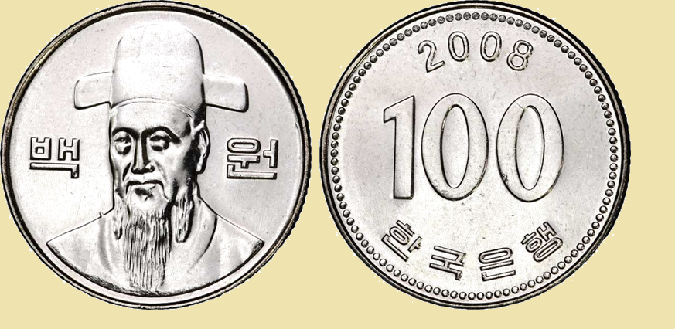
2. The other player will flip the coin.
Heads Tails

Slide 5
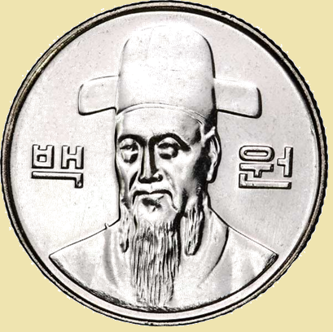


Heads =
1 2
“Ok, sounds good!”
Tails =
1 2
“Sorry, I can’t.”

Slide 6
Try to collect all of the activities.
Make a suggestion
  Let’s ______________________.
The other player will flip the coin.
Look at the coin
  Heads = “Ok, sounds good.”
  Tails = “Sorry, I can’t. I am busy / tired”

Slide 7



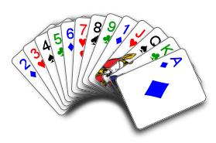


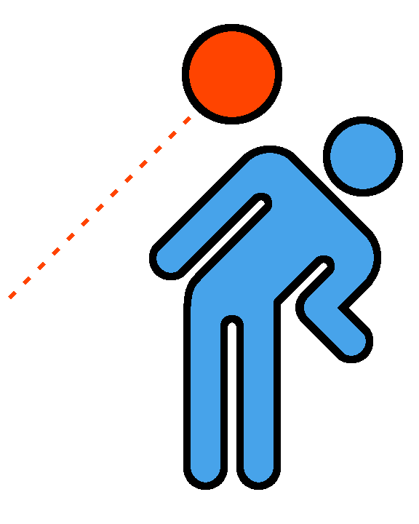
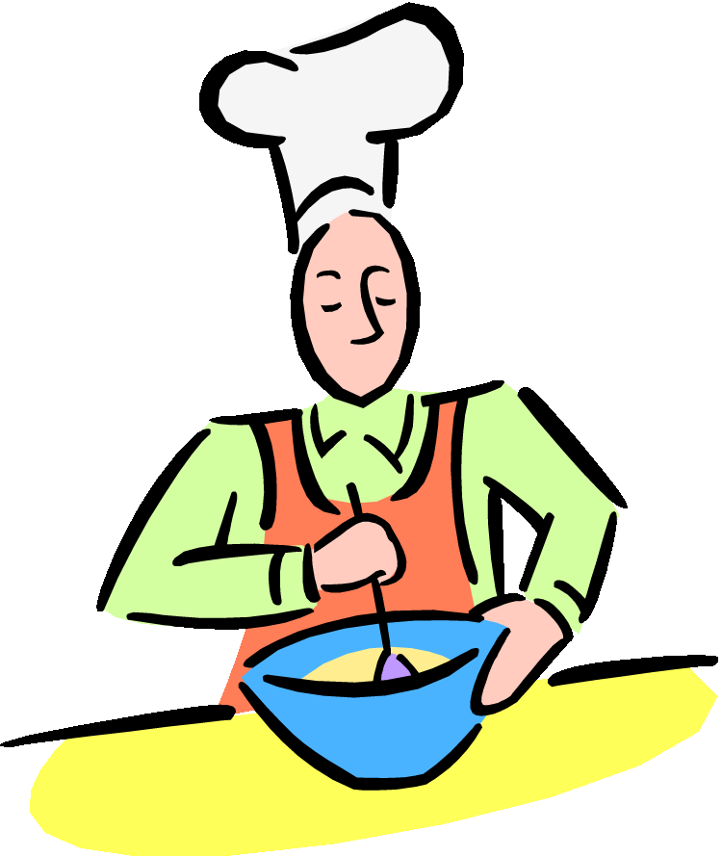

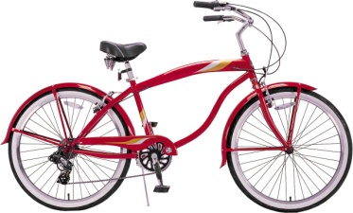


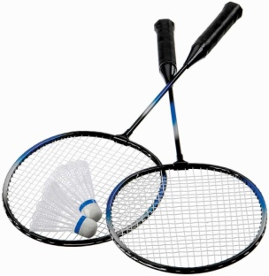

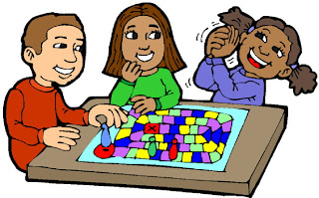
1 2
1 2
1 2
1 2
1 2
Let’s play video games.
Let’s play board games.
Let’s eat ice cream.
Let’s play dodgeball.
Let’s cook.
Let’s sing.
Let’s watch a movie.
Let’s ride a bike.
Let’s play soccer.
Let’s play badminton.
Let’s play cards.
Let’s play basketball.
Let’s paint.
Let’s play baseball.
Let’s dance.
1 2
1 2
1 2
1 2
1 2
1 2
1 2
1 2
1 2
1 2

Slide 8


1 2
1 2
1 2
1 2
1 2
1 2
1 2
1 2
1 2
1 2
Let’s dance.
Ok, Sounds good
1 2
1 2
1 2
1 2
1 2

Slide 9
1 2
1 2
1 2
1 2
1 2
1 2
1 2
1 2
1 2
1 2
Ok, Sounds good
Let’s play dodgeball.
1 2
1 2
1 2
1 2
1 2

Slide 10
No Check!
1 2
1 2
1 2
1 2
1 2
1 2
1 2
1 2
1 2
1 2
Let’s watch a movie.
Sorry, I can’t.
1 2
1 2
1 2
1 2
1 2

Slide 11
1 2
1 2
1 2
1 2
1 2
1 2
1 2
1 2
1 2
1 2
Ok, Sounds good
Let’s dance.
1 2
1 2
1 2
1 2
1 2

Slide 12
Heads =
1 2
“Ok, sounds good!”
Tails =
1 2
“Sorry, I can’t. I am _____.”

