Slide 1
Eoeun Olympics

Slide 2
Eoeun Olympic Rules
For each event, choose one person from your team
Only one event per person
Each winner will get a chocolate
The winning team gets a stamp.

Slide 3
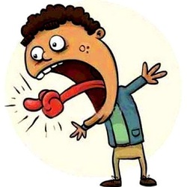
Event 1 (fastest speaking)

Slide 5
Event 2 (smartest)

Slide 7
Event 3 (fastest writing)

Slide 8
Event 3 (fastest writing)
Write the Alphabet

Slide 9
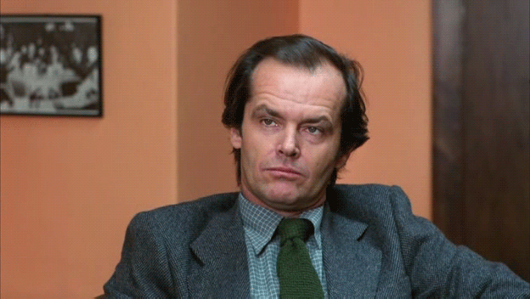
Event 4 – (Longest time without blinking)

Slide 10
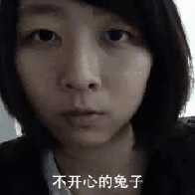
Event 5 – (ugliest face)
One person from each team come to the front.
You have one minute to make an ugly face.
Vote (not your own team)

Slide 11
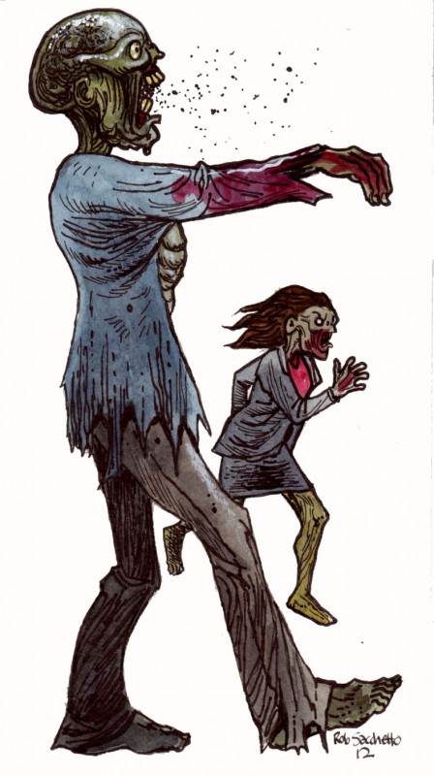
Event 7 (strongest zombie)
Hold your arms straight in front of you.
The longest without dropping arms is the winner.

Slide 12
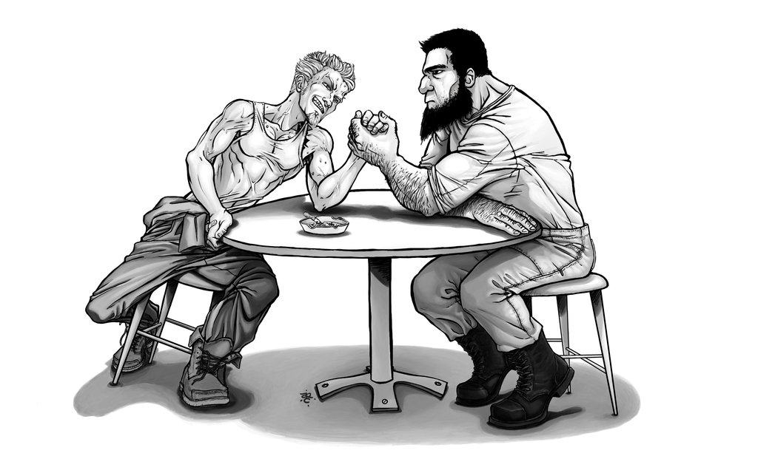
Event 6 (strongest 2)

Slide 13
Event 8 – (farthest flight)

Slide 14
Event 9 – (most accurate)

