Slide 1
Comparatives Game

Slide 2
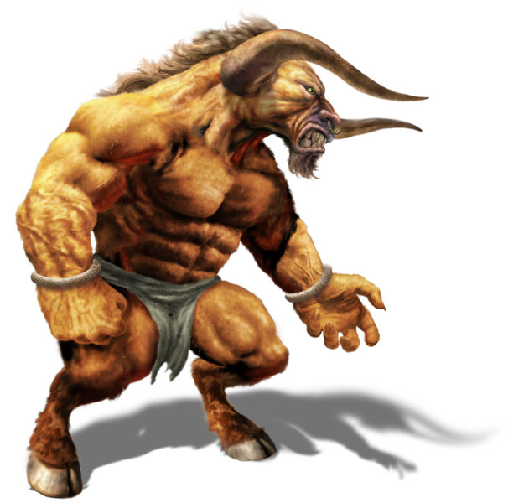
The Minotaur
55
78
99
20
Speed: Power:
Size: Intelligence:

Slide 3
Game
Fast, Faster
Speed
Power
Size
Intelligence
Strong, Stronger
Big, Bigger
Smart, Smarter

Slide 4
How to Play
Choose a card
Put it upside down on the table
Rock, Paper, Scissors
Choose a trait
Speed, Size, Power, Intelligence
Show your card
Same time
Make a sentence + The winner takes the card

Slide 5
Make a Sentence
If they don’t make a sentence, you don’t have to give them your card.
I am ________er than you.

