Slide 1
How Green Are You?
Modified version of:
http://www.ecofriendlykids.co.uk/how-green-are-you.html

Slide 2
Write 1 – 12 in your textbook Write your answers

Slide 3
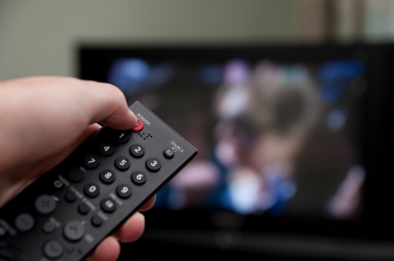
1. Do you turn off the TV and computer?
Always
Mostly
Sometimes

Slide 4
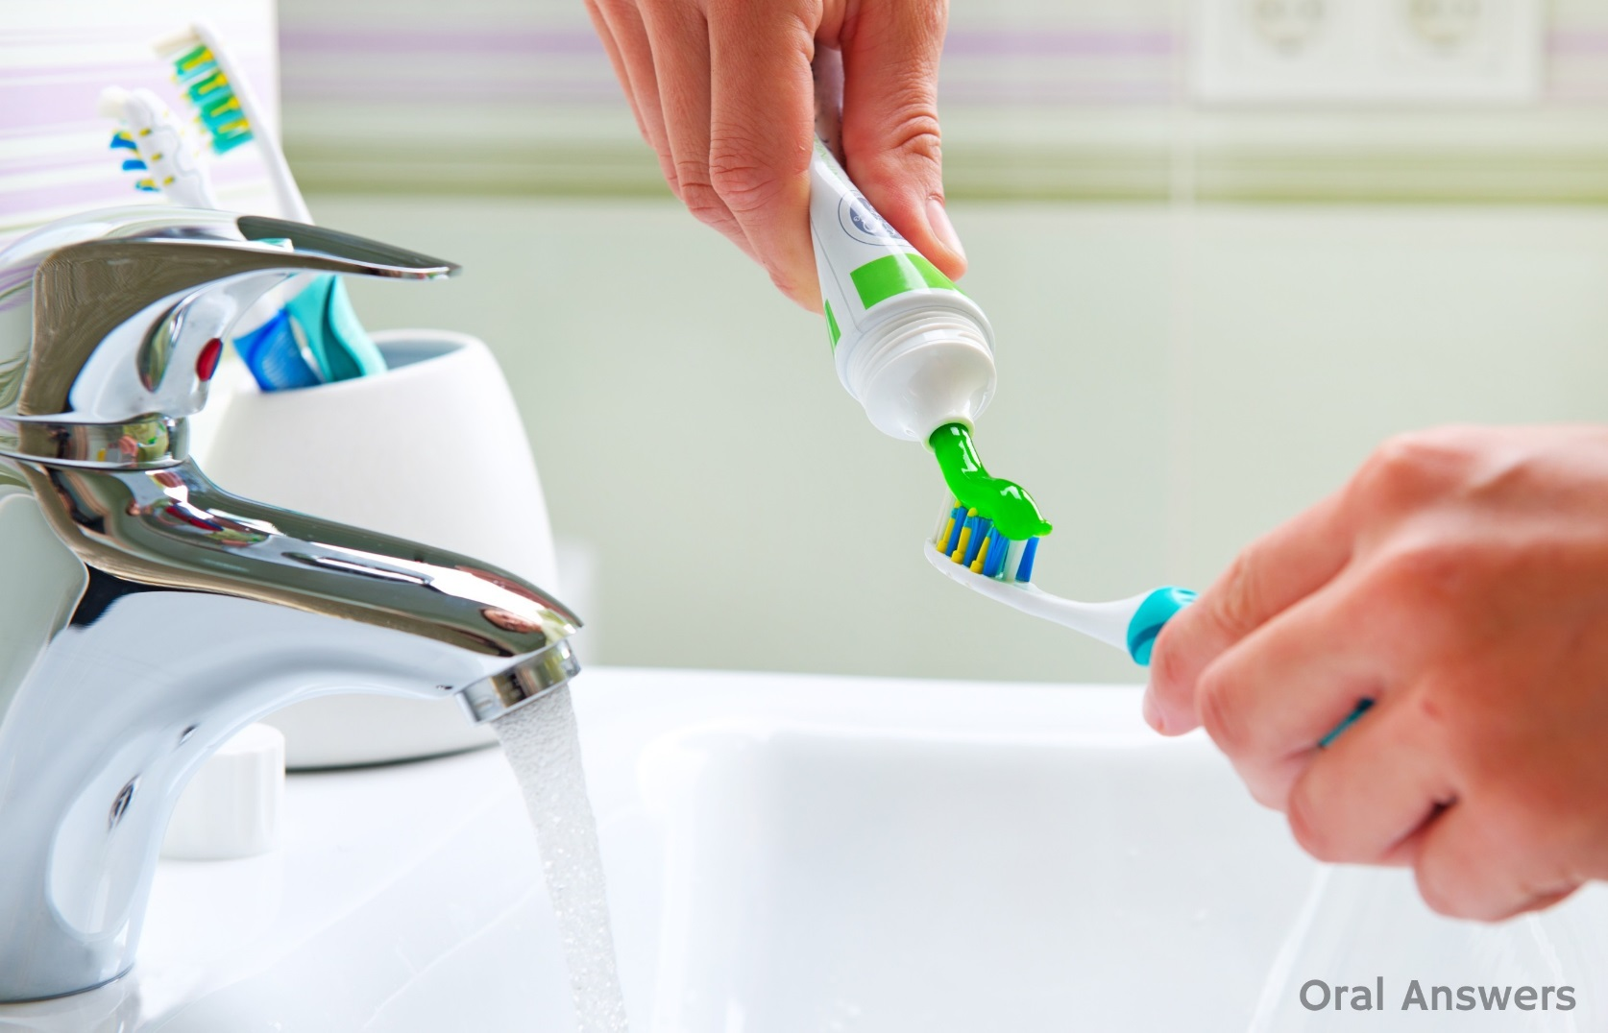
2. When you brush your teeth, do you let the water run?
Yes.
No!
Sometimes

Slide 5
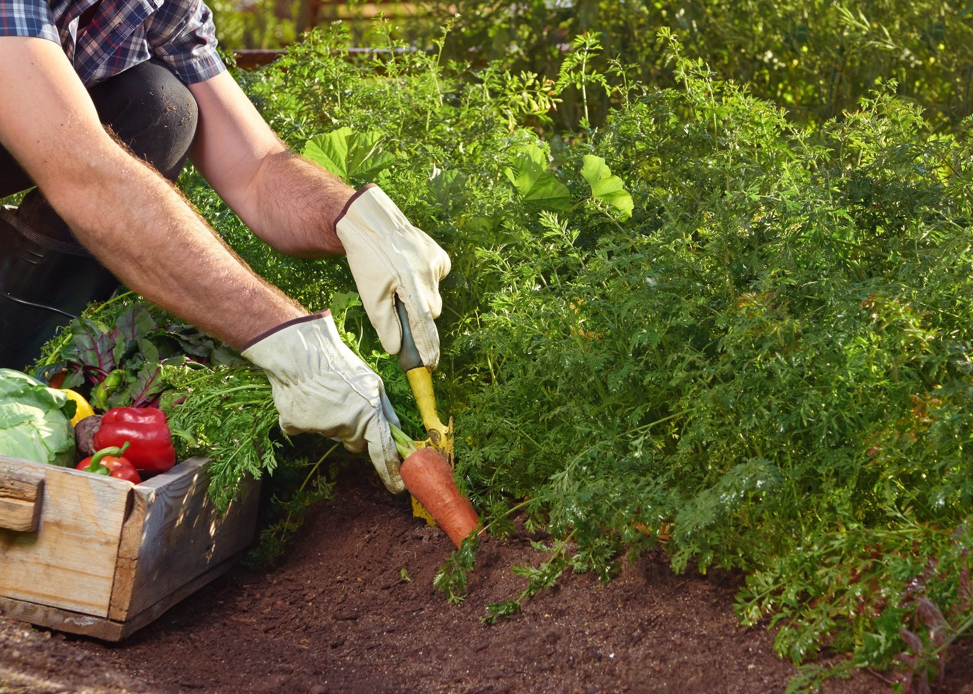
3. Do you grow your own food at home?
Yes, many.
Yes, some.
No.

Slide 6
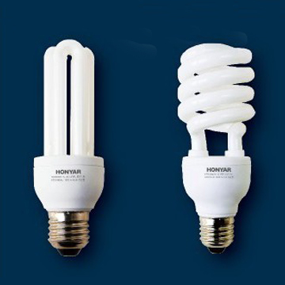
4. How many light bulbs are “low energy” light bulbs in your house?
None / one / two
Half of them
All of them

Slide 7
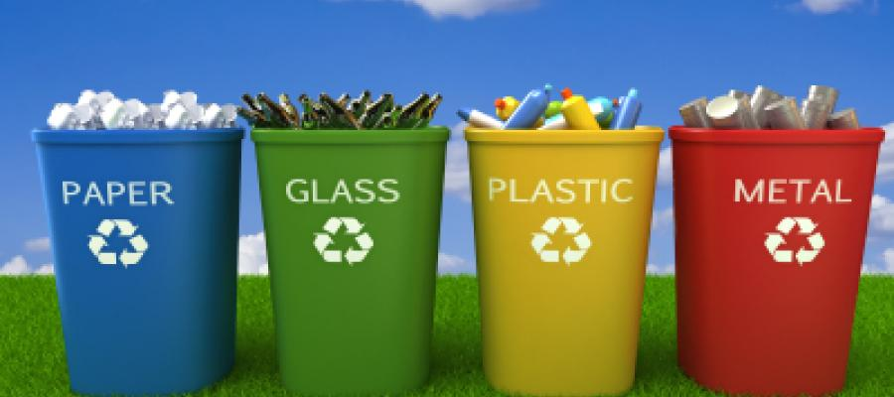
5. How much garbage do you recycle?
Just bottles
As much as possible
Most of what we can

Slide 8
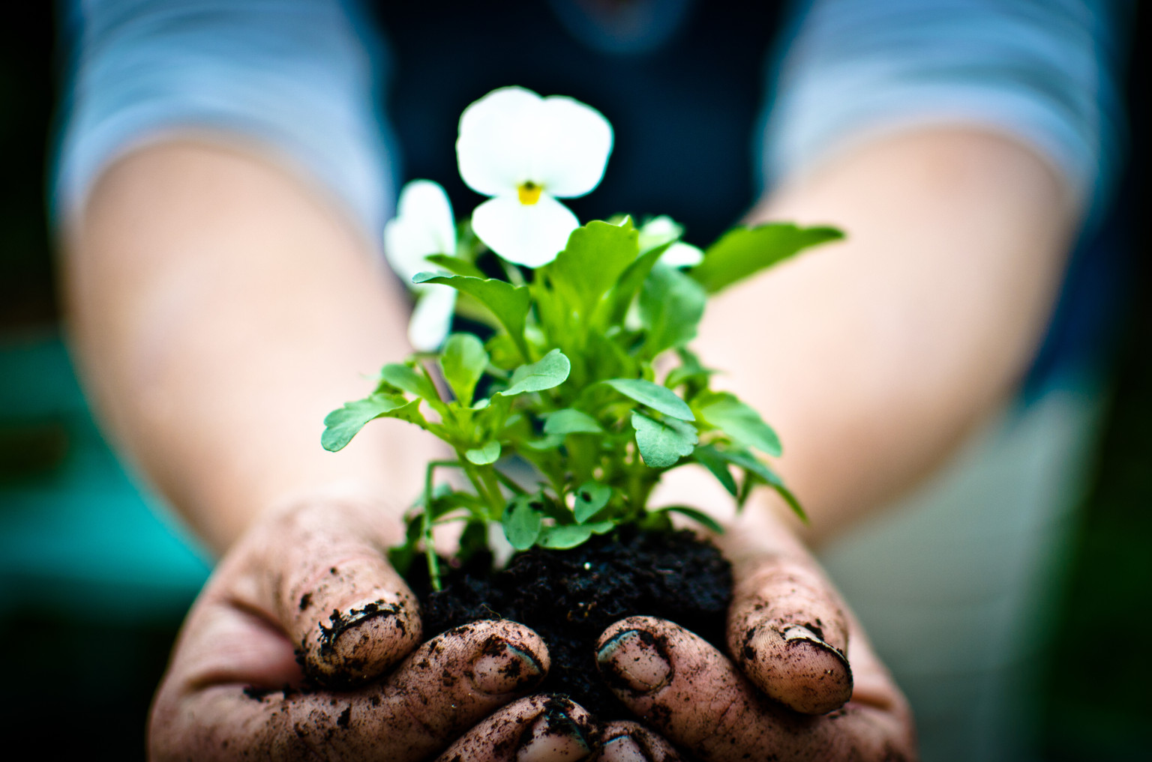
6. Do you grow flowers?
No.
I have some in my house
I have a garden

Slide 9
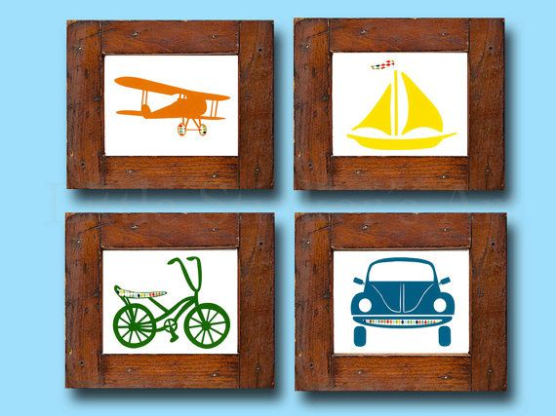
7. How did you travel on your last holiday?
Boat or Train or Car
Walking or Bicycle
Airplane

Slide 10
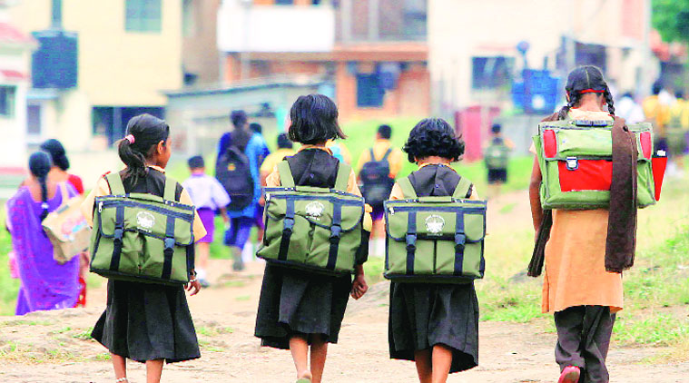
8. How do you travel to school?
Walk or Cycle
Bus
Car

Slide 11
9. Shower or Bath?
Bath
Shower
Don’t care

Slide 12
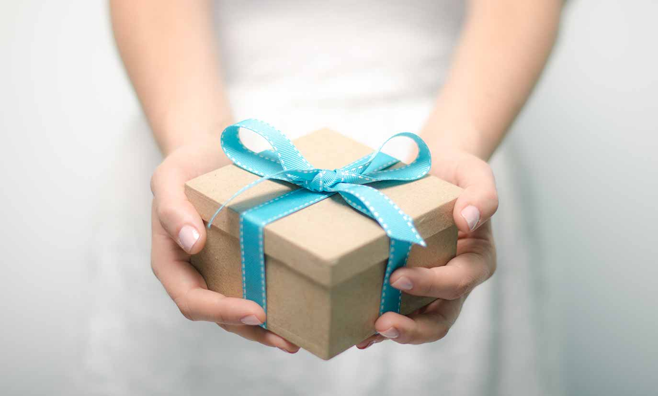
10. When you buy a present, what is most important?
Price
Was it made in Korea?
Will the person like it?

Slide 13
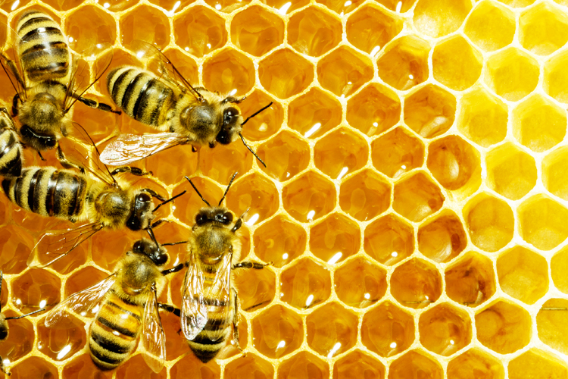
11. What do you think of bees?
I stay away from them, and they stay away from me.
I don’t like them.
They are important to the world

Slide 14
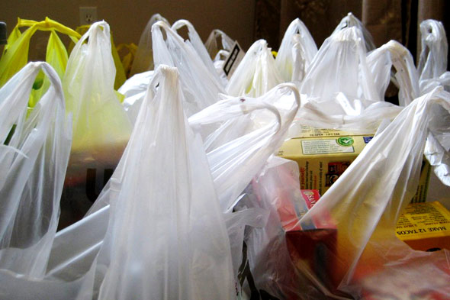
12. How many times do you reuse plastic bags?
Once, maybe.
3 or 4 times.
I don’t take the bag.

Slide 15
Results – add your points
a) 3 points b) 2 points c) 1 point
a) 1 point b) 3 points c) 2 point
a) 3 points b) 2 points c) 1 point
a) 1 point b) 2 points c) 3 point
a) 1 point b) 3 points c) 2 point
a) 1 point b) 2 points c) 3 points

Slide 16
Results – add your points
7. a) 2 points b) 3 points c) 1 point
8. a) 3 points b) 2 points c) 1 point
9. a) 2 points b) 3 points c) 1 point
10. a) 1 point b) 3 points c) 2 points
11. a) 2 points b) 1 point c) 3 points
12. a) 1 point b) 2 points c) 3 points

Slide 17
Results
29 to 36 – Dark Green!
Excellent. Keep up the good work.
19 to 28 – Emerald Green!
Very good. You can do more.
12 to 18 – Light Green!
You should try harder.

