Slide 1
What Did You Do?

Slide 2
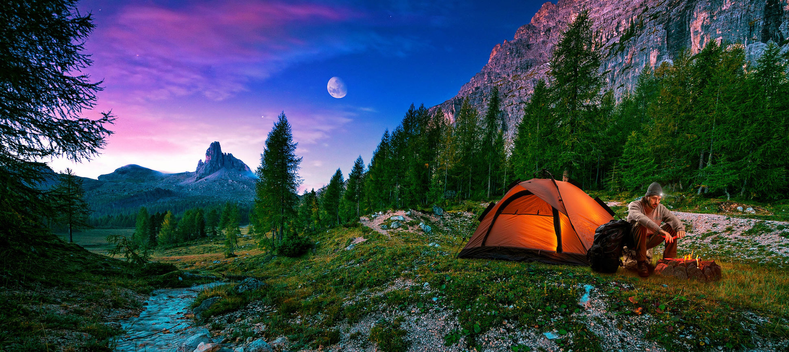
I went _______.

Slide 3
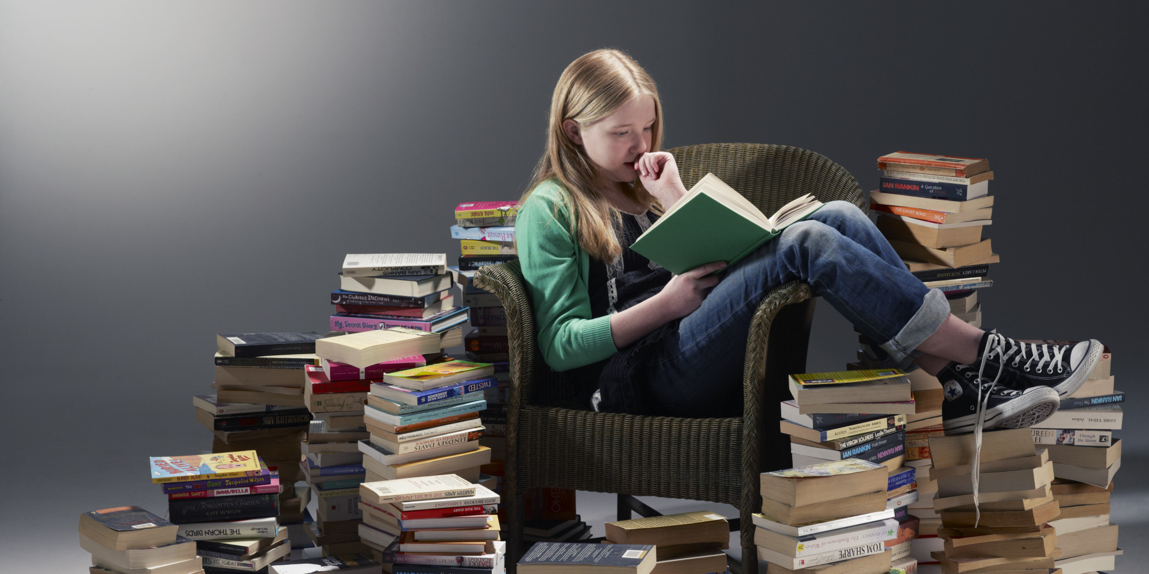
I _____ books.

Slide 4
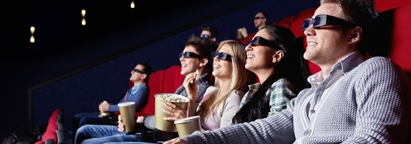
I ________ a movie.

Slide 5
I _____ stars.

Slide 6
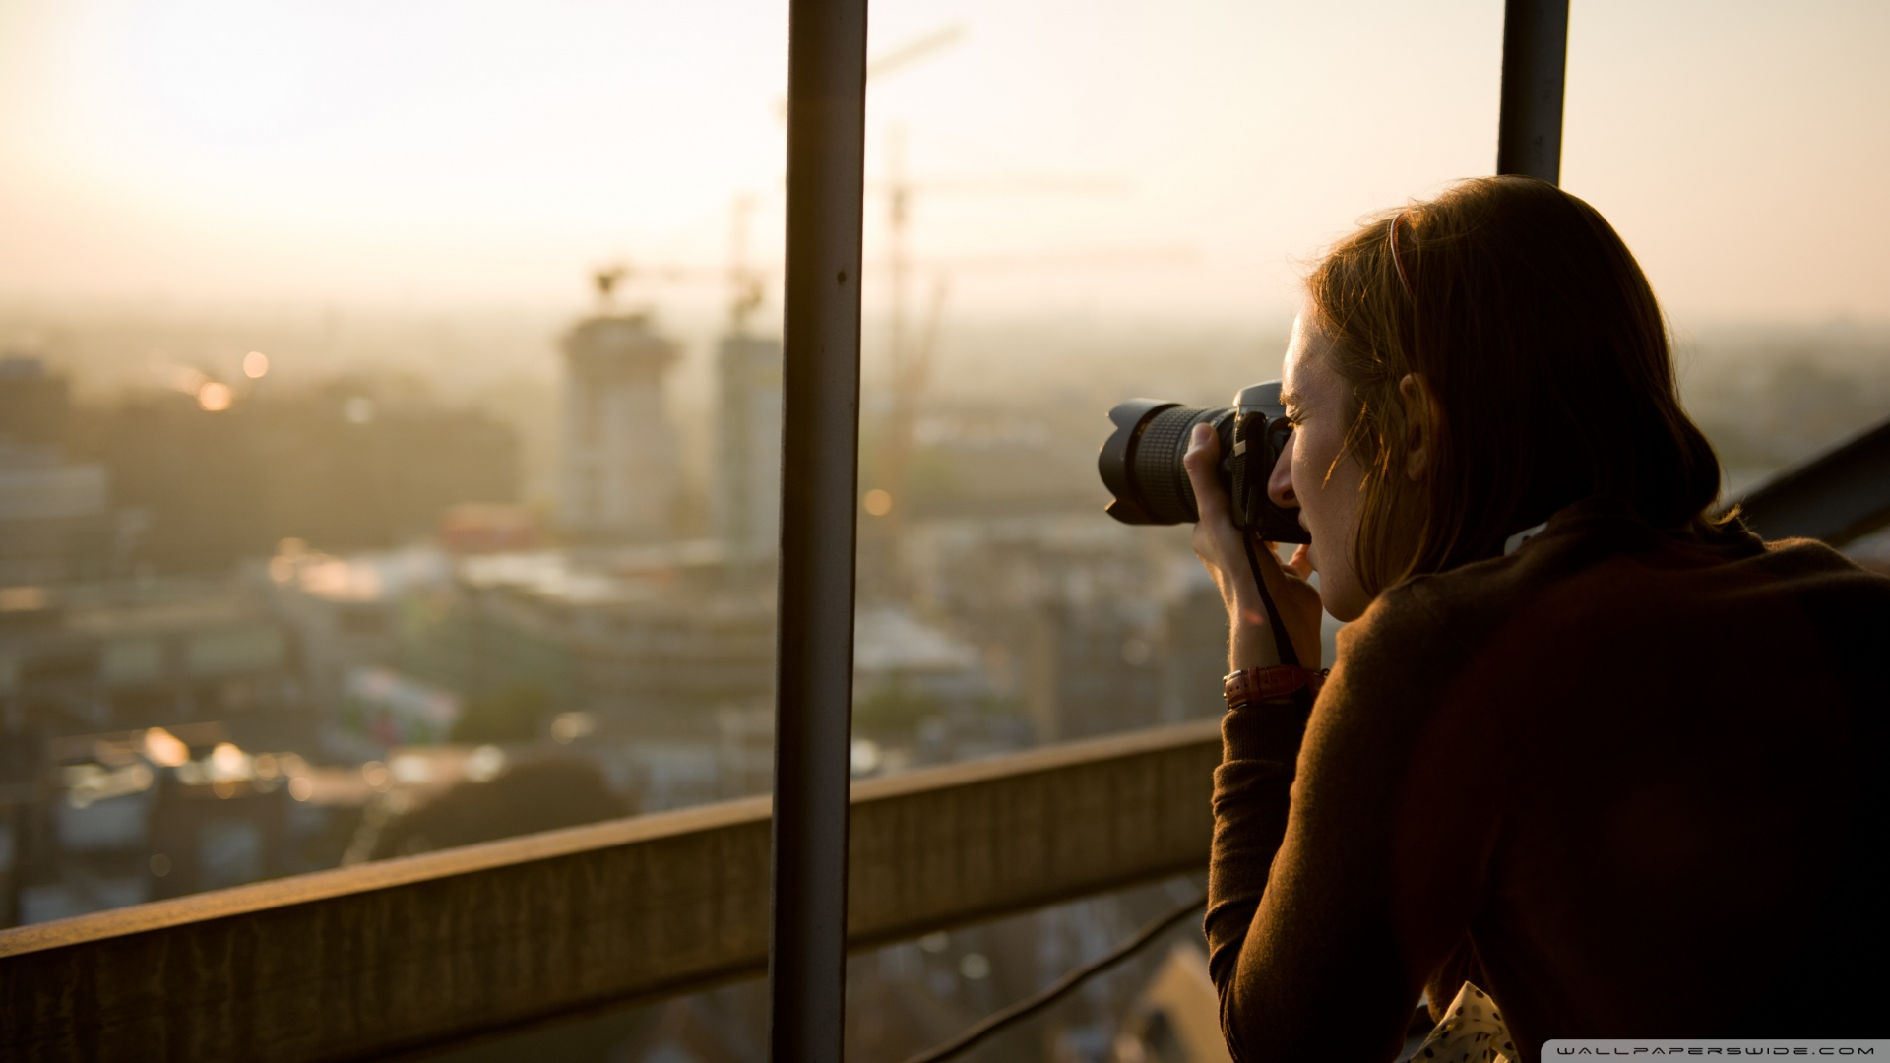
I _____ pictures.

Slide 7
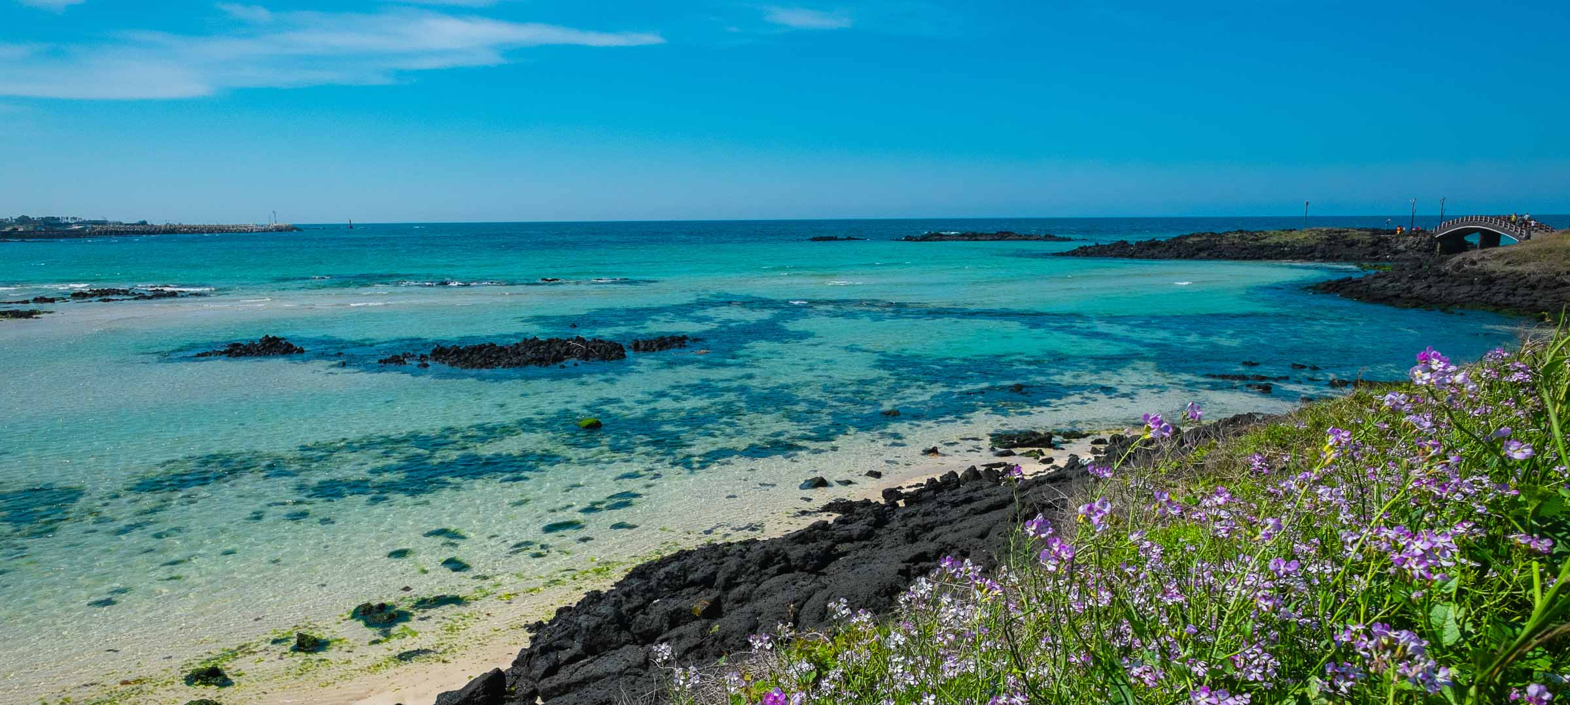
I _____ to Jeju Island.

Slide 8
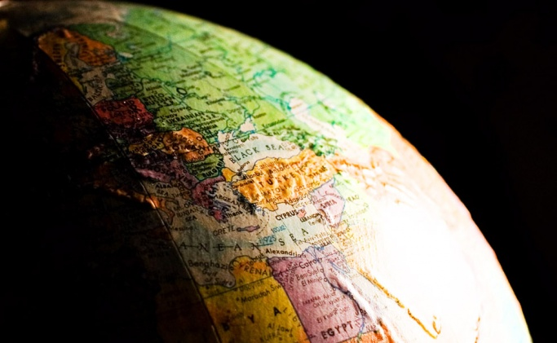
I _______ about the earth.

Slide 9
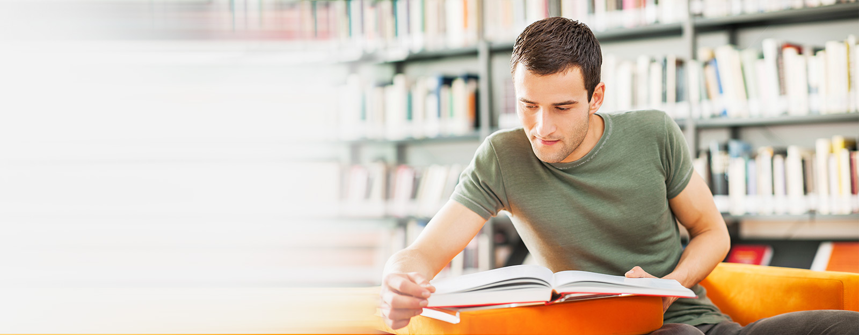
I _______ English.

Slide 10
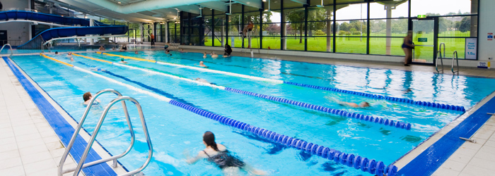
I _______ the swimming pool.

Slide 11
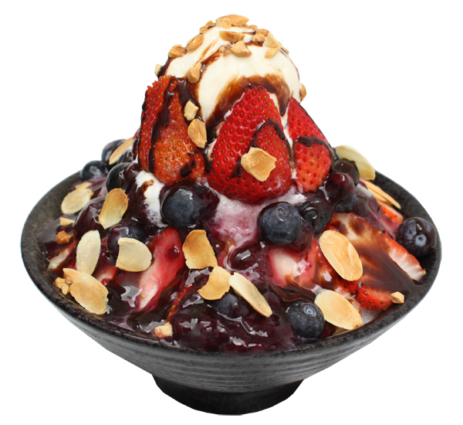
I ______ Berry Bingsu.

Slide 12
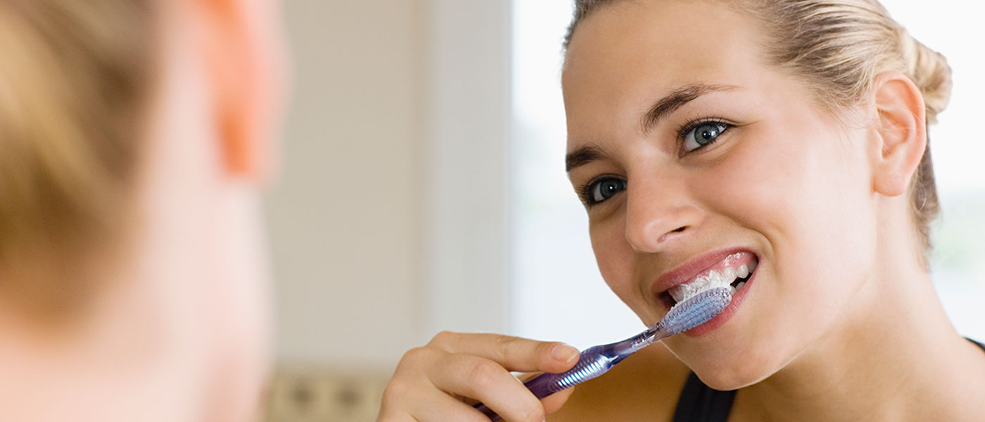
I ________ my teeth.

Slide 13
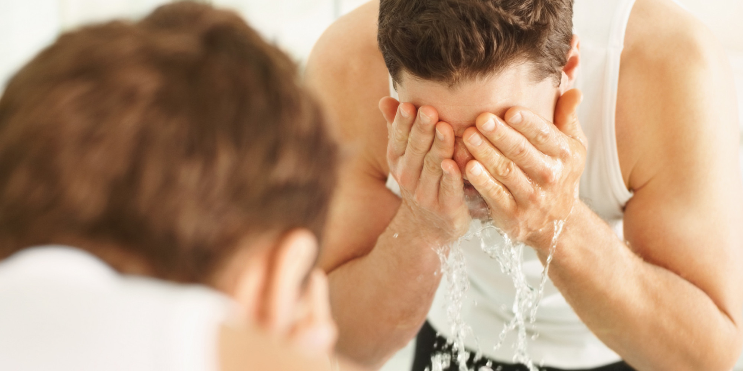
I _______ my face.

Slide 14
I _______ my face.
Did you wash your face?
Yes, I washed my face.

Slide 15
Did you… ?

Slide 16
Did you… ?

Slide 17
Did you… ?

Slide 18
Did you… ?

Slide 19
Did you… ?

Slide 20
Did you… ?

Slide 21
Did you… ?

Slide 22
What did you do during vacation?
One student will come to the front.
That student will write something they did during vacation secretly on the white board.
The other students take turns guessing, “Did you…?”
Whoever guesses correctly gets a stamp and is the next student to the front.

