Slide 1
Scattergory

Slide 2
Rules
Split the class into 6 groups
Each class will receive a white board or paper.
A category will be revealed (the following slides)
Students have 2 minutes to create as many “have to” rules / sentences as possible.
Take up the answers
If there is a repeat answer, no one gets the point.

Slide 3
1
2
3
4
5
6
7

Slide 4
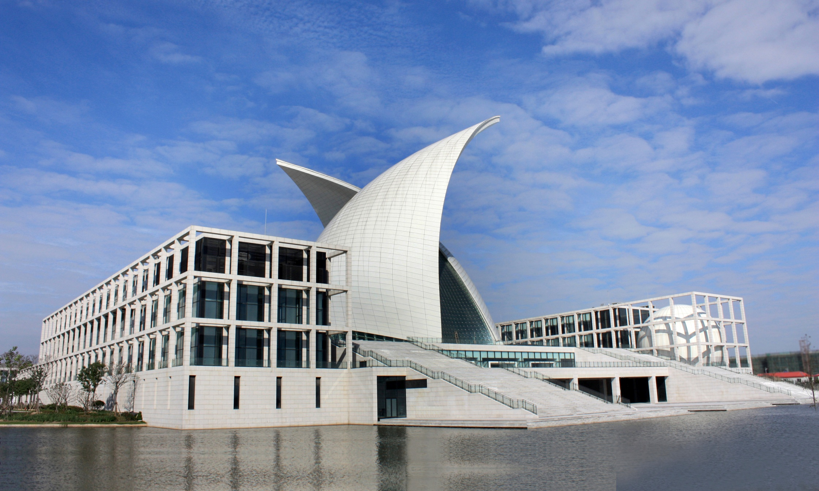
Museum
Return

Slide 5
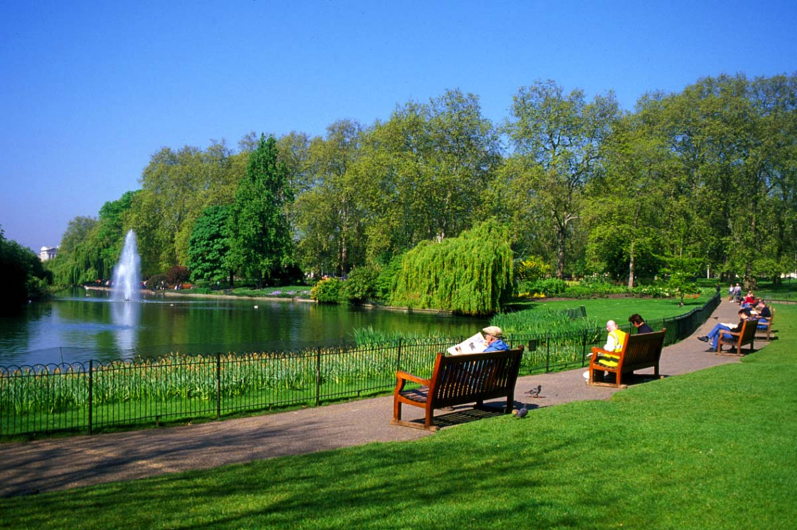
Park
Return

Slide 6
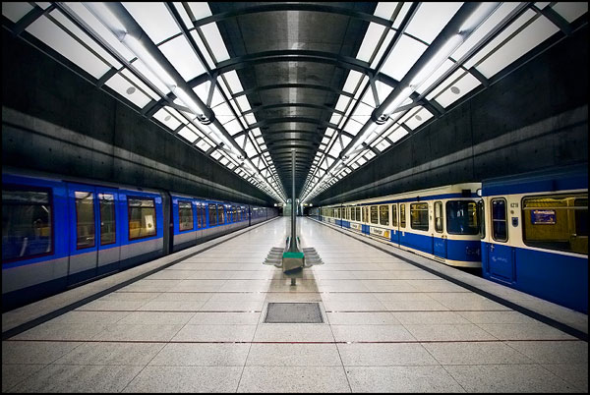
Subway
Return

Slide 7
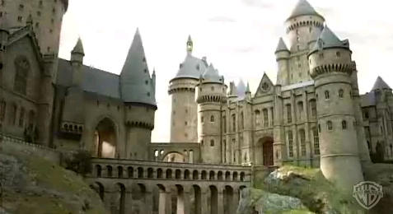
School
Return

Slide 8
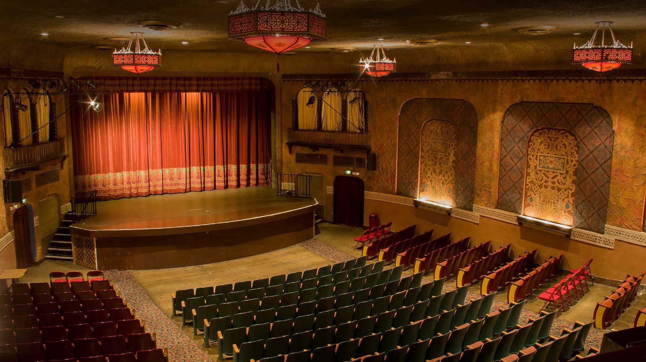
Theater
Return

Slide 9
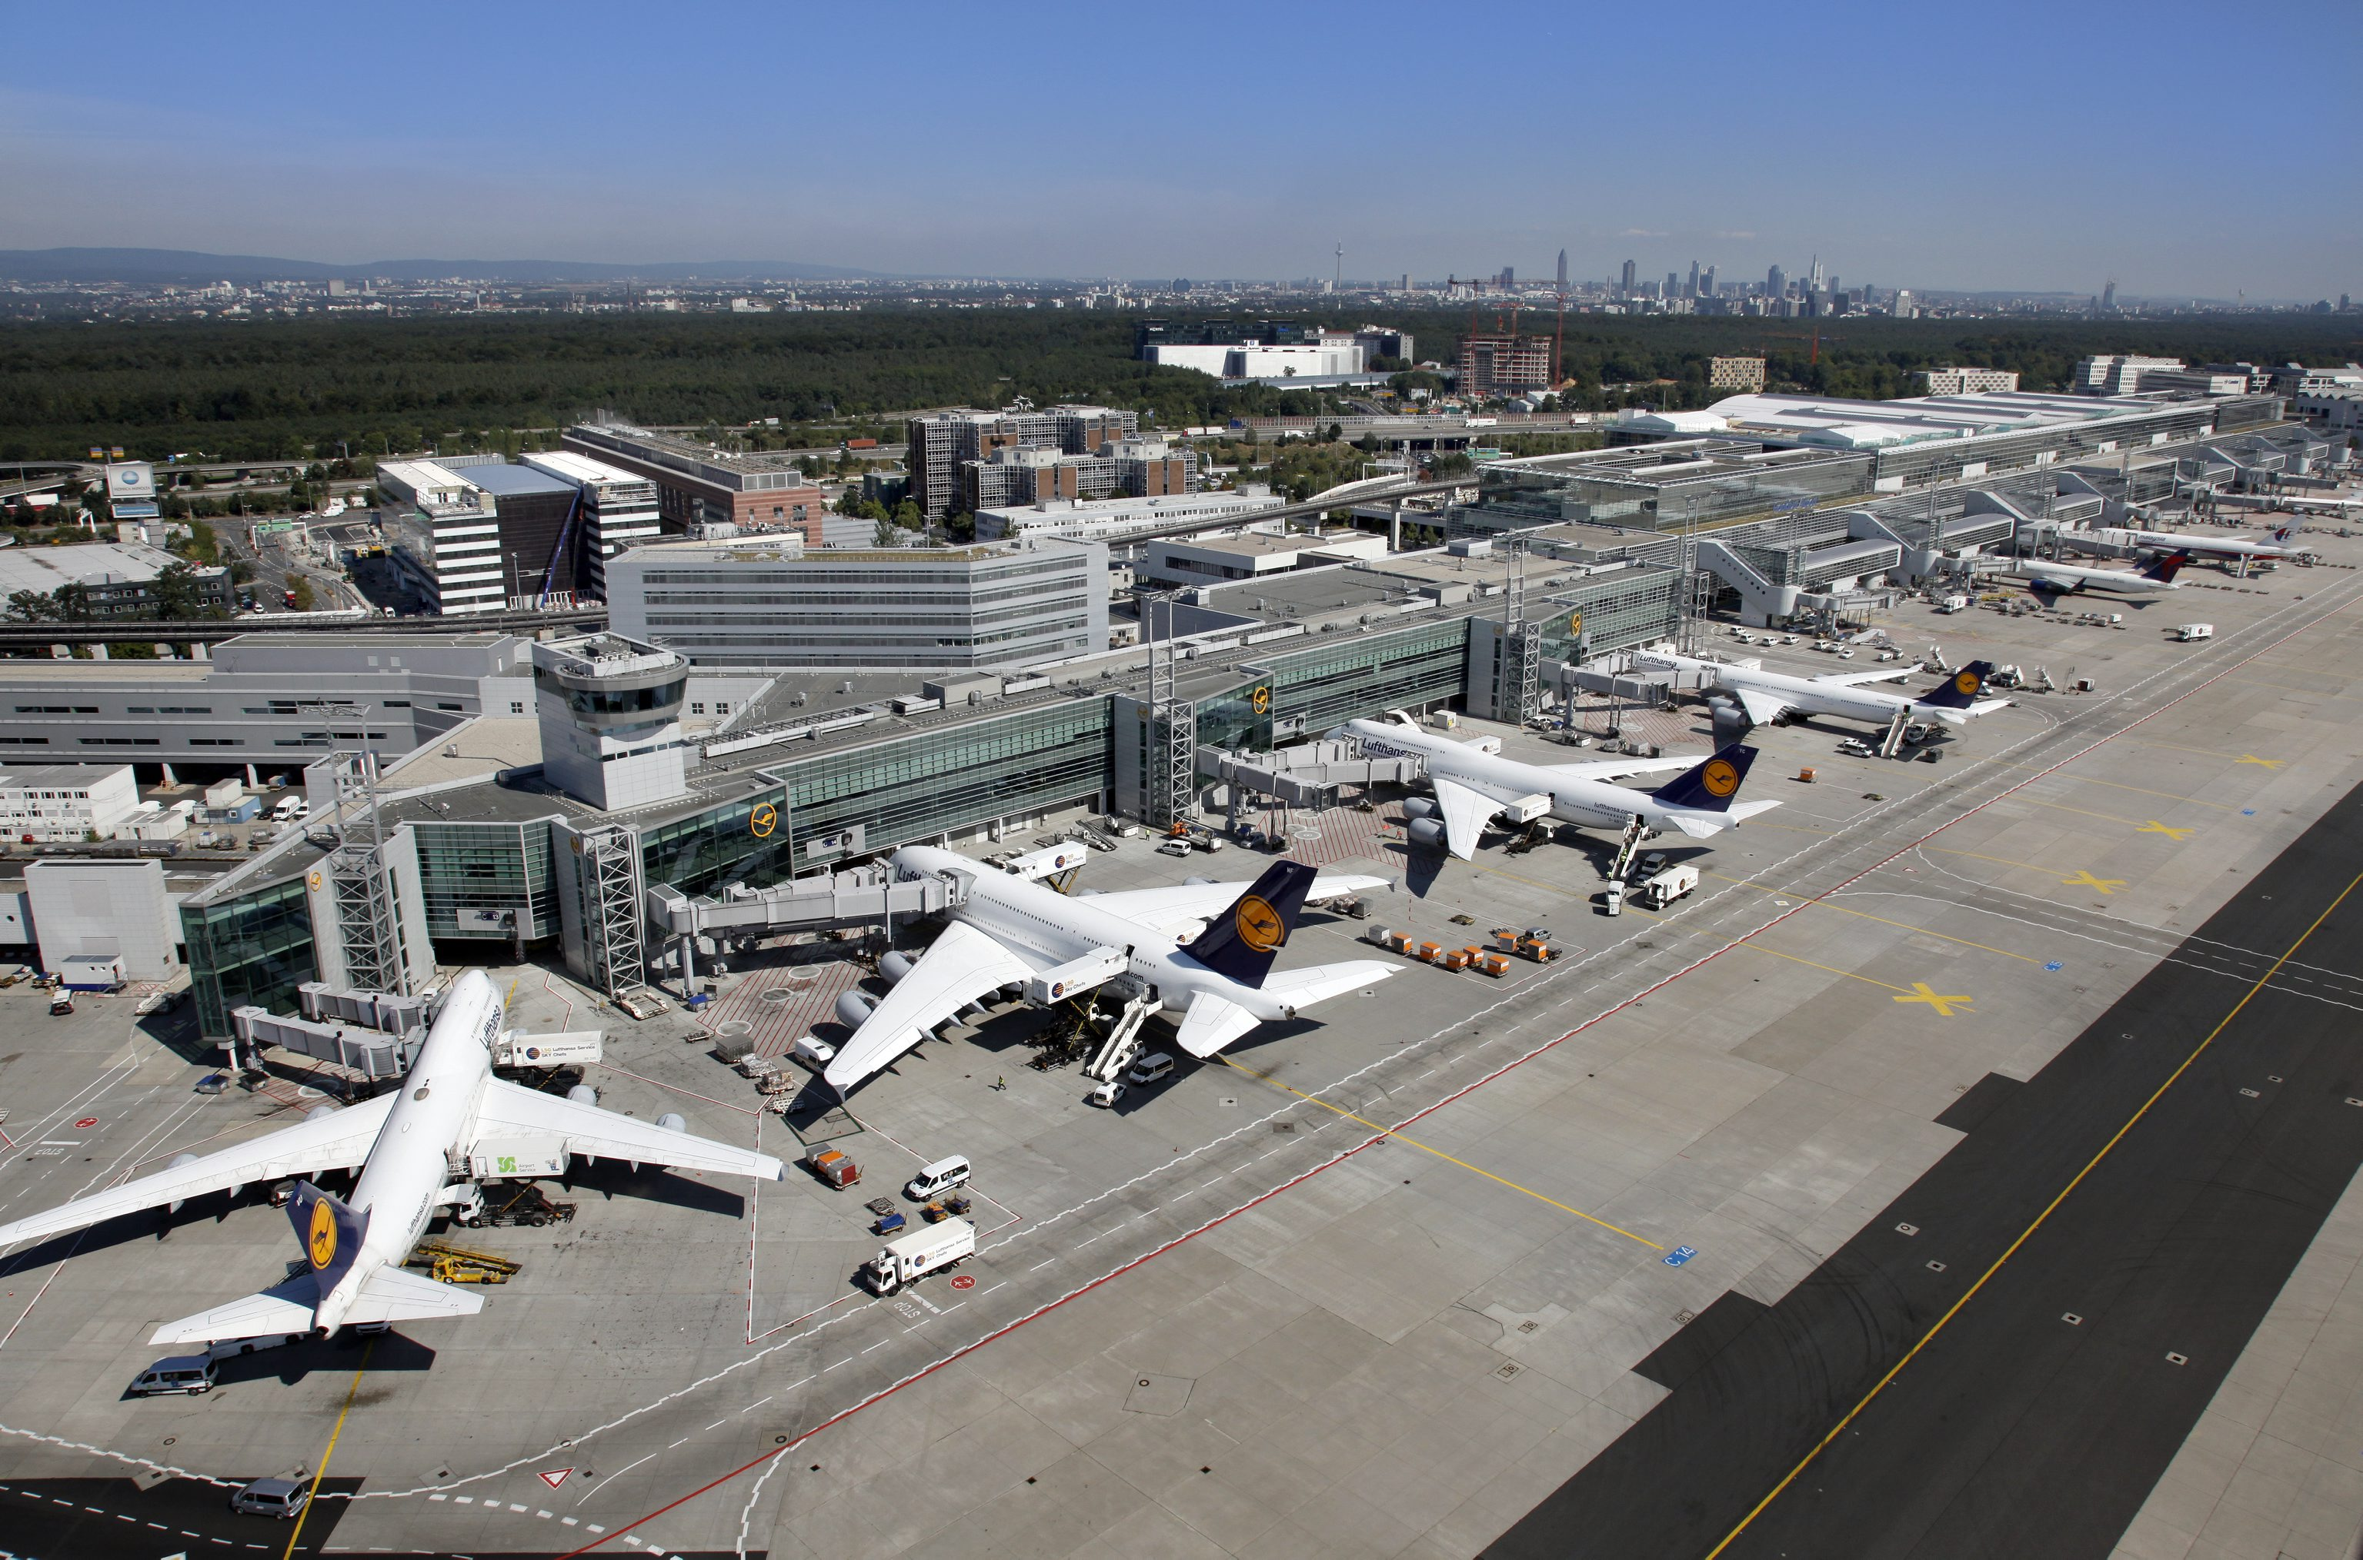
Airport
Return

Slide 10
Library
Return

