Slide 1
I’m good at ______. I want to be a (an) ______.

Slide 2
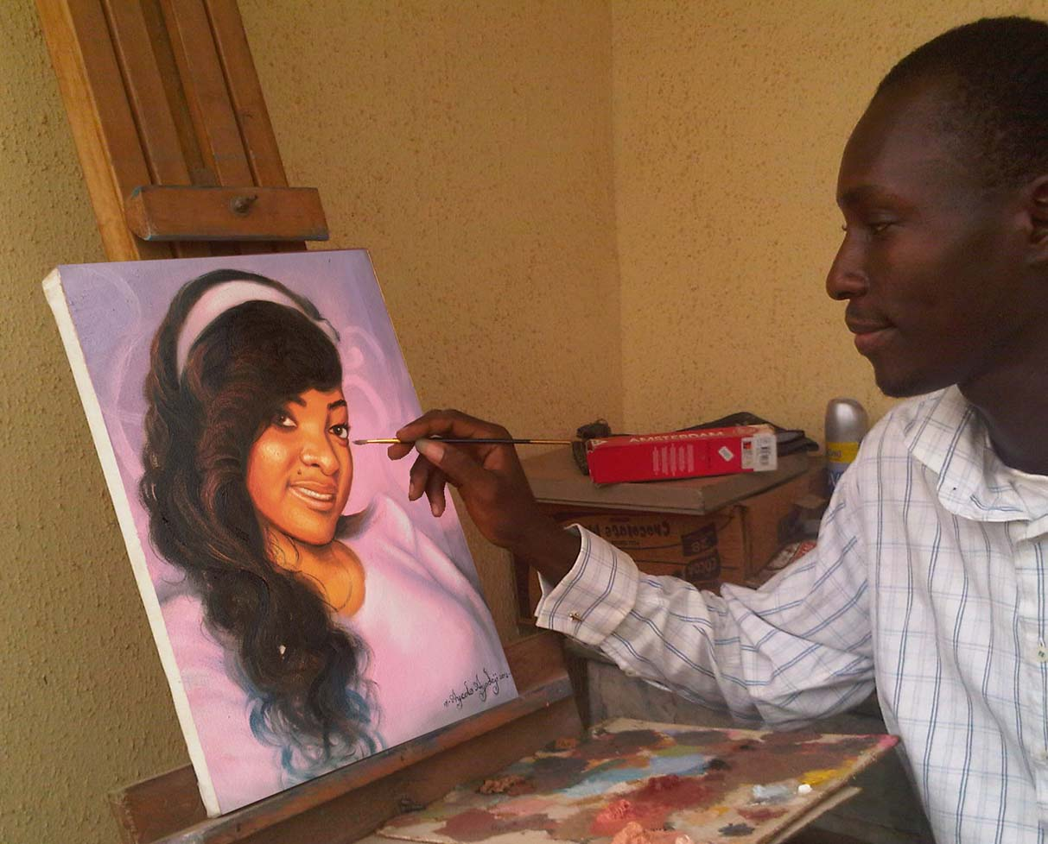
Make two sentences for the picture:
painting
an artist
I’m good at ___________.
I want to be ____________.

Slide 3
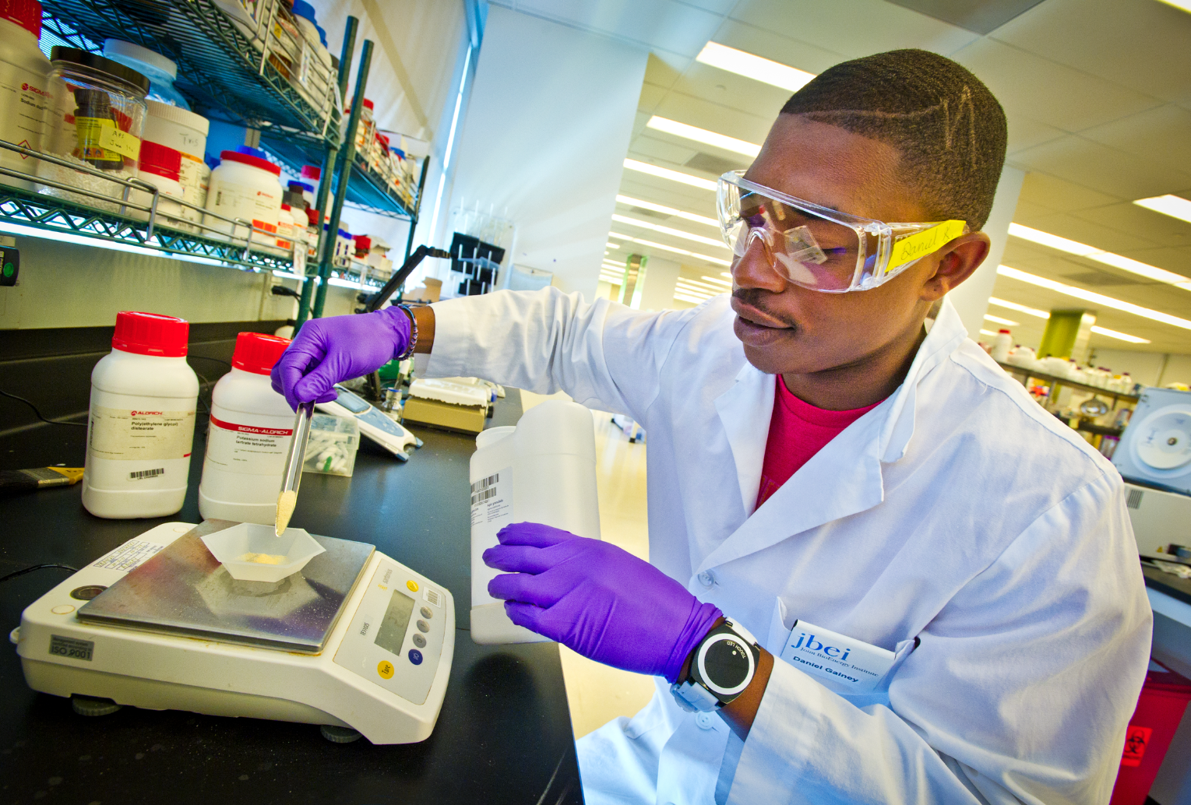
I’m good at ________. I want to be ___________.
science
a scientist

Slide 4
I’m good at ________. I want to be ___________.
singing
a singer

Slide 5
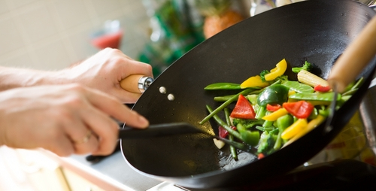
I’m good at ________. I want to be ___________.
cooking
a chef

Slide 6
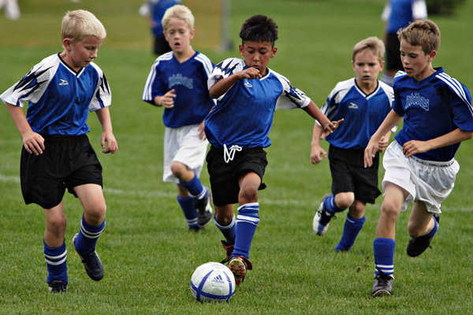
I’m good at playing soccer. I want to be a soccer player.

Slide 7
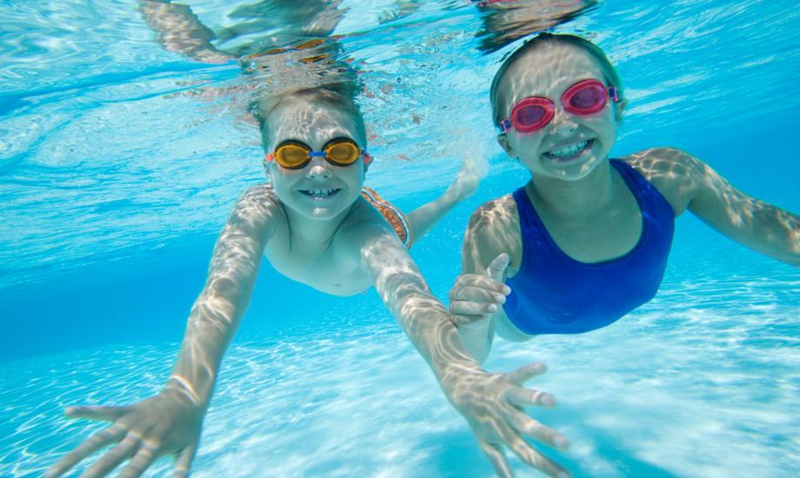
I’m good at swimming. I want to be a swimmer.

Slide 8
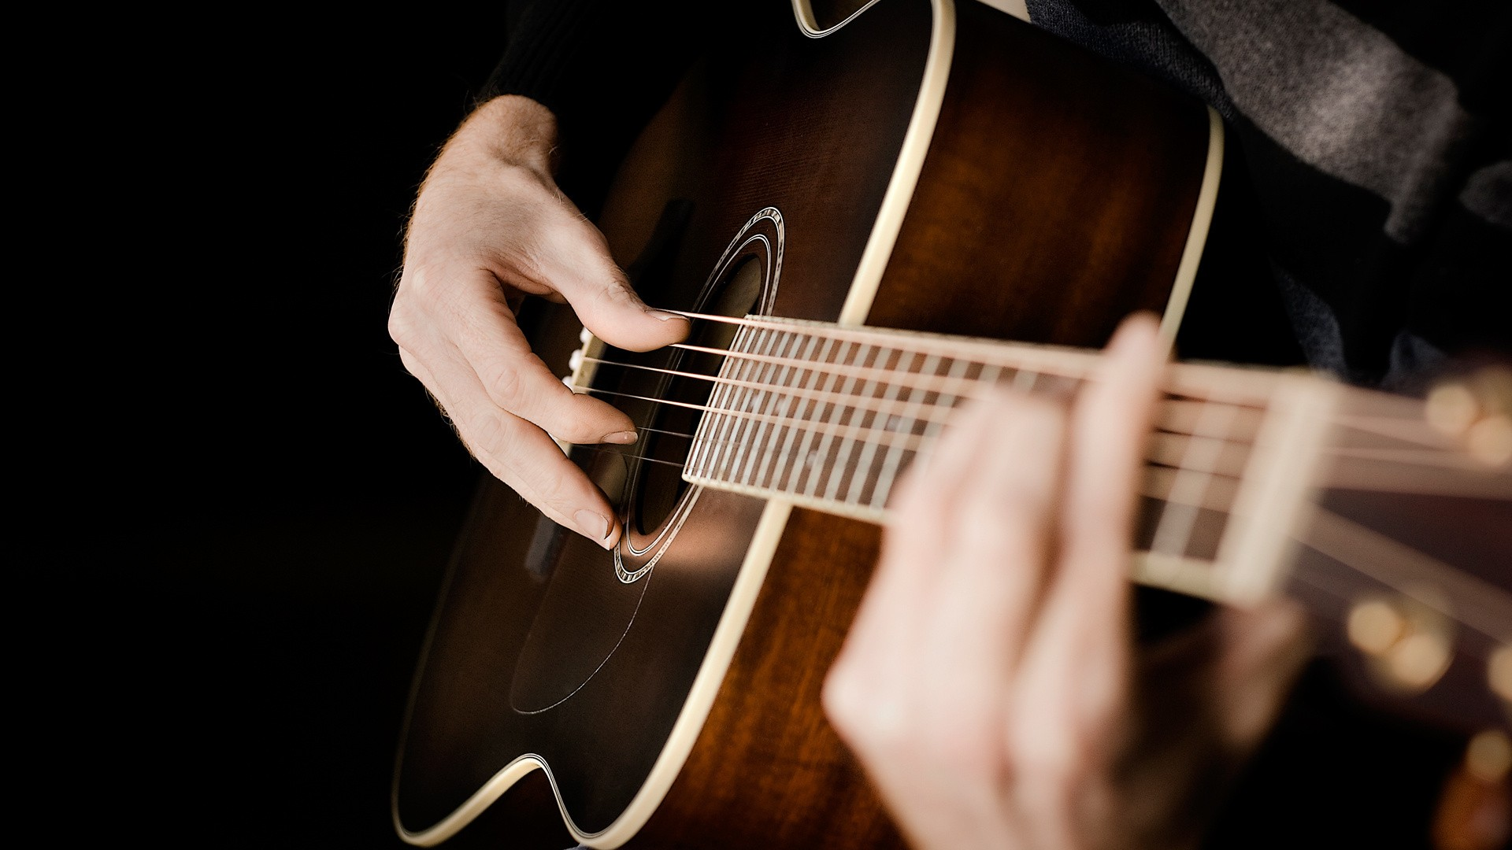
I’m good at playing guitar. I want to be a guitar player (guitarist).

Slide 9
I’m good at writing. I want to be an author.

Slide 10
I’m good at teaching. I want to be a teacher.

Slide 11
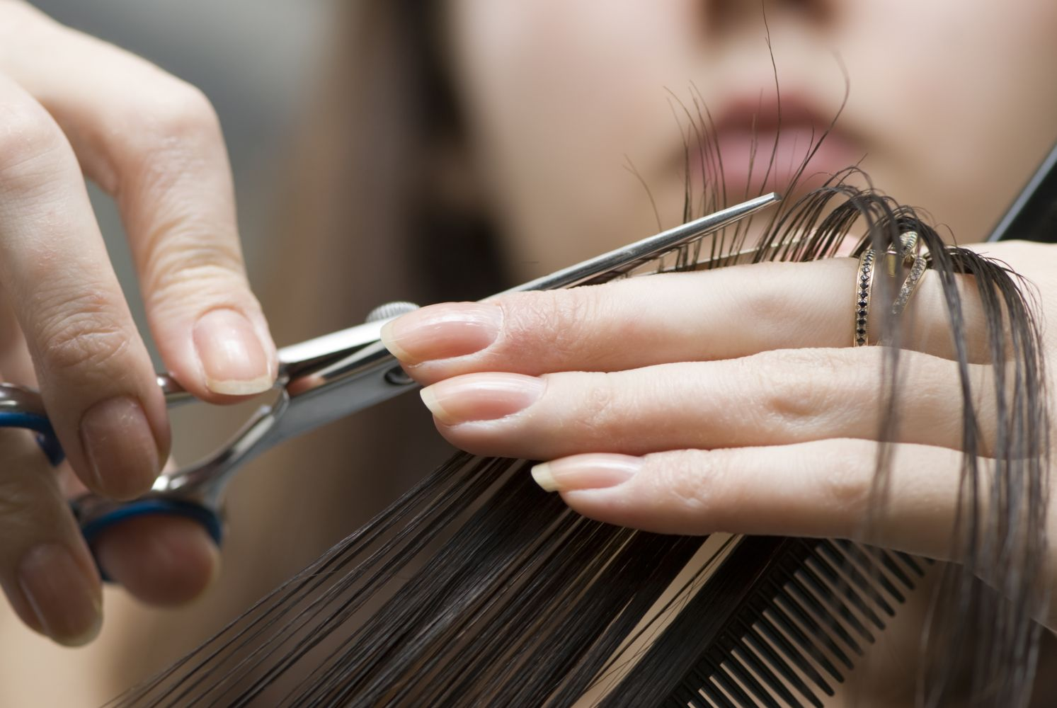
I’m good at cutting hair. I want to be a hair designer.

Slide 12
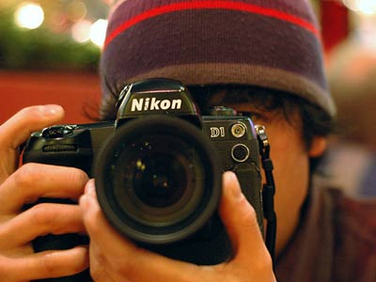
I’m good at taking photos. I want to be a photographer.

Slide 13
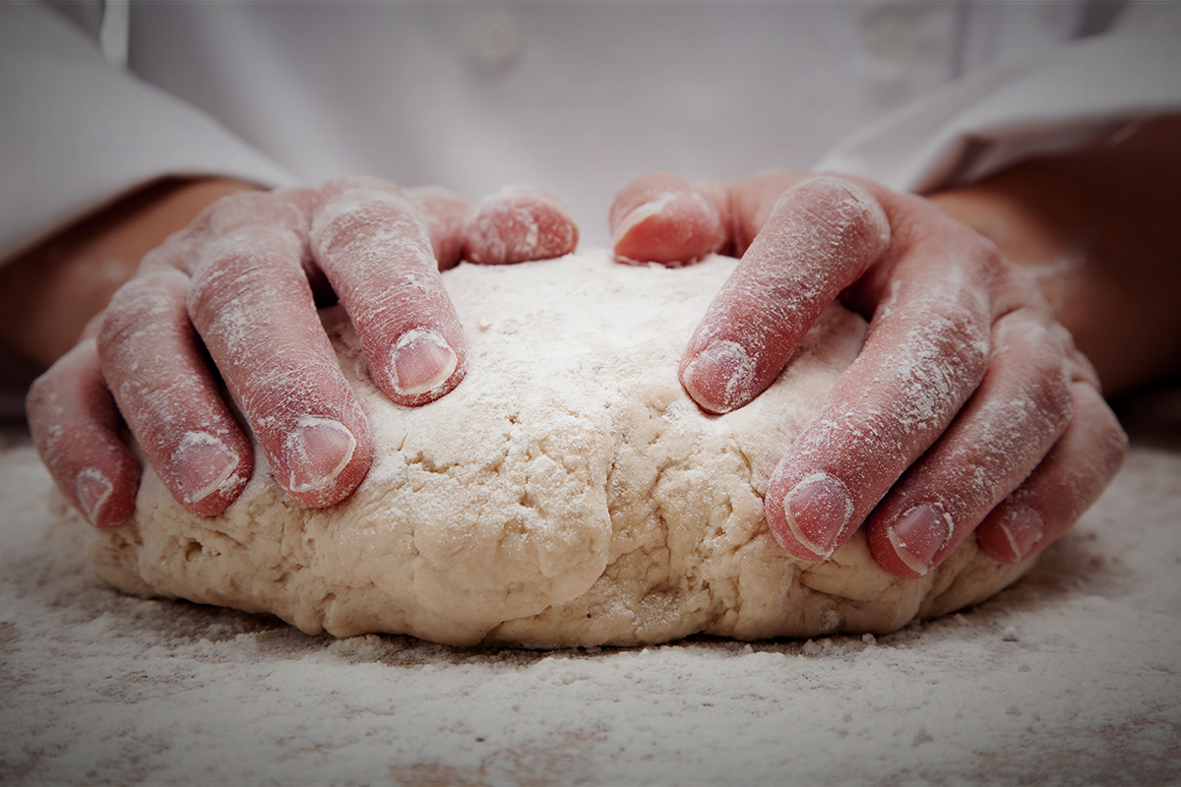
I’m good at baking. I want to be a baker.

Slide 14
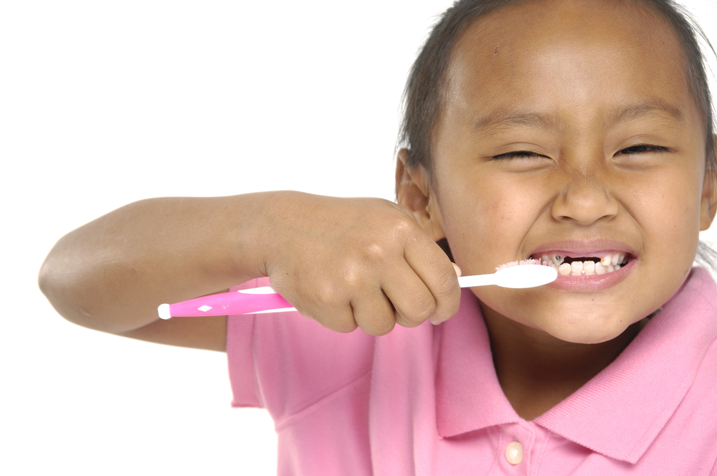
I’m good at brushing my teeth. I want to be a dentist.

Slide 15
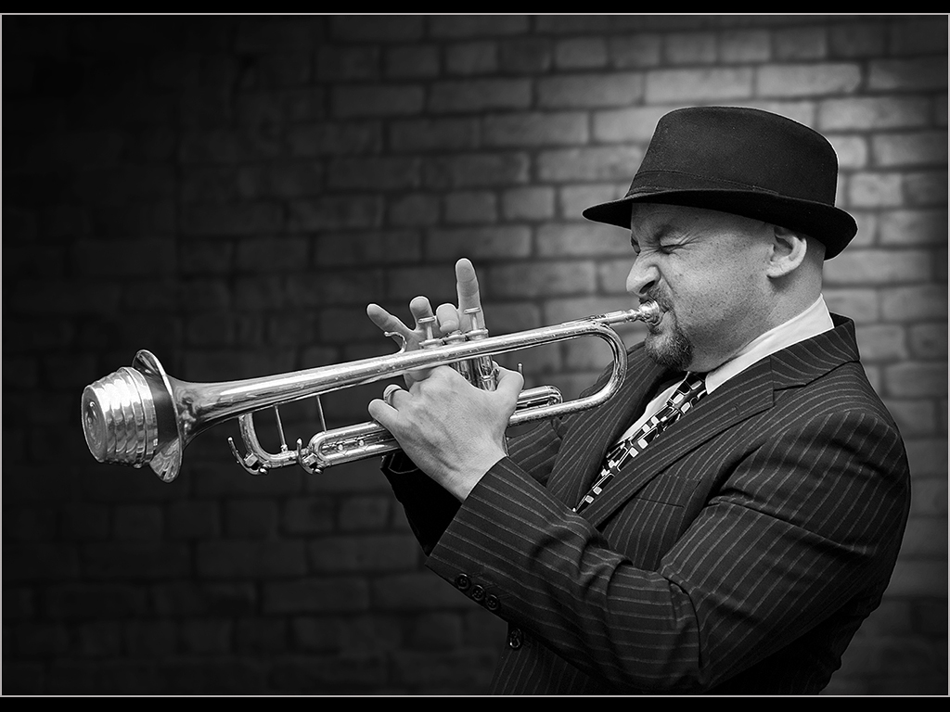
I’m good at playing the trumpet. I want to be a trumpet player (musician)

Slide 16
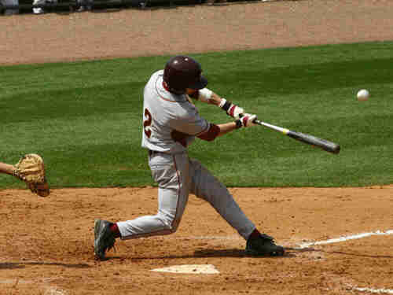
I’m good at hitting a baseball. I want to be a baseball player.

Slide 17
I’m good at driving. I want to be a race car driver.

Slide 18
I’m good at typing. I want to be a computer programmer.

Slide 19
I’m good at speaking. I want to be a president.

Slide 20
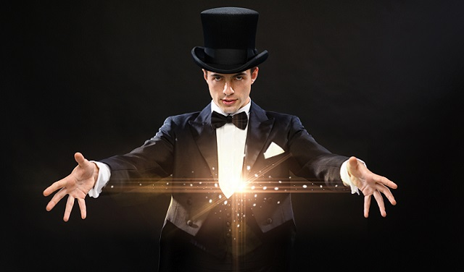
I’m good at doing magic tricks. I want to be a magician.

Slide 21
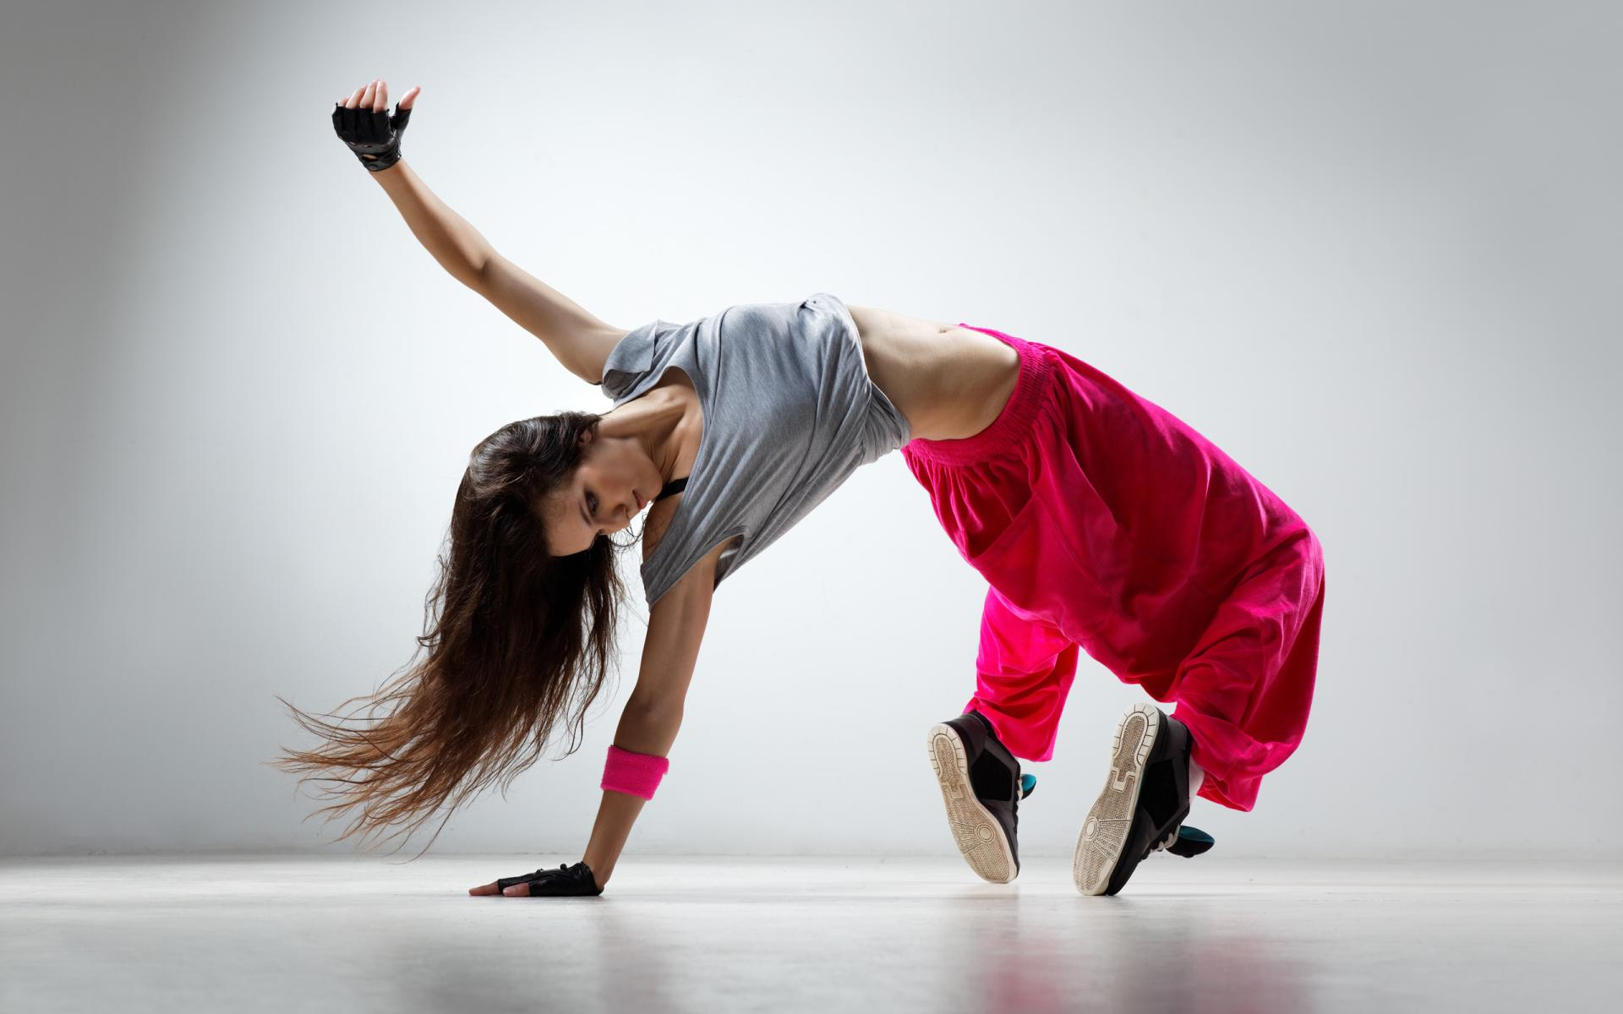
I’m good at dancing. I want to be a b boy.

Slide 22
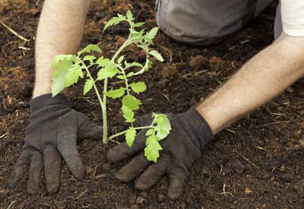
I’m good at growing vegetables. I want to be a farmer.

Slide 23
I’m good at fixing. I want to be a car mechanic.

Slide 24
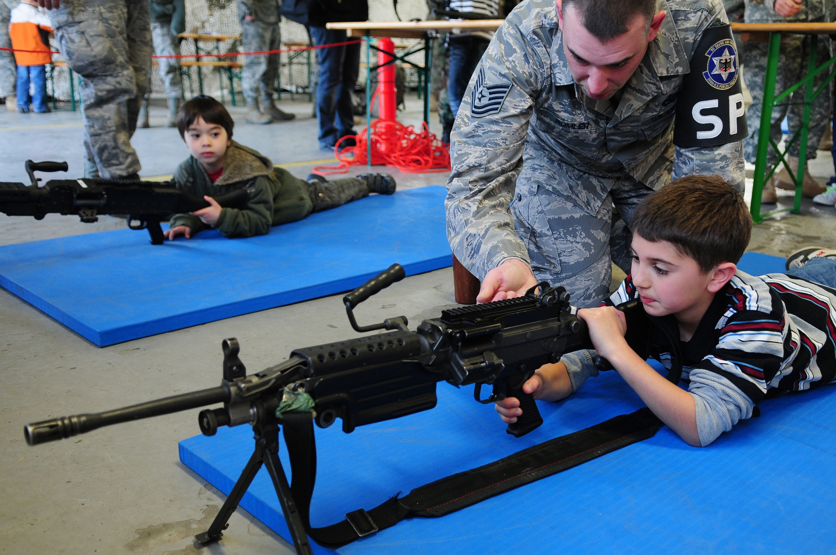
I’m good at shooting. I want to be a soldier.

Slide 25
I’m good at talking. I want to be a news anchor.

Slide 26
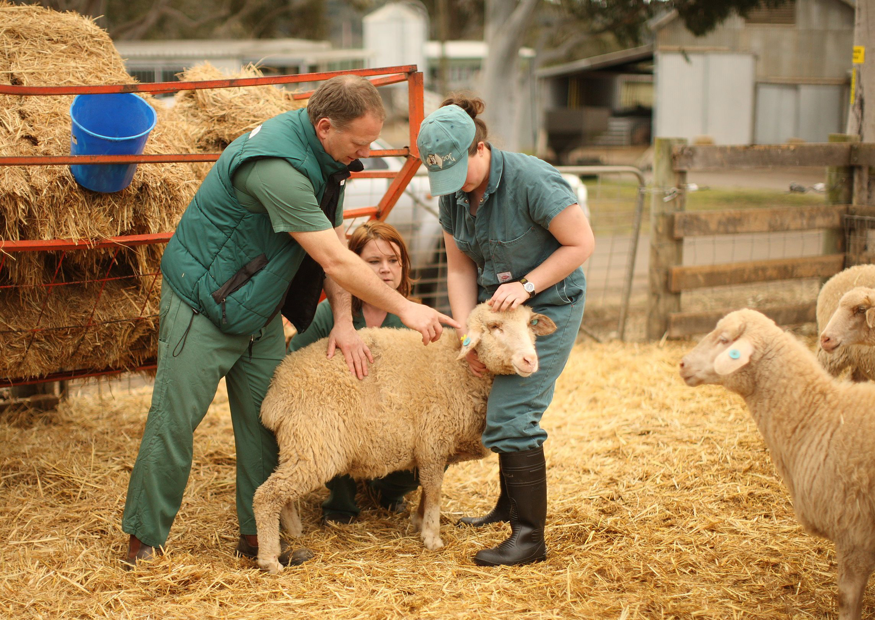
I’m good at caring for animals. I want to be a veterinarian.

Slide 27
I’m good at sewing. I want to be a tailor.

Slide 28
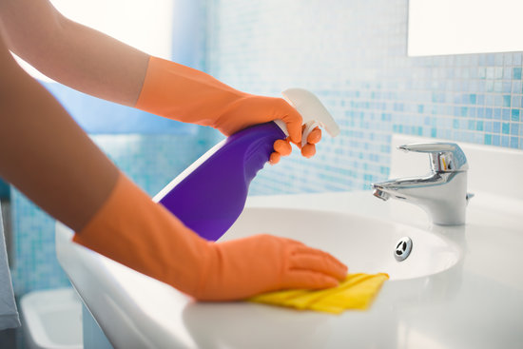
I’m good at cleaning. I want to be a housekeeper
(maid).

Slide 29
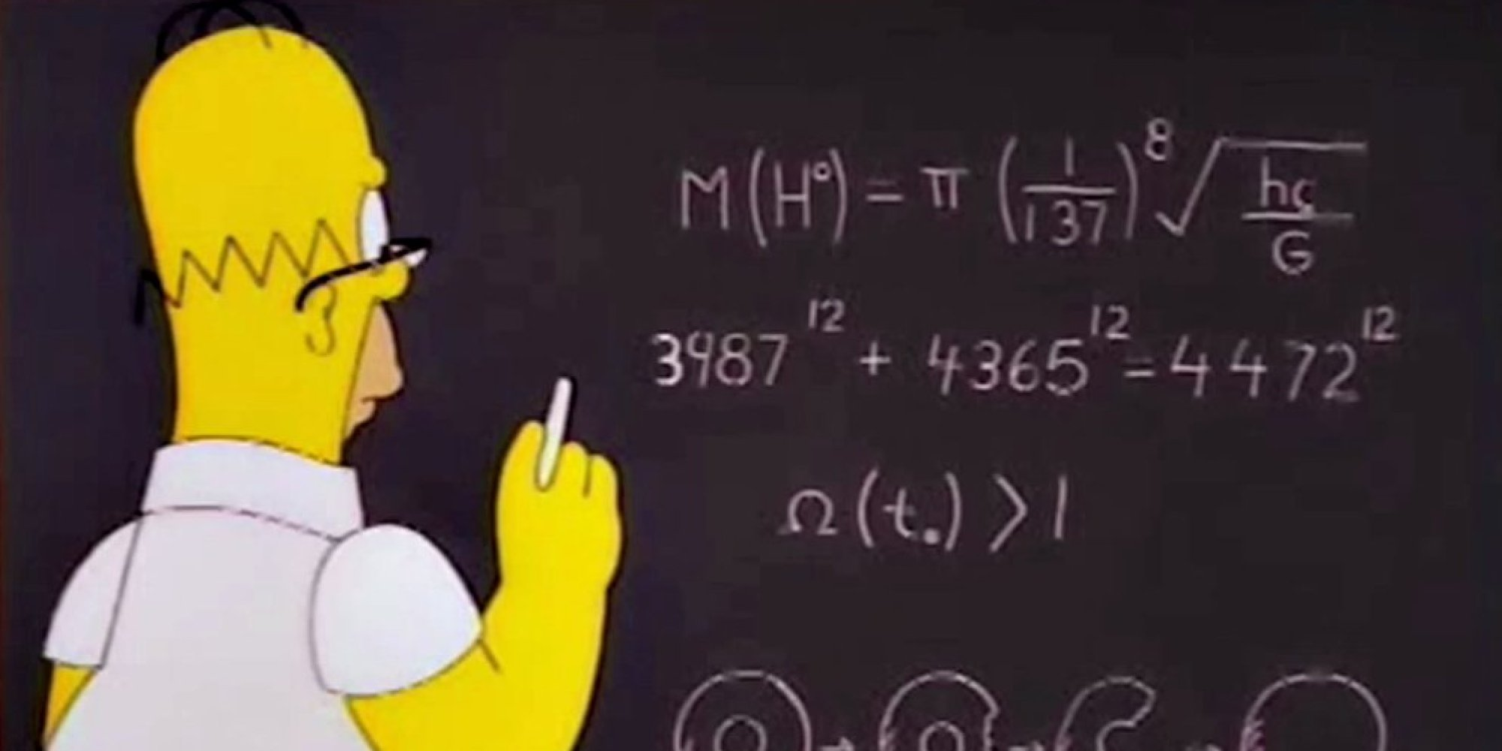
I’m good at math. I want to be an accountant.

Slide 30
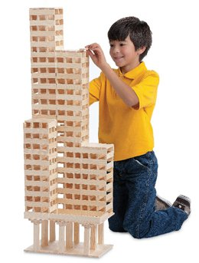
I’m good at building. I want to be a construction worker.

Slide 31
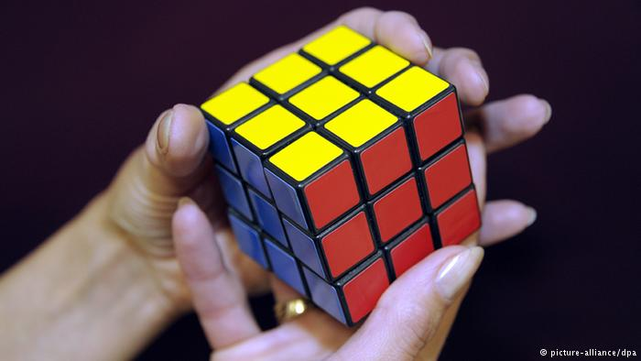
I’m good at solving problems. I want to be a detective.

Slide 32
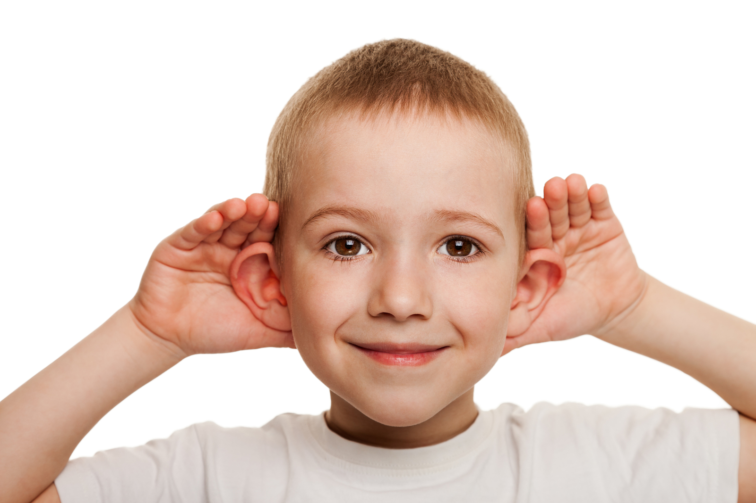
I’m good at listening. I want to be a therapist (psychologist).

