Slide 1
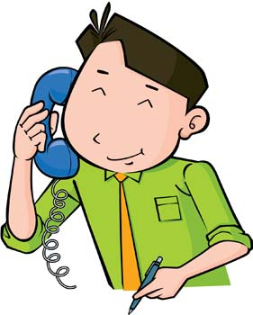
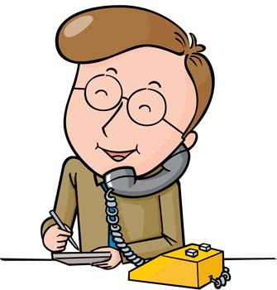
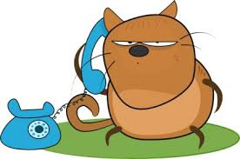
Ian
Ken
Steve
Megan
Luke
Kate
Brian
Jenny
Sarah
Ernie
Dale
Robin
Jeff
Kitty
Lacy

Slide 2
Luke
Ken
Steve
Megan
Sarah
Jenny
Kitty
Dale
Jeff
Robin

Slide 3
Ken
Megan
Brian
Luke
Jenny
Sarah
Robin
Jeff

Slide 4
Luke
Steve
Megan
Brian
Ian
Jenny
Ken
Sarah
Kate
Dale
Ernie
Robin
Jeff
Kitty
Lacy

Slide 5
Prepare:
Before starting, have the students make connections between phones on their paper.
Encourage students to use various colors to help keep track of phone lines.
There are two versions depending on how long you want the game to last.
You can print out a copy of the cards to aid in randomization or just call out names.
Having a prop phone is also a nice visual

Slide 6
Rules:
Choose a character and begin a conversation with the class:
T: Ring ( )
Ss: Hello
T: Hello, may I speak to ___________?
Ss: Who’s calling please?
Choose another character to whom you want to reach.
T: This is ____________.
^Note, you can have student play the role of “T”.

Slide 7
T: Ring
Ss: Hello
T: Hello, May I speak to_________?
Ss: Who’s calling please?
T: This is ___________.
Ring

