Slide 1
How much are these?
Amazon Game

Slide 2
Rules:
Use the dialogue and guess if its too cheap or expensive
Ss: How much are these?
T: They’re __________.
Ss: They’re cheap OR They’re expensive
* Show the real price *
If you are wrong, sit down.
Go until one student remains.

Slide 3
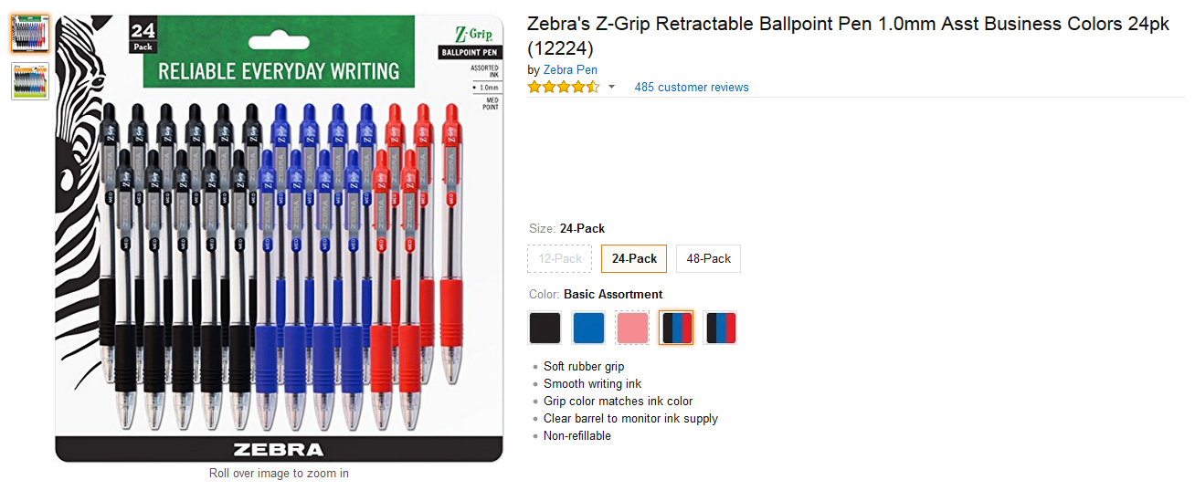
$13.49
They’re $10
Cheap

Slide 4
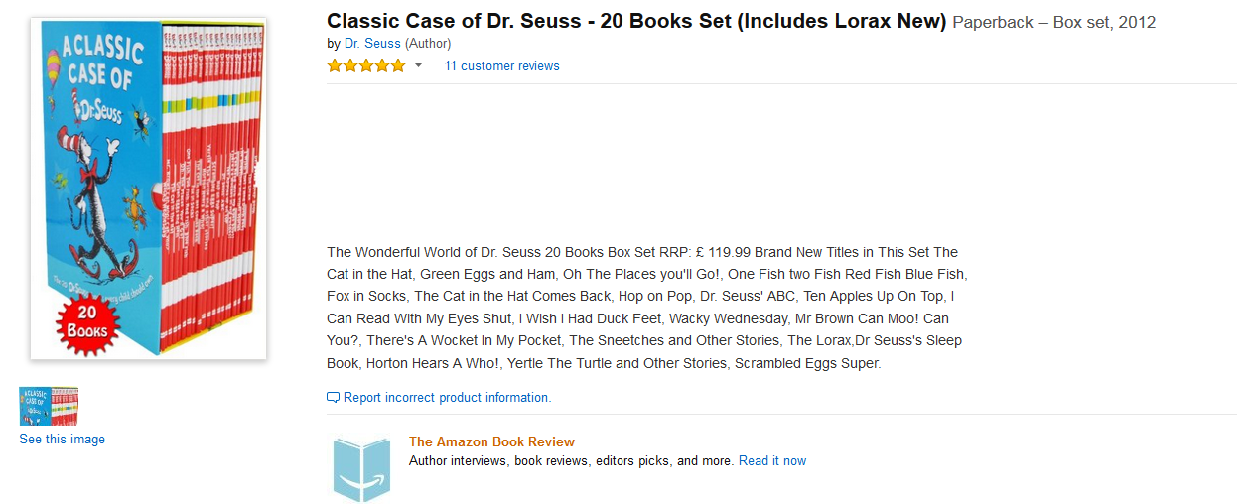
$56.99
They’re $40
Cheap

Slide 5
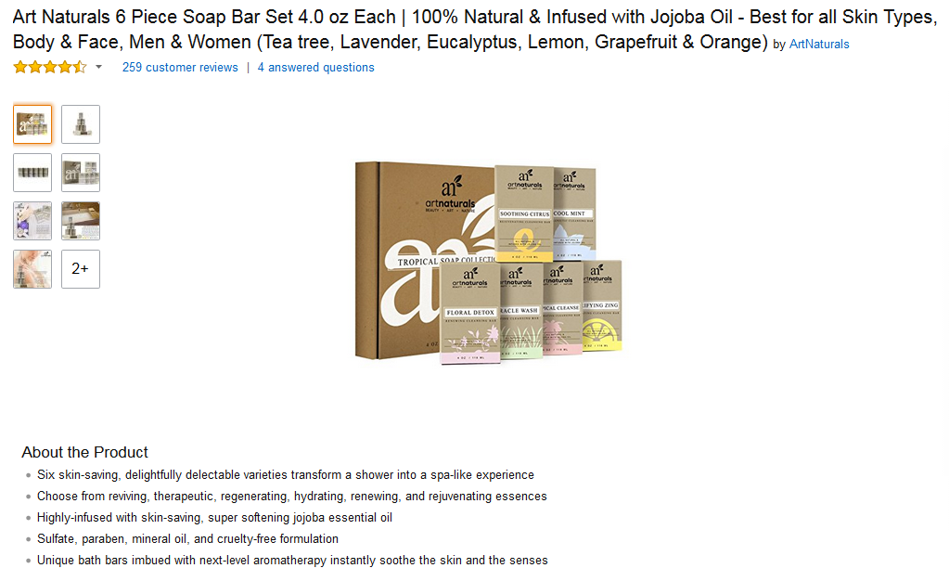
$11.35
They’re $25
Expensive

Slide 6
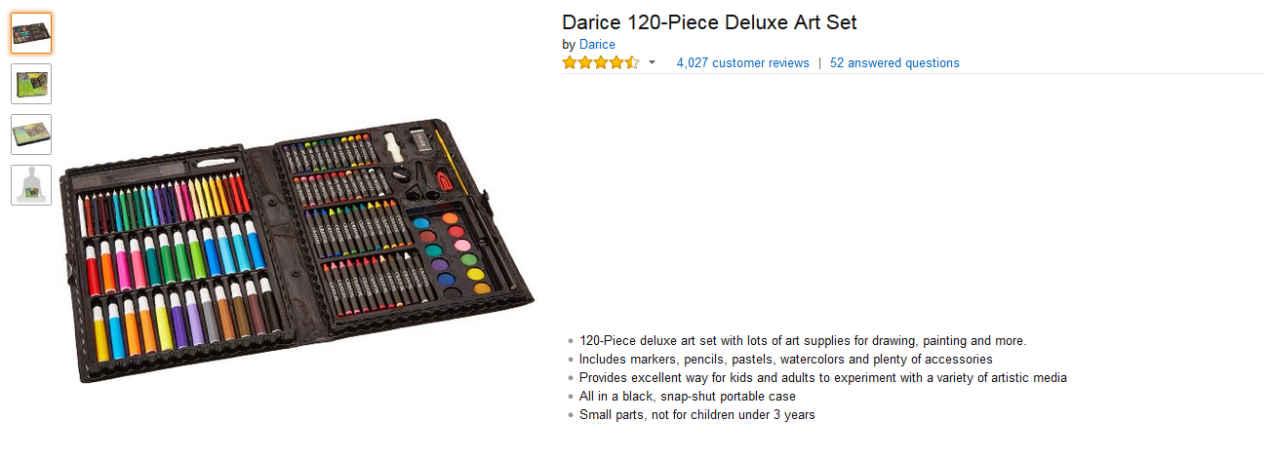
$7.37
They’re $35
Expensive

Slide 7
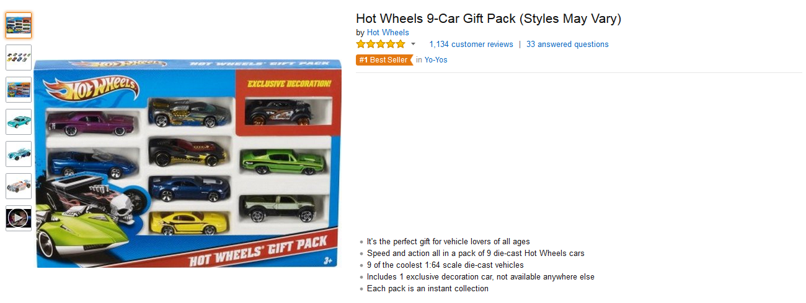
$9.47
They’re $7
Cheap

Slide 8
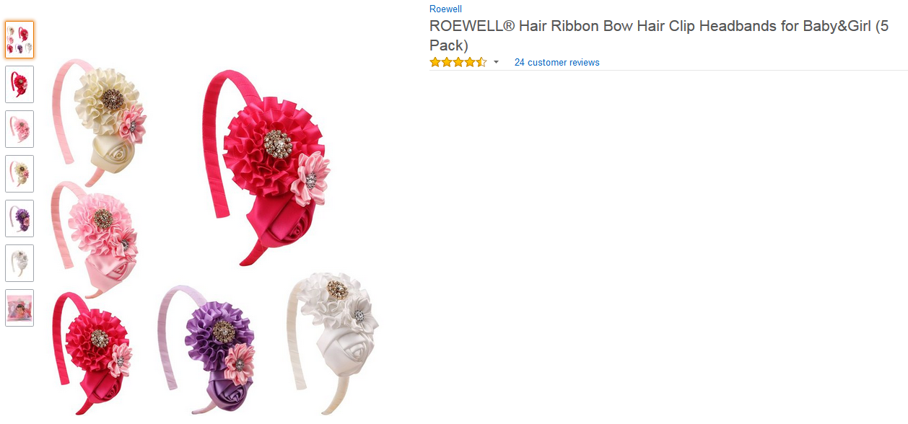
$13.99
They’re $5
Cheap

Slide 9
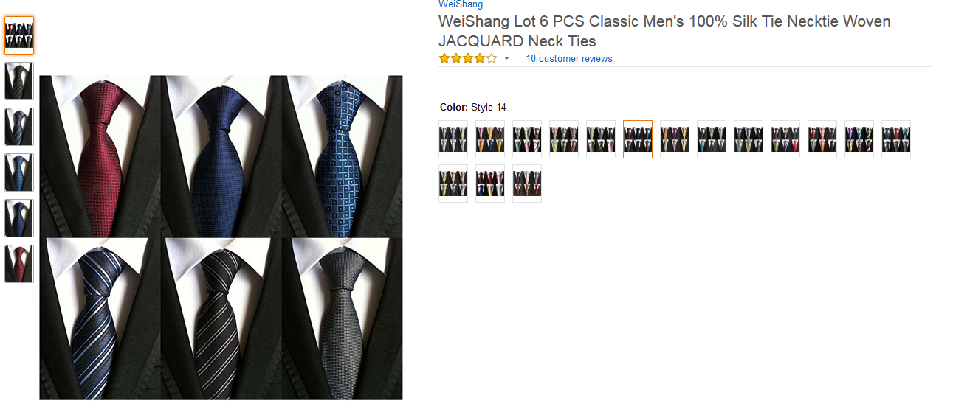
They’re $20
$22.99
Cheap

Slide 10
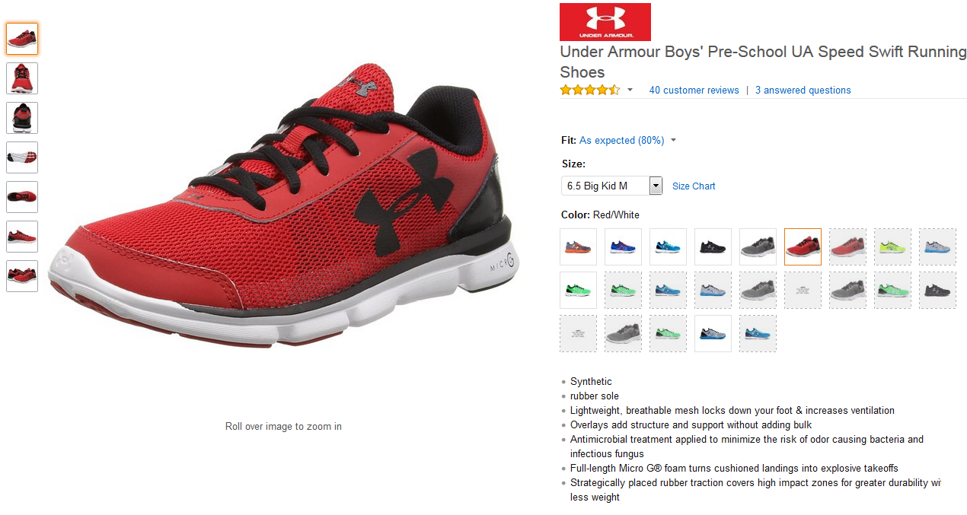
$61.13
They’re $38
Cheap

Slide 11
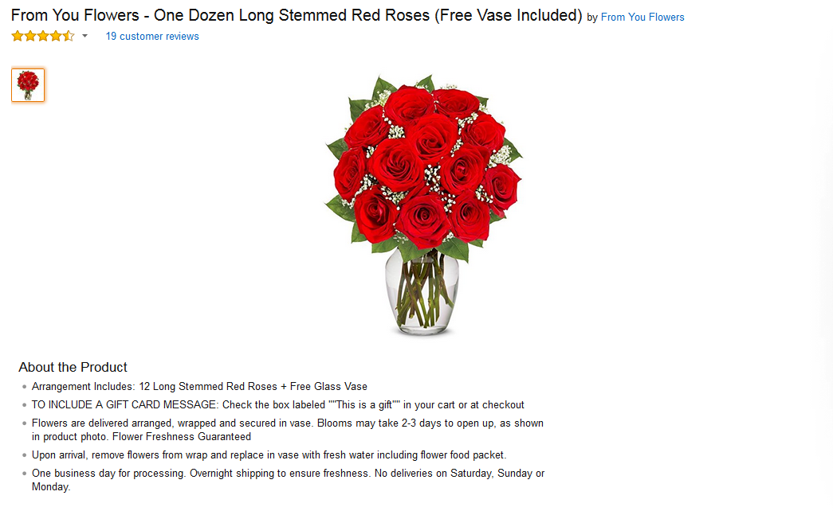
They’re $19
$24.99
Cheap

Slide 12
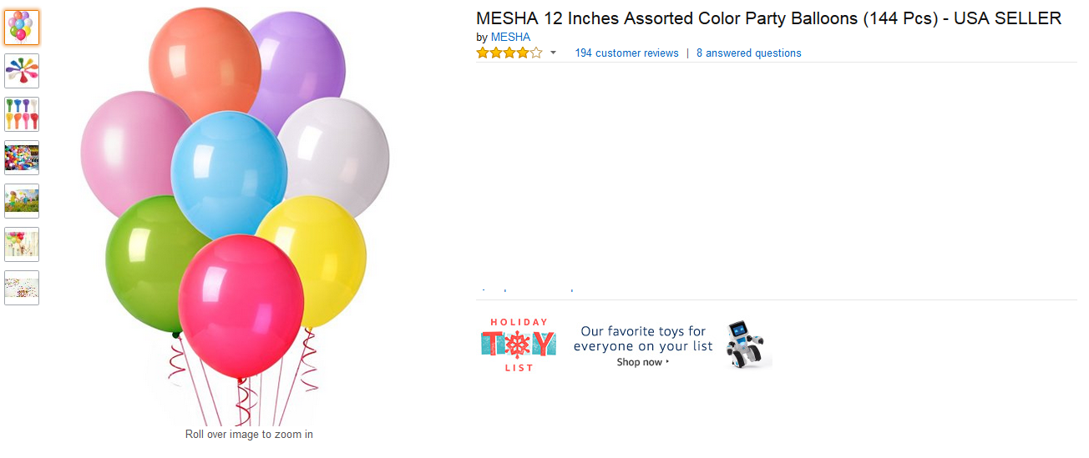
They’re $11.50
$9.99
Expensive

Slide 13
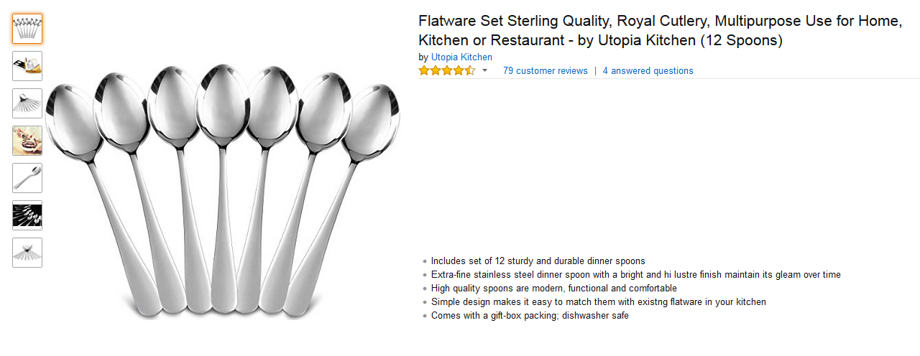
$10.99
They’re $26.30
Expensive

Slide 14
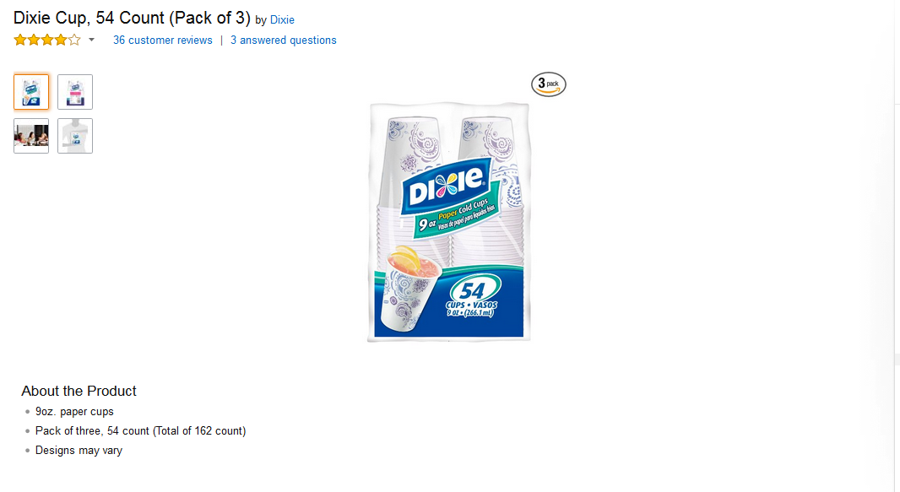
They’re $6.99
$7.74
Cheap

Slide 15
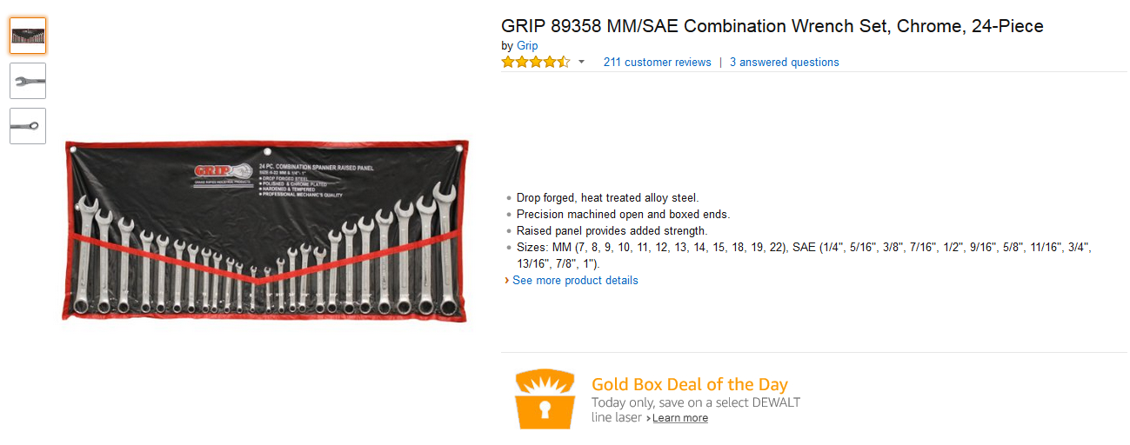
$24.99
They’re $48.65
Expensive

Slide 16
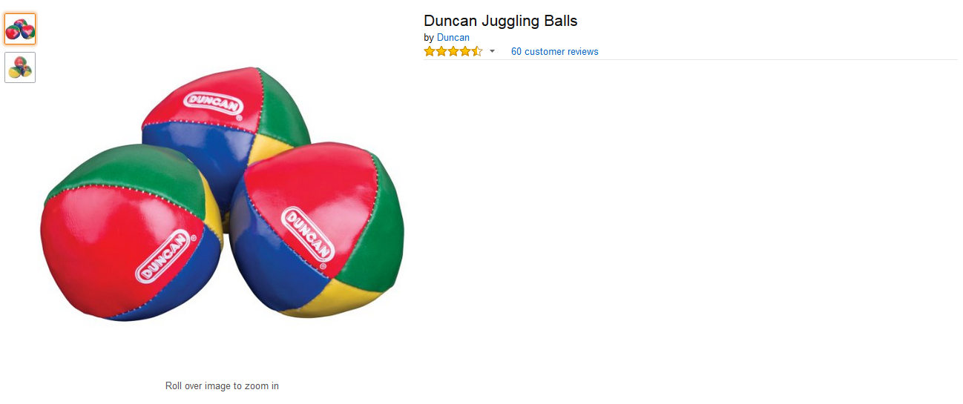
$9.00
They’re $4.99
Cheap

Slide 17
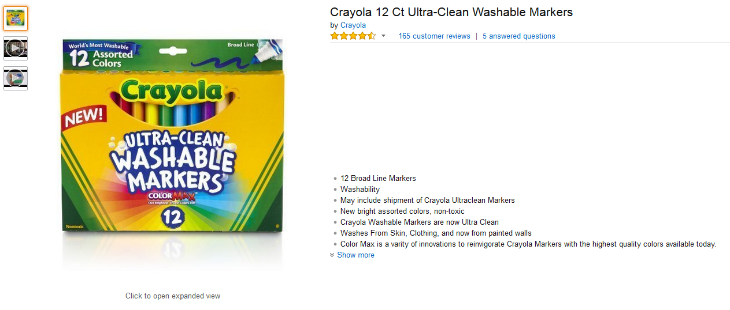
$5.47
They’re $9.99
Expensive

Slide 18
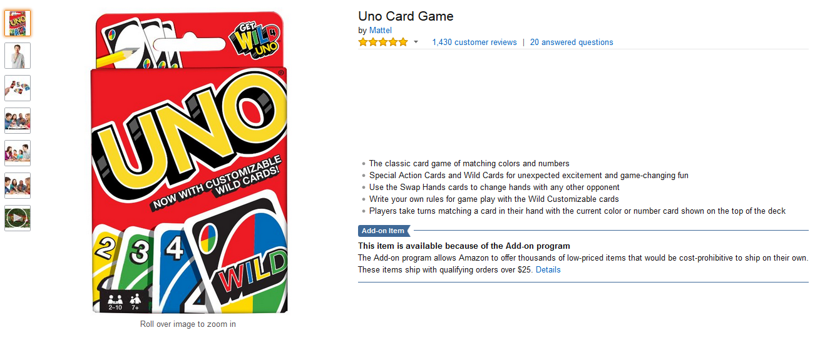
$5.92
They’re $8.64
Expensive

Slide 19
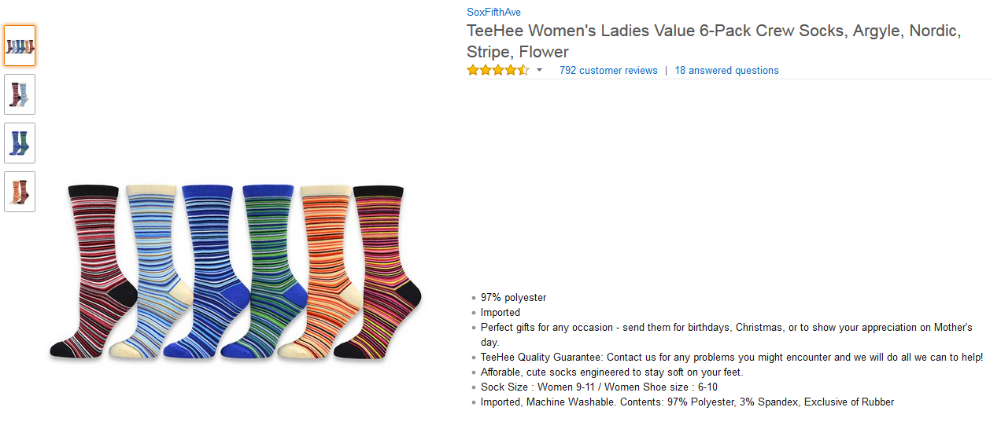
$9.99
They’re $12.44
Expensive

Slide 20
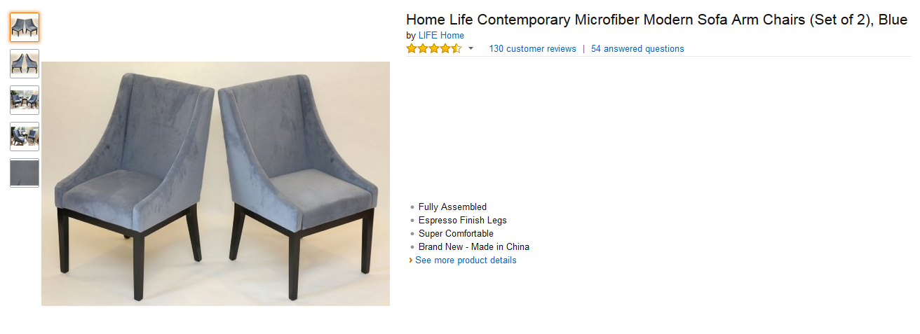
$144.24
They’re $115.18
Cheap

Slide 21
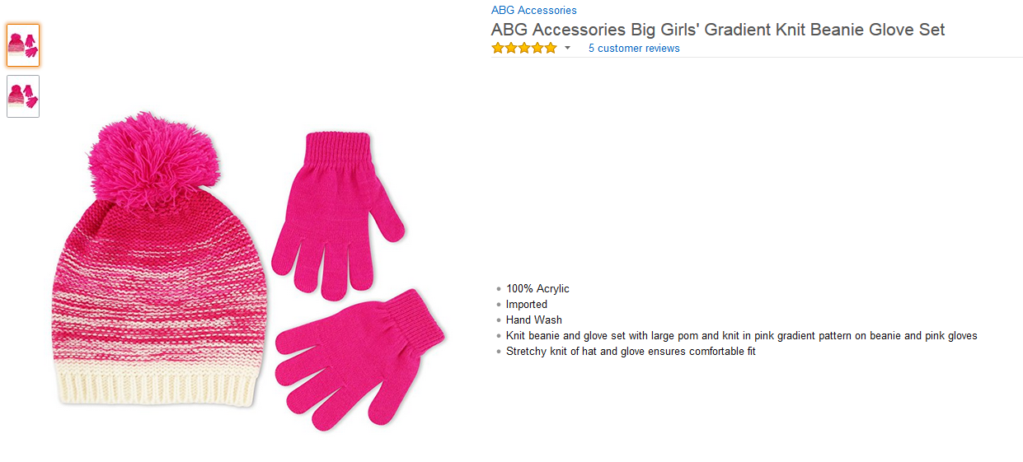
$6.13
They’re $4.33
Cheap

Slide 22
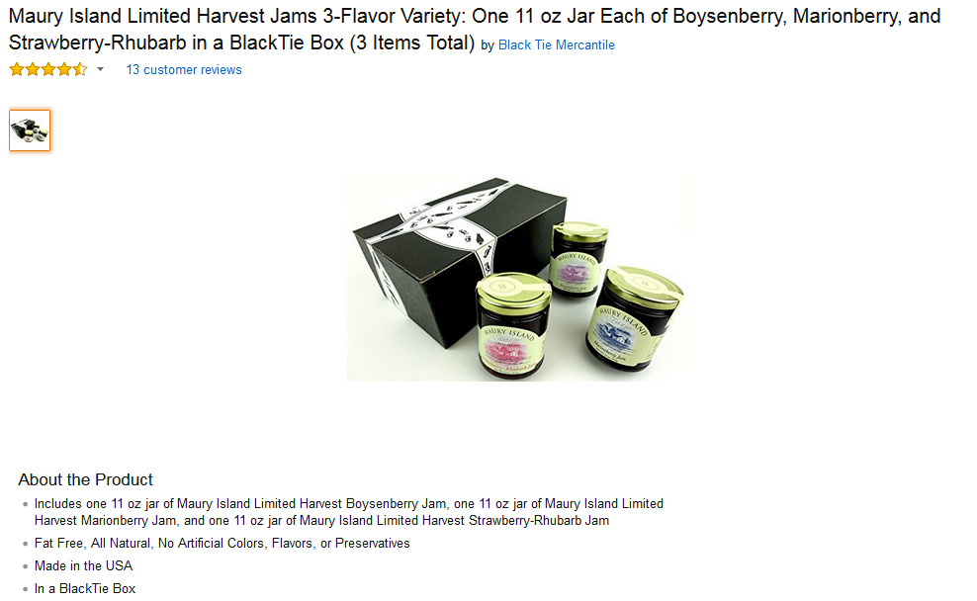
They’re $14.78
$25.00
Cheap

Slide 23
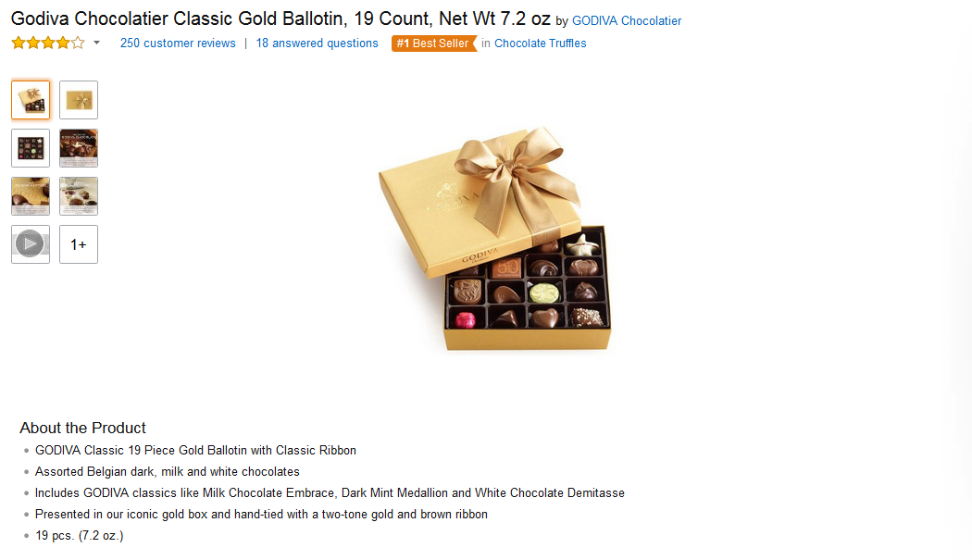
They’re $24.99
$29.98
Cheap

Slide 24
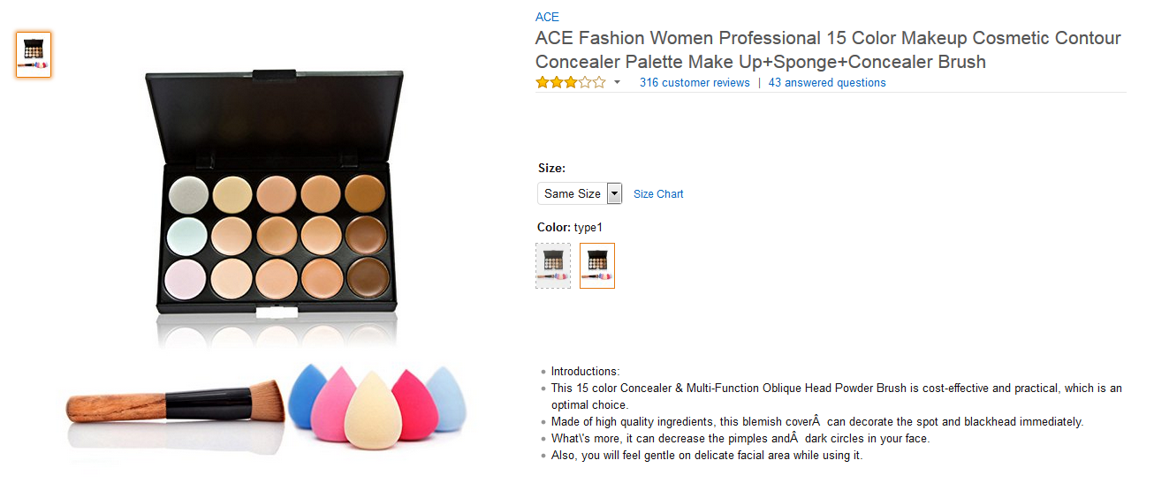
$4.07
They’re $5
Expensive

Slide 25
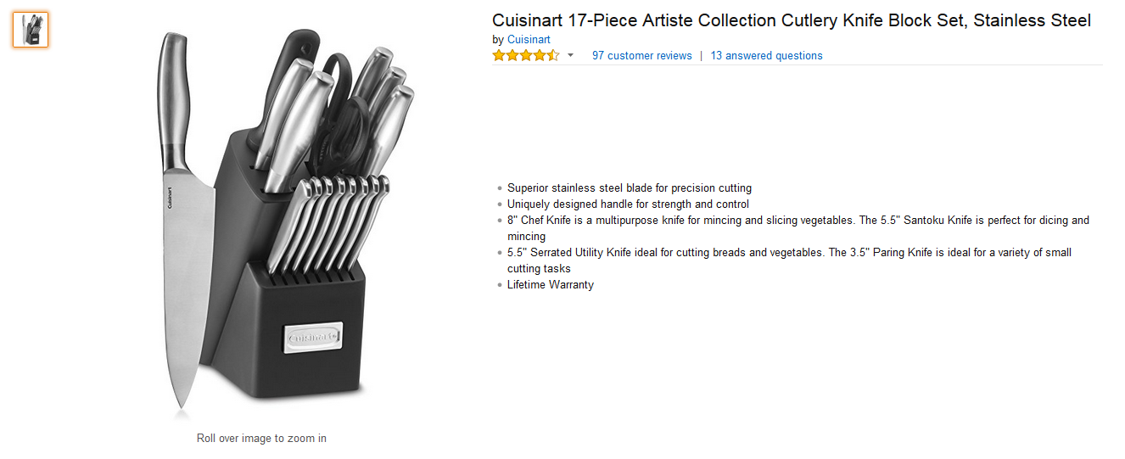
$59.95
They’re $38.47
Cheap

Slide 26
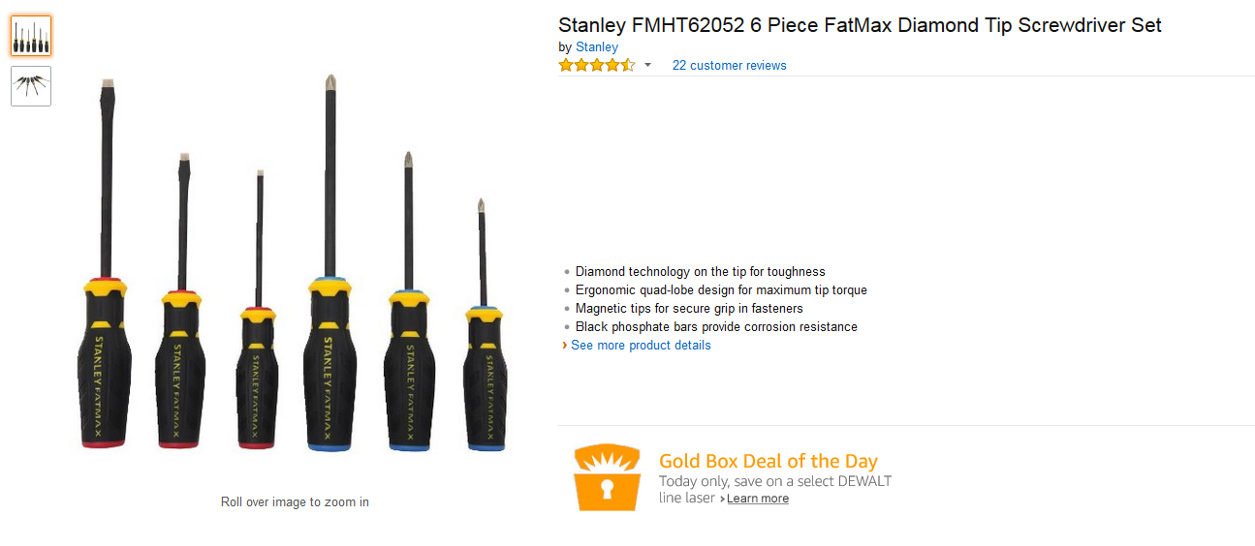
$13.99
They’re $9.99
Cheap

Slide 27
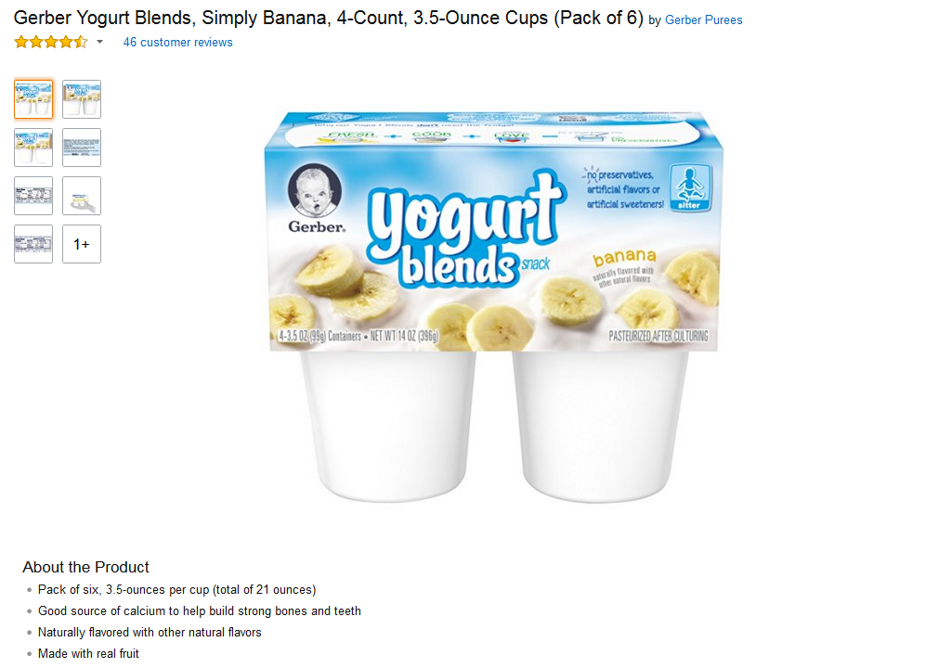
They’re $6.85
$14.92
Cheap

Slide 28
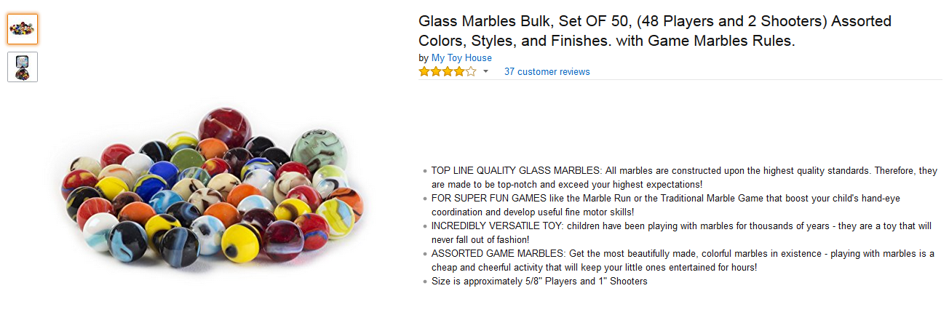
They’re $7.89
$9.45
Cheap

Slide 29
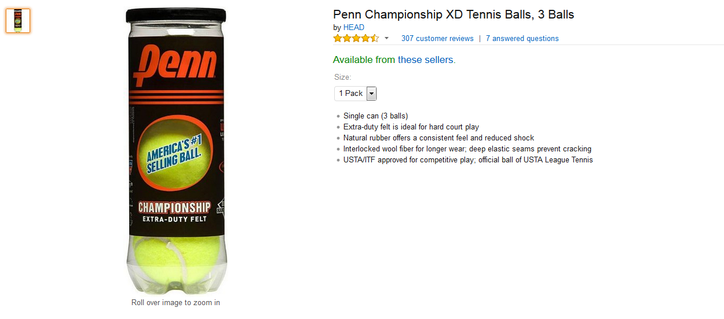
They’re $18.36
$5.50
Expensive

Slide 30
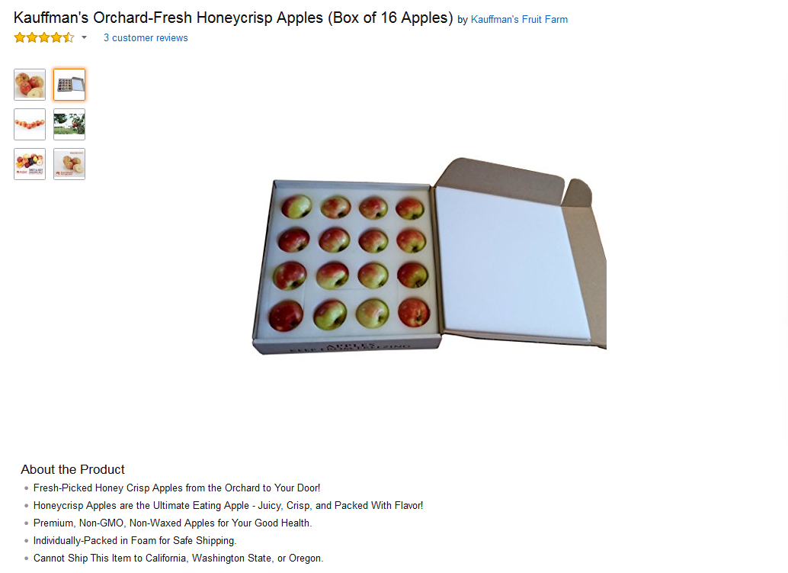
They’re $26.88
$31.99
Cheap

Slide 31
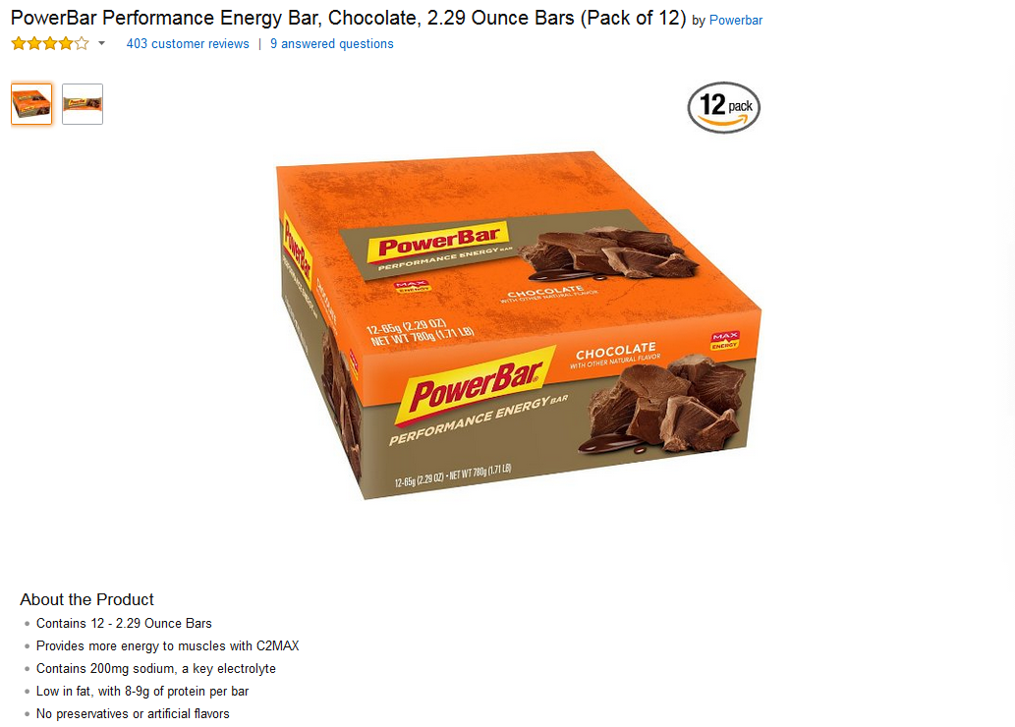
They’re $24.55
$13.69
Expensive

Slide 32
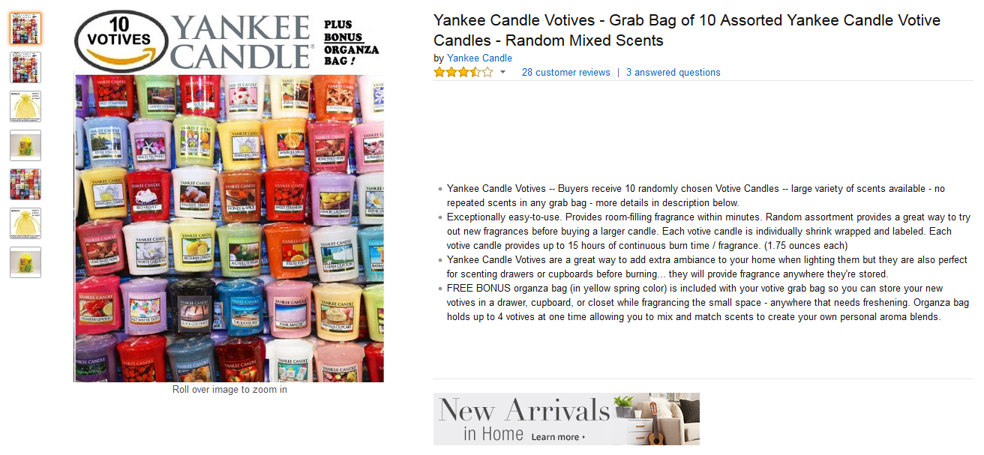
They’re $16.22
$22.99
Cheap

Slide 33
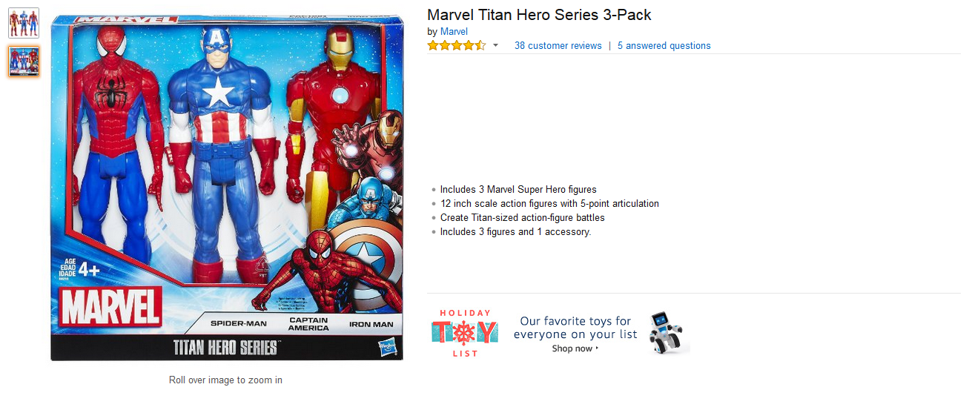
$22.16
They’re $35.77
Expensive

Slide 34
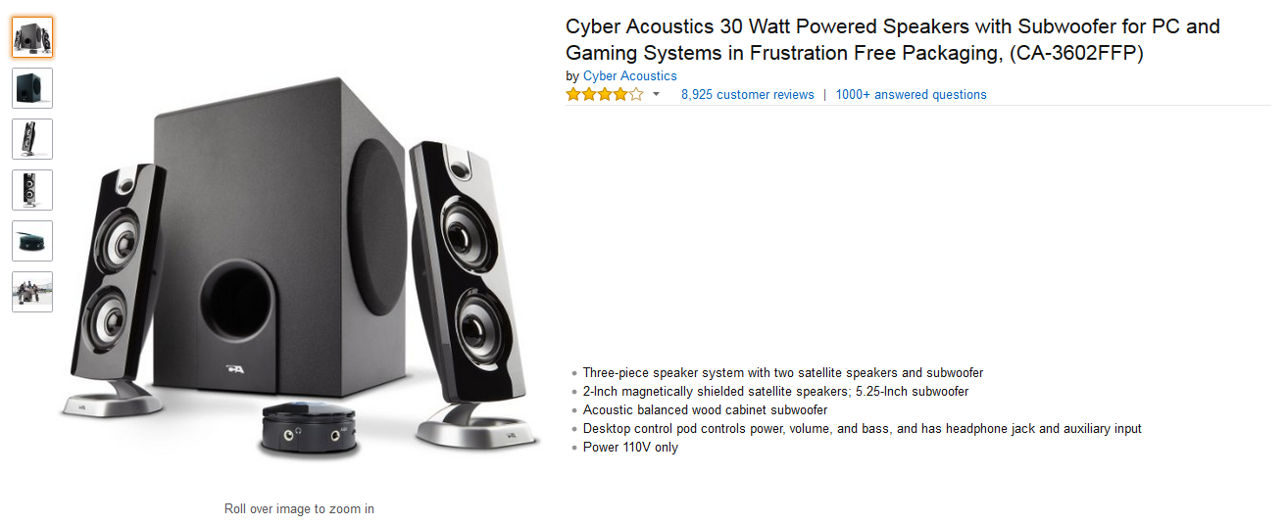
$41.25
They’re $59.89
Expensive

Slide 35
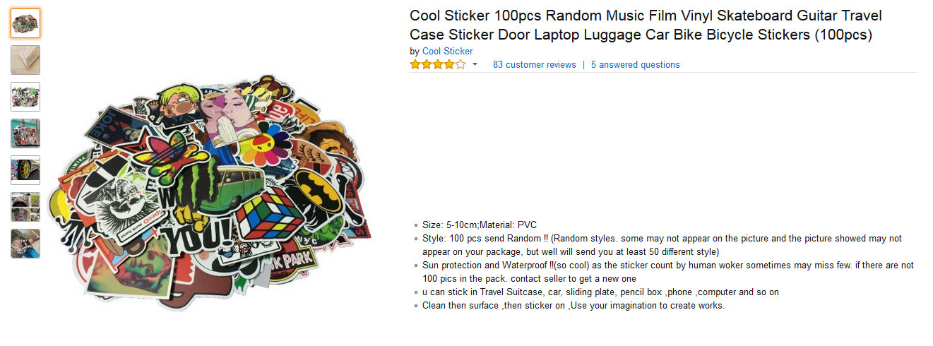
$7.93
They’re $5.63
Cheap

Slide 36
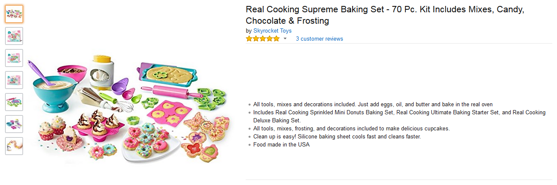
They’re $12.33
$37.71
Cheap

Slide 37
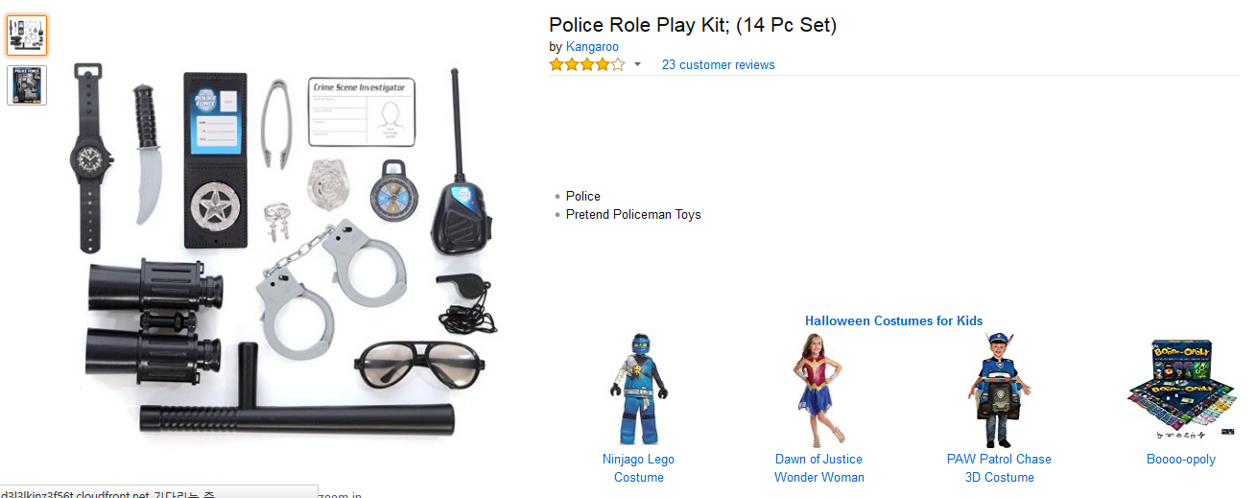
$14.74
They’re $17.55
Expensive

Slide 38
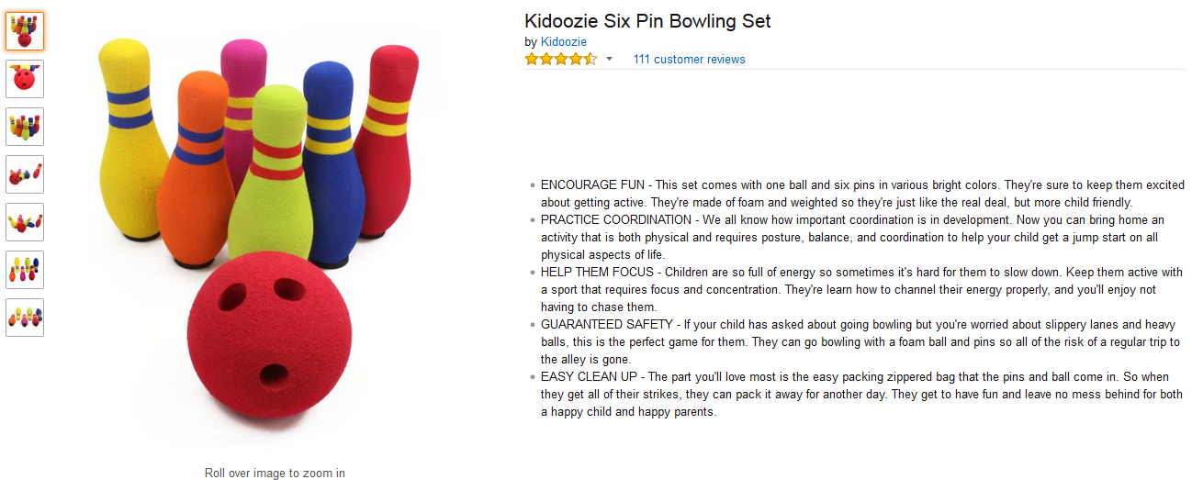
They’re $8.96
$23.99
Cheap

Slide 39
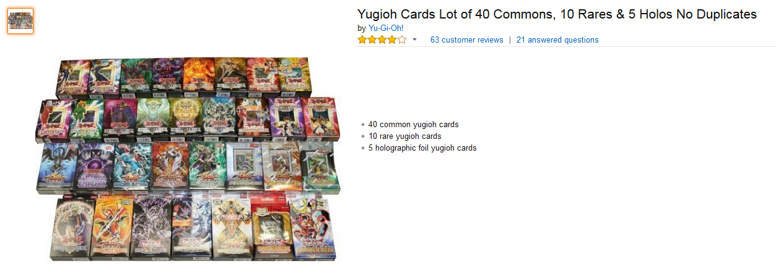
$7.47
They’re $14.65
Expensive

Slide 40
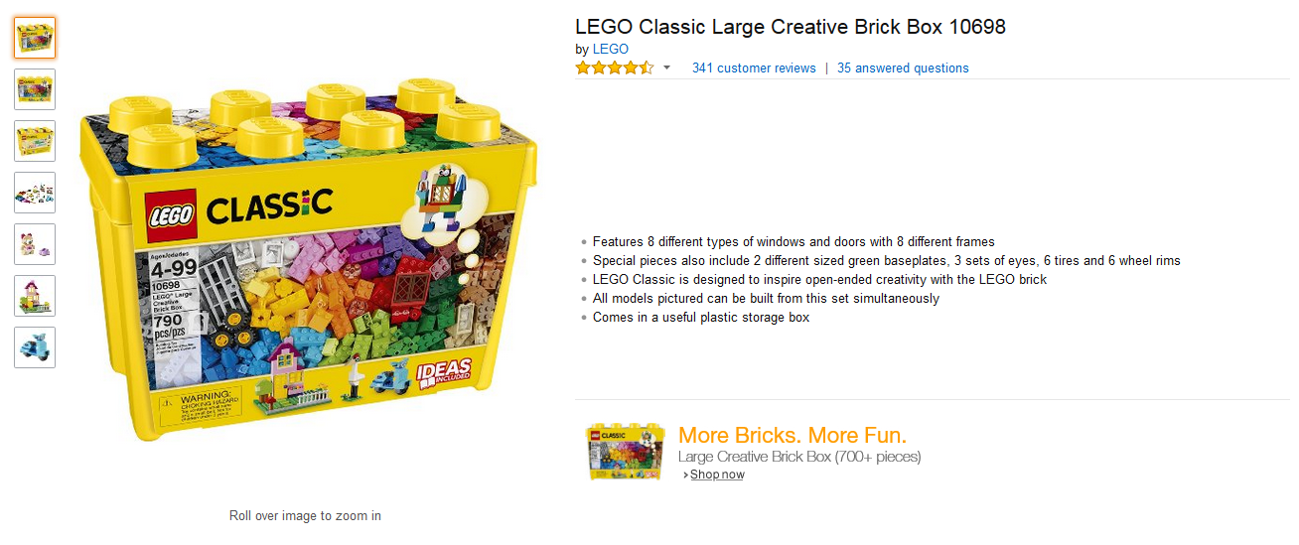
They’re $29.99
$49.99
Cheap

Slide 41
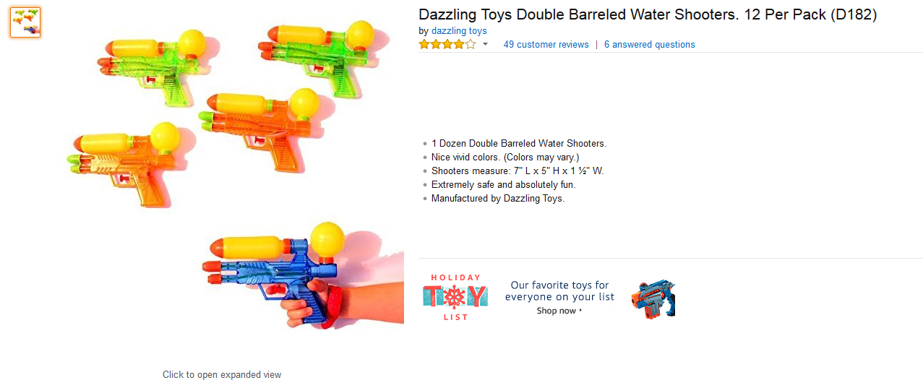
$14.99
They’re $9.33
Cheap

Slide 42
$13.49
They’re $10
Expensive

