Slide 1
What size do you want?
Role Play - Shopping

Slide 2
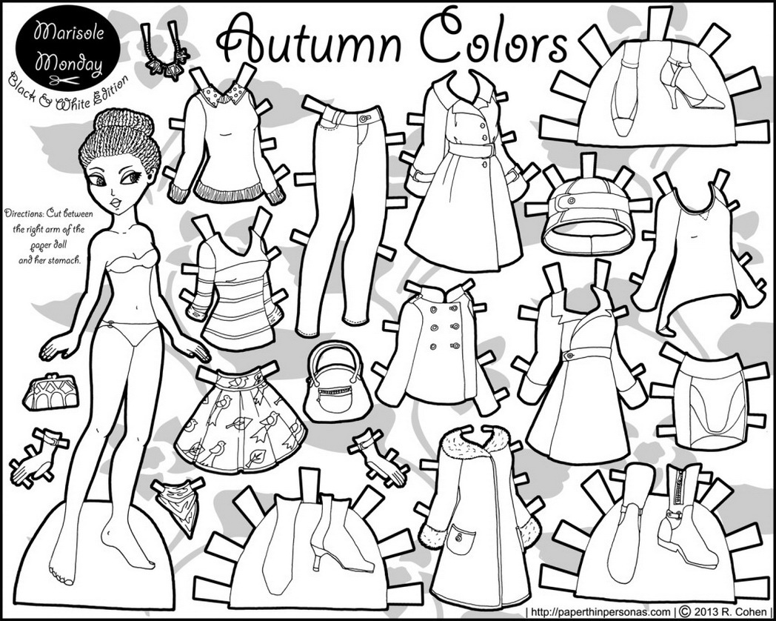
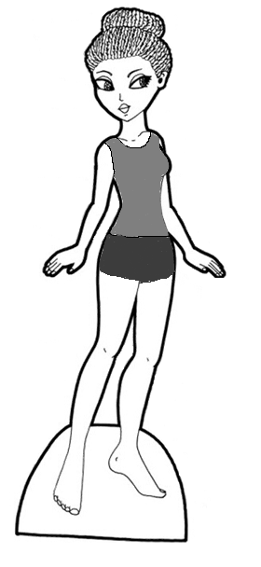

Slide 3
Roles
6 students will be clerks (sellers)
Everyone else is a customer (work in pairs)

Slide 4
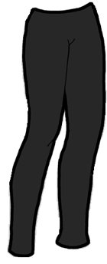
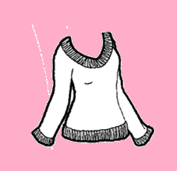
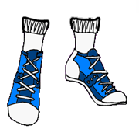
How to play
Each group will receive a paper cut out that they must dress.
Go to the stores to purchase some clothes.
In the end, you will dress your paper doll.

Slide 5
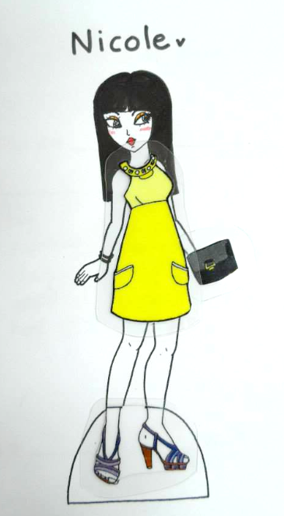
Use these sentences:
Can I help you?
Yes, please. I want to try on ___________.
What color do you want?
I want ___________.
What size do you want?
I want a __________ (small, medium, large)
How much are these?
They’re $_______
I’ll take it.
Sorry, we’re out of stock.

