Slide 1
Would you like to game

Slide 2
Prepare
Print, laminate and cut out the cards
Evenly hand out the cards to the students.

Slide 3
Rules
Move around the classroom and meet
with friends.
Ask them, “Would you like to ________?”
Yes, I’d love to. (give the card)
No thank you. (prove it by showing)
If you ask a question, so can they.

Slide 4
Winner
After 5 minutes, students will stop playing and sit down.
Randomly choose one of the activities.
Use the picker
( https://www.classtools.net/random-name-picker/95_ULBicK )

Slide 5
Eat pizza
Eat pizza
Eat pizza
Eat pizza
Eat pizza
Eat hamburger
Eat hamburger
Eat hamburger
Eat hamburger
Eat hamburger

Slide 6
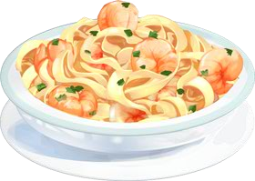
Eat pasta
Eat pasta
Eat pasta
Eat pasta
Eat pasta
Watch a movie
Watch a movie
Watch a movie
Watch a movie
Watch a movie

Slide 7
Play soccer
Play soccer
Play soccer
Play soccer
Play soccer
Play baseball
Play baseball
Play baseball
Play baseball
Play baseball

Slide 8
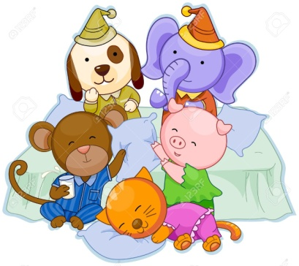
Play badminton
Play badminton
Play badminton
Play badminton
Play badminton
Have a pajama party
Have a pajama party
Have a pajama party
Have a pajama party
Have a pajama party

Slide 9
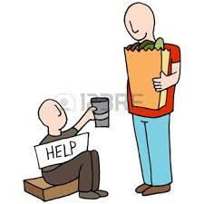
Come to my house
Come to my house
Come to my house
Come to my house
Come to my house
Help people in need
Help people in need
Help people in need
Help people in need
Help people in need

