Slide 1
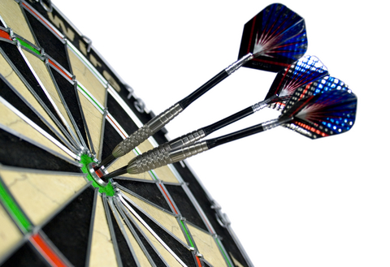
Body Darts

Slide 2
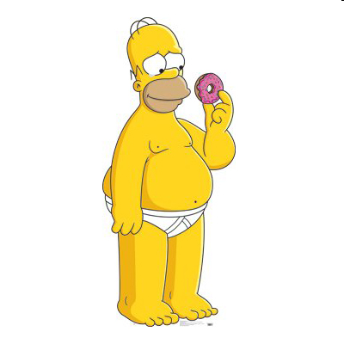
Name the body parts:

Slide 3
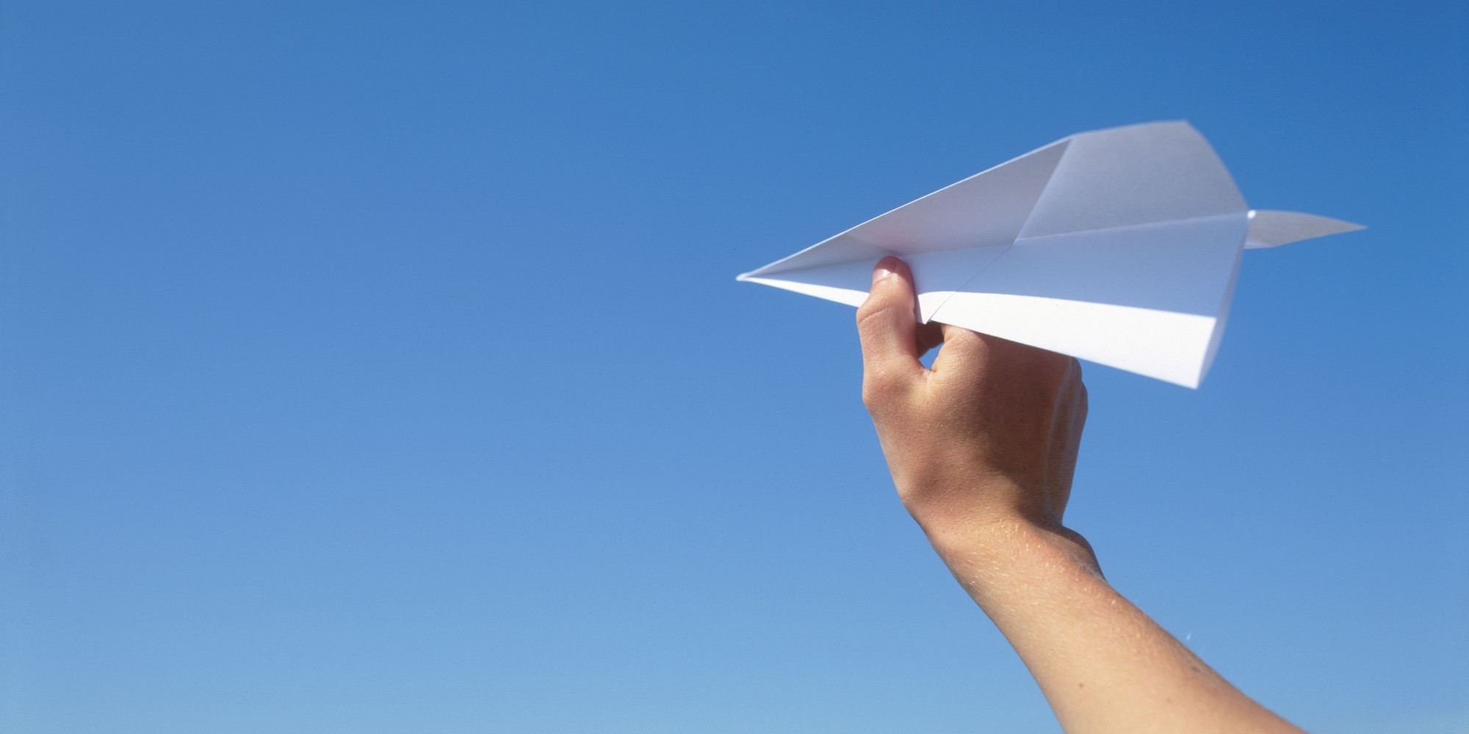
Make a paper airplane.

Slide 4
Choose a paper airplane for your team.
Throw the plane at the board.
Make a sentence for where it hits.
You can’t use the same sentence twice.
The most sentences wins.

Slide 5
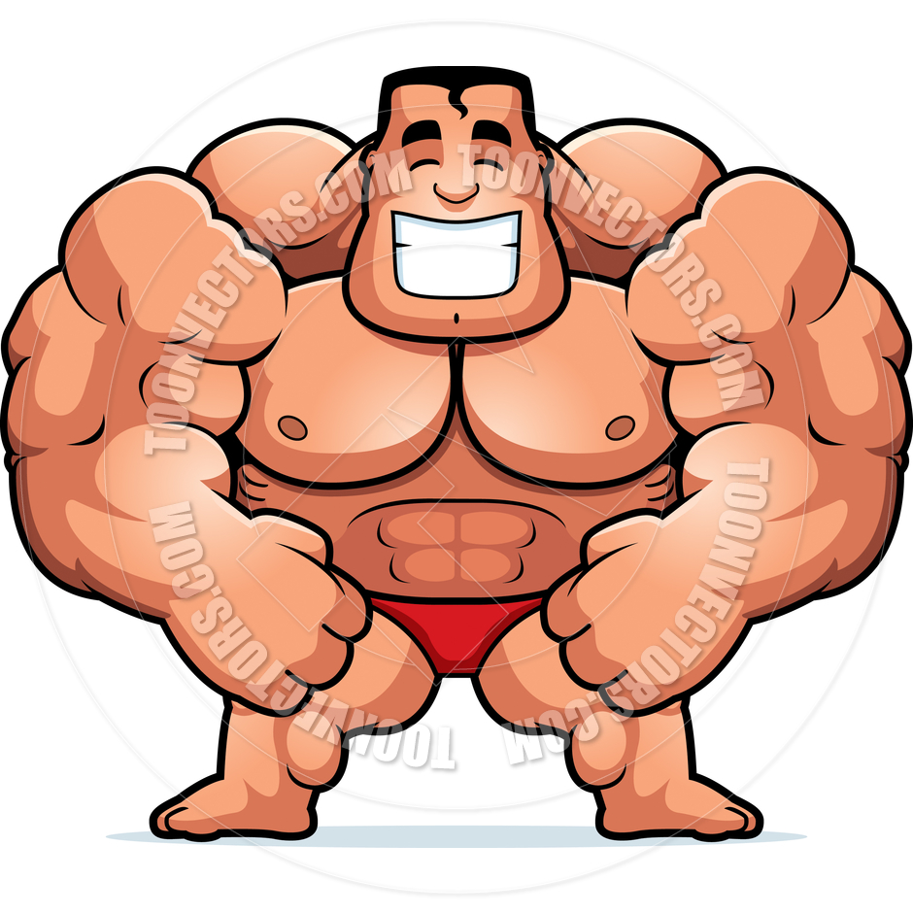

Slide 7
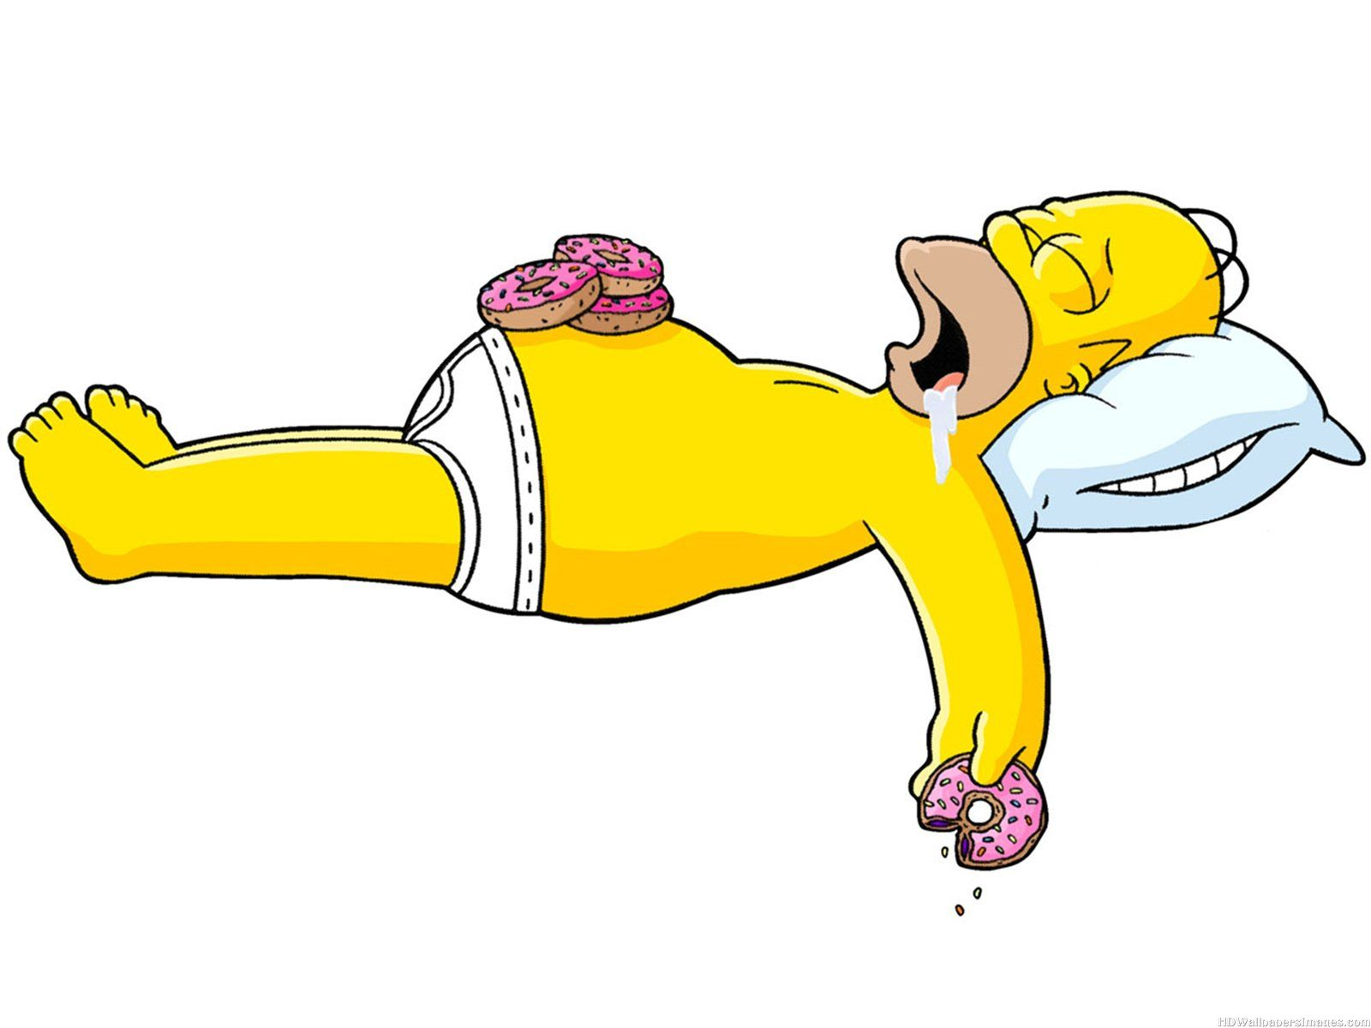

Slide 8
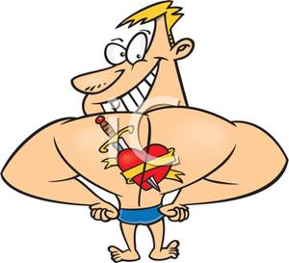

Slide 10
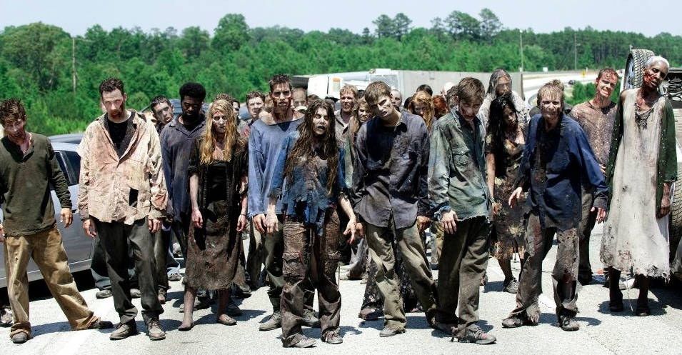

Slide 11
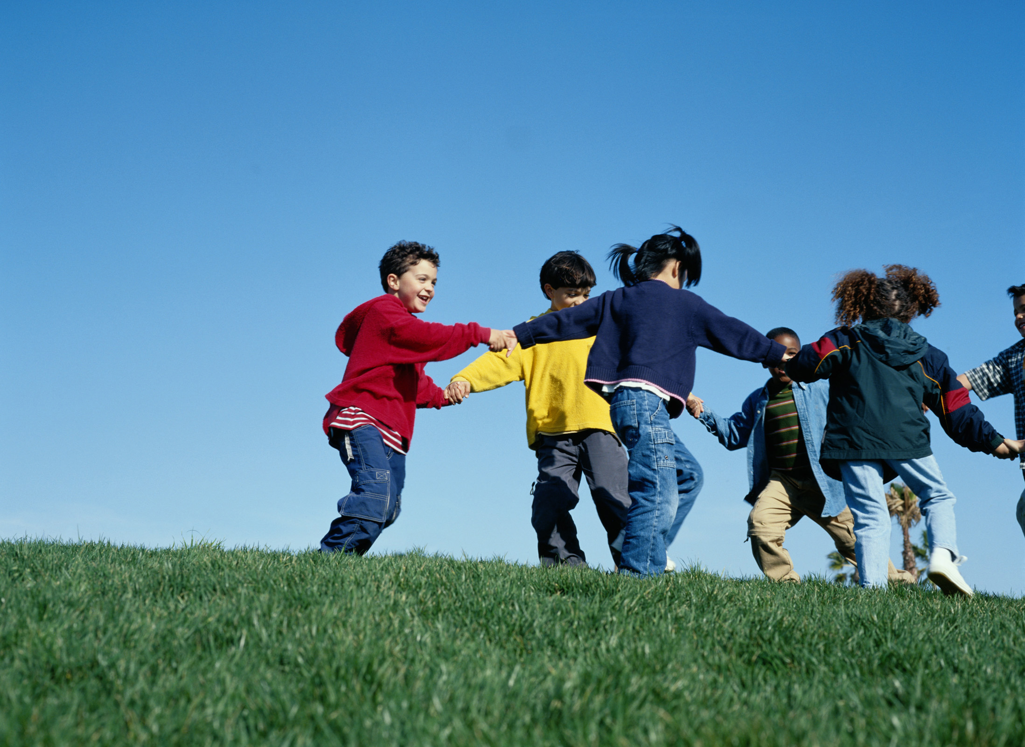

Slide 13
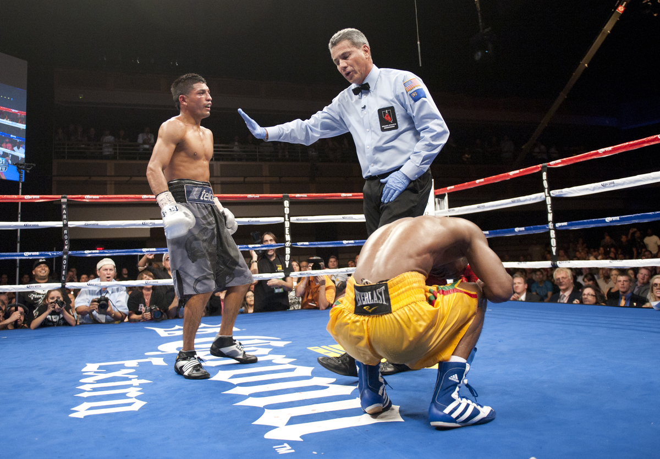

Slide 14
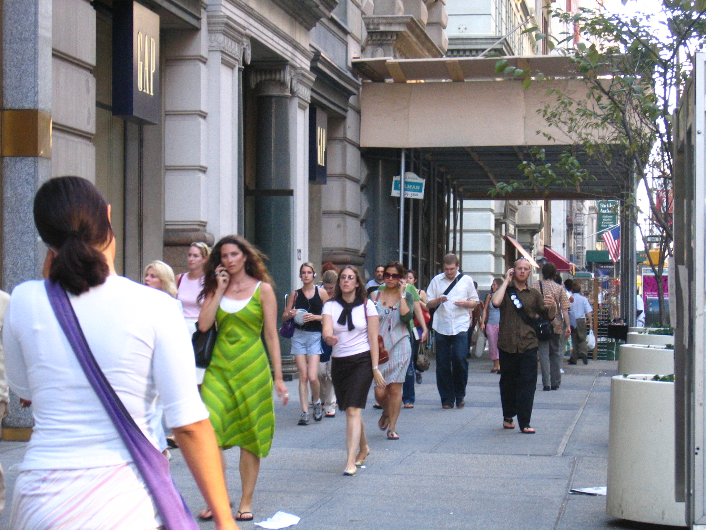

Slide 16
