Slide 1
Vacation Liar

Slide 2
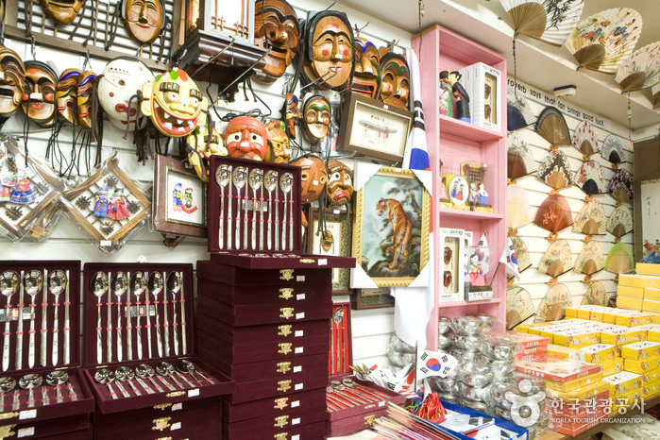
What is a souvenir?
It’s something you can buy on vacation

Slide 3
5 Ws
Who
Where
When
Why
What

Slide 4
did you go with?
did you buy?
did you go?
did you go there?

Slide 5
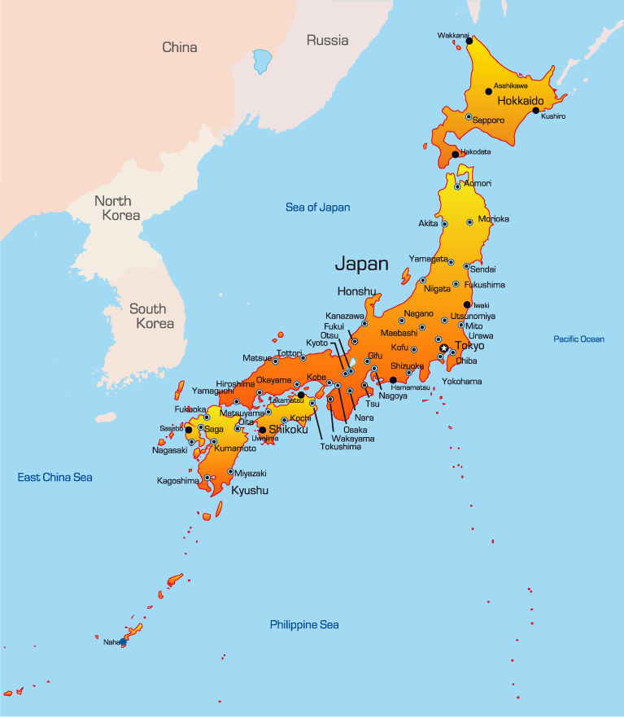
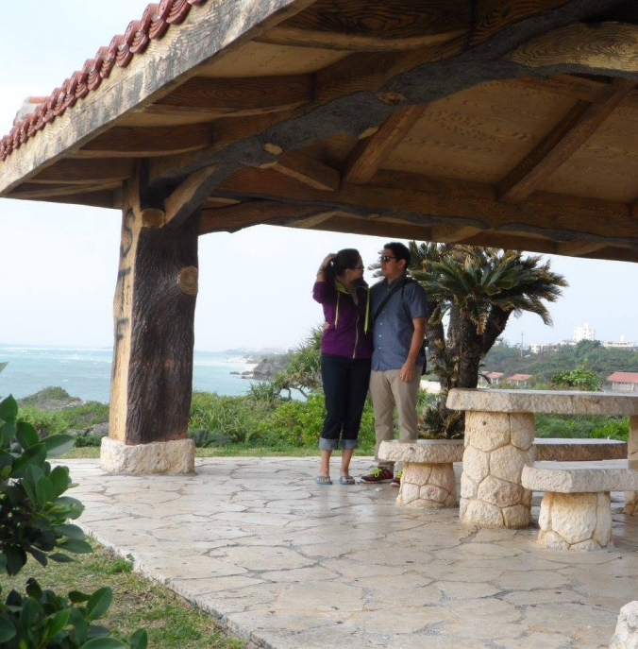
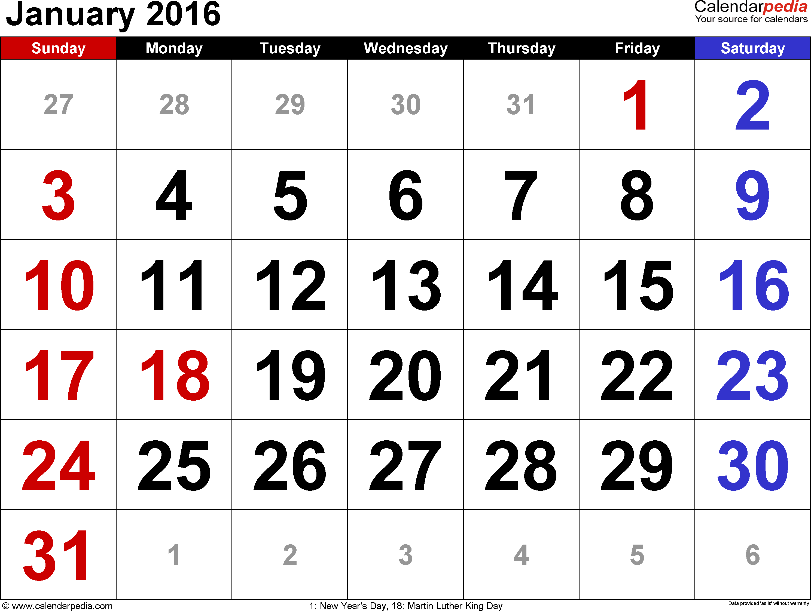
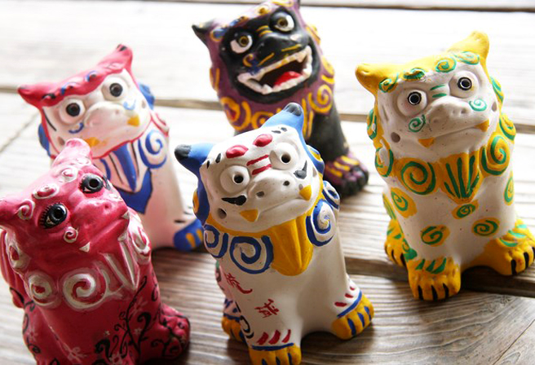
Mr.S’ Souvenir
What did you buy?
Where did you go?
When did you go there?
Who did you go with?

Slide 6
Vacation Liar!
Choose 6 students to be the suspects.
Each student has a souvenir.
Students can ask questions like:
What did you buy?
Where did you get it?
When did you go there?
Who did you go with?
One story will not be true. You must guess which one!

Slide 7
Round 1

Slide 8
Vacation Liar!
What did you buy?
Where did you go?
When did you go there?
Who did you go with?

Slide 9
Who is the liar?

Slide 10
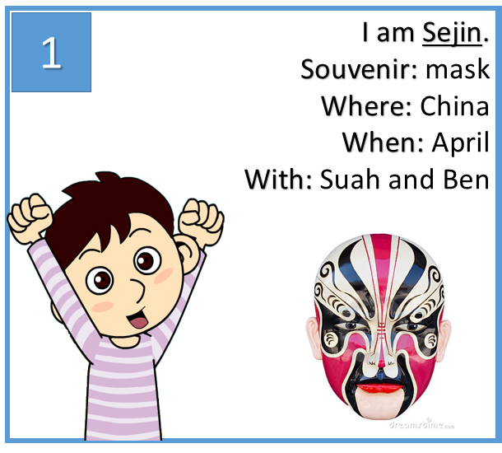

Slide 11
Round 2

Slide 12
Vacation Liar!
What did you buy?
Where did you go?
When did you go there?
Who did you go with?

Slide 13
Who is the liar?

Slide 15
Round 3

Slide 16
Vacation Liar!
What did you buy?
Where did you go?
When did you go there?
Who did you go with?

Slide 17
Who is the liar?

Slide 19
Round 4

Slide 20
Vacation Liar!
What did you buy?
Where did you go?
When did you go there?
Who did you go with?

Slide 21
Who is the liar?

Slide 23
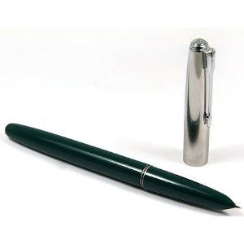
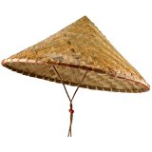
I am Ben.
Souvenir: pen
Where: China
When: April
With: Suah and Sejin
I am Tanya.
Souvenir: hat
Where: Vietnam
When: April
With: Ben and Bona
1
1

Slide 24
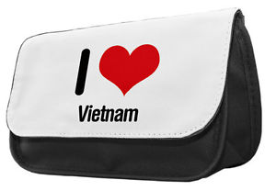
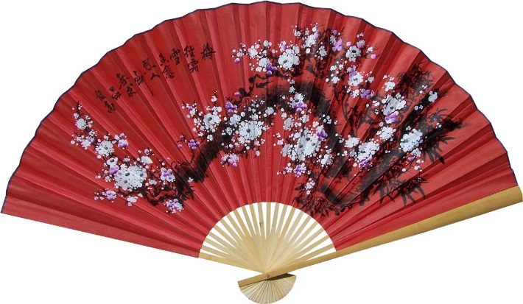
I am Bona.
Souvenir: pencil case
Where: Vietnam
When: May
With: Junho
I am Suah.
Souvenir: fan
Where: China
When: April
With: Ben and Sejin
1
1

Slide 25
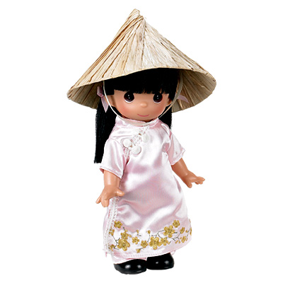
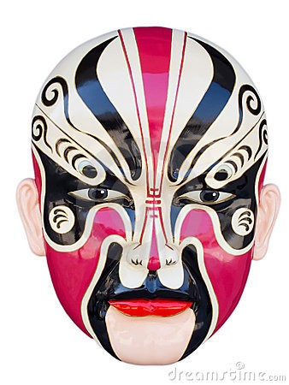
I am Sejin.
Souvenir: mask
Where: China
When: April
With: Suah and Ben
I am Juho.
Souvenir: doll
Where: Vietnam
When: May
With: Bona
1
1

Slide 26
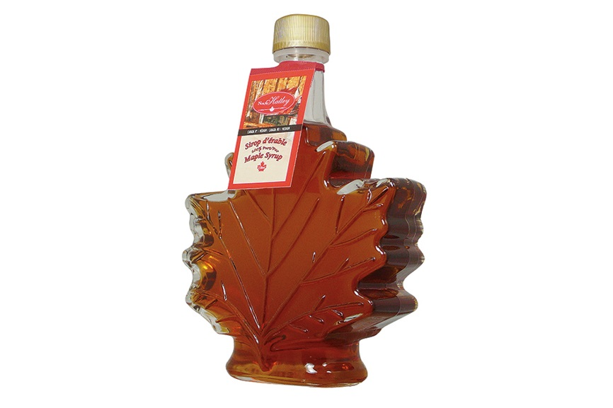
I am Ben.
Souvenir: maple syrup
Where: Canada
When: September
With: Tanya and Bona
I am Tanya.
Souvenir: flag
Where: Canada
When: September
With: Ben and Bona
2
2

Slide 27
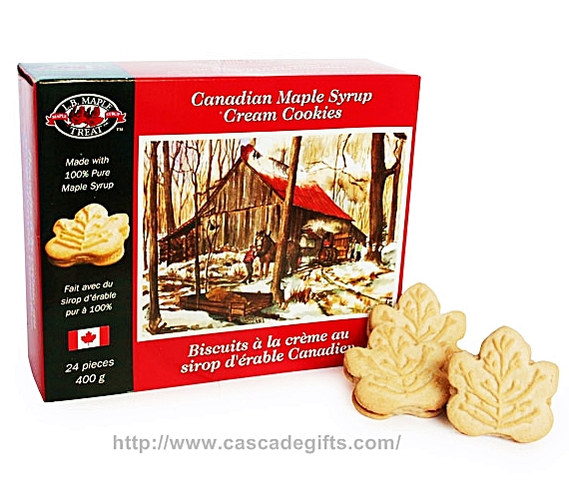
I am Bona.
Souvenir: cookies
Where: Canada
When: September
With: Tanya and Ben
I am Suah.
Souvenir: pin
Where: Canada
When: September
With: Sejin and Ben
2
2

Slide 28
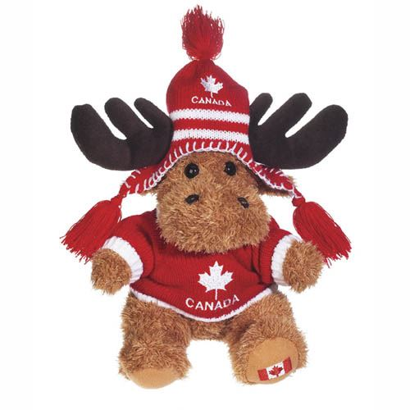
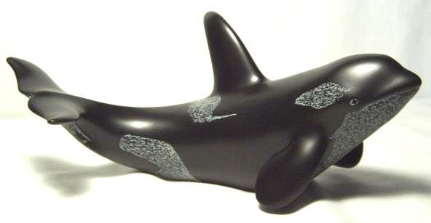
I am Sejin.
Souvenir: whale figurine
Where: Canada
When: March
With: Juho
I am Juho.
Souvenir: teddy bear
Where: Canada
When: March
With: Sejin
2
2

Slide 29
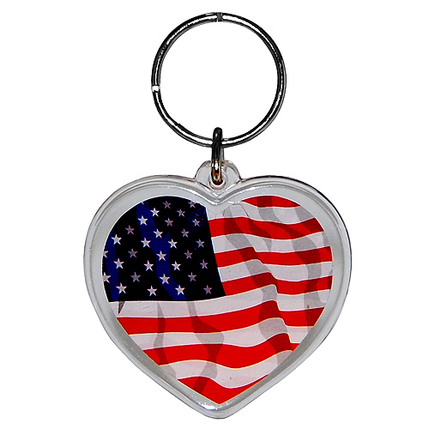
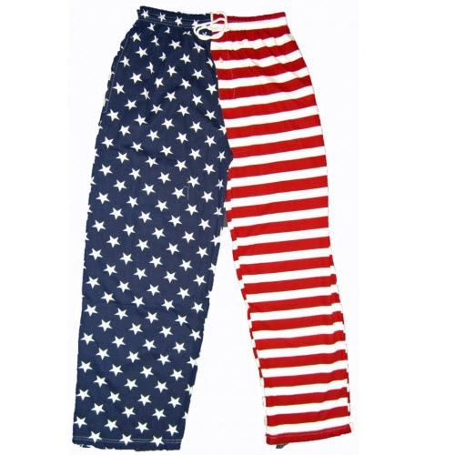
I am Ben.
Souvenir: keychain
Where: USA
When: February
With: Tanya and Bona
I am Tanya.
Souvenir: pants
Where: USA
When: February
With: Ben and Bona
3
3

Slide 30
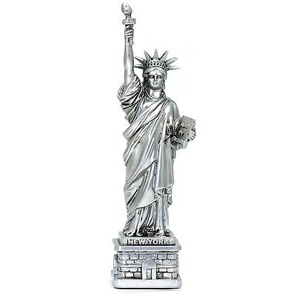
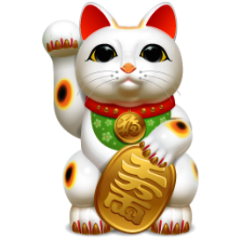
I am Bona.
Souvenir: statue
Where: USA
When: February
With: Ben and Tanya
I am Suah.
Souvenir: Lucky Cat
Where: Japan
When: January
With: Sejin and Juho
3
3

Slide 31
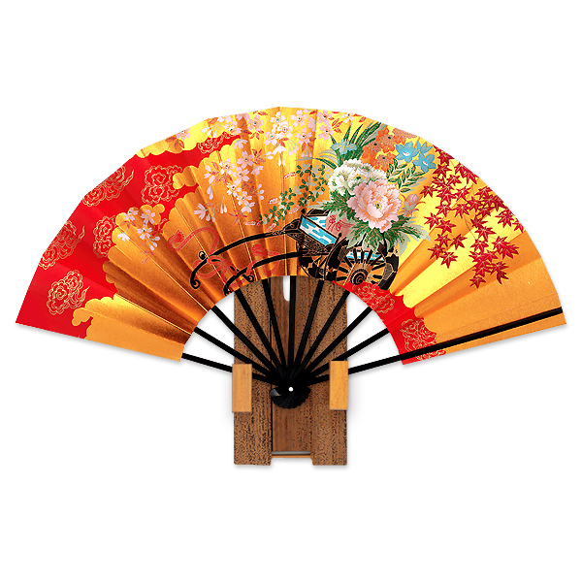
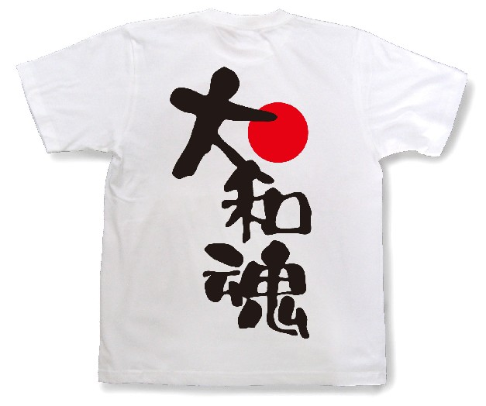
I am Sejin.
Souvenir: tshirt
Where: Japan
When: February
With: Juho and Suah
I am Juho.
Souvenir: fan
Where: Japan
When: January
With: Sejin and Suah
3
3

Slide 32
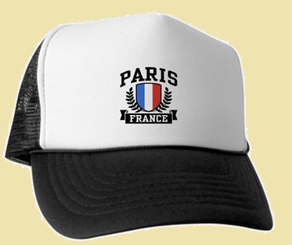
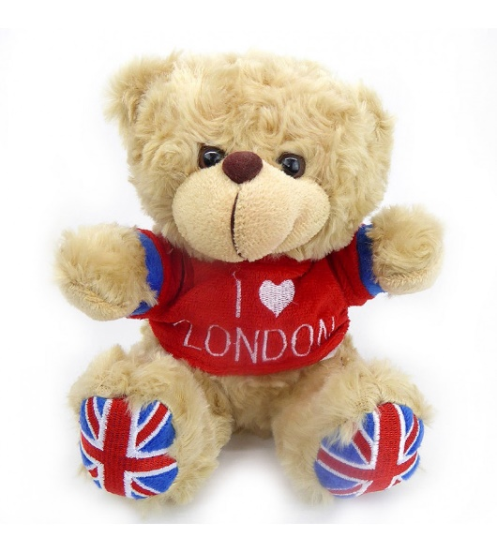
I am Ben.
Souvenir: hat
Where: France
When: June
With: Suah
I am Tanya.
Souvenir: teddy bear
Where: England
When: October
With: Suah and Sejin
4
4

Slide 33
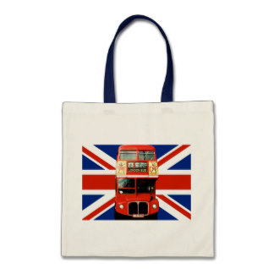
I am Bona.
Souvenir: cup
Where: France
When: June
With: Junho
I am Suah.
Souvenir: bag
Where: England
When: October
With: Tanya and Sejin
4
4

Slide 34
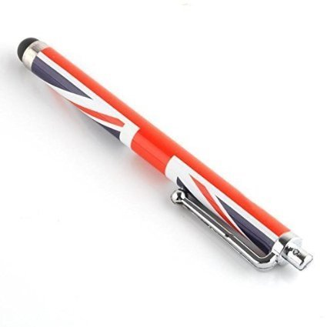
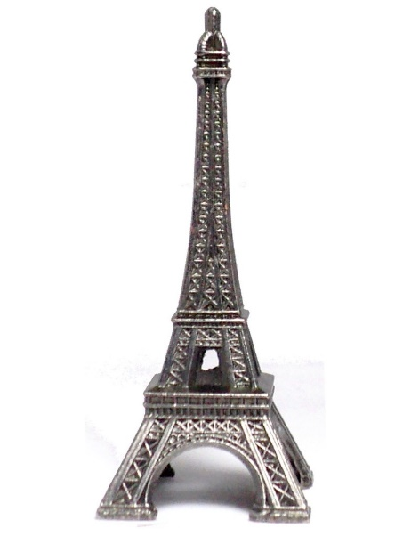
I am Sejin.
Souvenir: pen
Where: England
When: October
With: Suah and Tanya
I am Juho.
Souvenir: statue
Where: France
When: June
With: Bona
4
4

