Slide 1
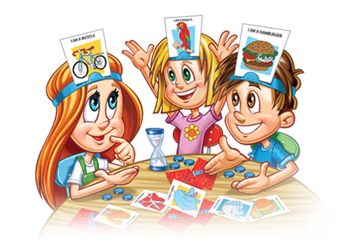
Headband Game

Slide 2
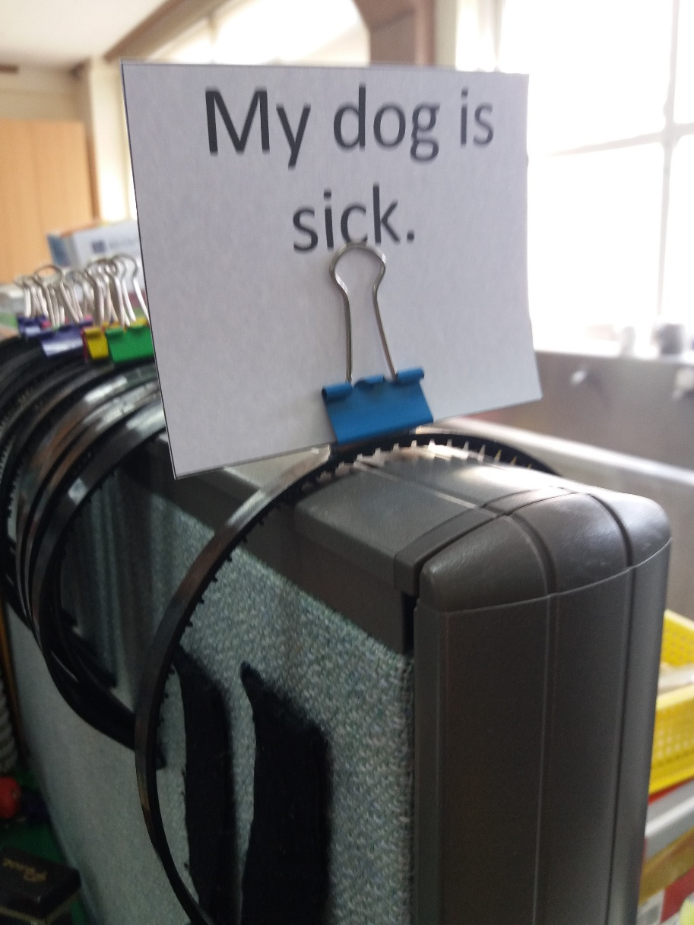
Prepare:
Purchase some cheap headbands and hot glue paperclips to the top.
Print (any maybe laminate) the cards
Before each round, put a card on the band.

Slide 3
Rules:
Half of the class will receive a headband.
If you have a headband, you must guess what it says.
If you don’t have a headband, talk to the headband people. “Why are you _________?”
When you think you know the answer, talk to the teacher. If it is correct, you can get a new card.

Slide 4
My dog is sick.
I lost my bag.
I got a bad grade.
I lost the soccer game
I lost my book.
I got a new ball.

Slide 5
My sister broke my watch.
I lost my phone.
I bought new shoes.
My sister ate my cookies.
I am doing my homework.
I lost my picture.

Slide 6
I broke my glasses.
I saw a ghost.
Because I am sick.
I lost the soccer game
I lost my book.
I got a new ball.

Slide 7
