Slide 1
Fashion Designer

Slide 2
Rules
One person will come to the front
(sit at the computer)
The other students must tell them to “Put on” or “Take off” clothes
Match the picture
Fastest total time is the winner.

Slide 3
Stage 1 – Girls Clothes
http://www.best-flash-games.net/girl-games/haifa-wehbe-dress-up.html

Slide 4
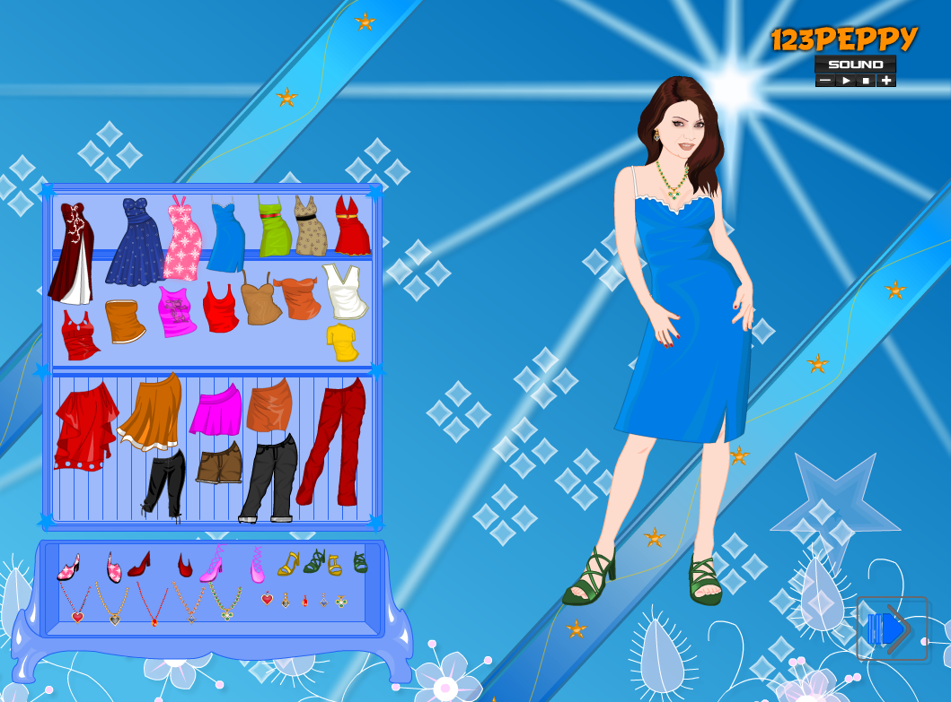

Slide 5
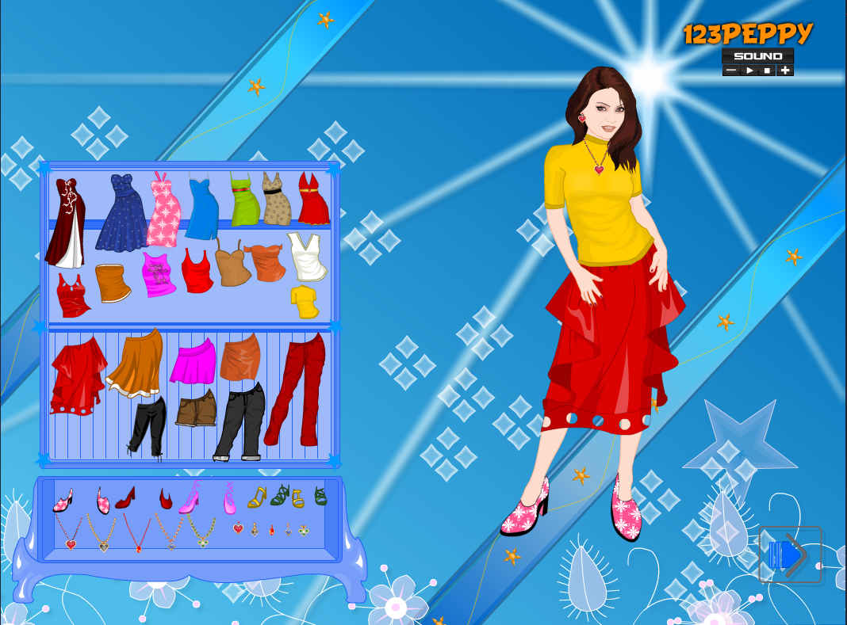

Slide 6
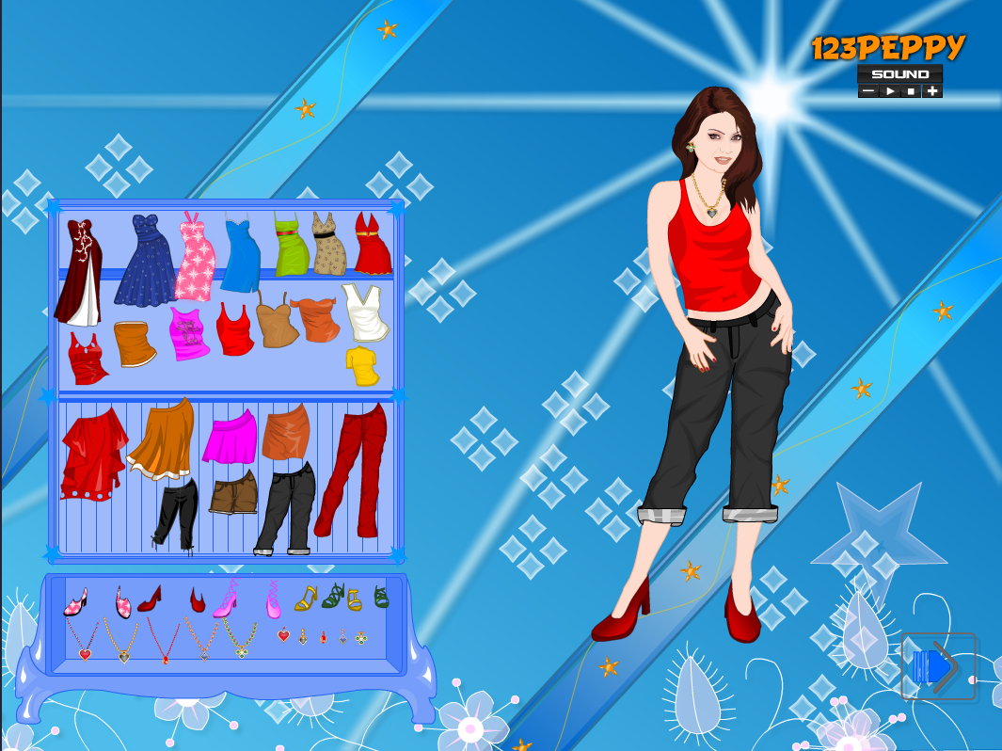

Slide 7
Stage 2 – Boy Clothes
http://www.best-flash-games.net/girl-games/boy-dress-up.html

Slide 8
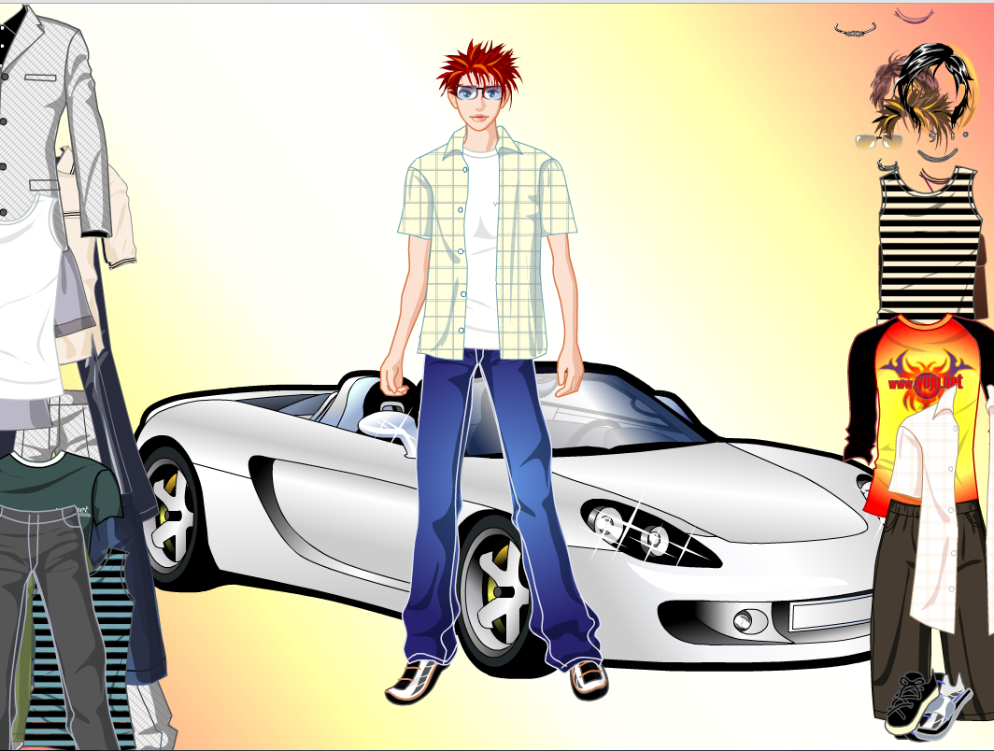

Slide 9
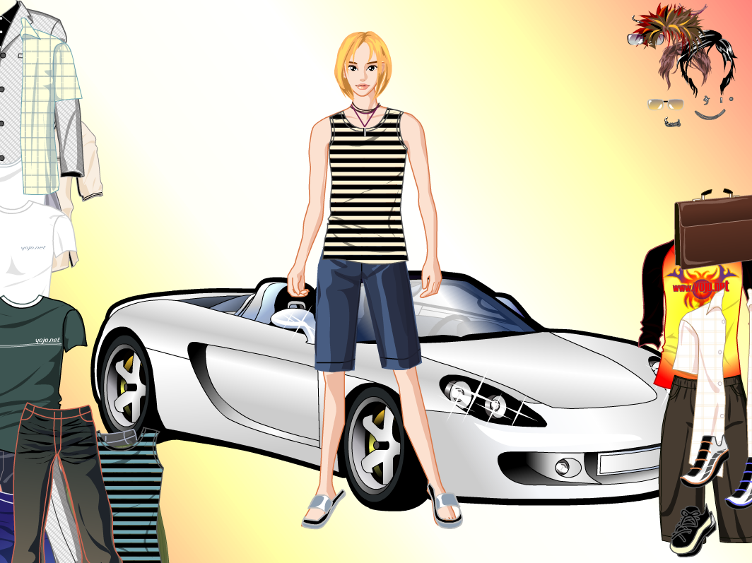

Slide 10
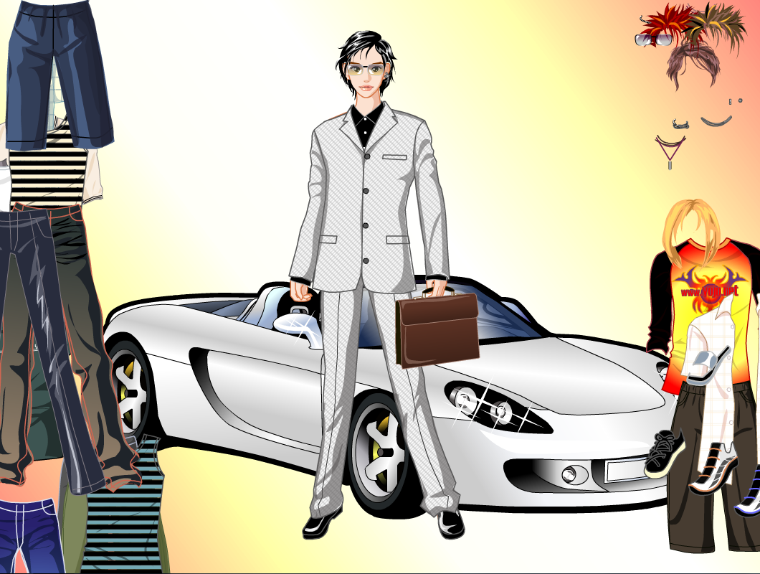

Slide 11
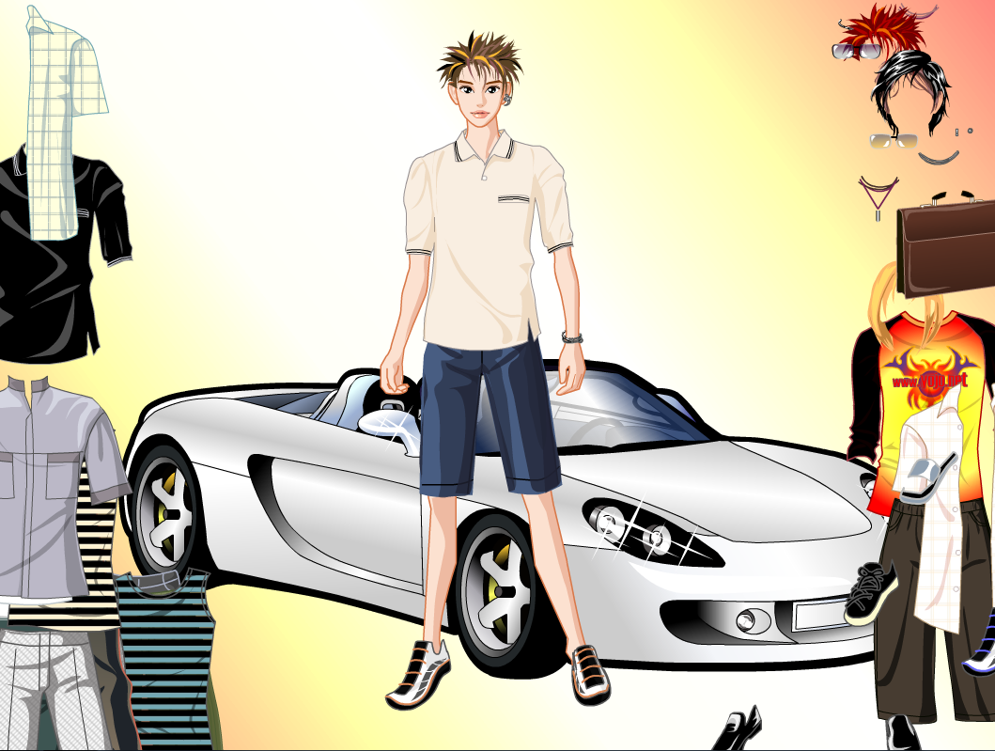

Slide 12
Stage 3 – Girl’s Again
http://www.best-flash-games.net/girl-games/barbie-dress-up.html

Slide 13
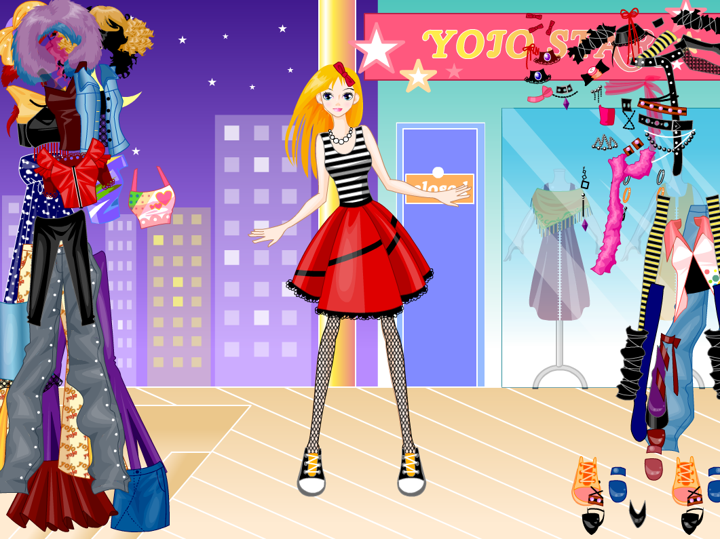

Slide 14
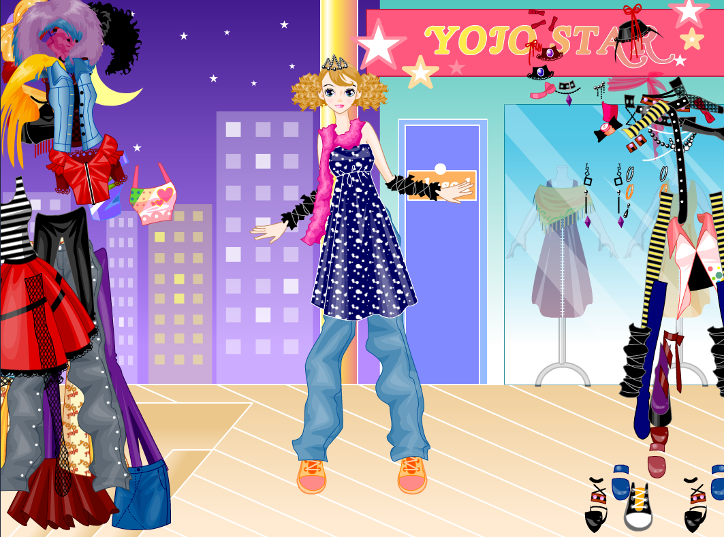

Slide 15
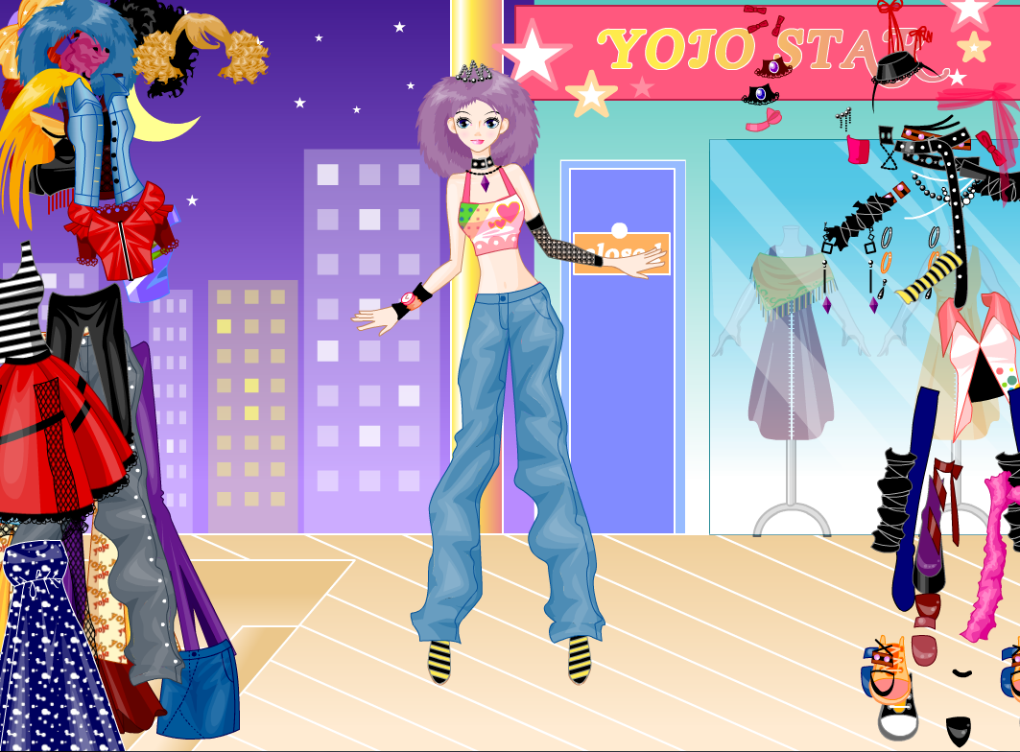

Slide 16
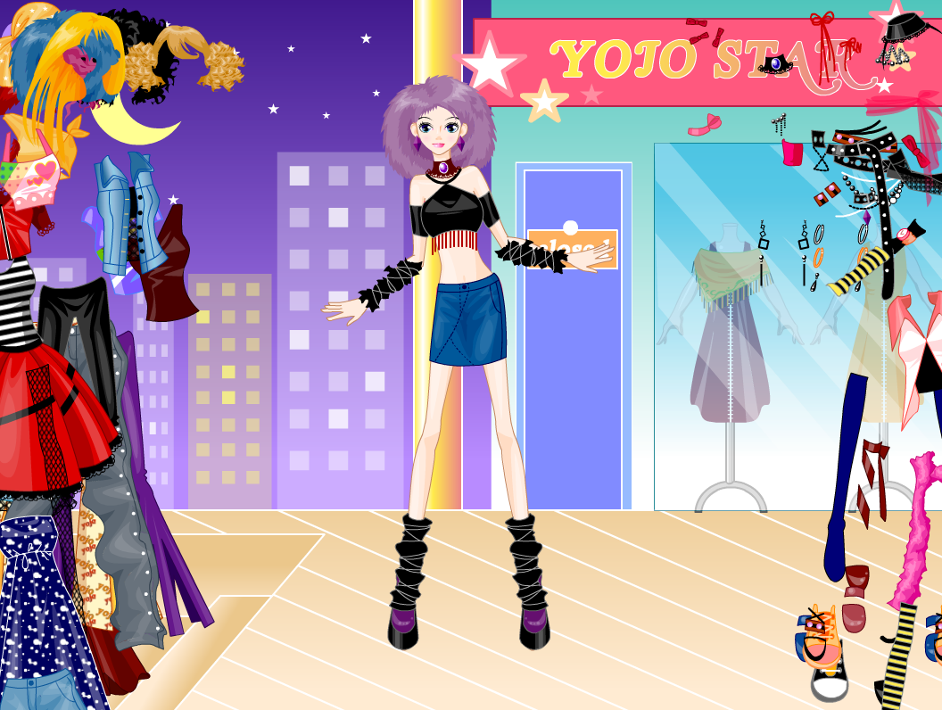

Slide 17
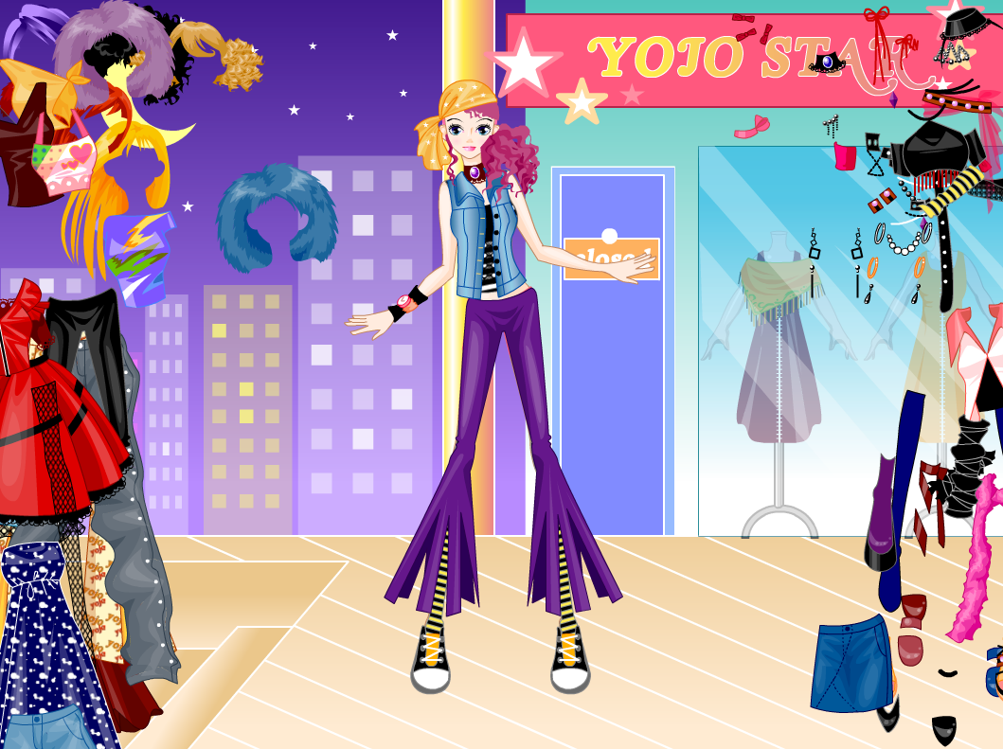

Slide 18
