Slide 1
I Like Winter
Lesson 13

Slide 2
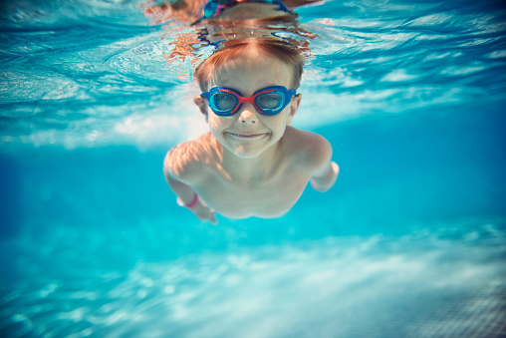
I like ________ because I can go swimming.
summer

Slide 3
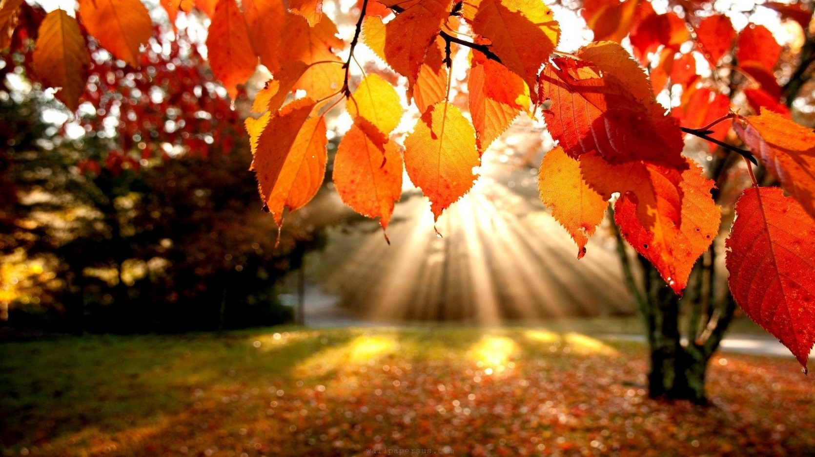
I like ________ because I can see trees change color .
fall

Slide 4
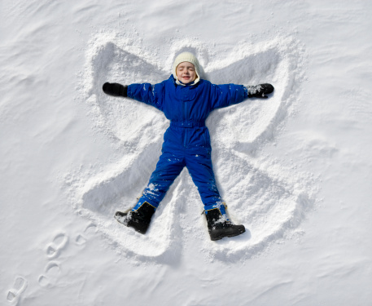
I like ________ because I can make snow angels.
winter

Slide 5
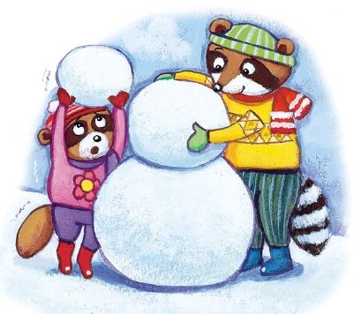
I like ________ because I can make a snowman.
winter

Slide 6
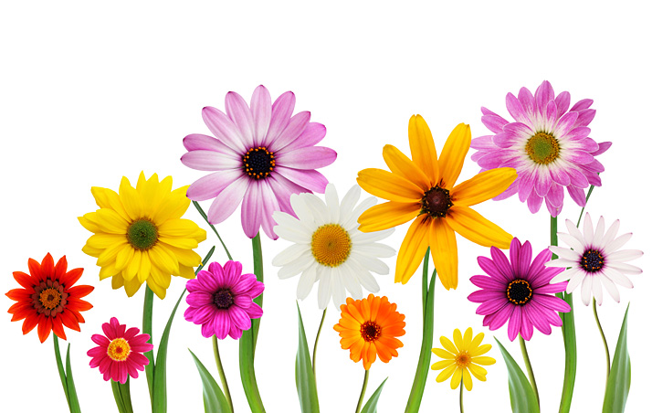
I like ________ because I can smell new flowers.
spring

Slide 7
Who Said It?
Secretly write a sentence.
What season do you like (and why)?
Write your name on the paper.
Make a paper ball and put it in the hat.

Slide 8
Who Said It?
One student will come to the front and unwrap a ball.
The class will ask, “What season do you like?”
Read the sentence.
The other students must guess who said it.
(don’t guess your own answer)
Whoever is correct will read the next sentence.

