Slide 1
Put on Your Hat
Lesson 13

Slide 2

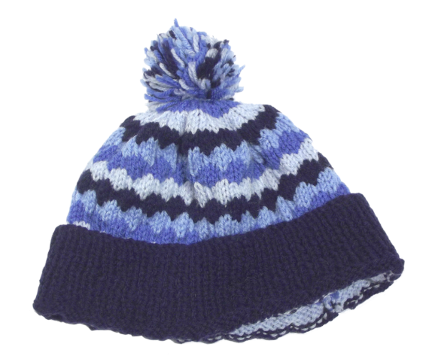
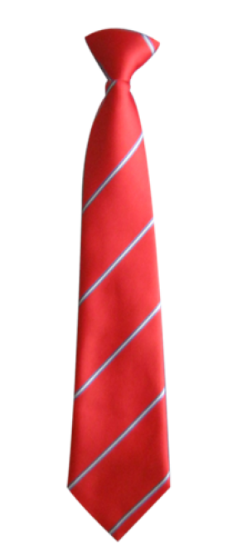


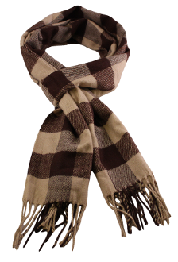
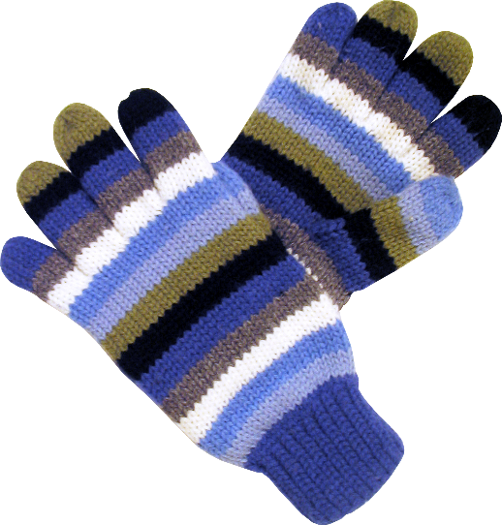
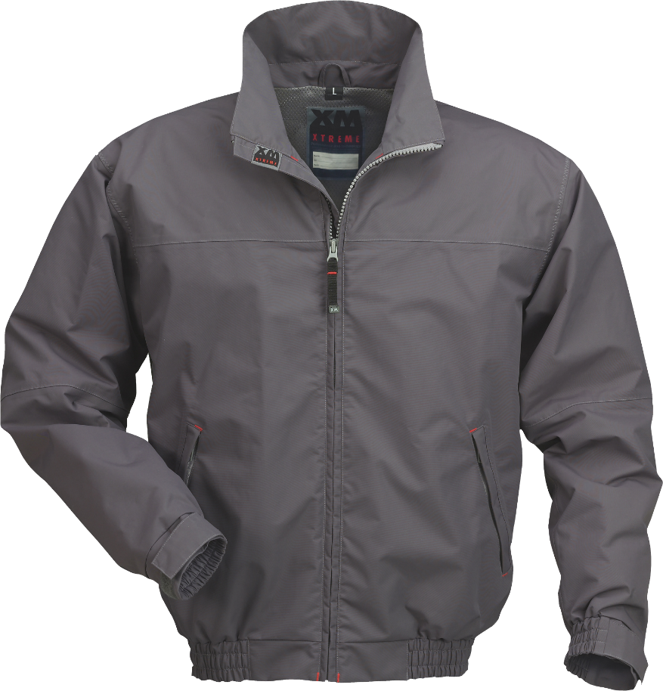
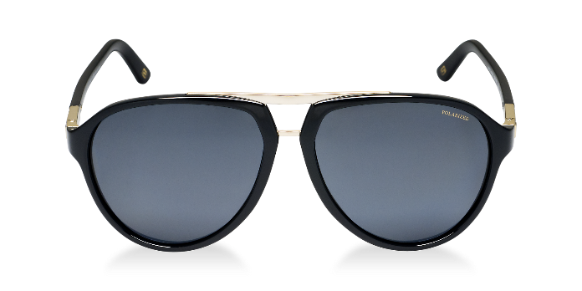
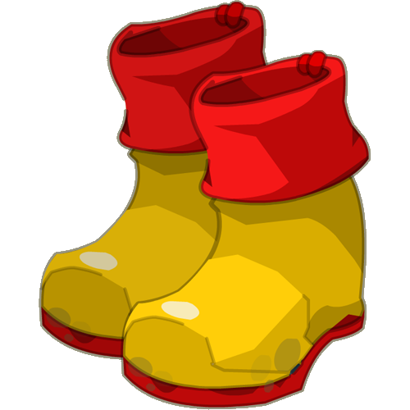

Clothes Review
What is it?

Slide 3
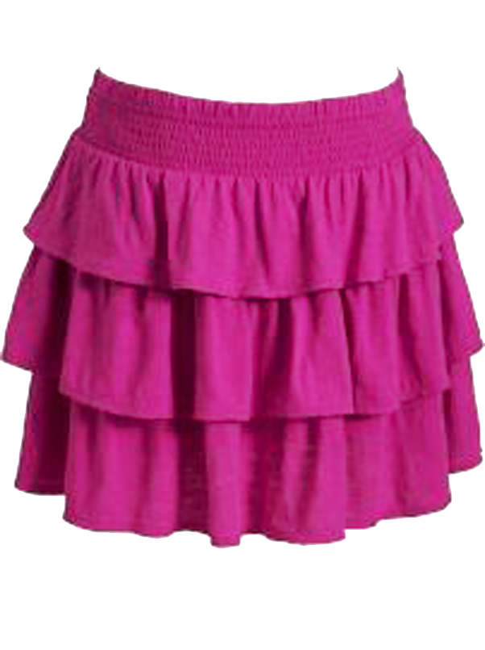
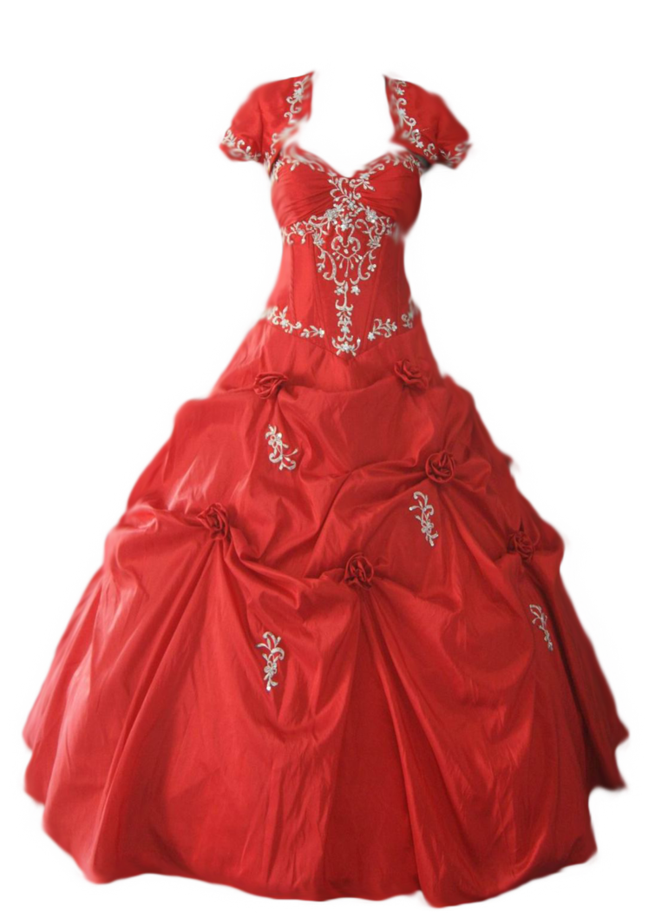
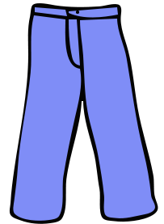
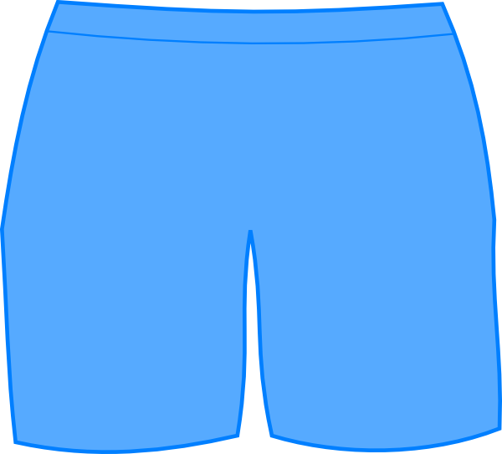

Slide 4
Prepare
Have a box of prop clothes that students can sort through.
Alternatively, you may use old hats / jackets

Slide 5


Rules
One student (from each group) will come to the
front of the class.
  They should not look at the TV.
There will be a picture of the weather on the TV
Tell the student, “Put on _____ / Take off ______”
  The students should follow the instructions
Repeat twice more before the next student comes to the front.

Slide 6
Ready?

Slide 7




Slide 8
Ready?

Slide 9

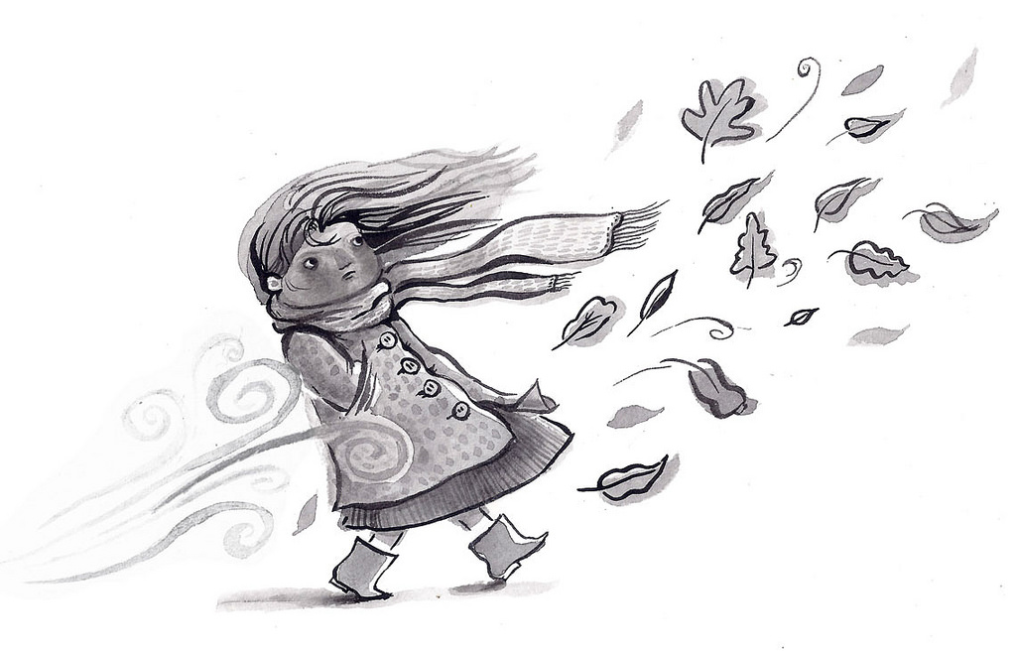


Slide 10
Ready?

Slide 11
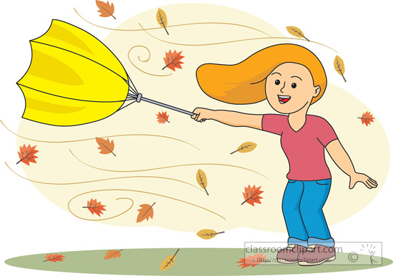
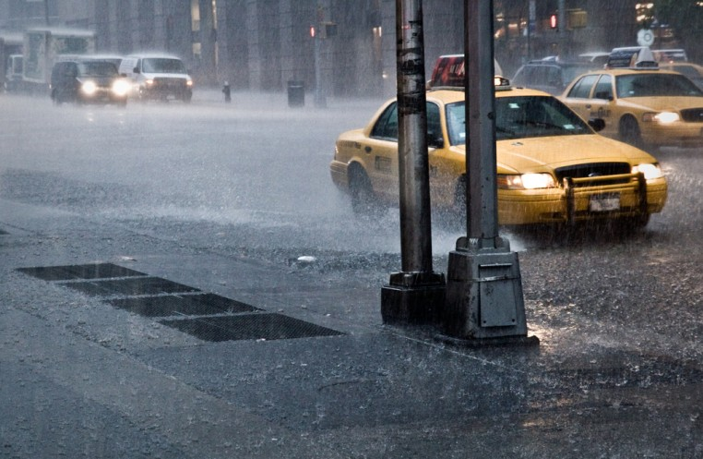
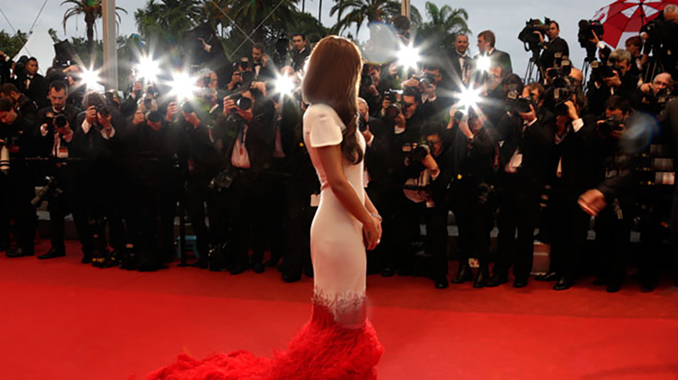

Slide 12
Ready?

Slide 13
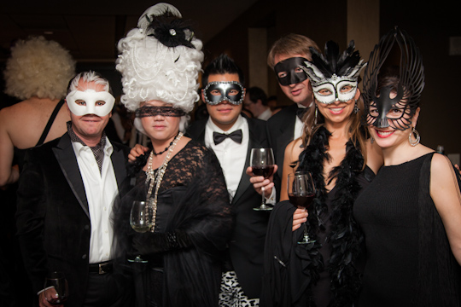

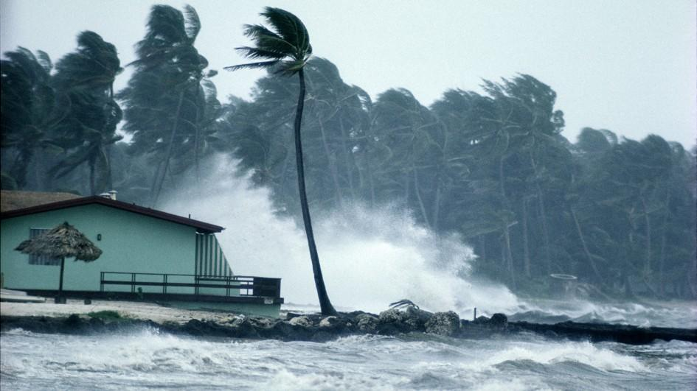

Slide 14
Ready?

Slide 15
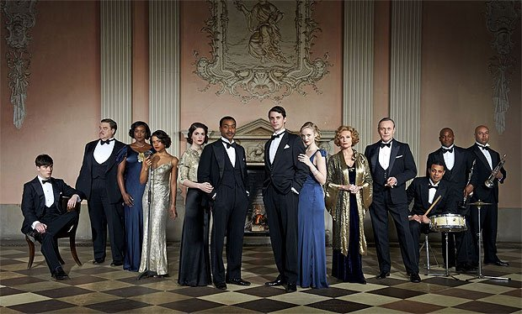



Slide 16
Ready?

Slide 17


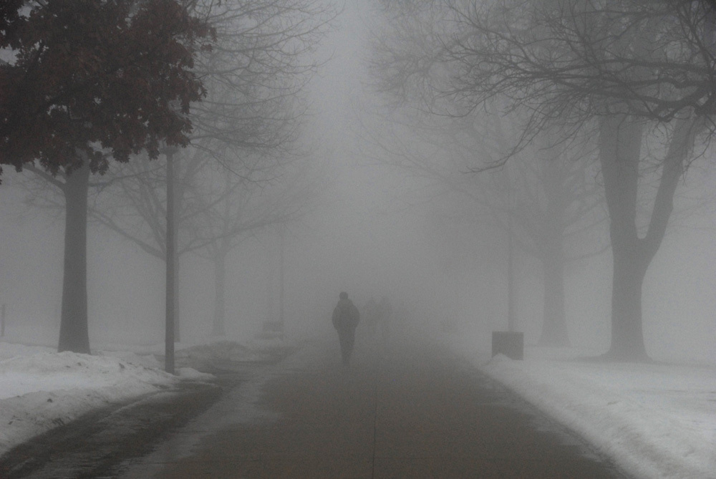

Slide 18
Ready?

Slide 19
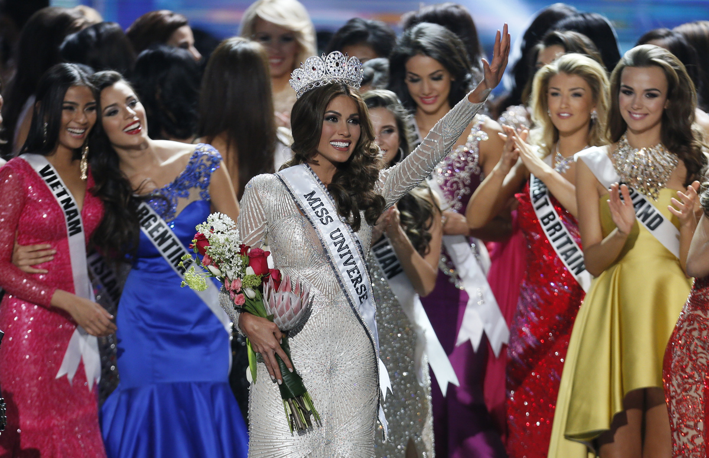
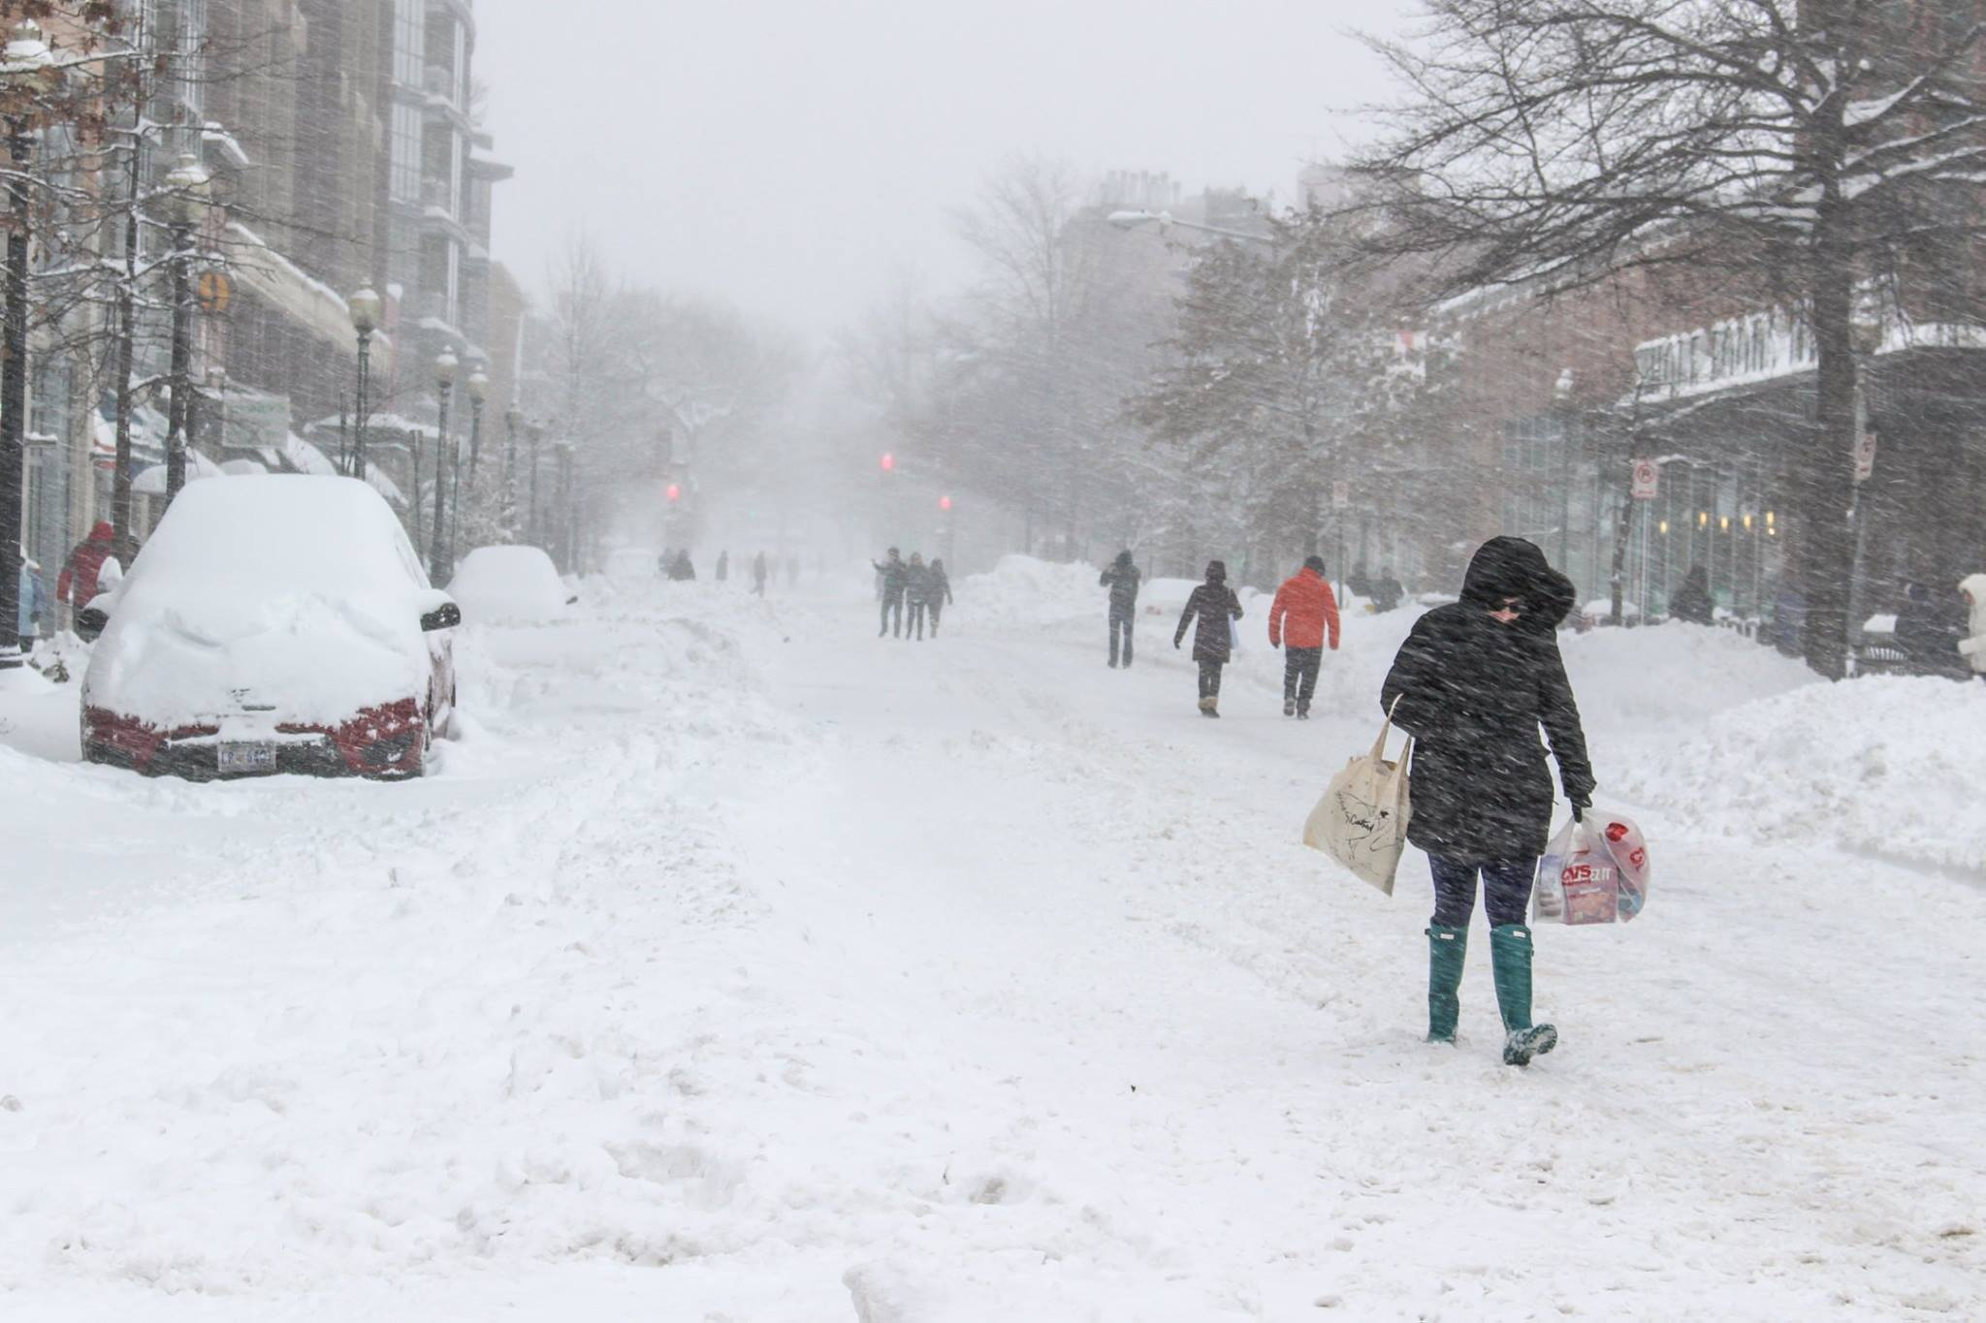


Slide 20
Ready?

Slide 21
