Slide 1
Battleship: What is he doing?
Lesson 13

Slide 2
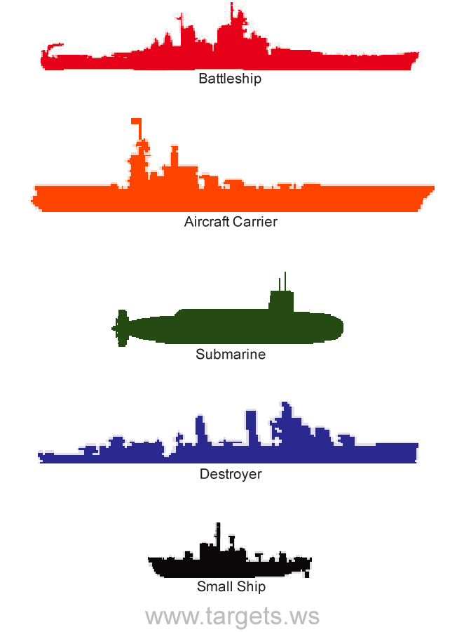
Rules
Divide the class into teams (2 or 3 is optimal)
The teacher will ask, “What is she/he doing?”
Students take turns creating a sentence.
Click the picture to reveal a space.
1 point for a hit
1 bonus point to sinking the ship (2 total)

Slide 4
