Slide 1
Tell me about your class:
(ordinals)

Slide 2
What grade are you in?

Slide 3
What is your class number?

Slide 4
Where is your classroom?

Slide 5
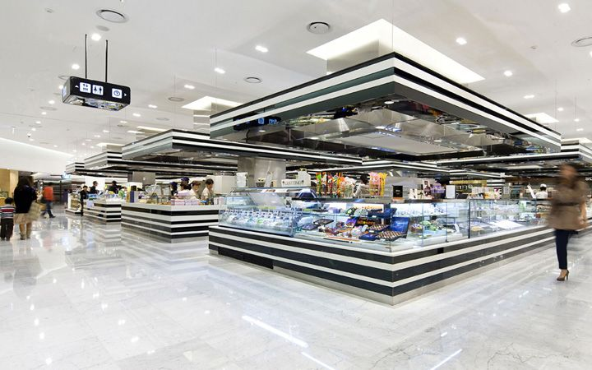

Slide 6
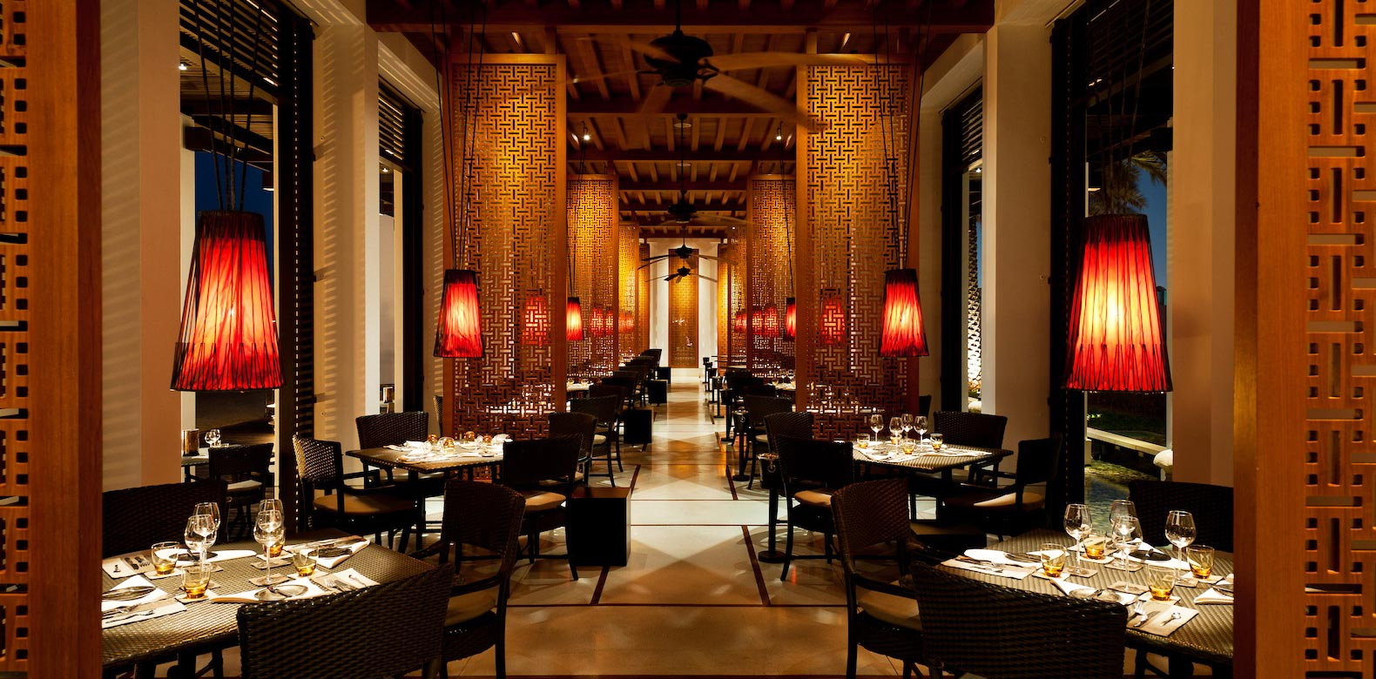
Restaurant

Slide 7
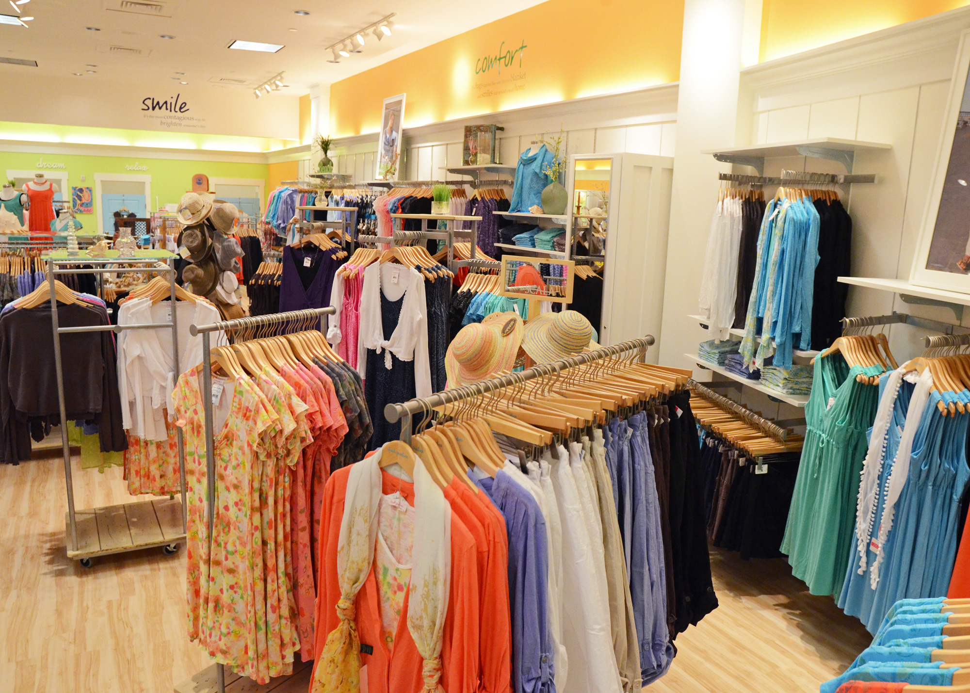
Clothing Store

Slide 8
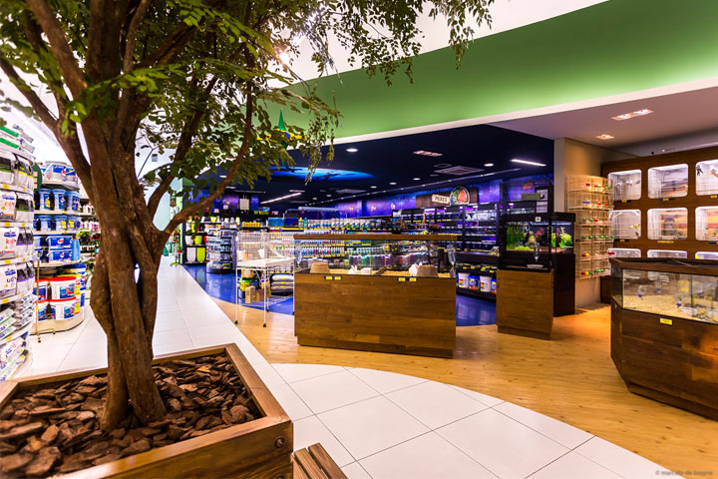
Pet Shop

Slide 9
Theater

Slide 10
Electronics

Slide 11
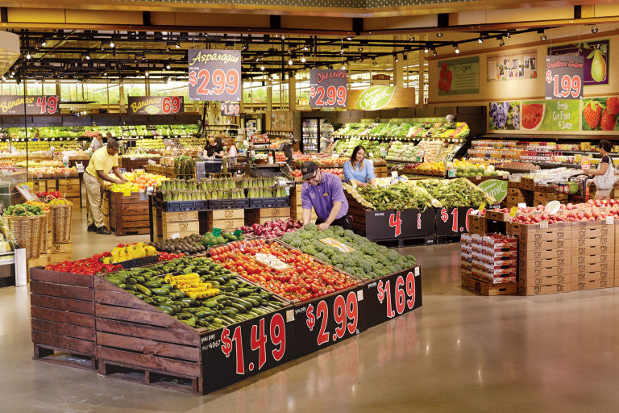
Grocery Store

Slide 12
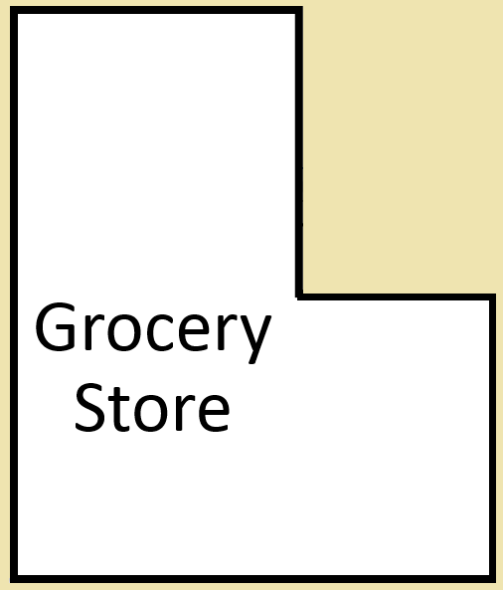
Build a Department Store:
Put the stores into the mall on different floors
You can only put it there if there is space
Electronics
Theater
Shoe Store
Clothing Store
Pet Shop
Restaurant

Slide 13
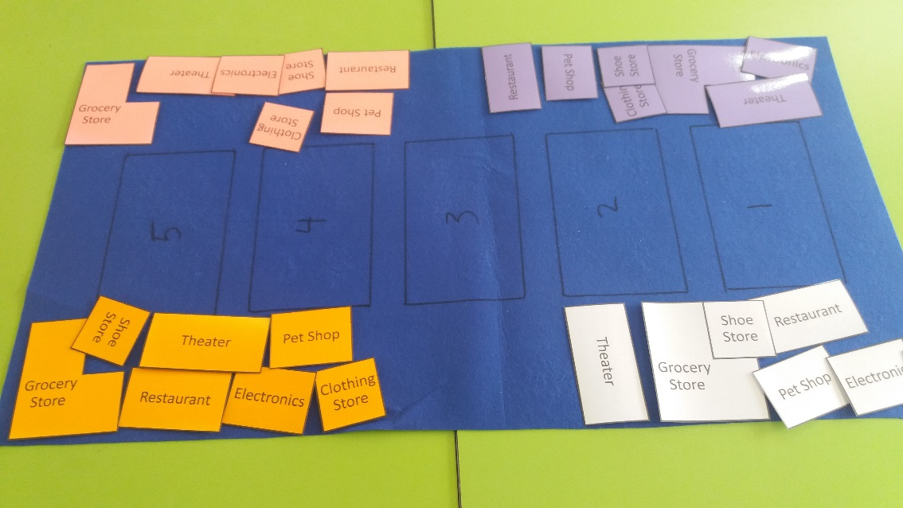
Build a Department Store:
Put the store in the middle of the table
Each student gets one color of department stores

Slide 14
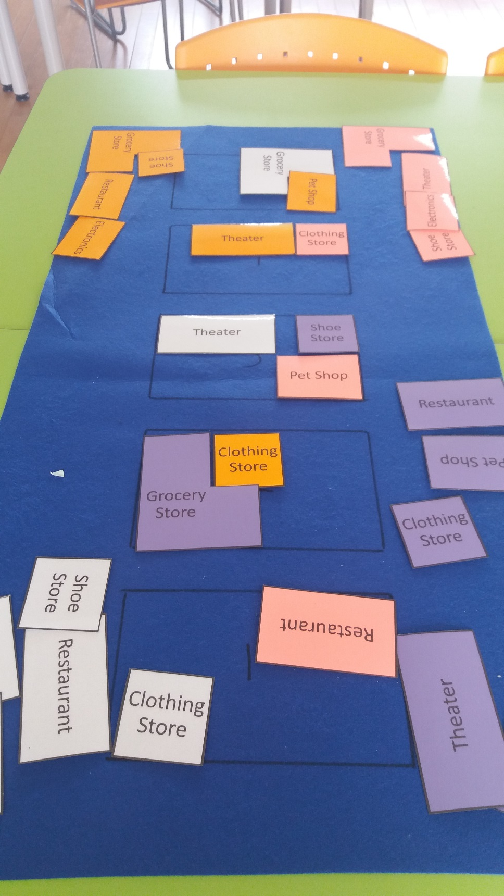
Build a Department Store:
You can’t place the same store
If the store doesn’t fit, you can’t put it in the store
Take turns and be kind.

Slide 15
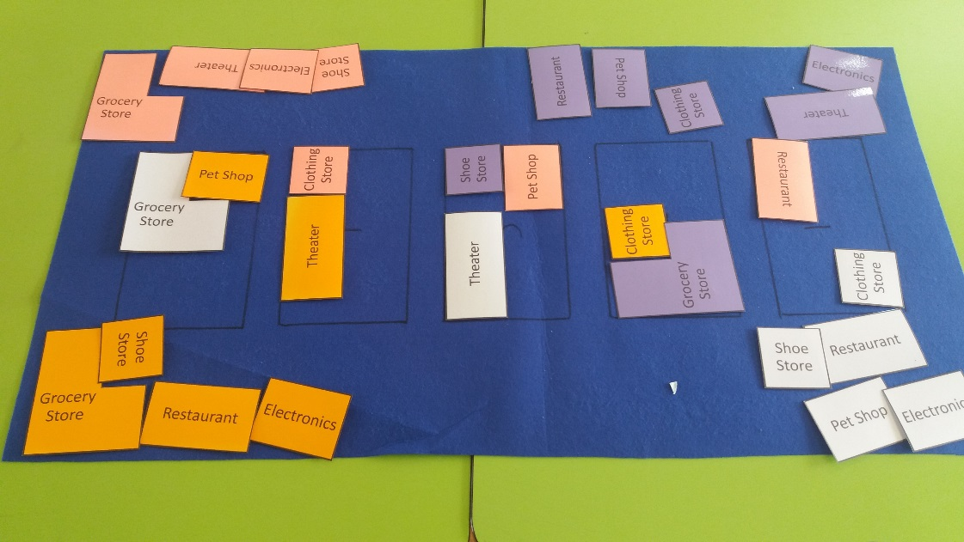
How to Play:
Choose a store
The other players will ask, “Where is the _______”
Roll the dice and say, “It’s on the _________ floor.” (6 = choice)
Try placing it on the board
If it doesn’t fit, put it back in your hand.

Slide 16
Points
One point for each store
One bonus point for 2 stores on the same floor.
One more bonus point for 3 stores on the same floor.

