Slide 1
Lesson 13 – The Calendar
Ch.4

Slide 2
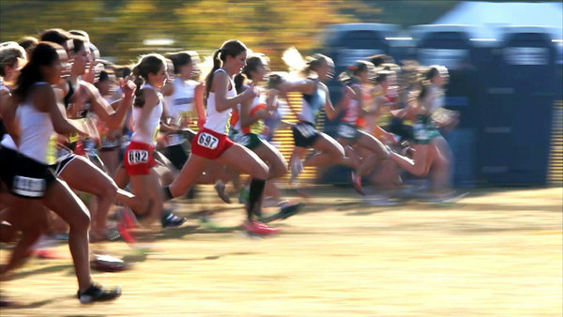
Ordinal Numbers
Order

Slide 3
Order:
1st
2nd
3rd
4th
5th
6th
21st
22nd
23rd
24th
100th
234th

Slide 5
Order:
1st =
2^{nd =}
3^{rd =}
4^{th =}
5^{th =}
6th =
First
Second
Third
Fourth
Fifth
Sixth
21^{st =}
22^{nd =}
23^{rd =}
24^{th =}
100^{th =}
234th =
Twenty-first
Twenty-second
Twenty-third
Twenty-fourth
One Hundredth
Two hundred and thirty-fourth

Slide 6
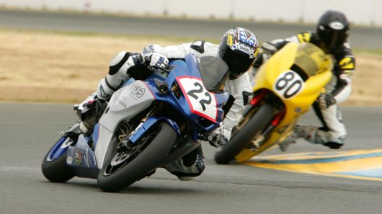
Who is in first?

Slide 7
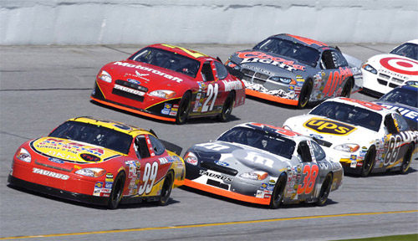
What position is he in?

Slide 8
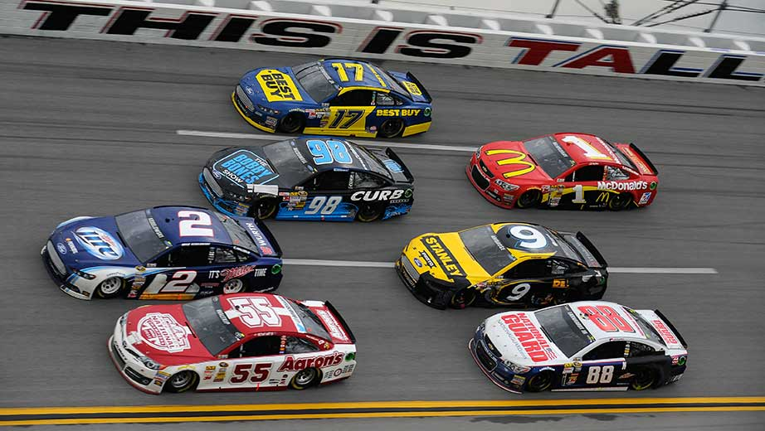
What position is he in?
#1 -
#2 -
#9 -
#17 -
#55 -
#88 -
#98 -

Slide 9
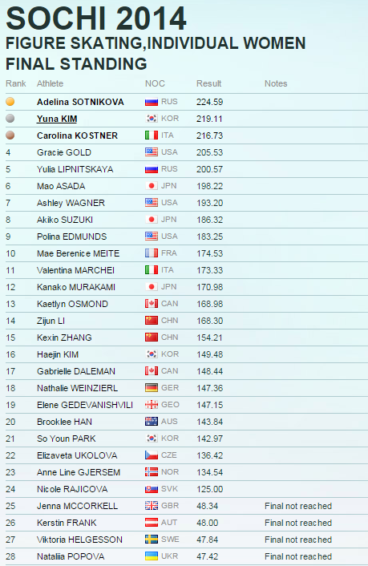
Who finished first?

Slide 10
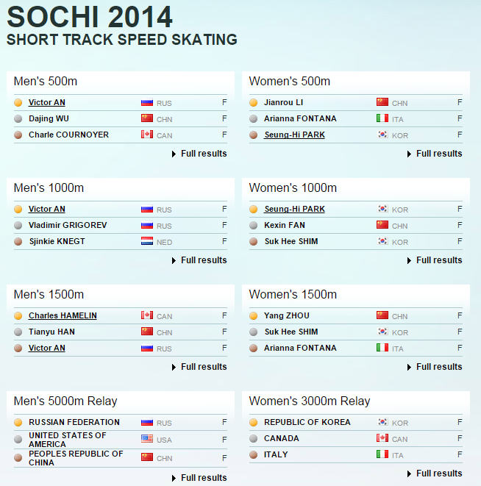

Slide 11
Betting Game
Who will finish first?

Slide 12
Betting Game Rules
You start with $10.
Or just have students guess for fun.
You can bet as much money as you want on as many players as you want.
If you are right, you win money
2 players = 1:1
3 players = 1:2
4 players = 1:3

Slide 13
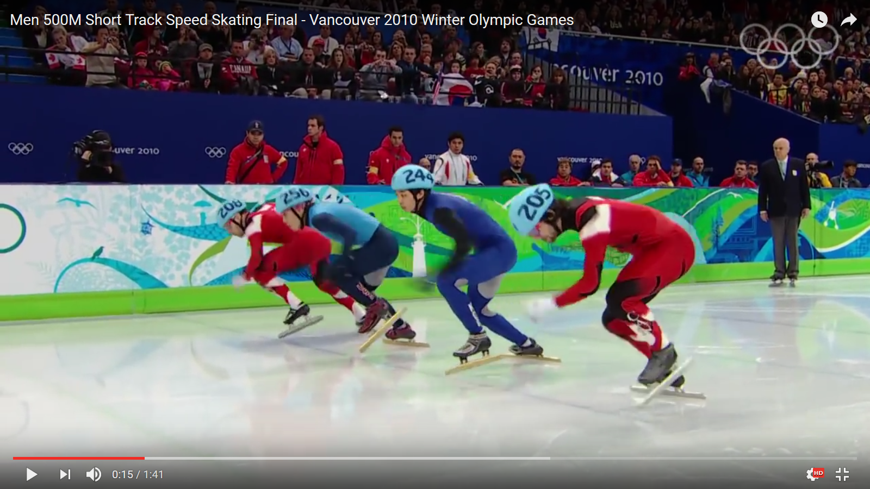
Betting Game
https://www.youtube.com/watch?v=2QFXP8BxMME

Slide 14
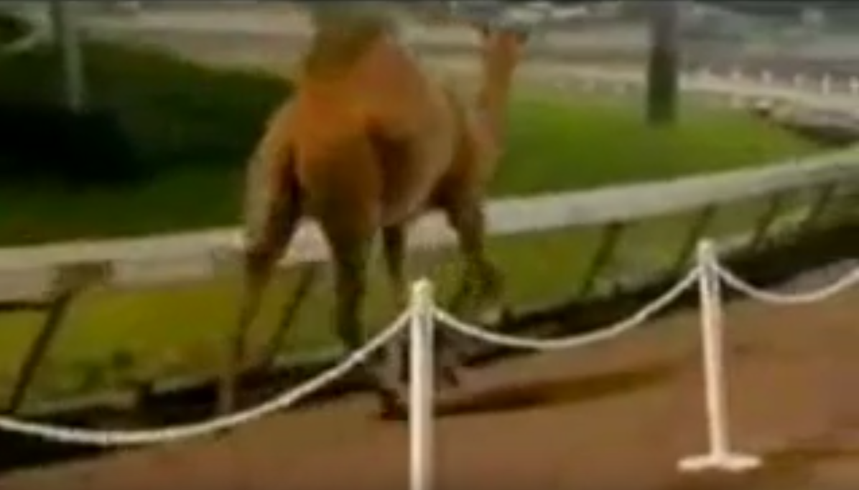
Midgets vs Camel
https://www.youtube.com/watch?v=X8KdawFd874

Slide 15
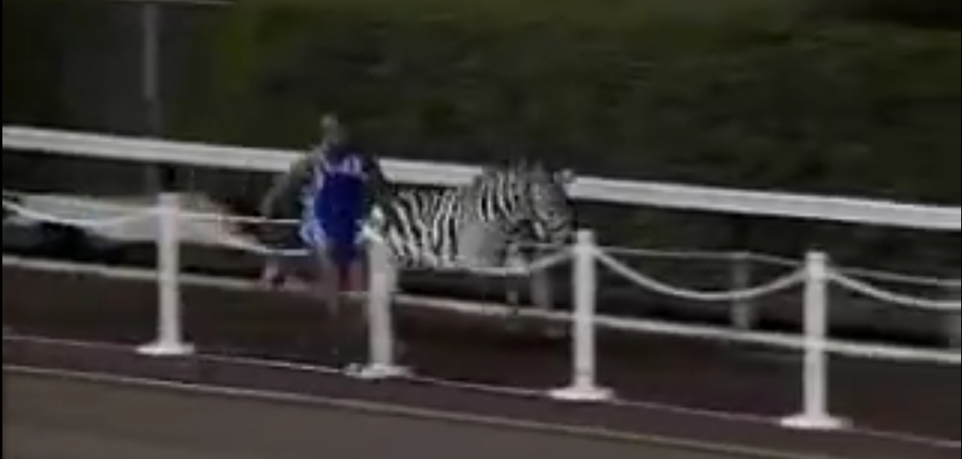
Man vs Giraffe vs Zebra
https://www.youtube.com/watch?v=Y5QwYJoLUfE

Slide 16
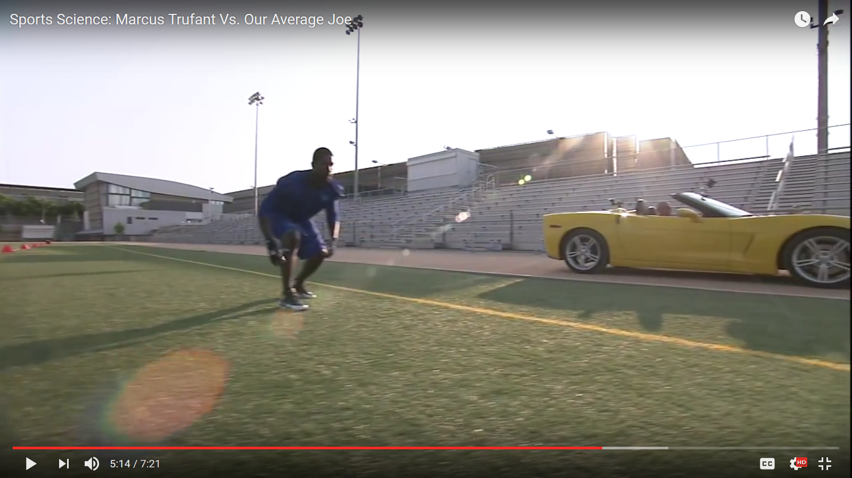
Backwards Race – Man vs Car
https://www.youtube.com/watch?v=0olAvlNsWZI

Slide 17
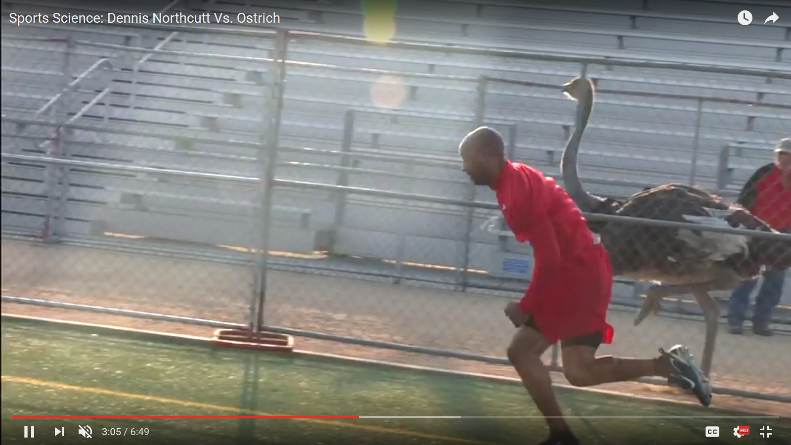
Man vs Ostrich
https://www.youtube.com/watch?v=2WcMRpozO4s

Slide 18
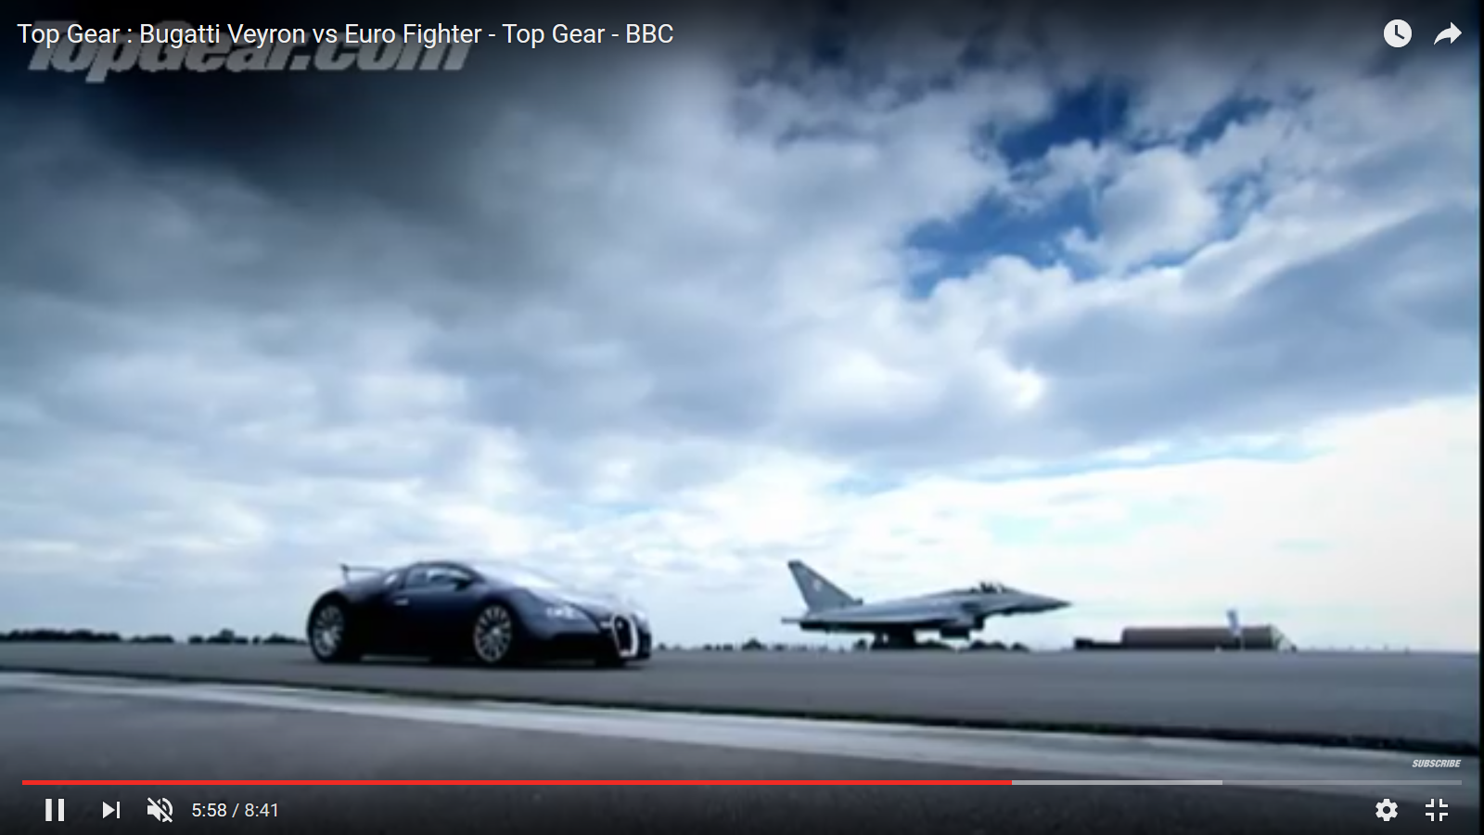
Veyron vs Jet
https://www.youtube.com/watch?v=7NZ9X9A2efA

Slide 19
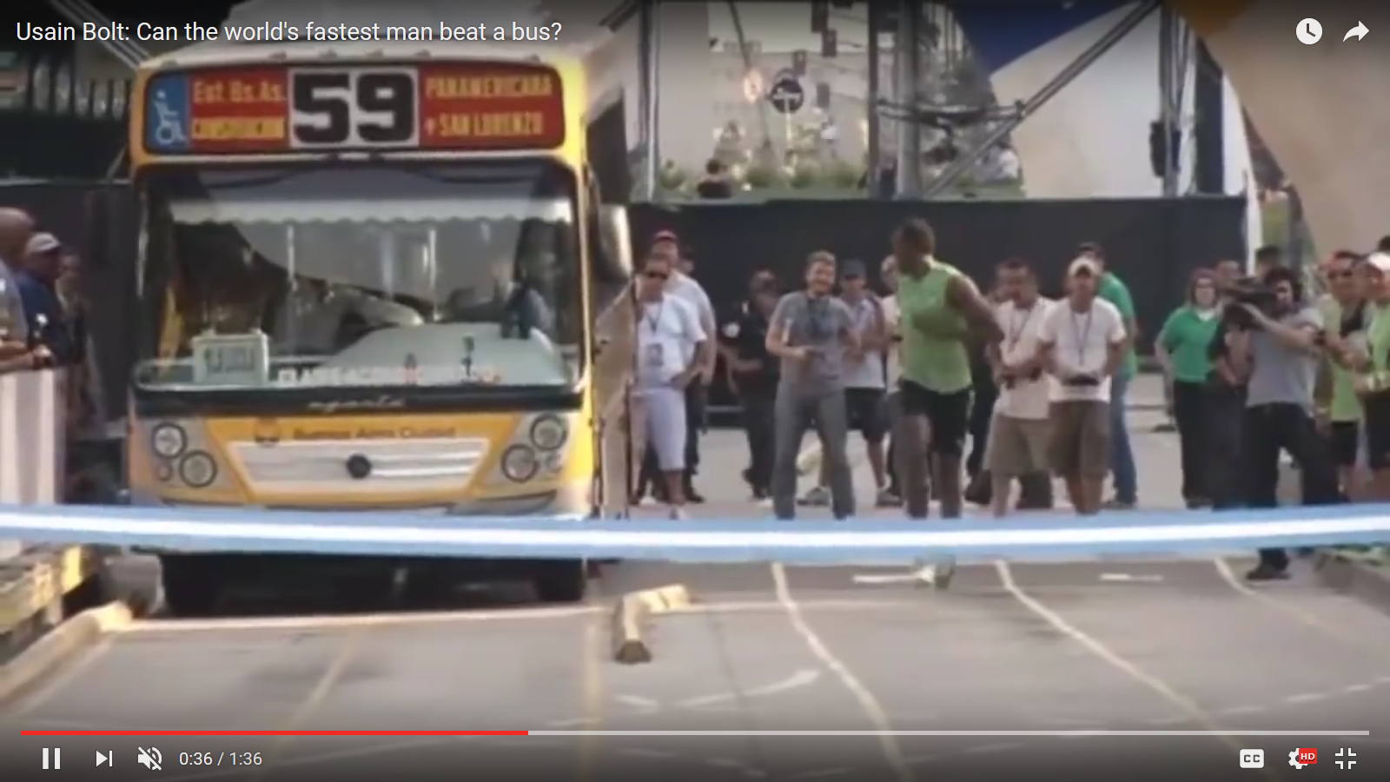
Usain Bolt vs Bus
https://www.youtube.com/watch?v=OHwU5Krd8l0

Slide 20
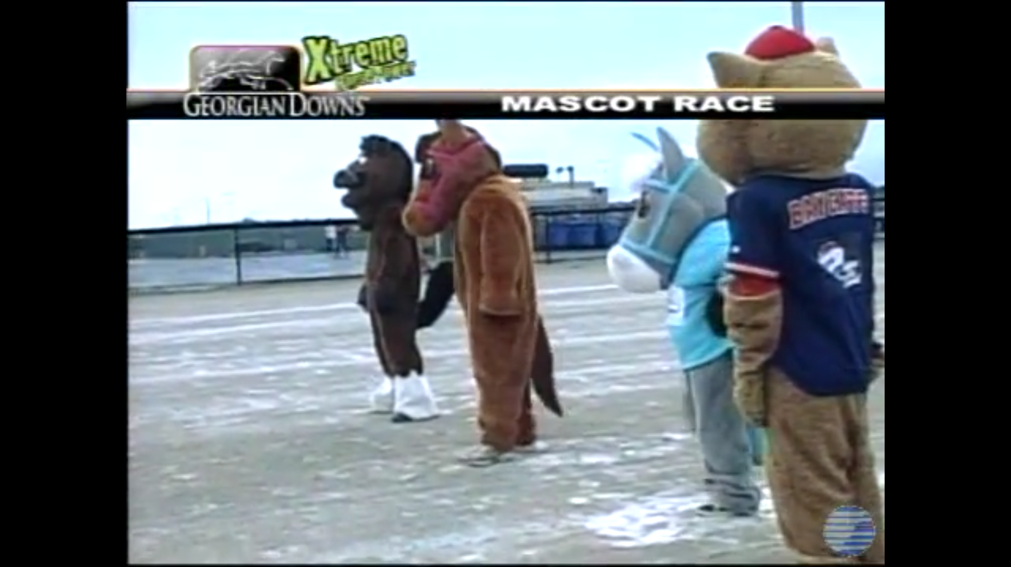
Mascot Race
https://www.youtube.com/watch?v=eCvrnn6Hi10

