Slide 1
Police Sketch Artist

Slide 2
Rules:
Students work in pairs
One student will be the artist
Their back is to the TV
The other student is facing the TV and can see the picture.
For added complexity, allow students to see the picture for a limited time before describing the character. Click to the next screen, so they have to use their memory.
The artist must draw the picture on the TV by asking questions.
For example: “Is he wearing a hat?” “Does she have blue eyes?”
There is also a 3 minute timer for drawing
The other student can only answer in “yes” or “no.”
Switch the roles.

Slide 3
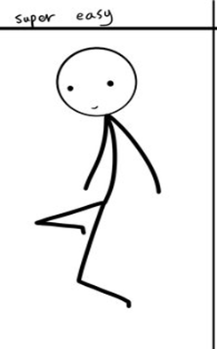
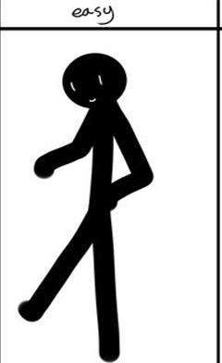
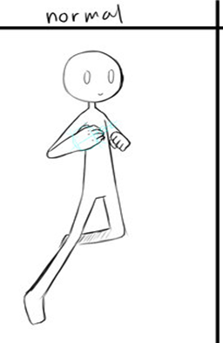
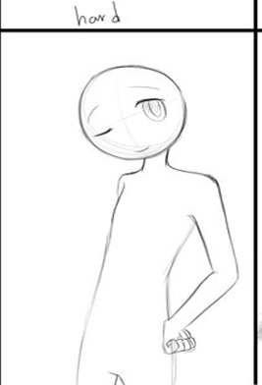
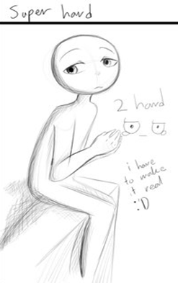
Choose a character:

Slide 4
Ready?

Slide 6
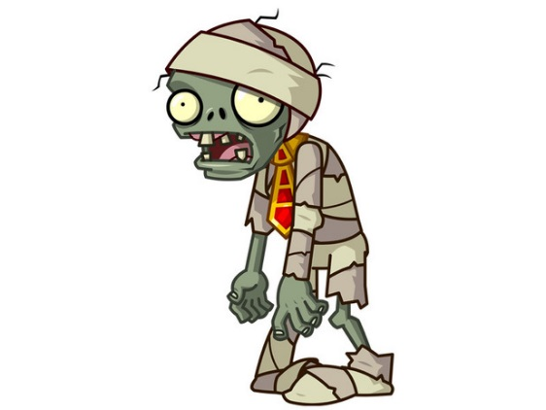
Draw!
Time’s Up!

Slide 7
Choose a character:

Slide 8
Ready?

Slide 10
Draw!
Time’s Up!

Slide 11
Choose a character:

Slide 12
Ready?

Slide 14
Draw!
Time’s Up!

Slide 15
Choose a character:

Slide 16
Ready?

Slide 18
Draw!
Time’s Up!

Slide 19
Choose a character:

Slide 20
Ready?

Slide 22
Draw!
Time’s Up!

Slide 23
Choose a character:

Slide 24
Ready?

Slide 26
Draw!
Time’s Up!

Slide 27
Choose a character:

Slide 28
Ready?

Slide 29
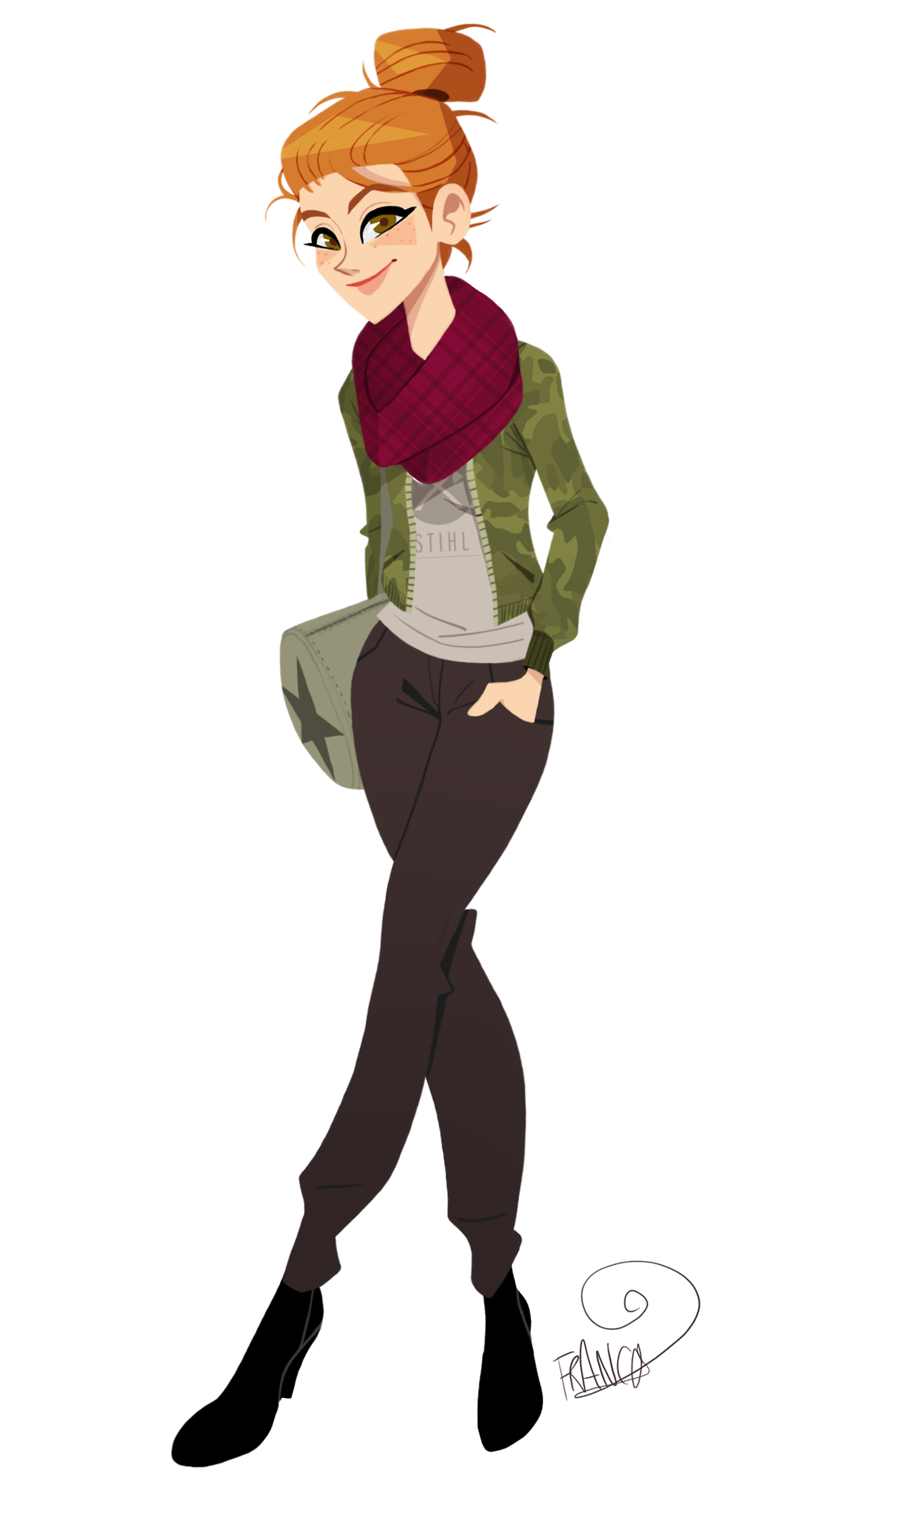

Slide 30
Draw!
Time’s Up!

Slide 31
Choose a character:

Slide 32
Ready?

Slide 33
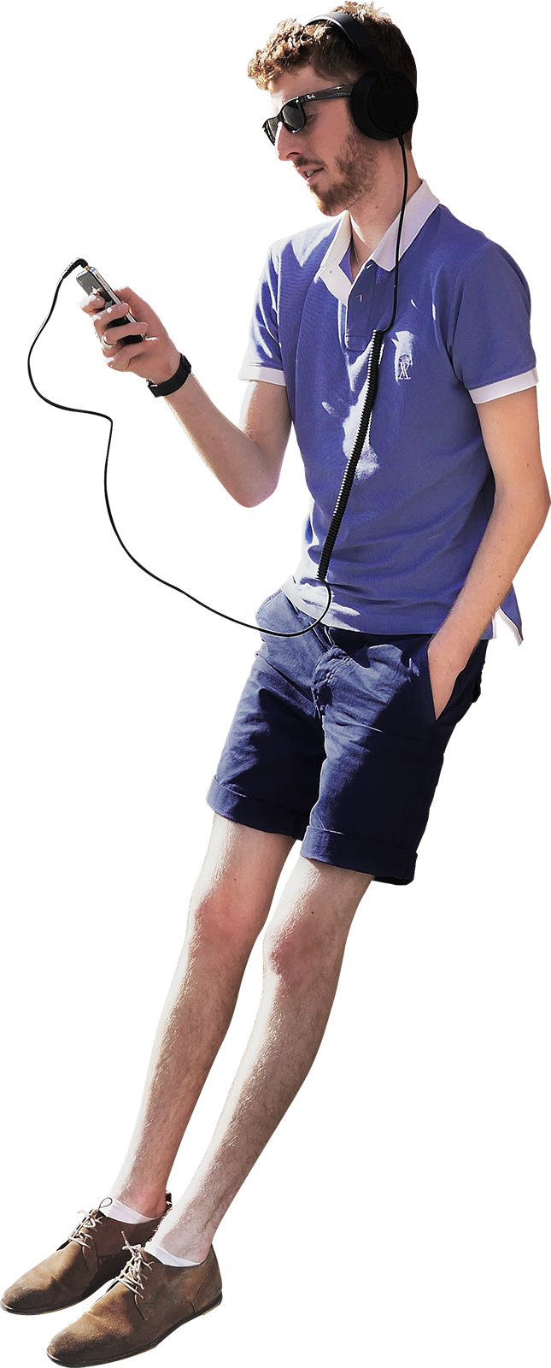

Slide 34
Draw!
Time’s Up!

Slide 35
Choose a character:

Slide 36
Ready?

Slide 38
Draw!
Time’s Up!

Slide 39
Choose a character:

Slide 40
Ready?

Slide 42
Draw!
Time’s Up!

Slide 43
Choose a character:

