Slide 1
What does she look like?
Anatomy

Slide 2
Show me some body parts:
Point to them on your body.

Slide 3
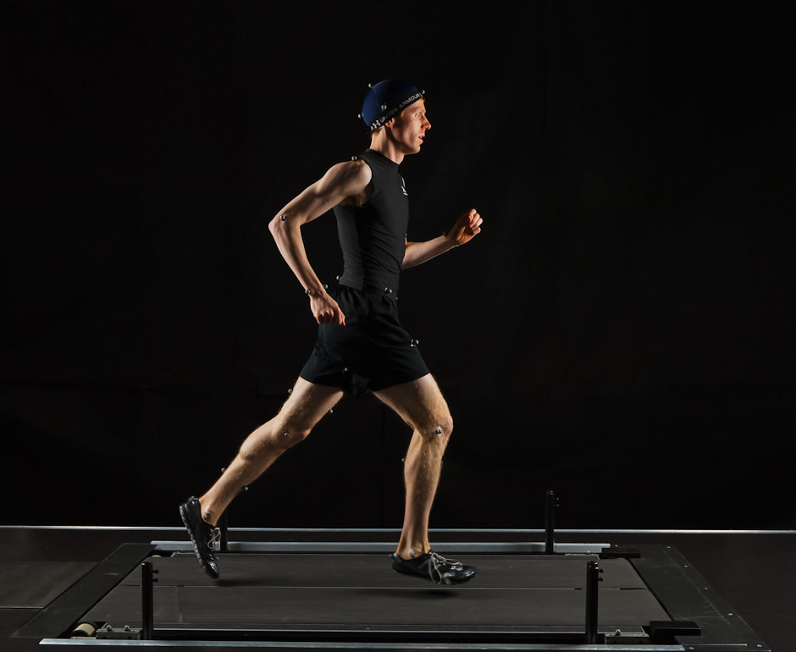
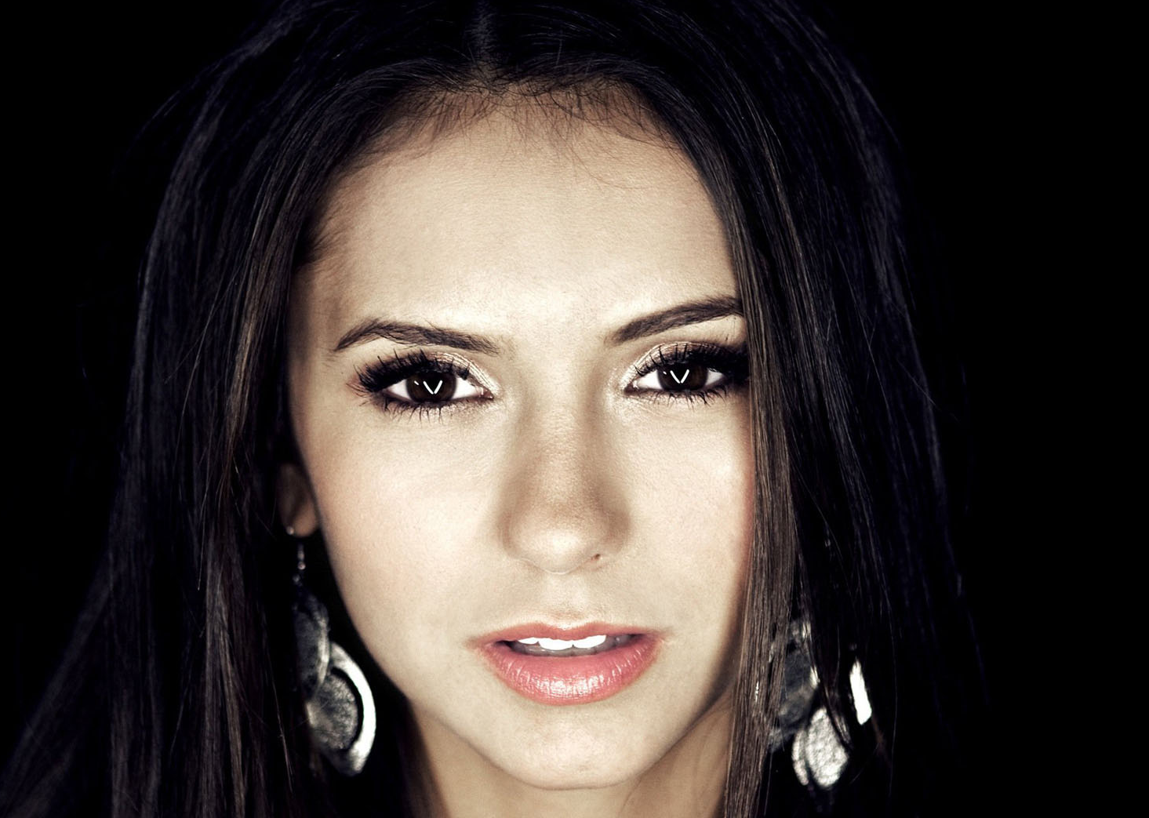

Slide 4
He / She has ________ _________.
She has blue eyes.
He has a big nose.
She has long hair.
He has short legs.

Slide 6
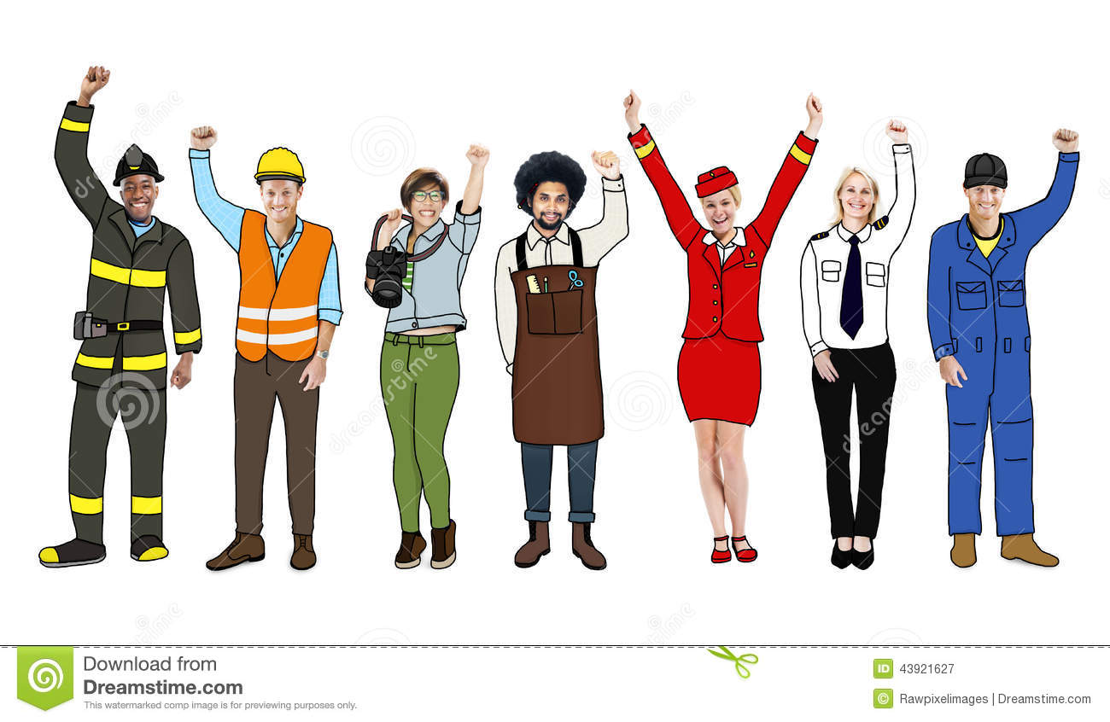

Slide 9
Who is it?
One person will describe someone from the classroom.
They will give one clue.
“He / She has ______________________”
If you know the answer, raise your hand
CORRECT: Chose the next person to do the describing.
INCORRECT: The describer will give another clue.

