Slide 1
Connect 4

Slide 2
January 1st
New Year’s Day

Slide 3
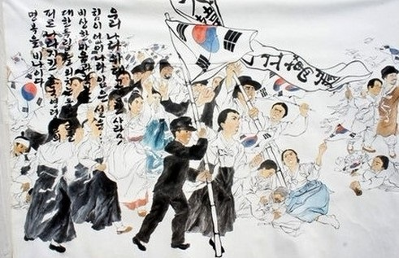
Mar. 1
Independence Movement Day

Slide 4
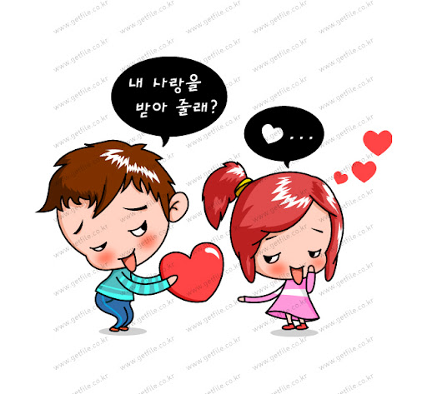
Mar. 14
White Day

Slide 5
04.01
April Fools Day

Slide 6
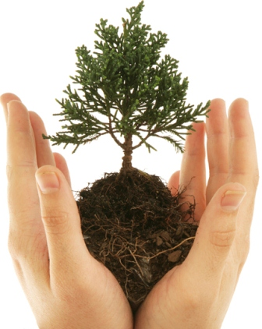
April 5
Arbor Day

Slide 7
May 5
Children’s Day

Slide 8
05.08
Parent’s Day

Slide 9
May 15
Teacher’s Day

Slide 10
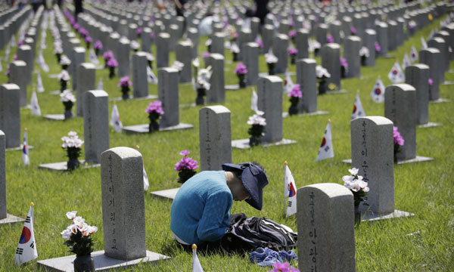
June 6
Memorial Day

Slide 11
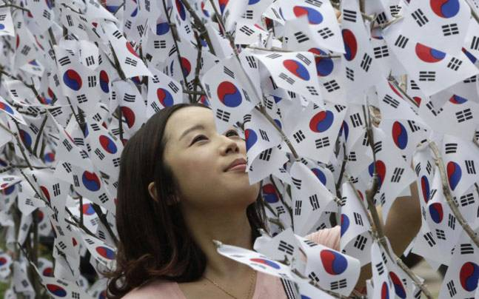
Aug. 15
Liberation Day

Slide 12
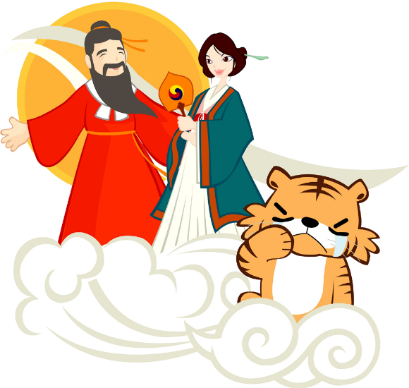
October 3
National Foundation Day

Slide 13
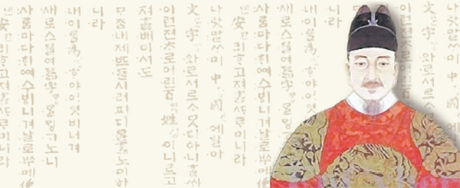
Oct. 9
Hangeul Day

Slide 14
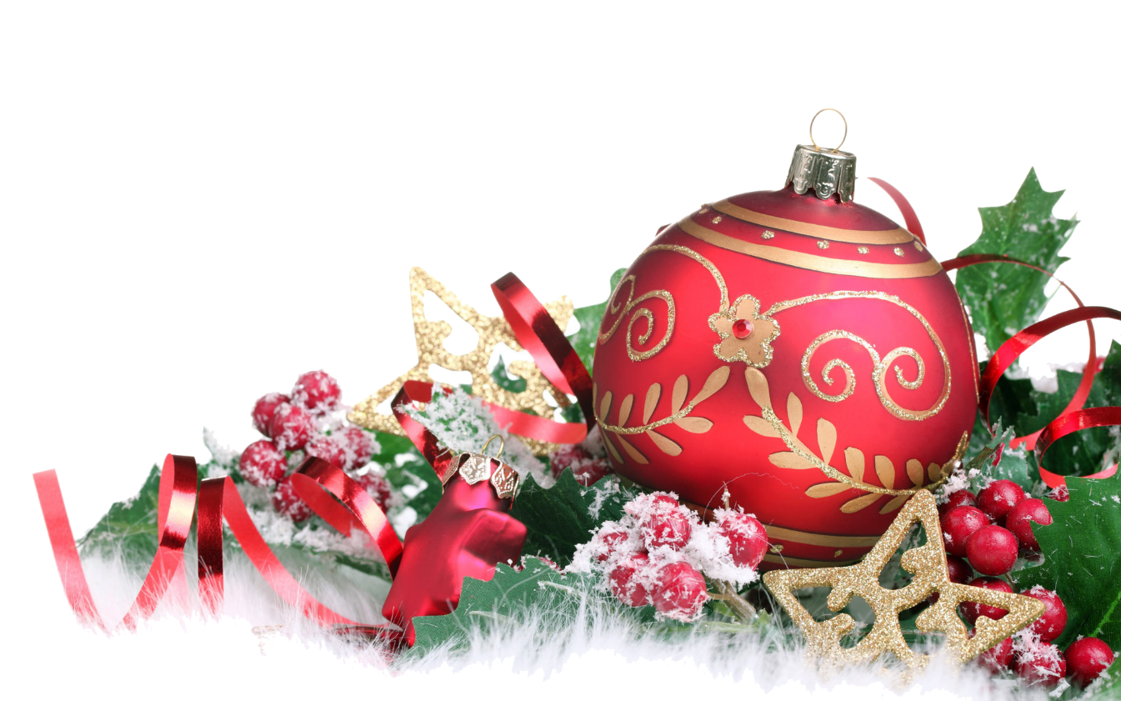
12.25
Christmas

Slide 15
December 24th
Christmas Eve

Slide 16
12.31
New Year’s Eve

Slide 17
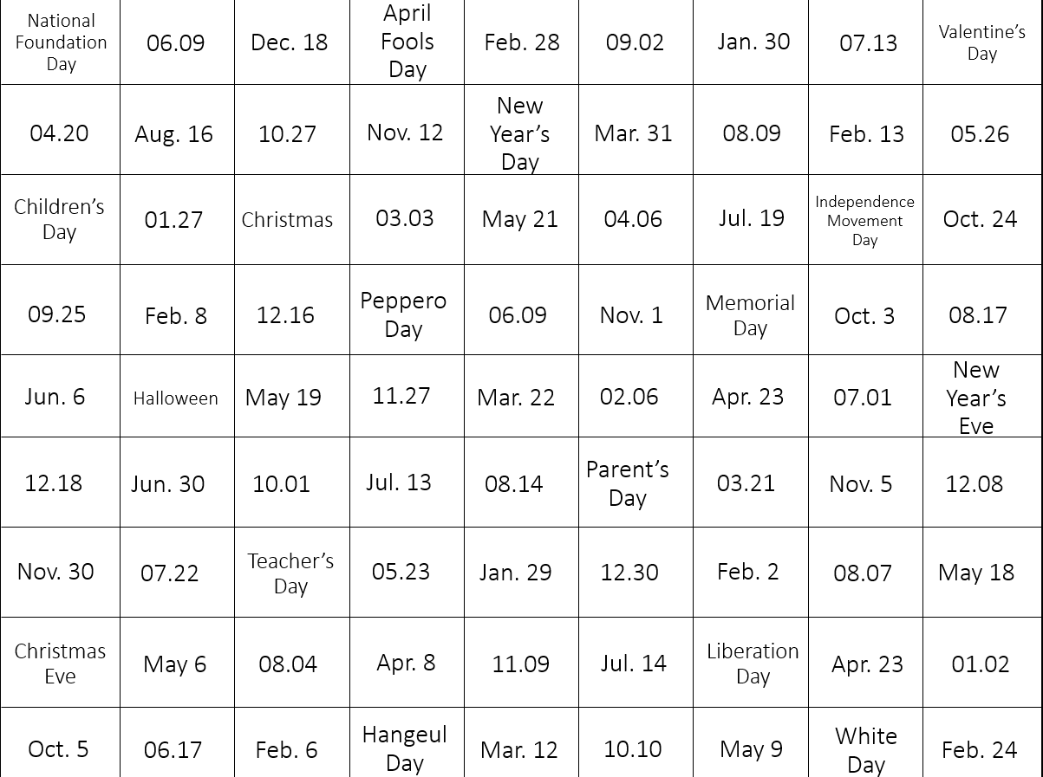
Connect 4
Get 4 spaces in a straight line (up, down, left, right, diagonal)
“What’s the date today?”
“It’s ________.”
Must use the date “It’s Christmas Eve”
Can’t go over another line
*Most lines win*

Slide 18
National Foundation Day
06.09
Dec. 18
April Fools Day
Feb. 28
09.02
Jan. 30
07.13
Valentine’s Day
04.20
Aug. 16
10.27
Nov. 12
New Year’s Day
Mar. 31
08.09
Feb. 13
05.26
Children’s Day
01.27
Christmas
03.03
May 21
04.06
Jul. 19
Jan. 30
Oct. 24
09.25
Feb. 8
12.16
Peppero Day
07.09
Nov. 1
Memorial Day
Oct. 3
08.17
Jun. 6
Halloween
May 19
11.27
Mar. 22
02.06
Apr. 23
07.01
New Year’s Eve
12.18
Jun. 30
10.01
Jul. 13
08.14
Parent’s Day
03.21
Nov. 5
12.08
Nov. 30
07.22
Teacher’s Day
05.23
Jan. 29
12.30
Feb. 2
08.07
May 18
Christmas Eve
May 6
08.04
Apr. 8
11.09
Jul. 14
Liberation Day
Apr. 23
01.02
Oct. 5
06.17
Feb. 6
Hangeul Day
Mar. 12
10.10
May 9
White Day
Feb. 24

Slide 19
Instructions:
Laminate a copy of this page for every pair of students.
Give each pair of students two different colors of white board marker.
Also give each pair of students a dry erase eraser to clean the board for the next group.
Alternatively, you may print out a copy for each pair that they can use their own pencil or pen.

Slide 20
Rules
Rock, Paper, Scissors for start.
Students take turns saying dates and marking them on the paper.
Dialogue:
“What’s the date today?”
“It’s __________________.”
The winner is the student to make the most lines (4 squares long).
NOTE: They must use the date even on the squares with holidays listed on them.

