Slide 1
Happy Birthday

Slide 2
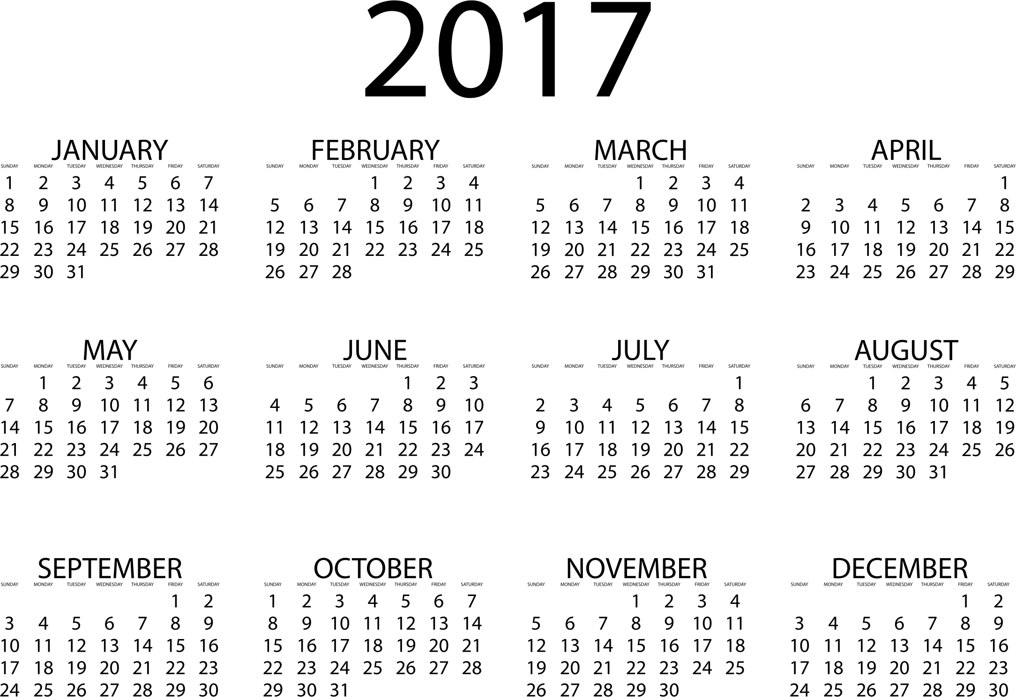
Months:

Slide 3
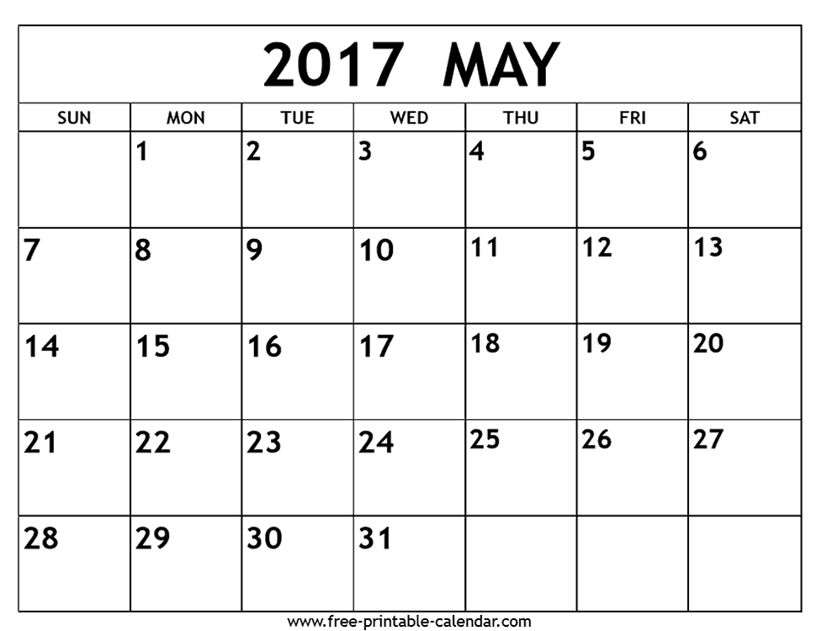
Days:

Slide 4
Take a card
Write your name and birthday on the card.
Keep it secret.
Put it in the hat.
Name: __________________
Birthday: _________________

Slide 6
Guess the Birthday
One person will come to the front.
They choose a card and say, “My birthday is ___________”
But don’t say the name!
The other students must guess whose birthday it is.
Whoever wrote it must come to the front next.

