Slide 1
New Year’s Day
Australia Day
Valentine’s Day
World Radio Day
January 1
January 26
February 14
February 13

Slide 2
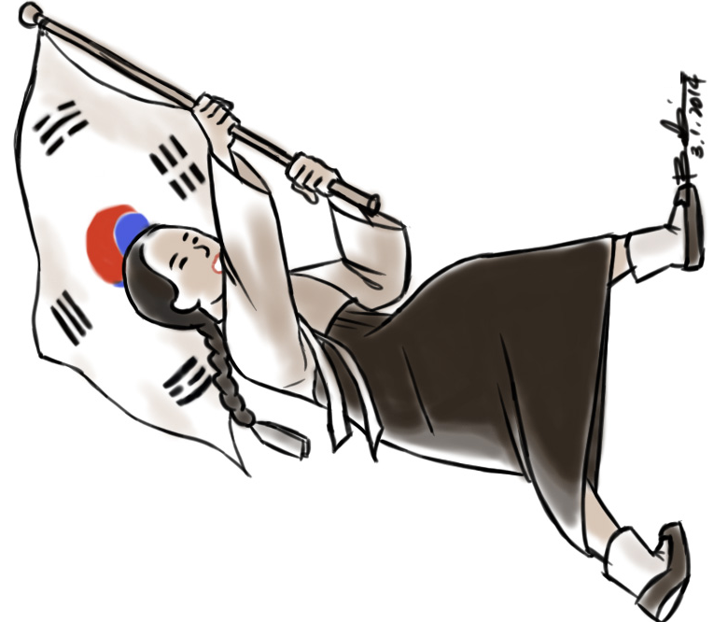
Independence Movement Day
Saint Patrick’s Day
Arbor Day
English Language Day
March 1
March 17
April 5
April 23

Slide 3
Teacher’s Day
Children’s Day
Memorial Day
International Picnic Day
May 15
May 5
June 6
June 18

Slide 4
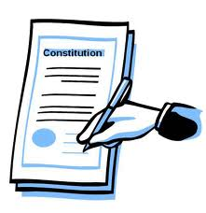
Constitution Day
Canada Day
Liberation Day
Youth Day
July 17
July 1
August 15
August 12

Slide 5
Talk Like a Pirate Day
Day
of Peace
Halloween
Hangeul Day
September 19
September 20
October 31
October 9

Slide 6
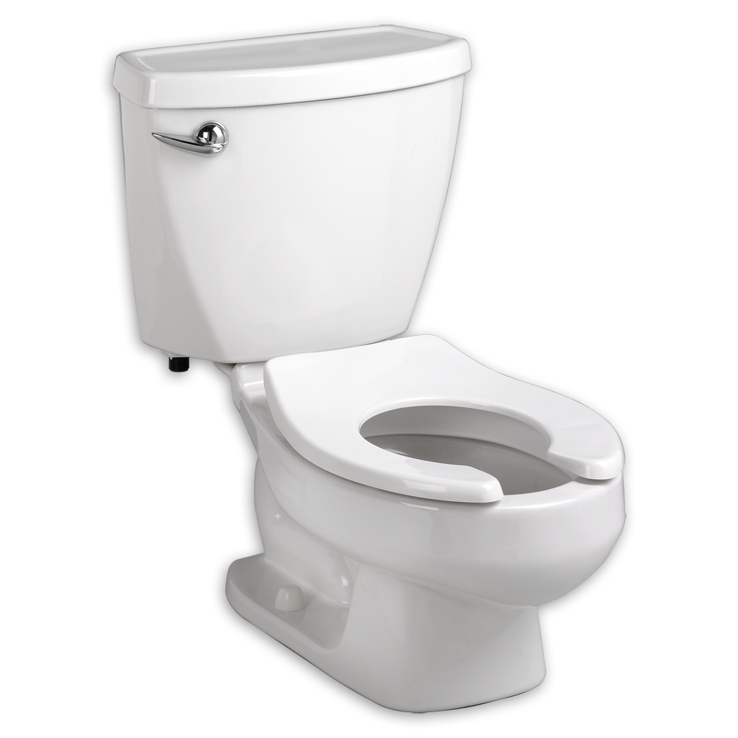
Peppero Day
World Toilet Day
Christmas
New Year’s Eve
November 11
November 19
December 25
December 31

