Slide 1
When is the Holiday?

Slide 2
How to Play
Every student receives a card and a calendar.
Students must ask each other, “When is __________?”
Write the name of the holiday on the calendar.
Take up the answers at the end.

Slide 3
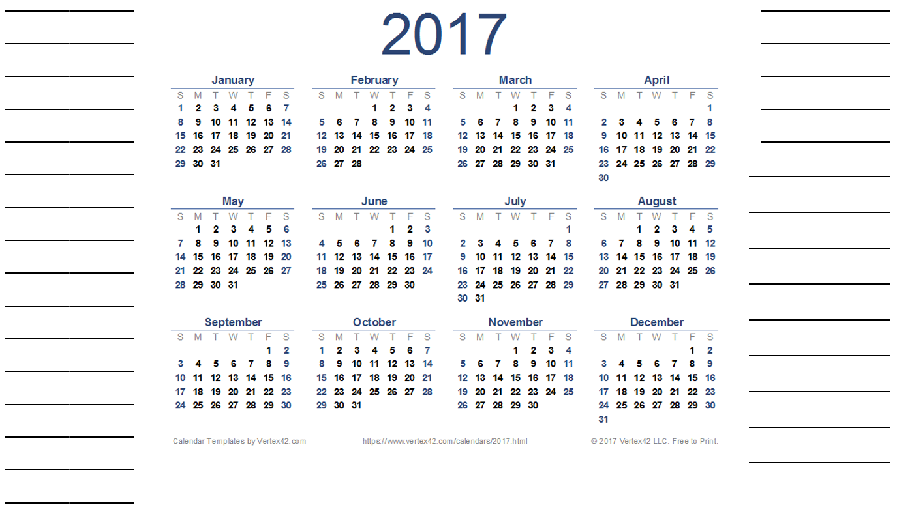

Slide 4
New Year’s Day
Independence Movement Day
Australia Day
St. Patrick’s Day
World Radio Day
Arbor Day
Valentine’s Day
English Language Day
Children’s Day
Canada Day
Teacher’s Day
Constitution Day
Youth Day
Memorial Day
Liberation Day
Picnic Day
Talk Like Pirate Day
Peppero Day
World Toilet Day
Day of Peace
Christmas
Hangeul Day
Halloween
New Year’s Eve

