Slide 1
Pizza Artist

Slide 2
What’s this?
Cheese

Slide 3
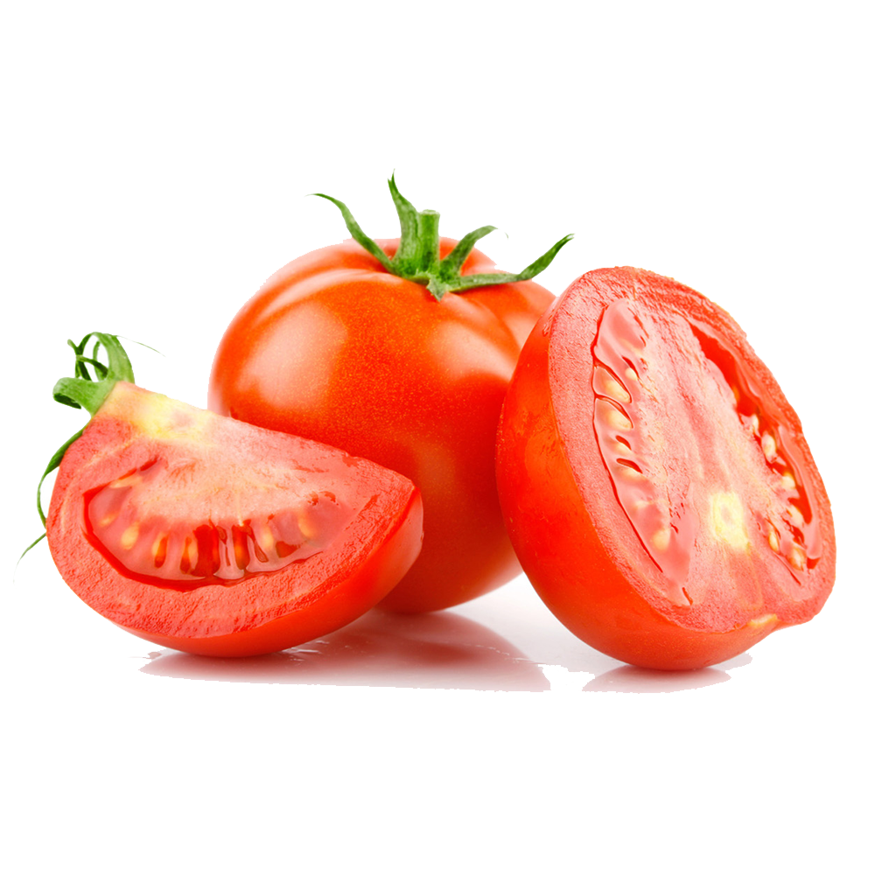
What’s this?
Cheese
Tomato

Slide 4
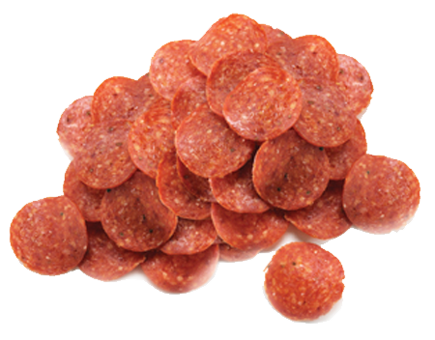
What’s this?
Cheese
Tomato
Pepperoni

Slide 5
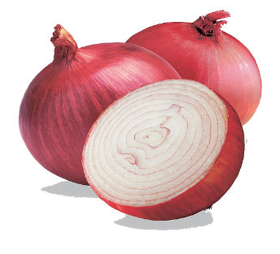
What’s this?
Cheese
Tomato
Pepperoni
Onion

Slide 6
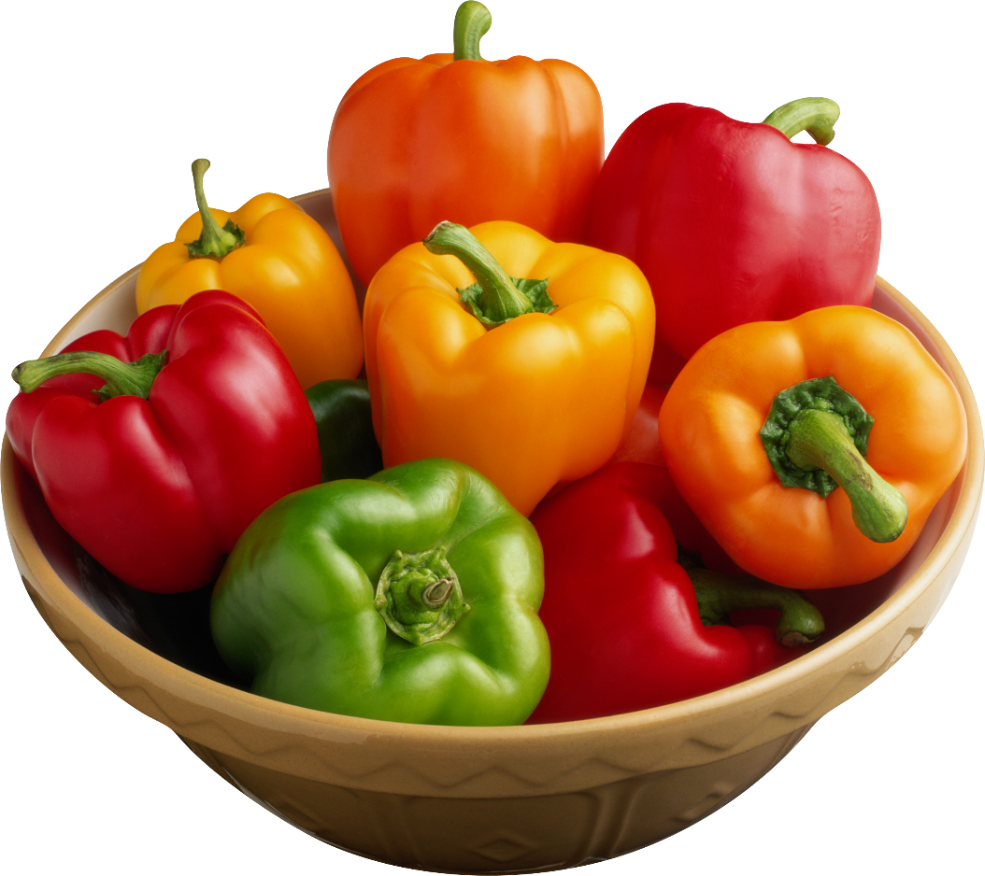
What’s this?
Cheese
Tomato
Pepperoni
Onion
Pepper

Slide 7
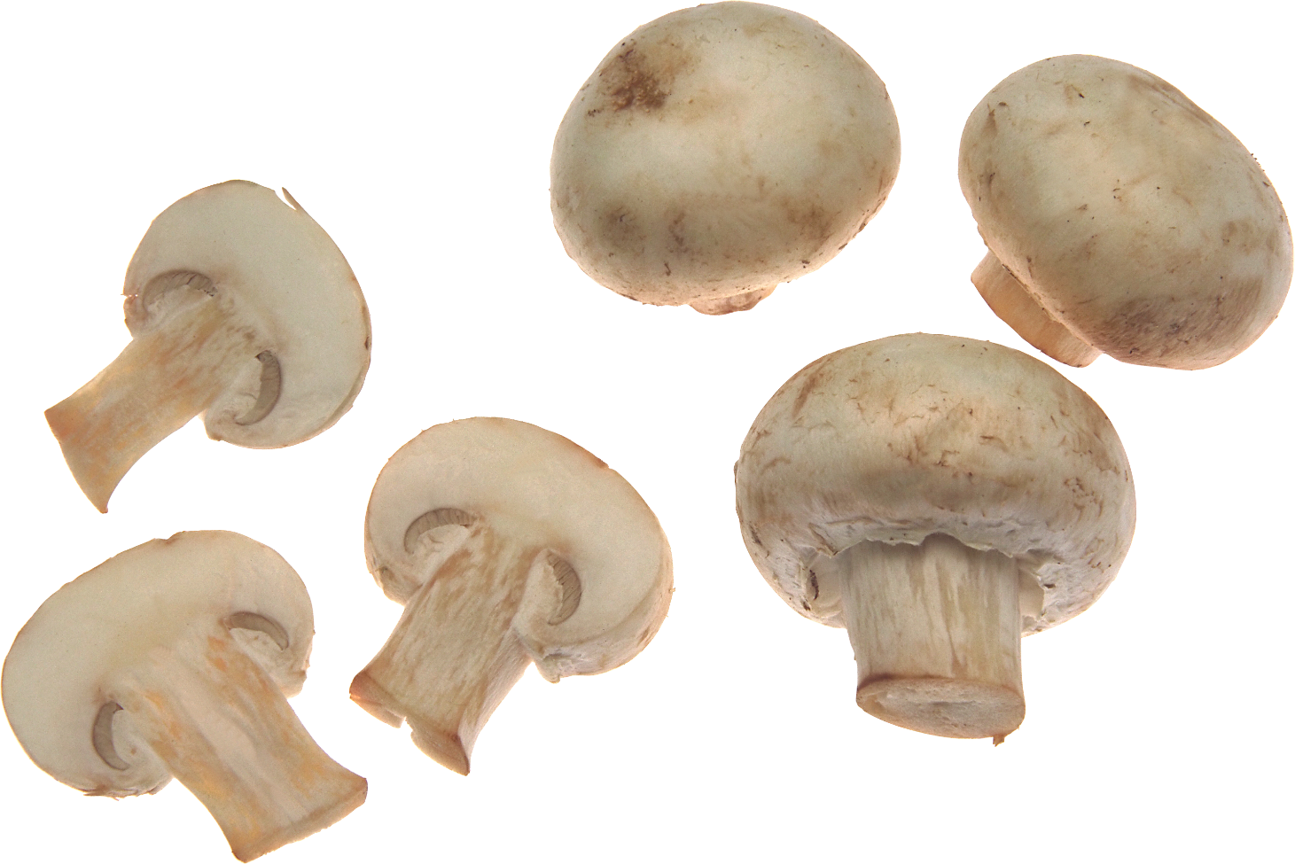
What’s this?
Cheese
Tomato
Pepperoni
Onion
Pepper
Mushroom

Slide 8
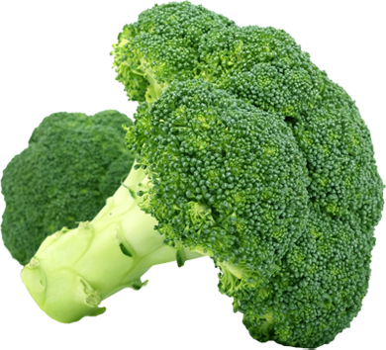
What’s this?
Broccoli

Slide 9
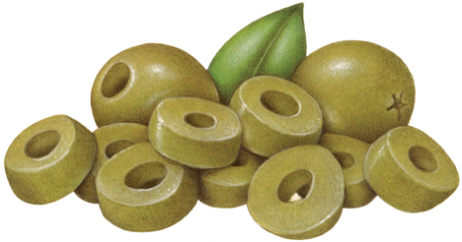
What’s this?
Broccoli
Olives

Slide 10
What’s this?
Broccoli
Olives
Bacon

Slide 11
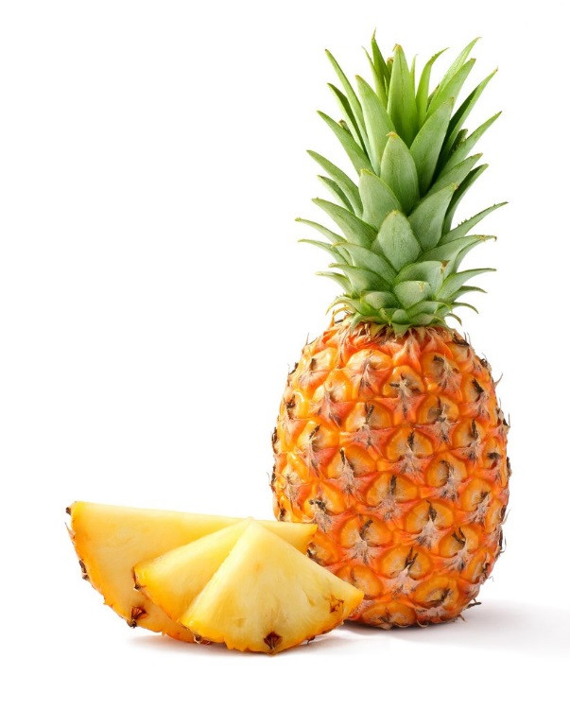
What’s this?
Broccoli
Olives
Bacon
Pineapple

Slide 12
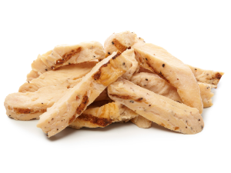
What’s this?
Broccoli
Olives
Bacon
Pineapple
Chicken

Slide 13
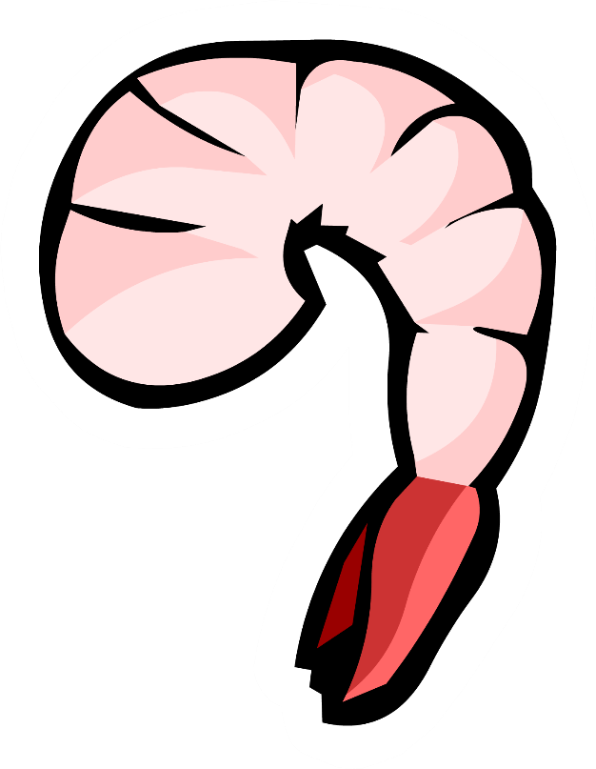
What’s this?
Broccoli
Olives
Bacon
Pineapple
Chicken
Shrimp

Slide 14
How to Play:
Ask your partner, “Do you like ___________?”
“Yes, I do” = draw it
“No, I don’t” = don’t draw it
Switch the roles.
** make a funny pizza **

Slide 15
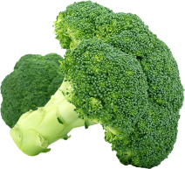
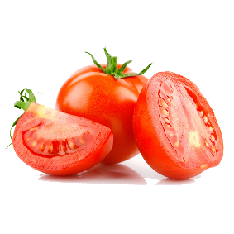
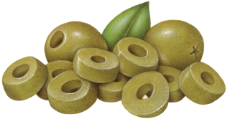
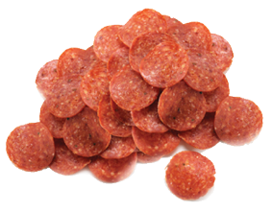
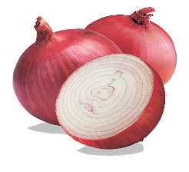
Cheese
Broccoli
Tomato
Olives
Pepperoni
Bacon
Onion
Pineapple
Pepper
Chicken
Mushroom
Shrimp

