Slide 1
Sorry. Why?
The GIF game

Slide 2
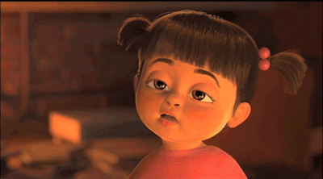
Sorry, I can’t. I’m ________.
tired.

Slide 3
Complete the Sentences:
Practice:
“Let’s _________”
“Ok. Sounds good.”
“Sorry, I can’t. I’m ________”
Dive the class in half.
One side will make a question. The other will make an answer.

Slide 4
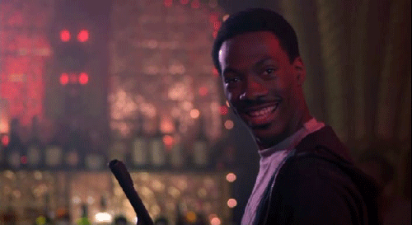
Ok. Sounds good.
Lets ___________.

Slide 5
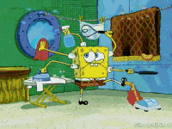
Sorry, I can’t. I’m __________
Let’s _________
busy

Slide 6
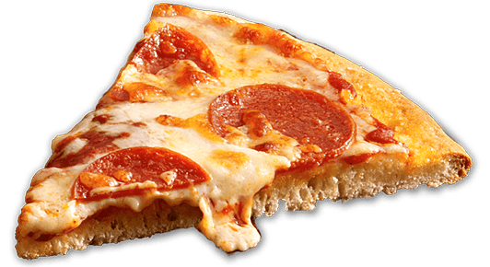
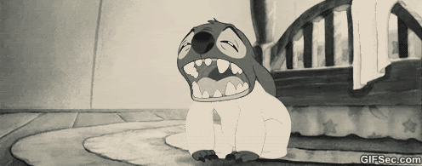
Lets ___________.
Sorry, I can’t. I’m _________
tired.

Slide 7
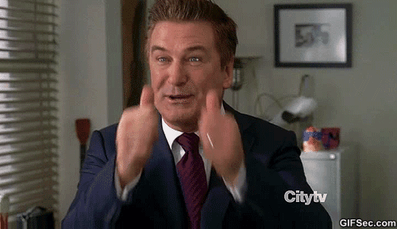
Ok. Sounds Good.
Let’s ___________

Slide 8
Lets ___________.
Sorry, I can’t. I’m tired.

Slide 9
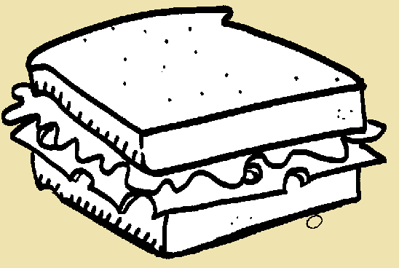
Sorry, I can’t. I’m busy.
Let’s ___________

Slide 10
Lets ___________.
Ok. Sounds good.

Slide 11
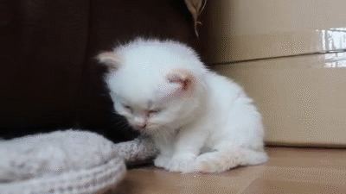
Sorry, I can’t.
I’m tired.
Let’s __________

Slide 12
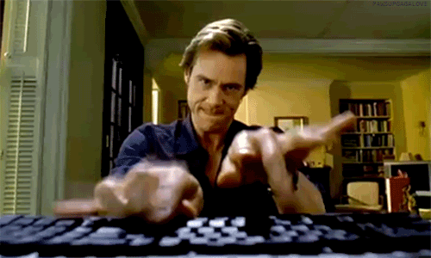
Lets ___________.
Sorry, I can’t. I’m busy.

Slide 13
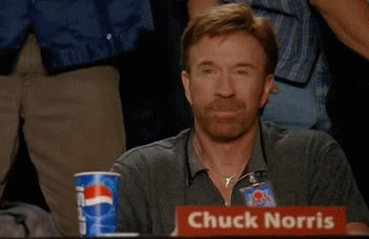
Ok. Sounds Good.
Let’s ___________

Slide 14
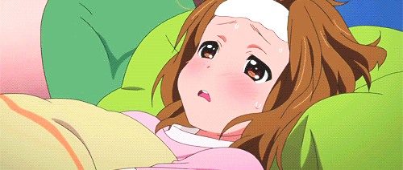
Lets ___________.
Sorry, I can’t. I’m sick.

Slide 15
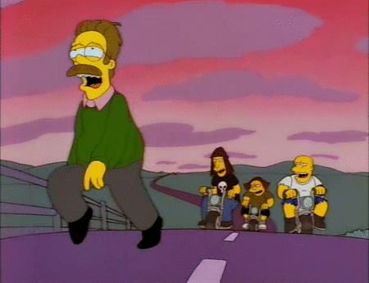
Sorry, I can’t.
I’m tired.
Let’s ___________

Slide 16
Lets ___________.
Ok. Sounds good.

Slide 17
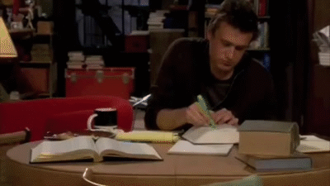
Sorry, I can’t. I’m studying.
Let’s ___________

Slide 18
Lets ___________.
Sorry, I can’t. I’m exercising.

Slide 19
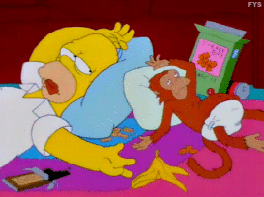
Sorry, I can’t. I’m full.
Let’s ___________

Slide 20
Lets ___________.
Ok. Sounds good.

Slide 21
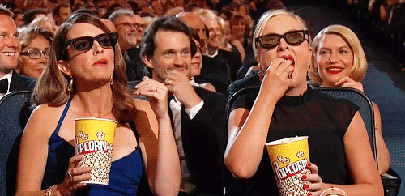
Sorry, I can’t. I’m watching a movie.
Let’s __________.

Slide 22
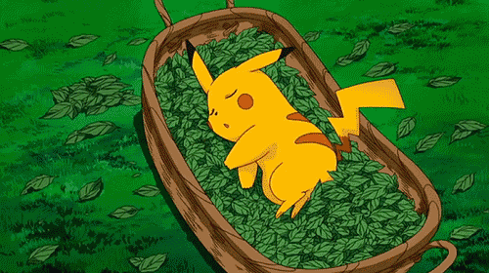
Lets ___________.
Sorry, I can’t. I’m sleeping.

Slide 23
“Sorry, I Can’t” Game.
One student will come to the front.
They will make a suggestion.
“Let’s ______________.”
The other students can make an excuse.
“Sorry, I can’t. I’m ___________.”

