Slide 1
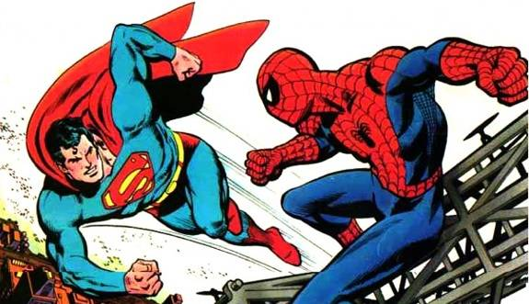
Hero vs Hero
https://www.youtube.com/watch?v=ygrxQgZfQfw

Slide 2

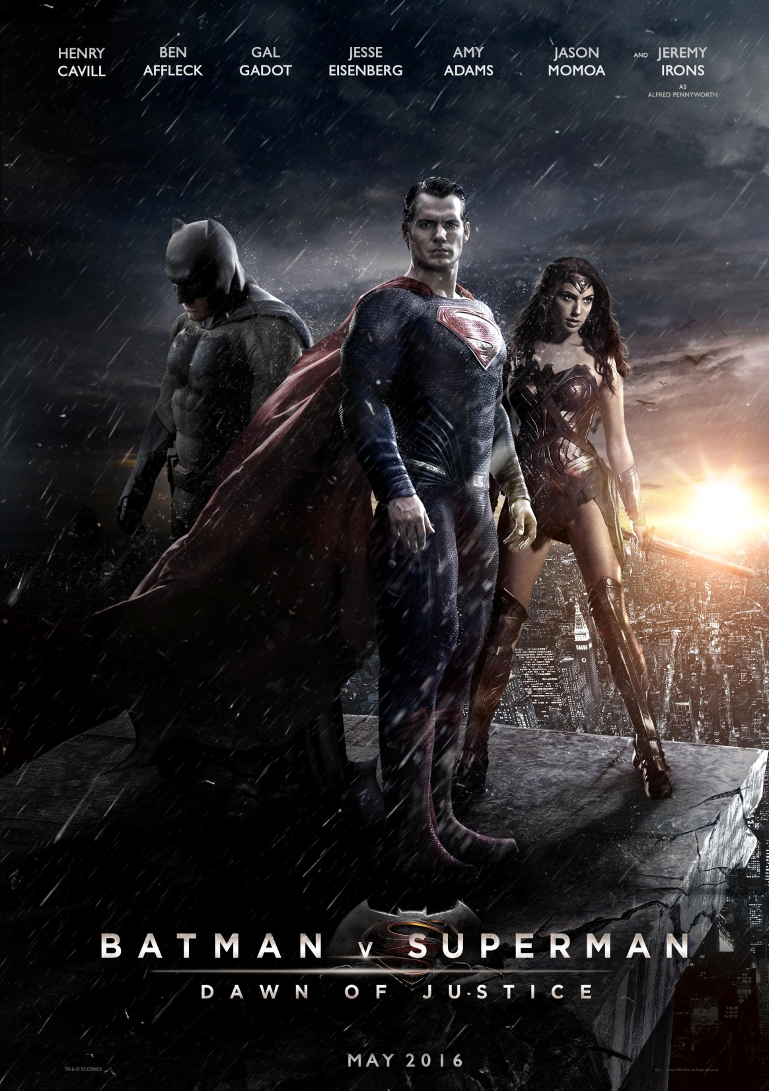

Slide 3
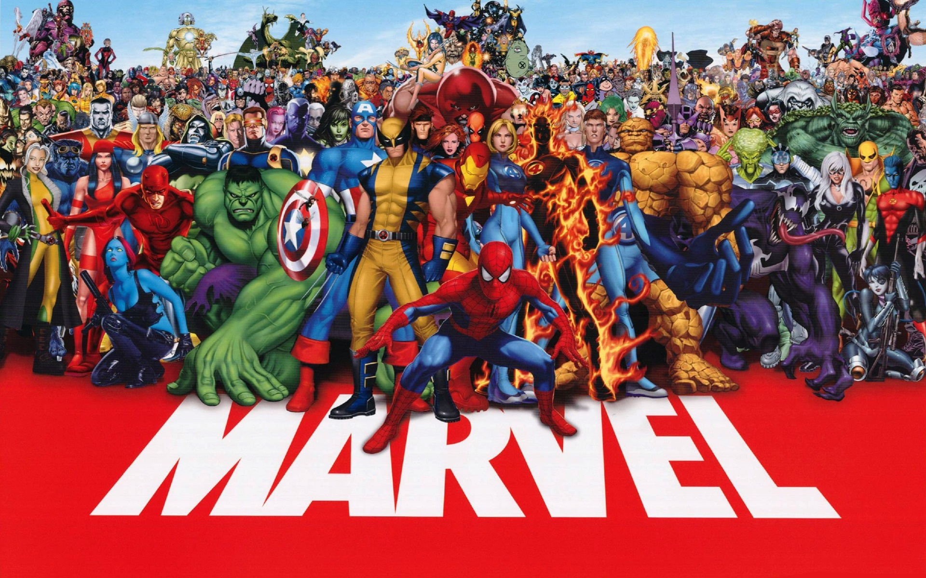

Slide 4
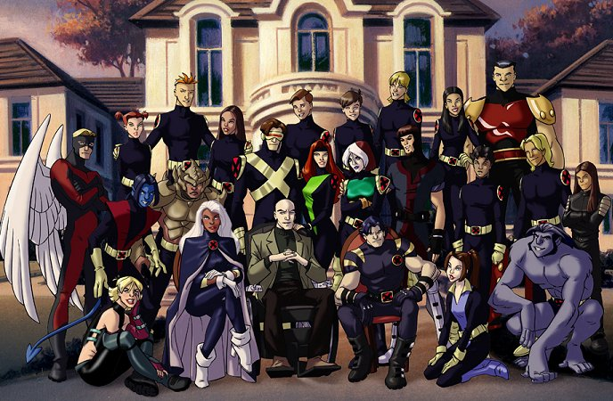

Slide 5
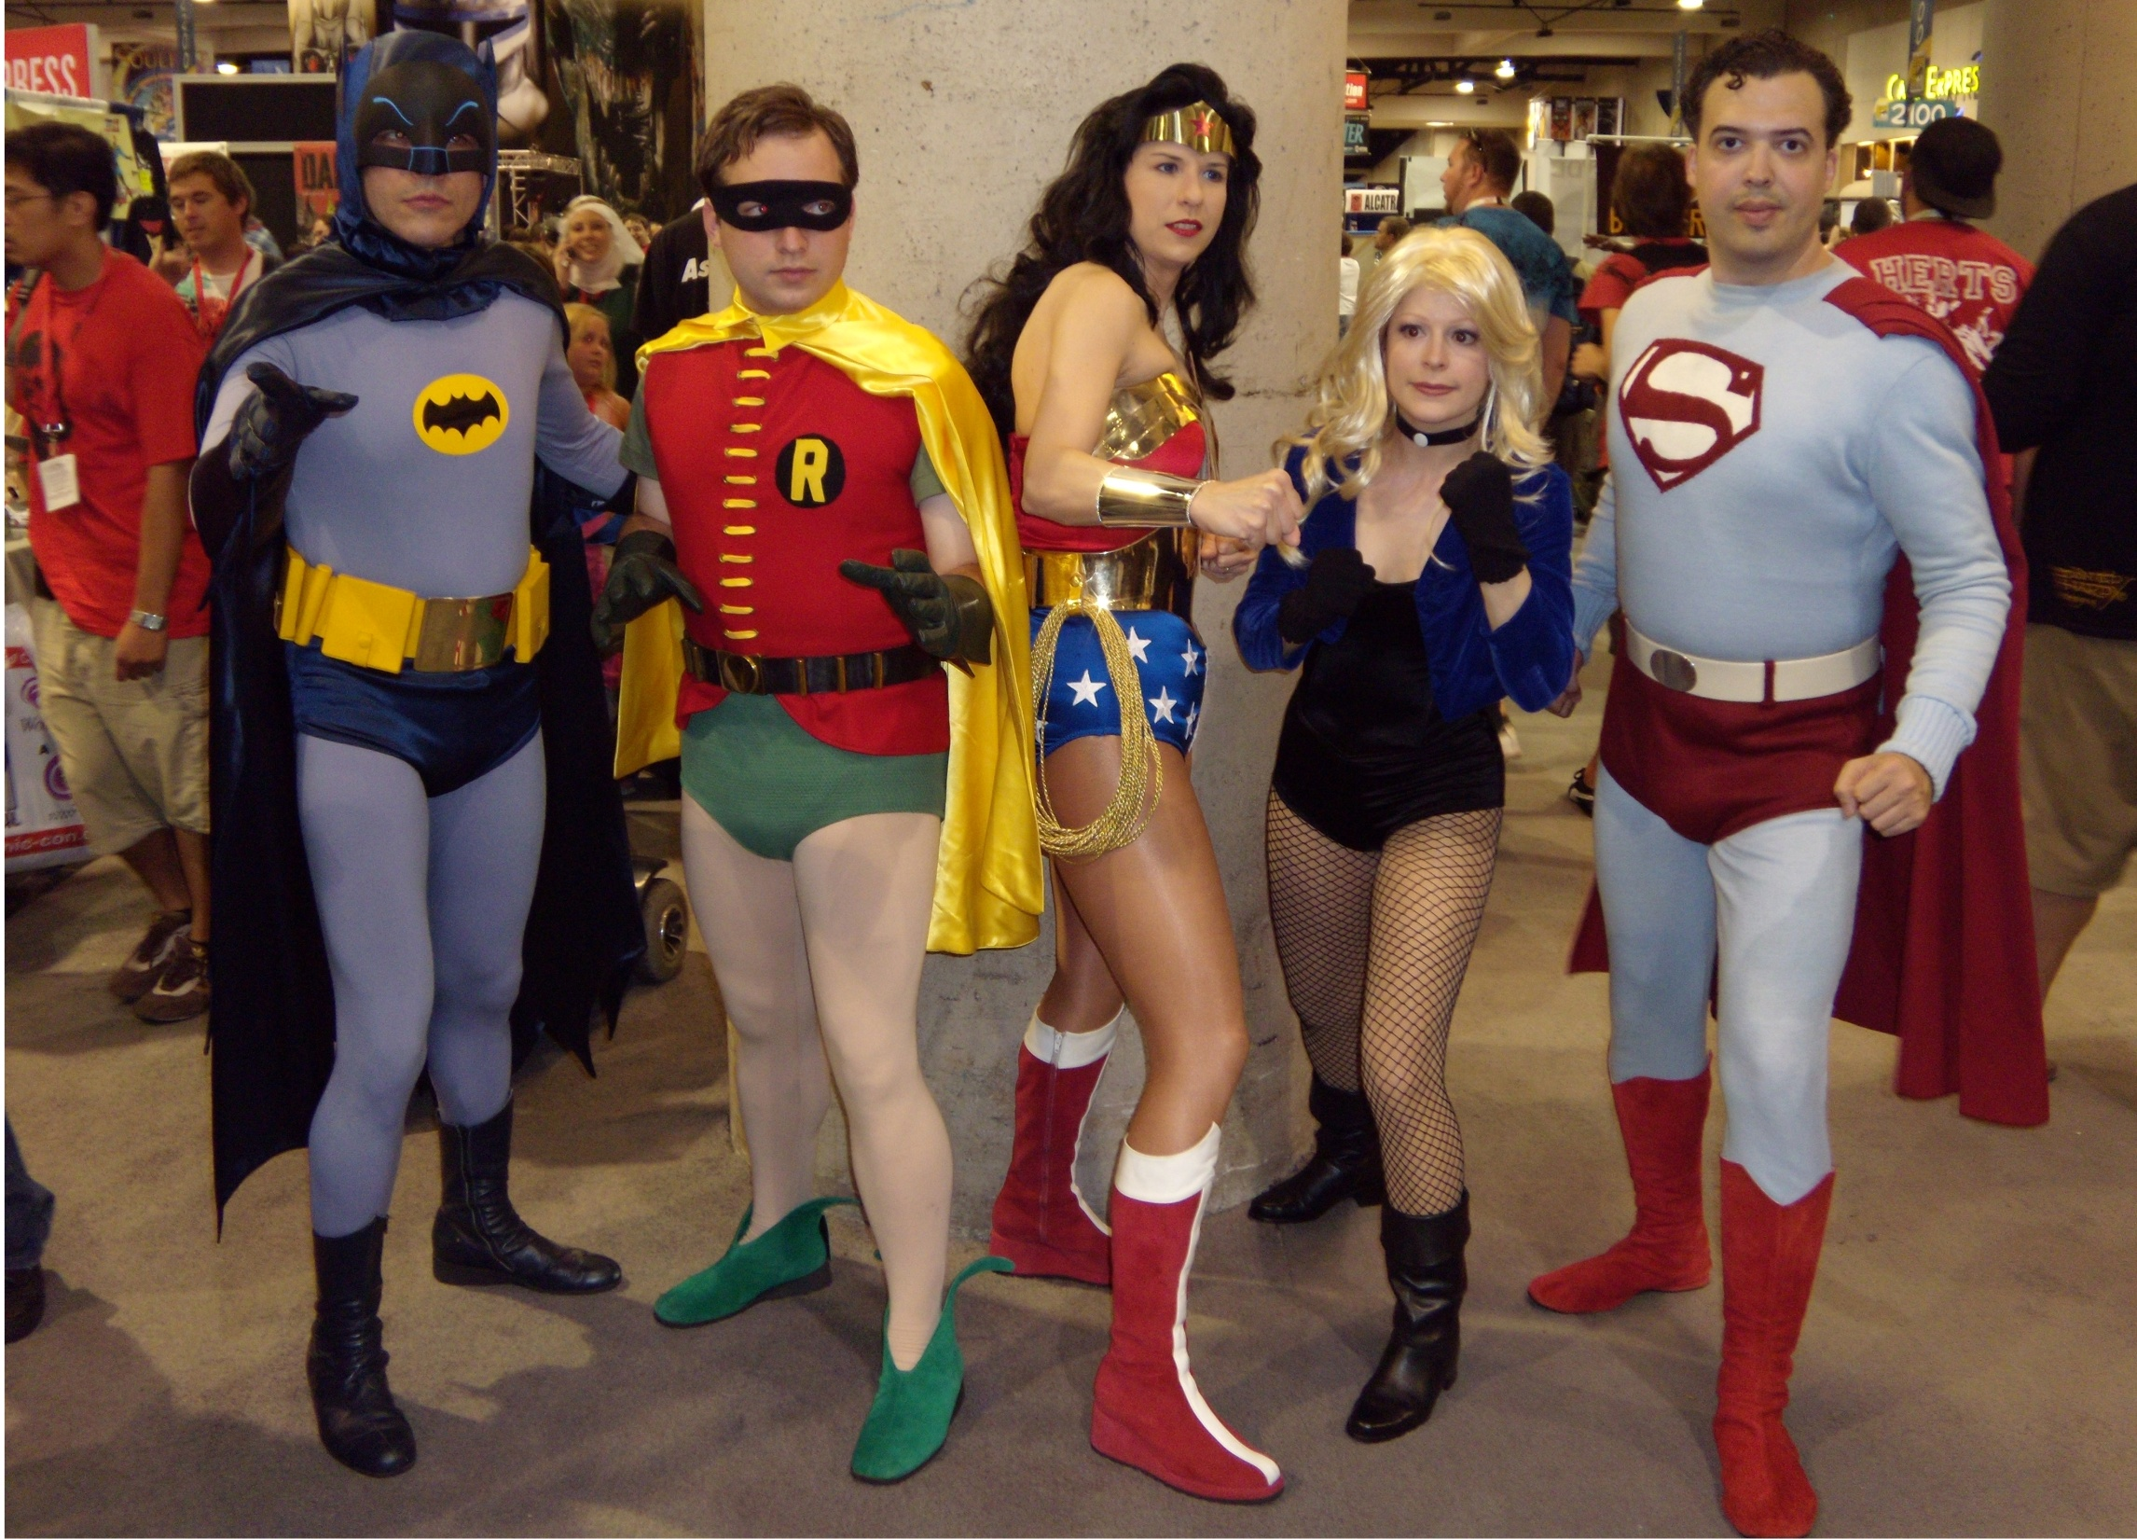

Slide 6
_______ is ______er than ______
Use Comparative Sentences

Slide 7
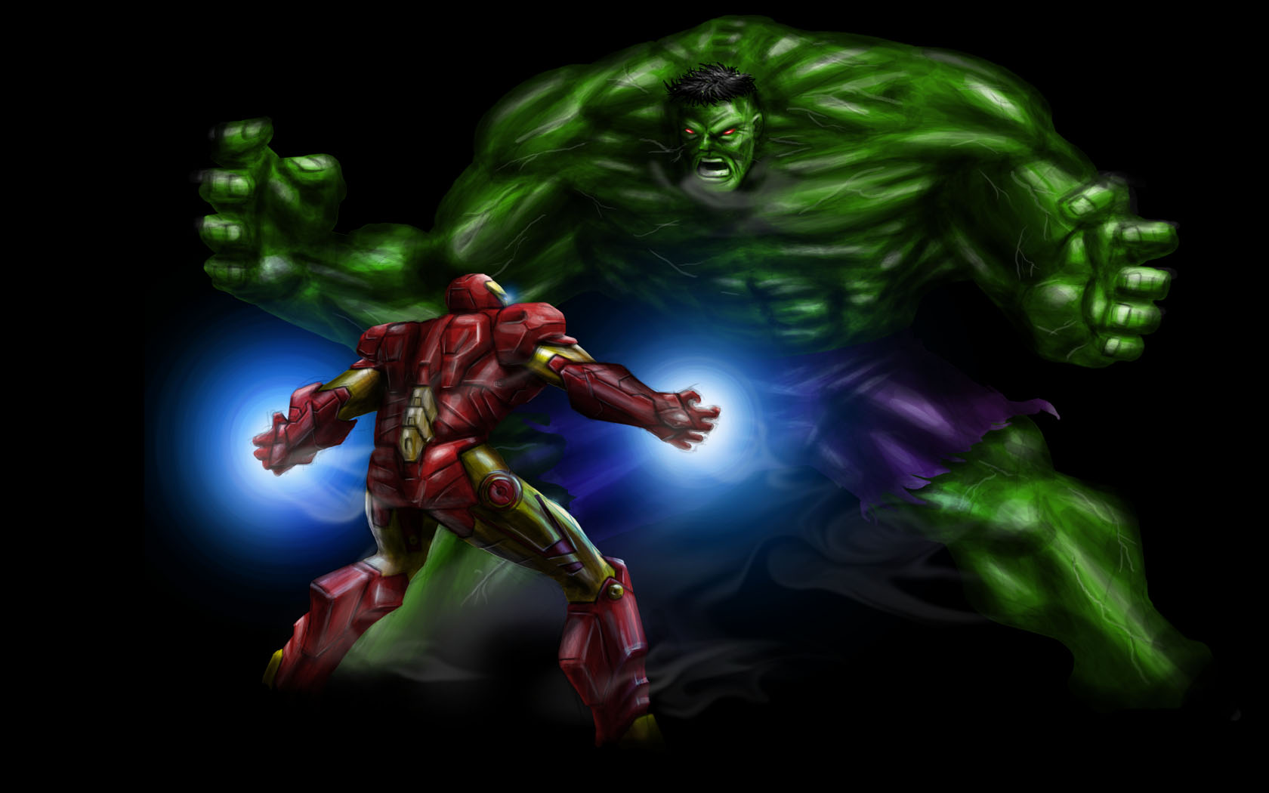
Ironman vs Hulk

Slide 8
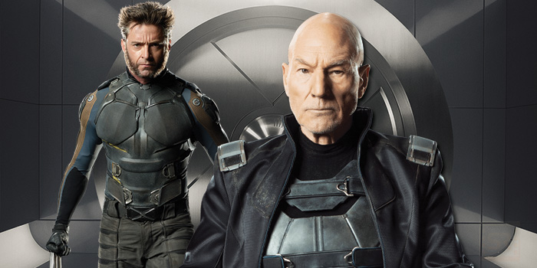
Wolverine vs Professor X

Slide 9
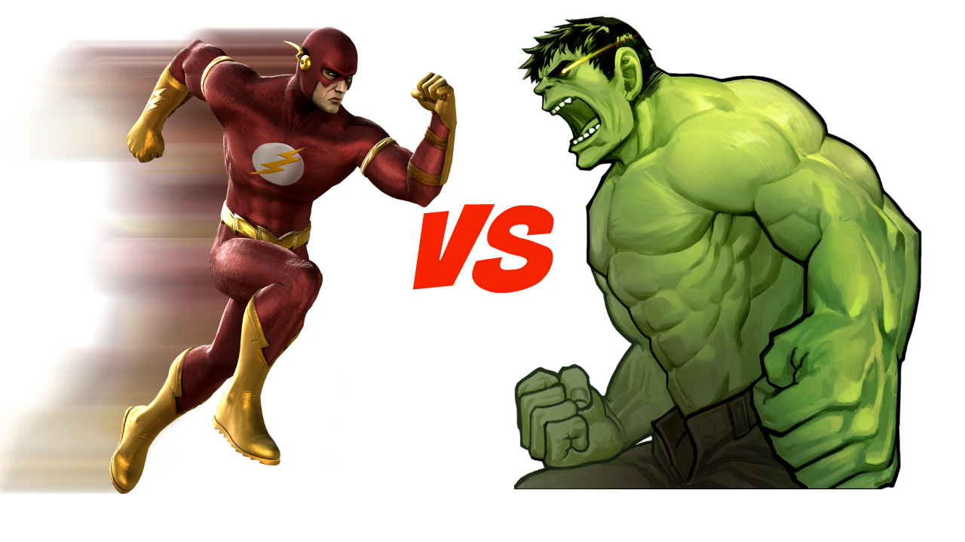
Hulk vs Flash

Slide 10
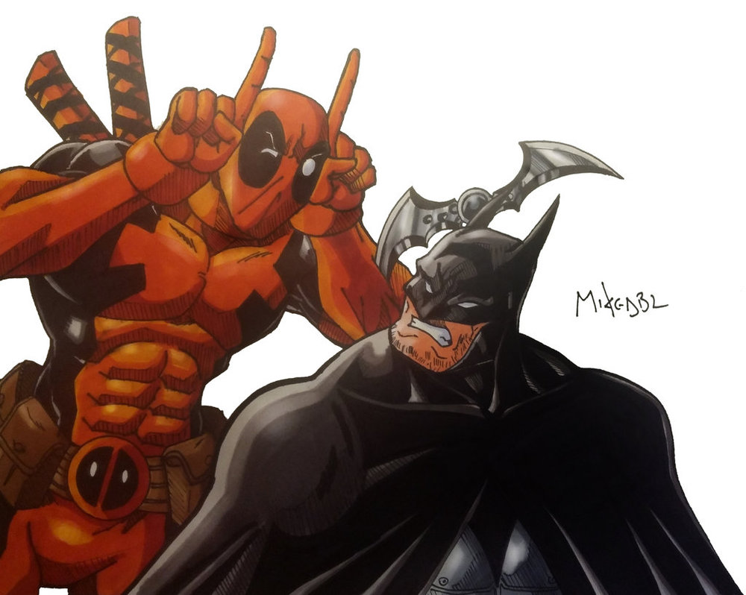
Batman vs Deadpool

Slide 11
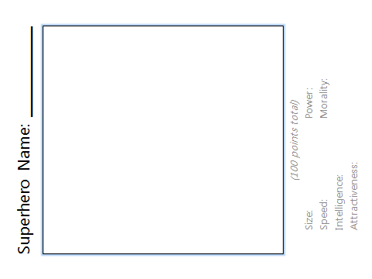
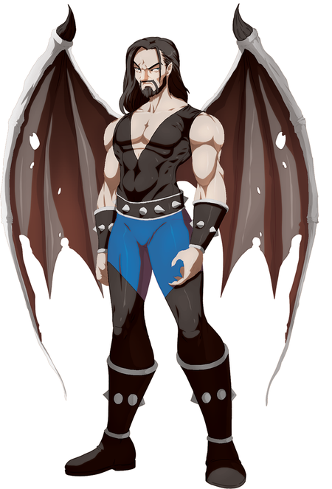
Pteroman
(100 points total)
Size: 15 Power: 25
Speed: 10 Morality: 36
Intelligence: 10
Attractiveness: 4

Slide 12
Stats
Size = bigger, smaller
Speed =
Intelligence =
Attractiveness =
Power =
Morality =
faster, slower
Smarter, stupider
Prettier, more handsome
Stronger, Weaker
Better, Worse

Slide 13
Rules
Two heroes will battle.
Roll the dice
  1 = size 2 = Power 3 = Speed,
  4 = Morality 5 = Intelligence 6 = Attractiveness
Flip a coin
  Heads = more Tails = Less
Whoever wins must use a comparative sentence.
Last One Alive Will Win

Slide 14
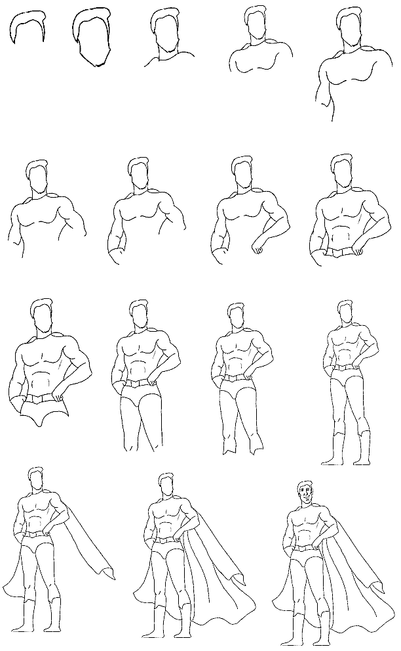
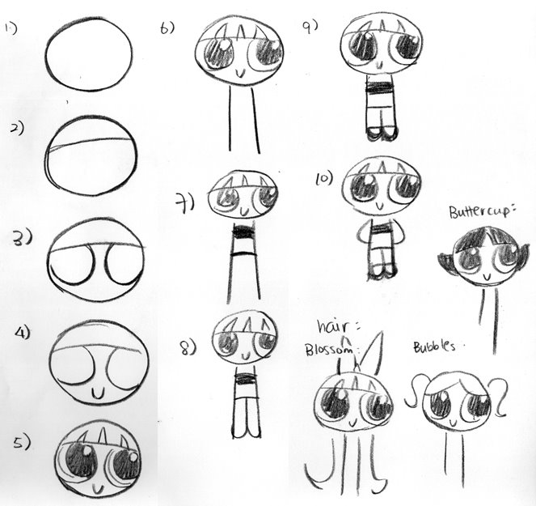

Slide 15
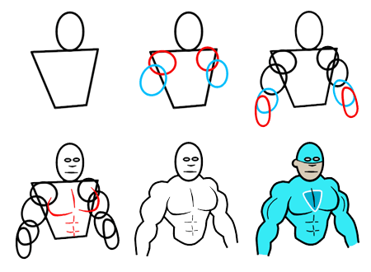
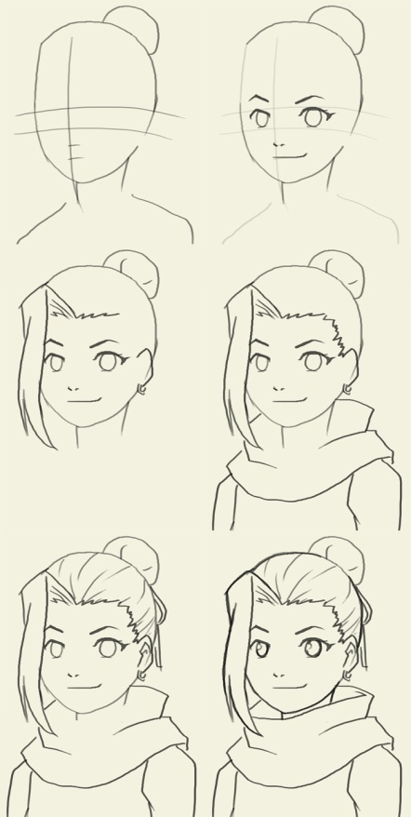
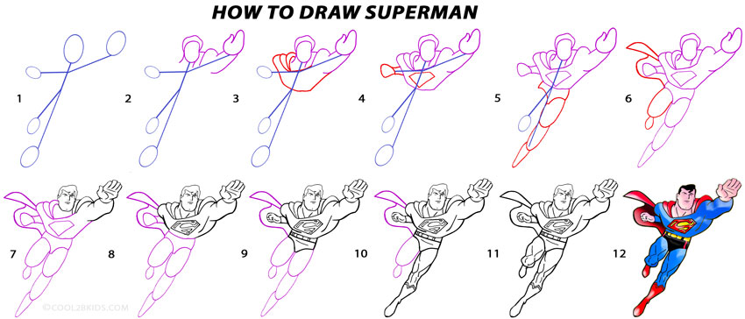

Slide 16
Superhero Name: _____________
(100 points total)
Size: Power:
Speed: Morality:
Intelligence:
Attractiveness:

