Slide 1
Is it a pencil?
Guessing Game

Slide 2
How to play:
Click a box to reveal a part of the picture
Let a student take a guess, “Is it a __________?”
“No, it isn’t.” = repeat process
“Yes, it is.” = click, “reveal all”

Slide 3
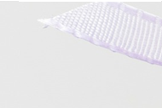
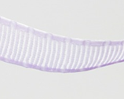
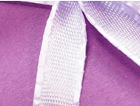
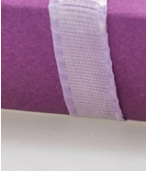
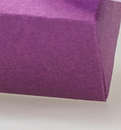
Reveal All

Slide 4
Reveal All

Slide 5
Reveal All

Slide 6
Reveal All

Slide 7
Reveal All

Slide 8
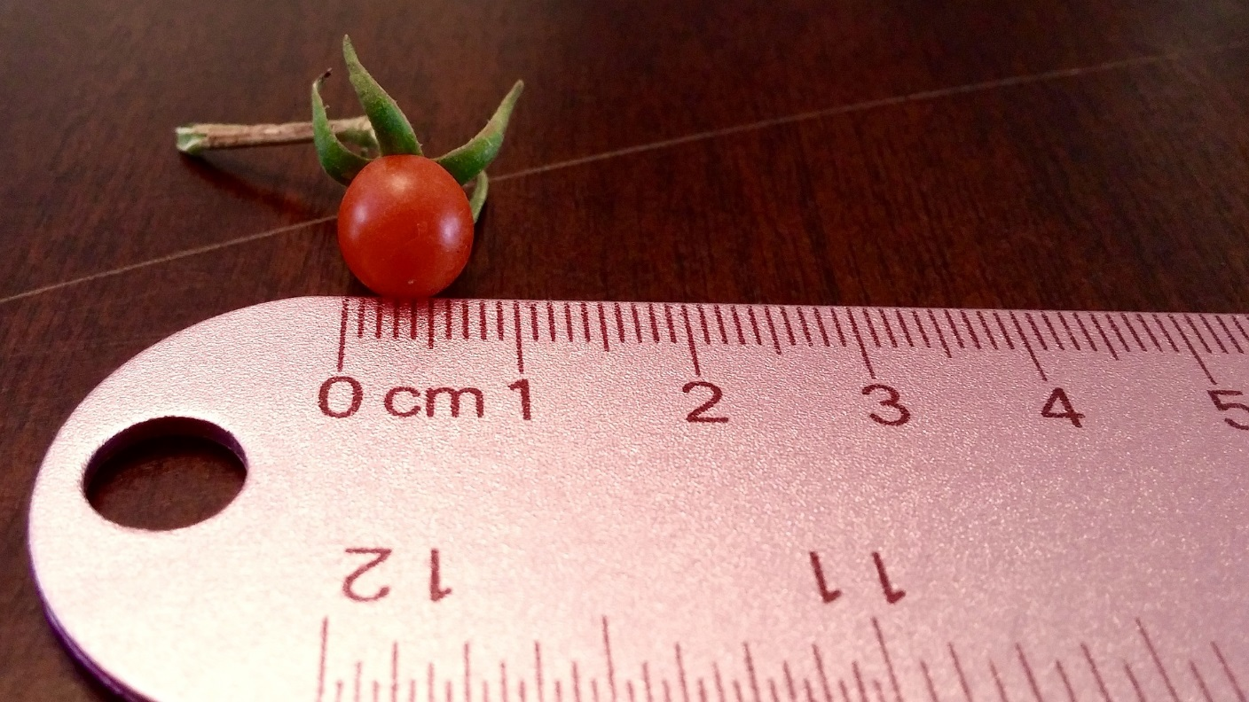
Reveal All

Slide 9
Reveal All

Slide 10
Reveal All

Slide 11
Reveal All

Slide 12
Reveal All

Slide 13
Reveal All

Slide 14
Reveal All

Slide 15
Reveal All

Slide 16
Reveal All

Slide 17
Reveal All

Slide 18
Reveal All

