Slide 1
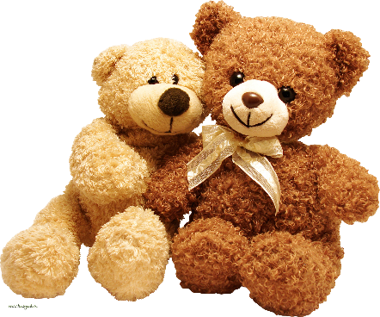
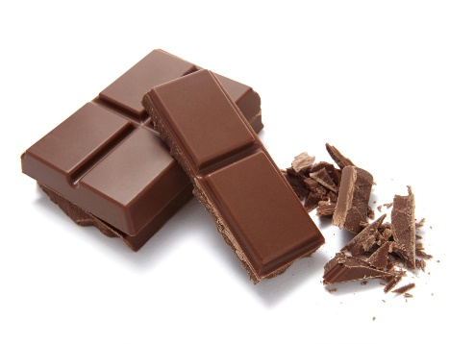
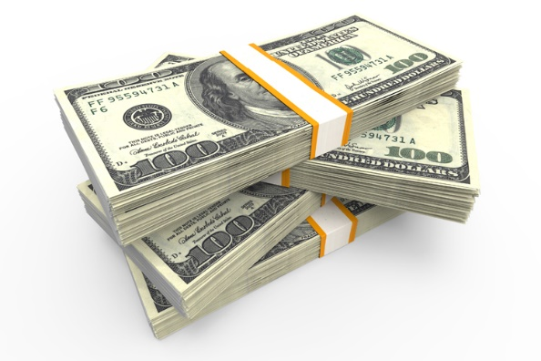
Toy
Toy
Toy
Toy
Chocolate
Chocolate
Chocolate
Chocolate
Money
Money

Slide 2
Water
Water
Water
Water
Ice Cream
Ice Cream
Ice Cream
Ice Cream
Money
Money

Slide 3
How To Play:
Take turns dealing cards
Shuffle the cards
The second student guesses what card will come next by saying, “May I have some ____________”
The first student will reveal one card. If it matches the guess, they may take that card.
If it is different, continue playing
The first student will ask, do you want some more?
“Yes, please.” (next guess)
“No thank you.” (The player can keep the cards and switch the roles)
If two of the same cards are revealed:
Return all cards and shuffle
Switch the Roles

