Slide 1
Connect 4

Slide 2
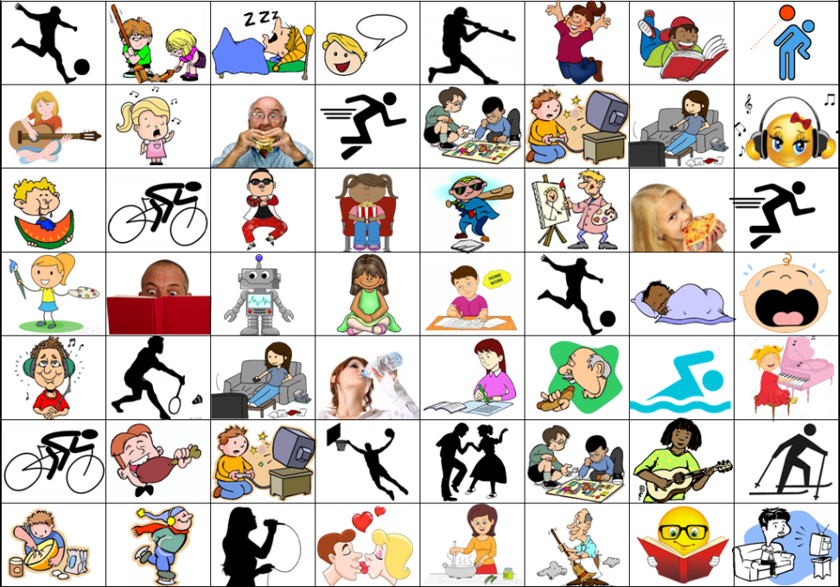
Connect 4
Get 4 spaces in a straight line (up, down, left, right, diagonal)
“What are you doing?”
“I’m ________.”
Can’t go over another line
*Most lines win*

Slide 3

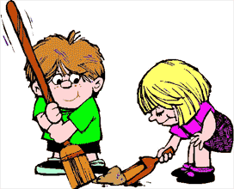








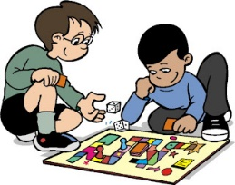


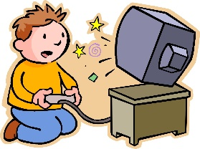
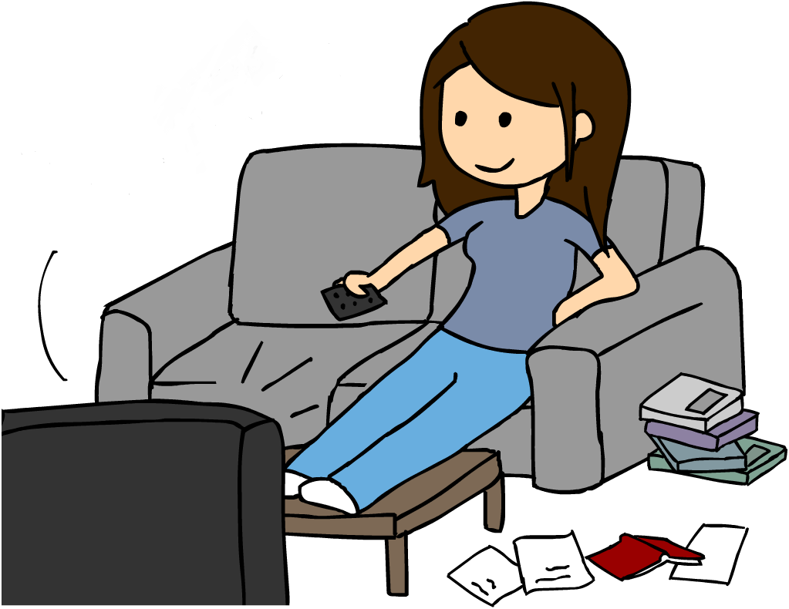



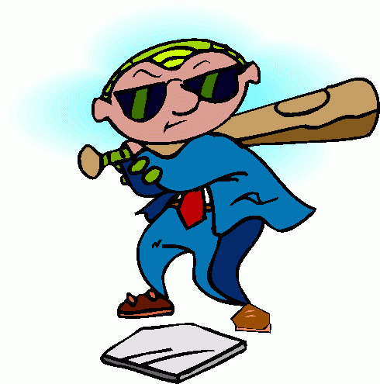
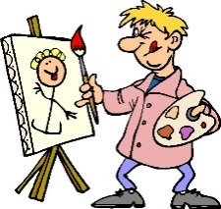
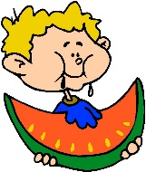


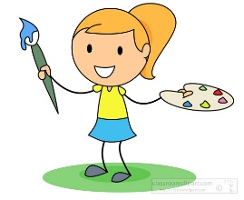


















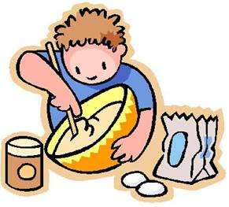



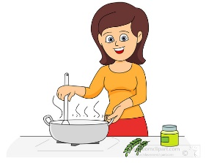




Slide 4
Instructions:
Laminate a copy of this page for every pair of students.
Give each pair of students two different colors of white board marker.
Also give each pair of students a dry erase eraser to clean the board for the next group.
Alternatively, you may print out a copy for each pair that they can use their own pencil or pen.

Slide 5
Rules
Rock, Paper, Scissors for start.
Students take turns making sentences and marking them on the paper.
Dialogue:
  “What are you doing?”
  “I’m __________________.”
The winner is the student to make the most lines (4 squares long).

