Slide 1
The Best Advice
Apples to Apples

Slide 2
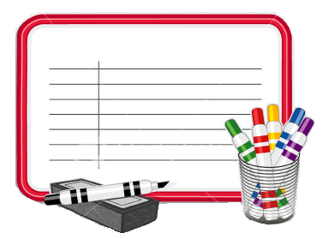
Materials:
White boards
White board markers
White board erasers
OR
Pencils
Scrap Paper

Slide 3
How to play:
Split the class into 6 groups
One group will be the judge (rotated each round)
The judge (or group) chooses a random problem.
The other groups will write a solution using, “You should…”
The judge’s group will choose their favorite suggestion (not their own group).

Slide 4
Medical
School
Random
1
1
1
2
2
2
3
3
3
4
4
4
5
5
5
6
6
6

Slide 5
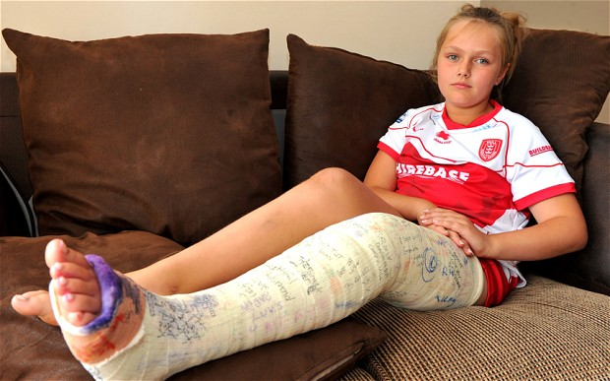
I broke my leg.

Slide 6
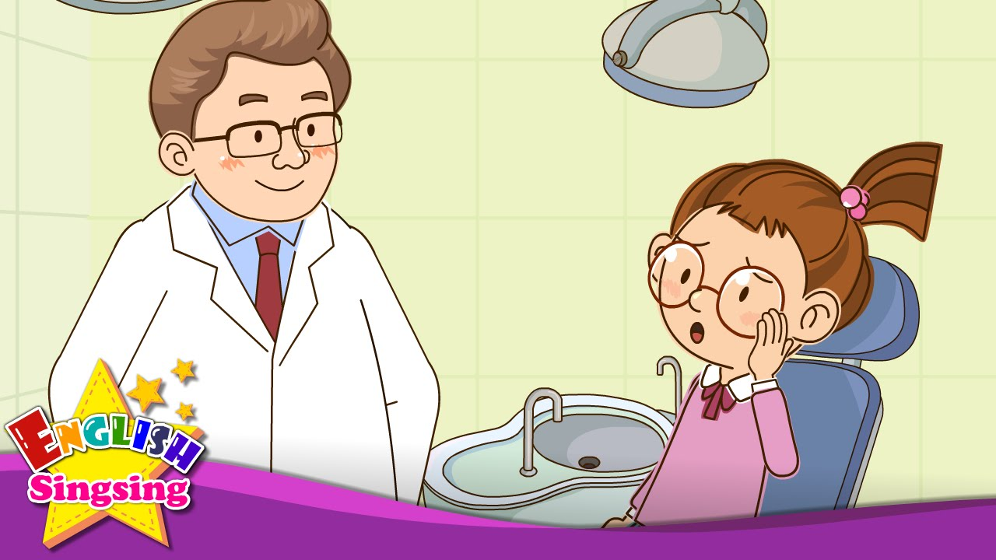
I have a toothache.

Slide 7
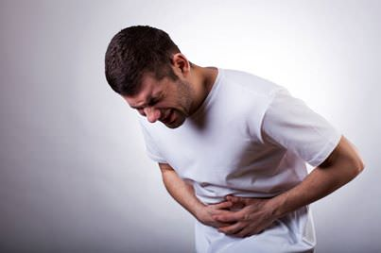
I have a stomachache.

Slide 8
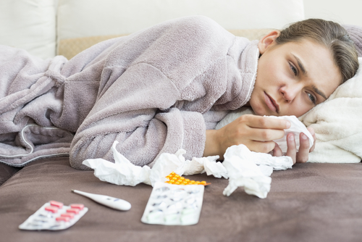
I have a cold.

Slide 9
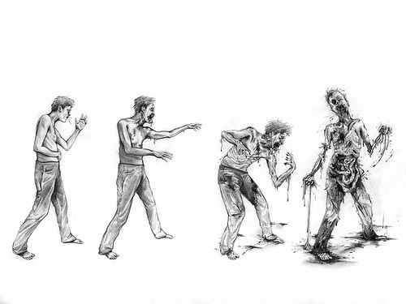
I’m turning into a zombie.

Slide 10
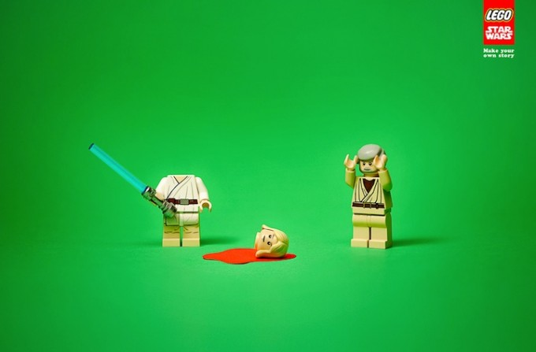
I cut off my head.

Slide 11
My friend is moving to France.

Slide 12
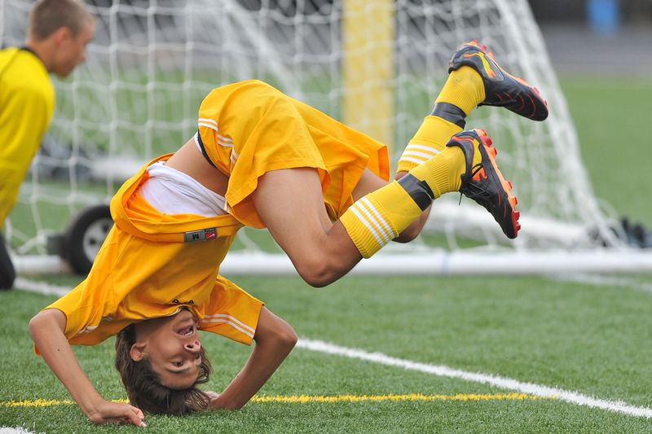
I’m not good at sports

Slide 13
I have too much homework.

Slide 14
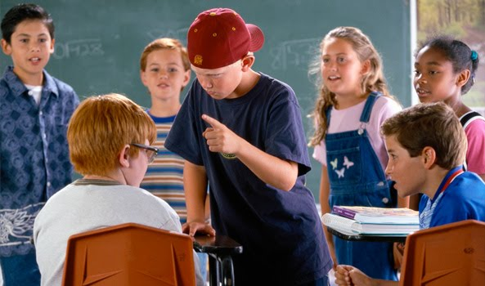
Someone is bullying me.

Slide 15
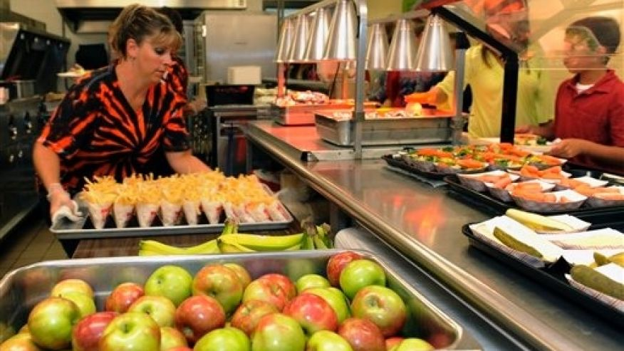
I don’t like the cafeteria food.

Slide 16
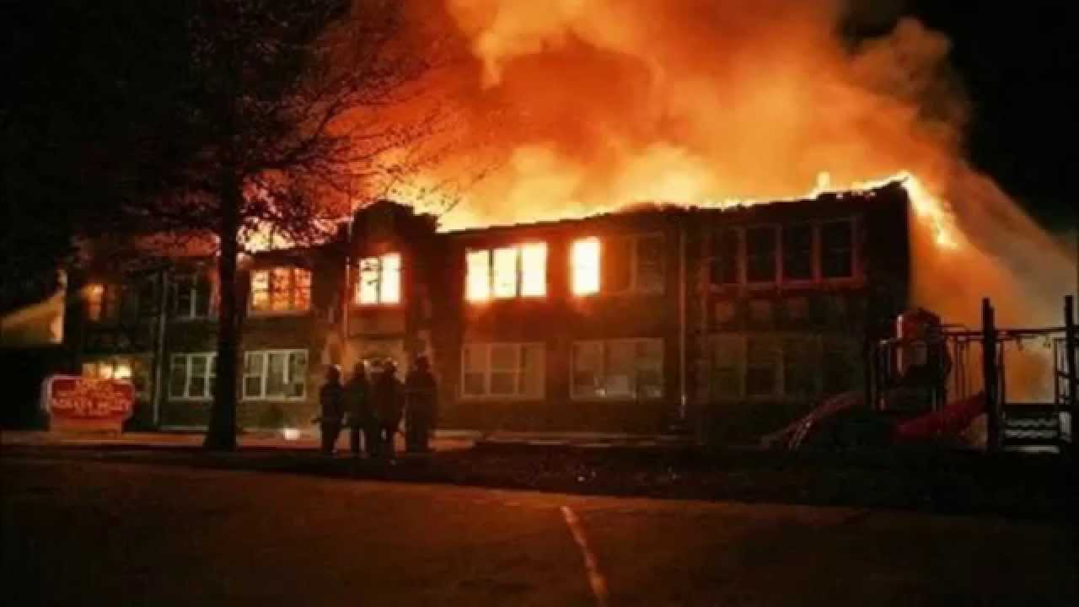
The school is on fire!

Slide 17
Aliens are invading earth.

Slide 18
I invented a time machine.

Slide 19
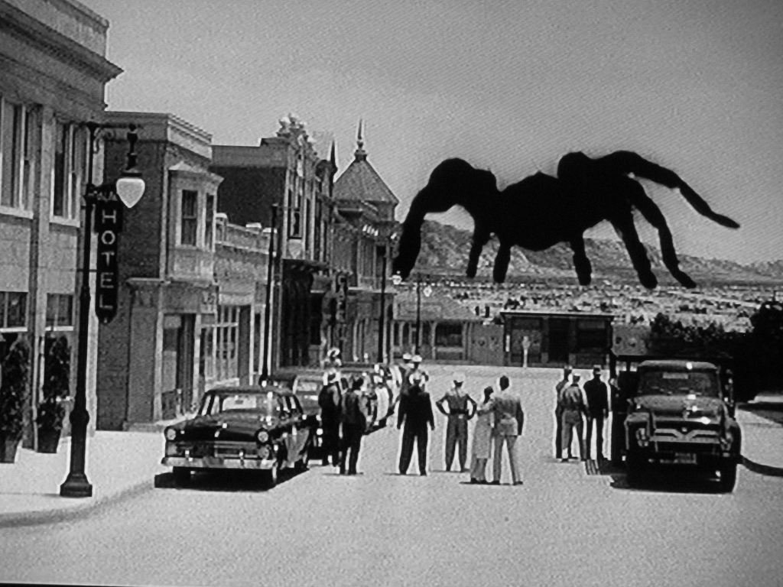
I’m afraid of spiders.

Slide 20
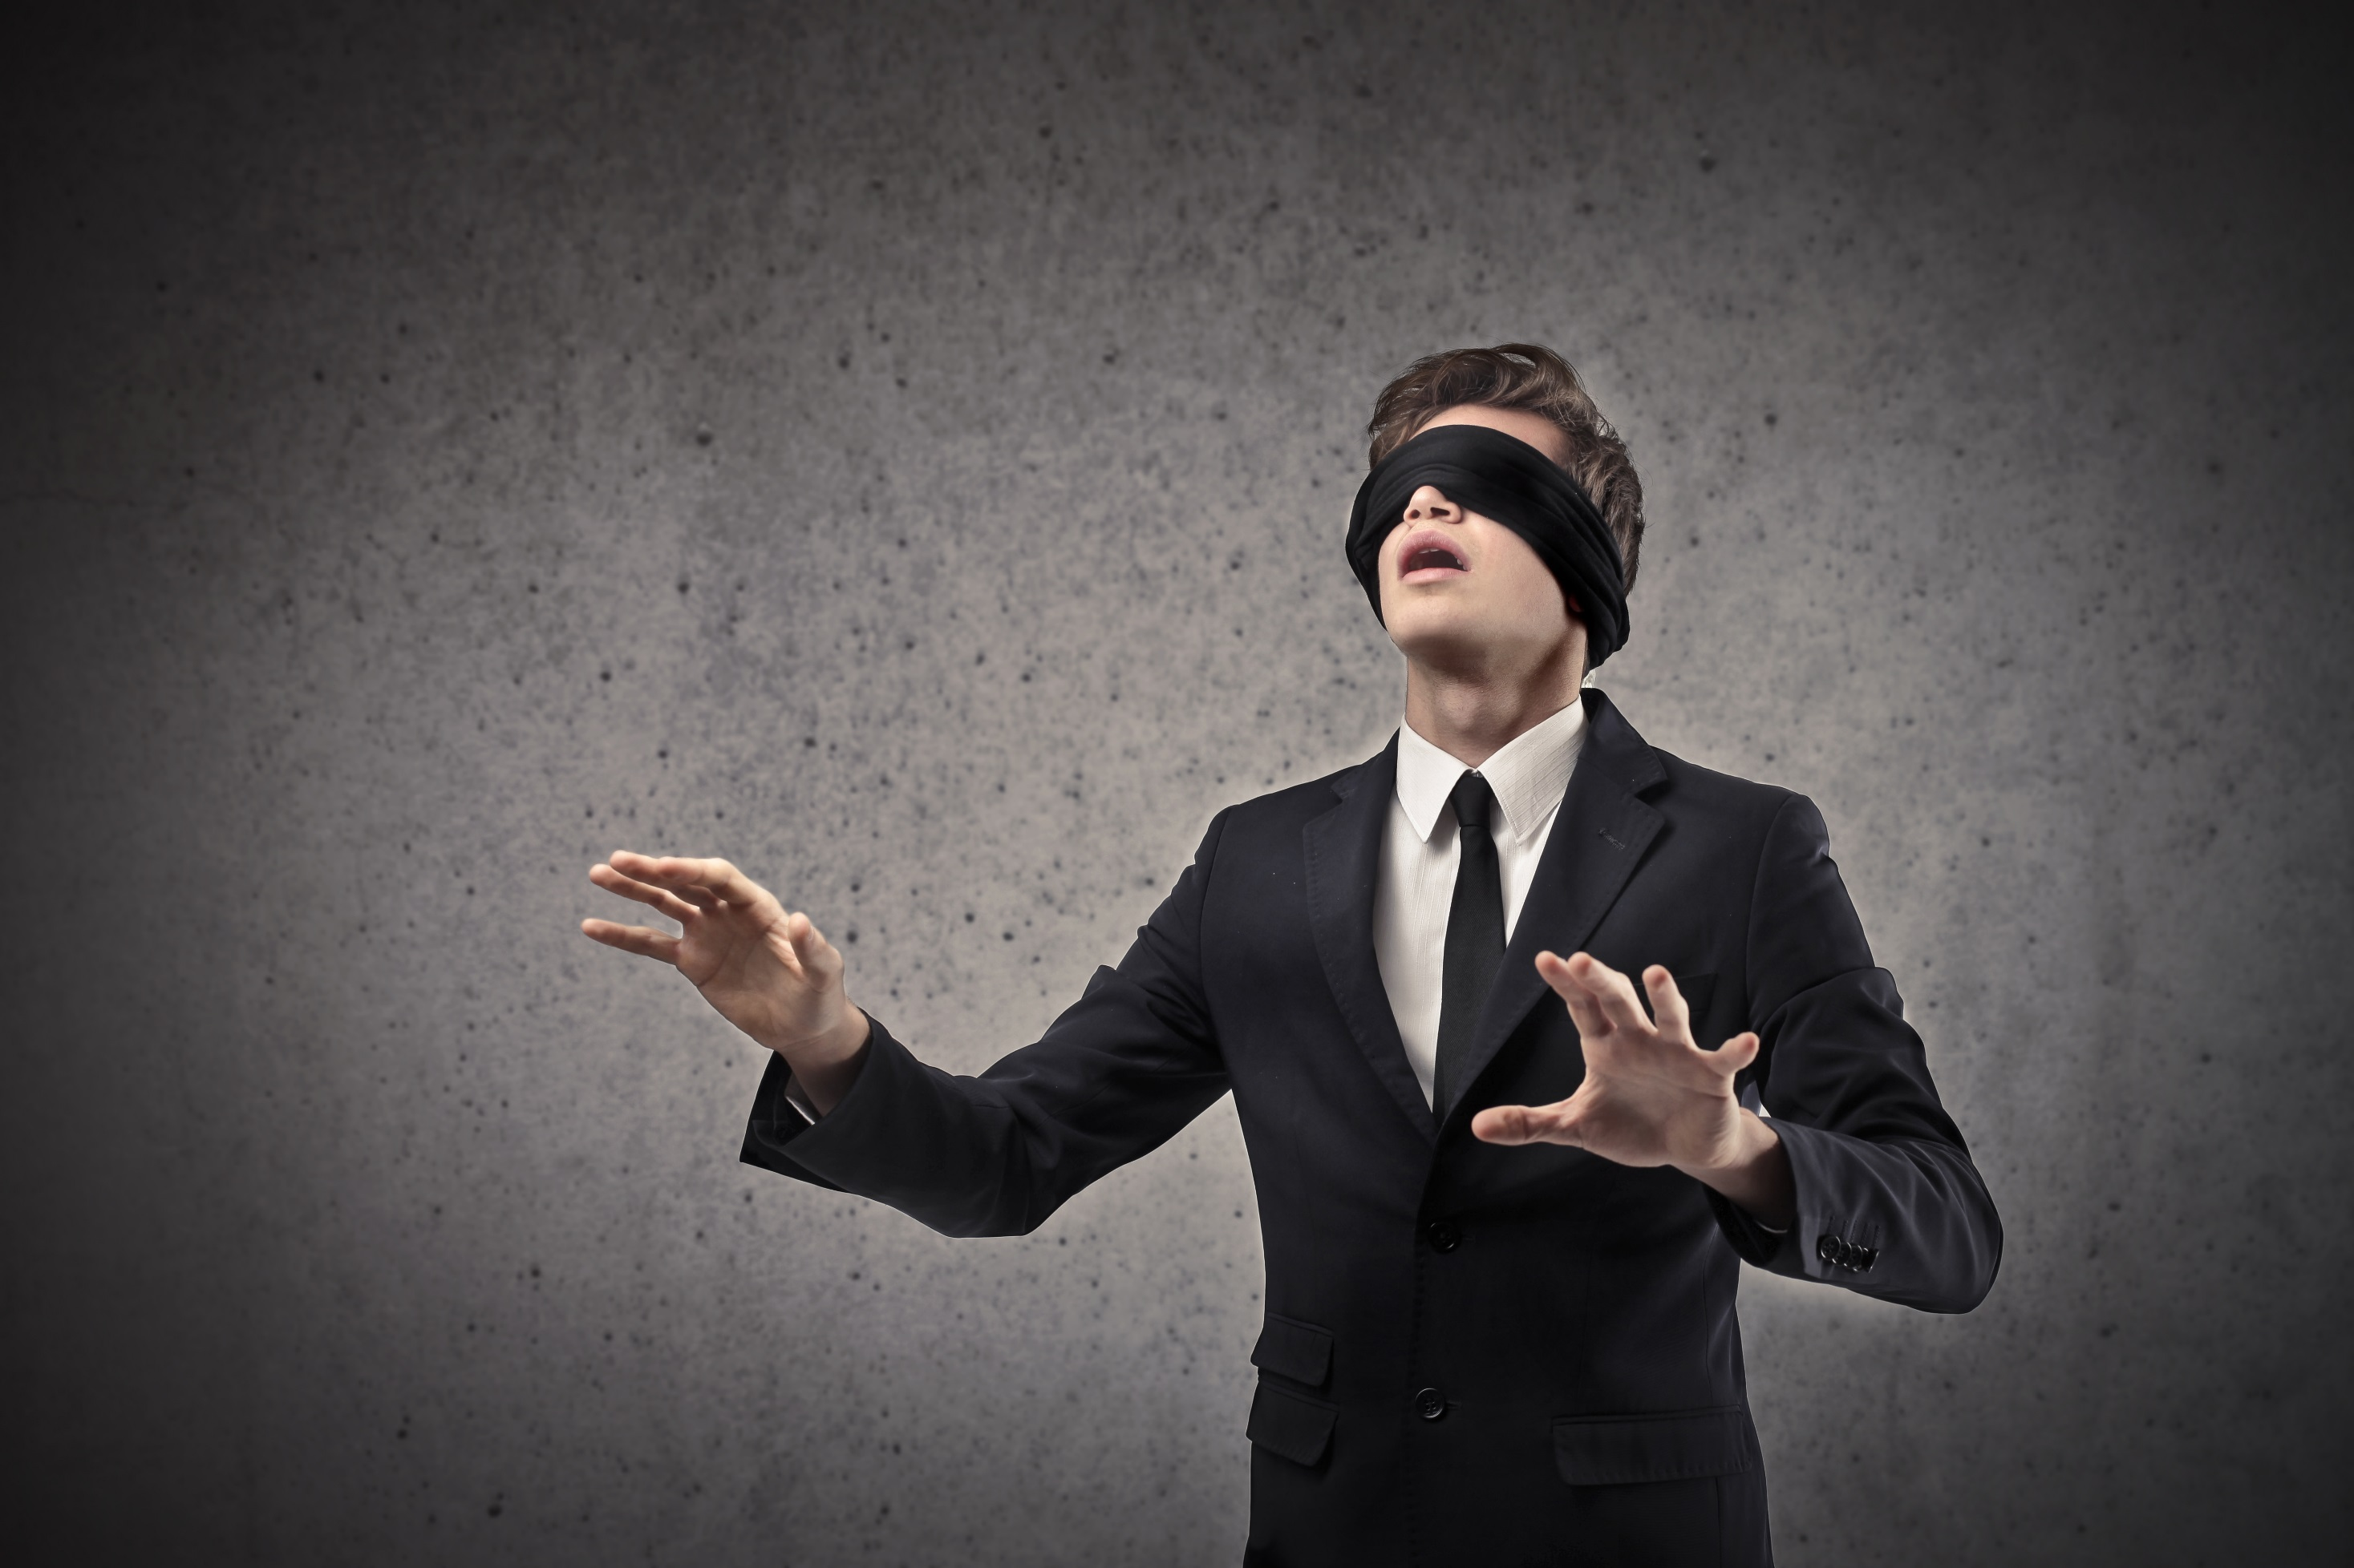
I am blind.

Slide 21
Everyone on earth disappeared.

Slide 22
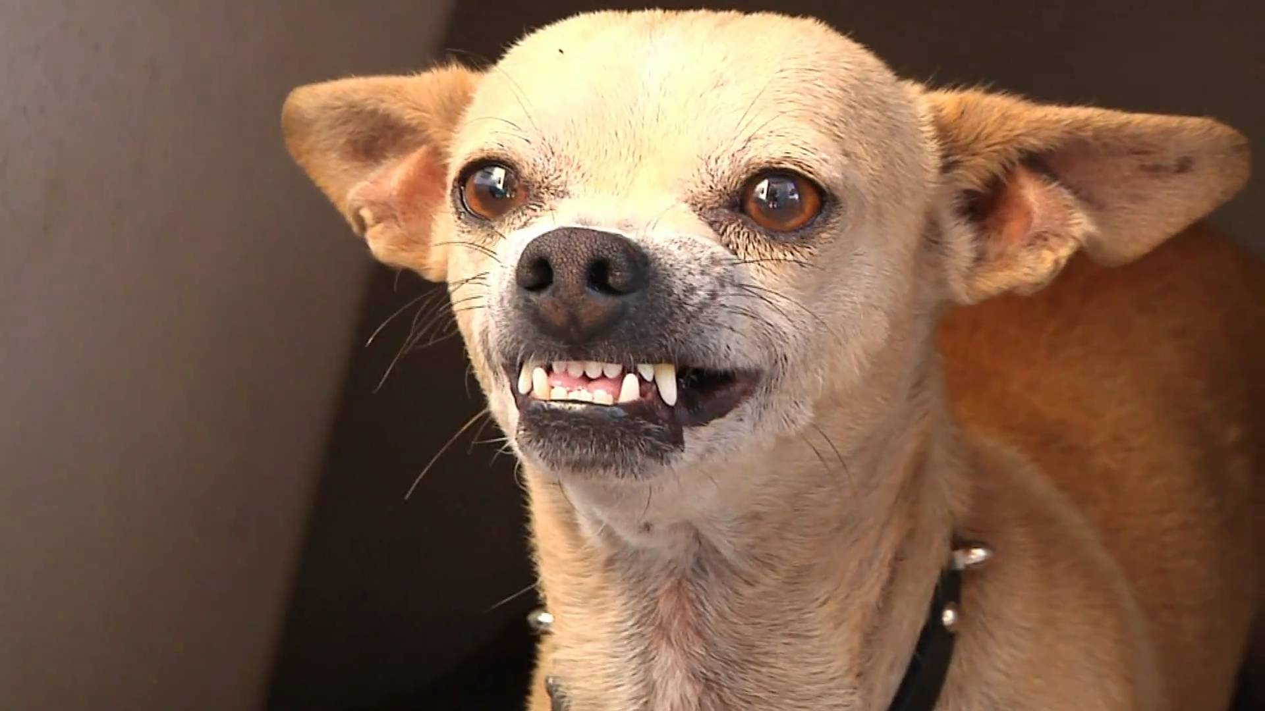
My dog is trying to kill me.

Slide 23
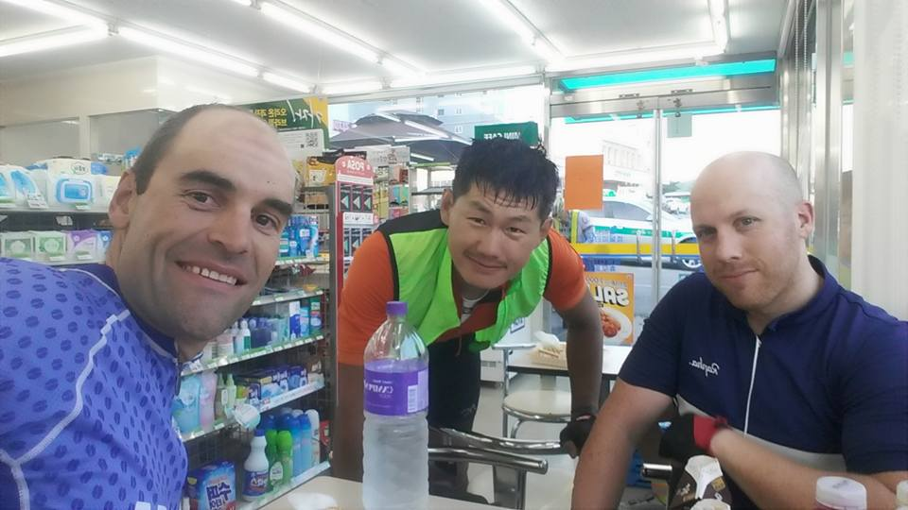
Bonus: Mr. S Round
I can’t grow hair.

