Slide 1
Do you know about _____?

Slide 2
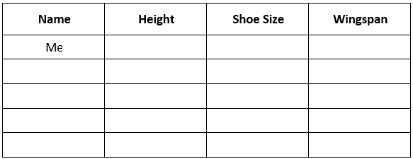
Step 1: Data Collection
Each student will receive a chart to record height, weight, and wingspan.
Students will start by filling in their own information
Next the students must ask, “How much do you weight?” etc. to fill in information for 9 other students.

Slide 3
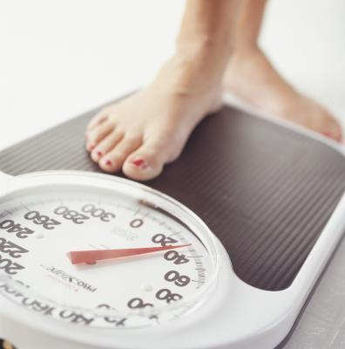
Step 1: Data Collection
Use the scales and rulers to find your:
Height
Shoe size
Arm length

Slide 4
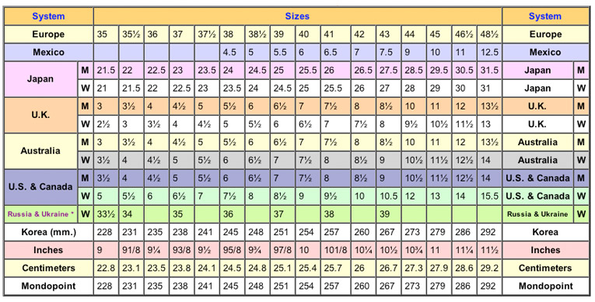
Shoe Size
Put a ruler on the floor against the wall.
Measure from your heel to your big toe.
Use the conversion chart.

Slide 5
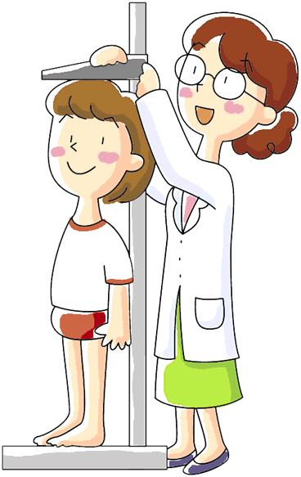
Height
Use the wall ruler

Slide 6
Step 1: Data Collection
Use the measuring tape

Slide 8
Step 1: Data Collection
Fill in your chart
Ask 5 other students about their data
How big ae your feet?
How tall are you?
How long are your arms?

Slide 9
Step 2: Do you know about ______?
One student will come to the front of the class.
They will describe a classmate by saying, “He/She is ____cm tall.” etc. using information from the data collection step.
The other students will then guess the identity of the student by using the phrase, “Do you know about ____?”

Slide 10
Step 2: Do you know about ______?
How tall is she / he?
How much does she / he weigh?
How long are her / his arms?

