Slide 1
Do you know about?
Guess then answer by saying, “Do you know about _____?”

Slide 2
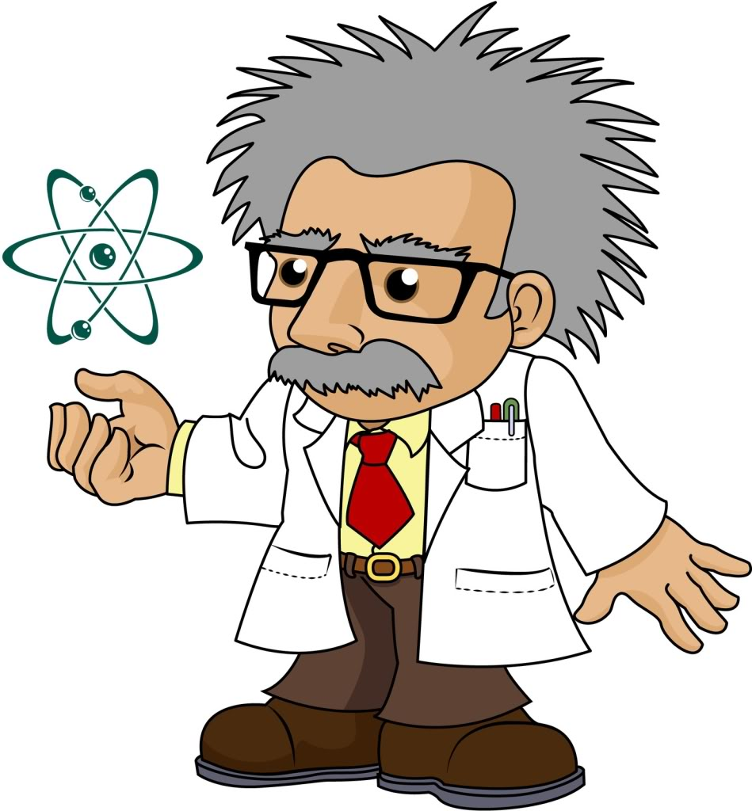
Do you know about Einstein?
He was a famous physicist
He was a genius.
He made E = mc2

Slide 3
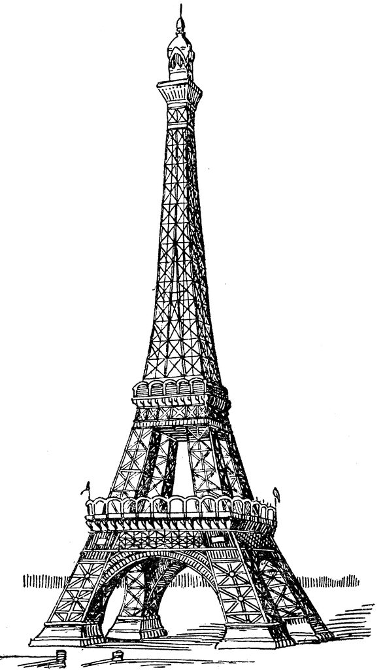
Do you know about Eiffel Tower?
It was the tallest in the world
It is a famous tower.
It’s in France.

Slide 4
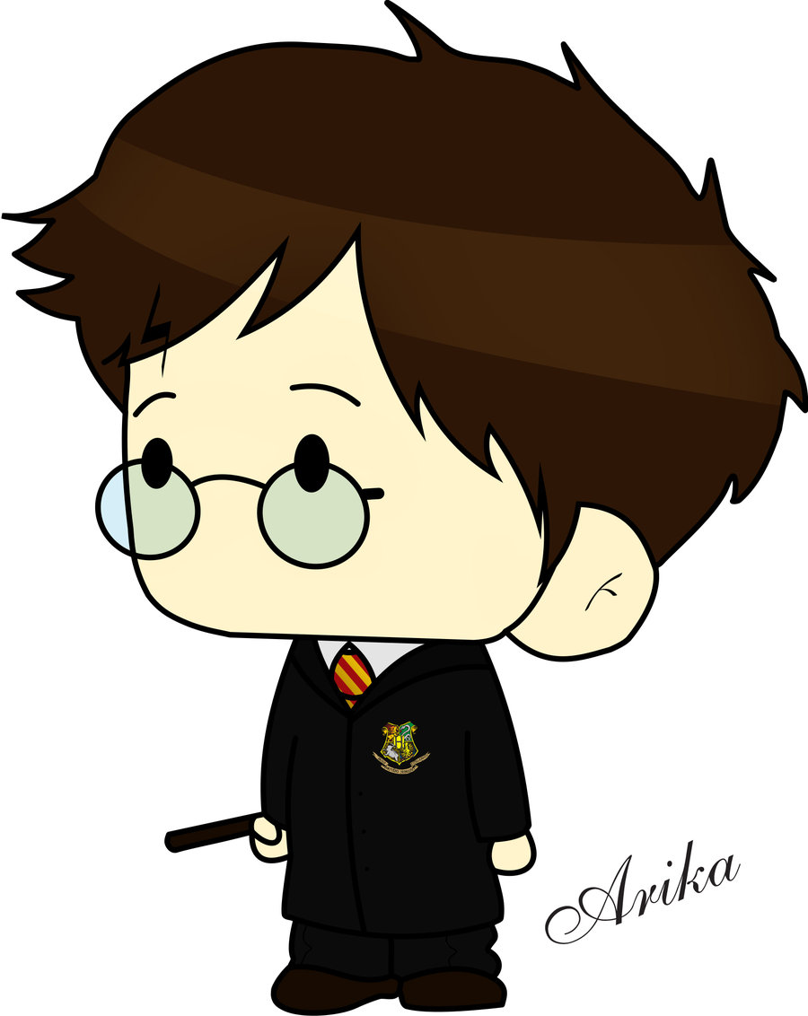
Do you know about Harry Potter?
He wears glasses.
He plays quidditch.
He is a wizard.

Slide 5
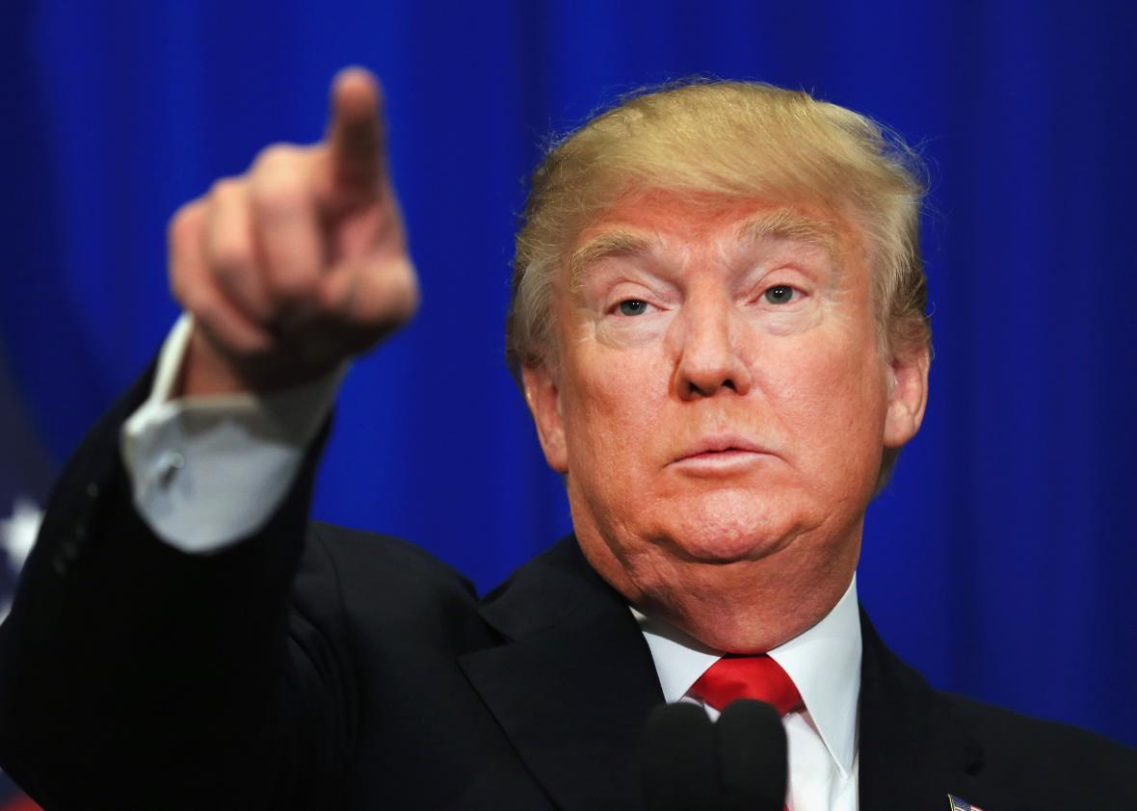
Do you know about Donald Trump
He is a famous leader.
He has orange skin and yellow hair. .
He is the president of America.

Slide 6
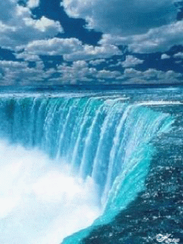
Do you know about Niagara Falls?
It is between Canada and America
It is very big.
It has a lot of water.

Slide 7
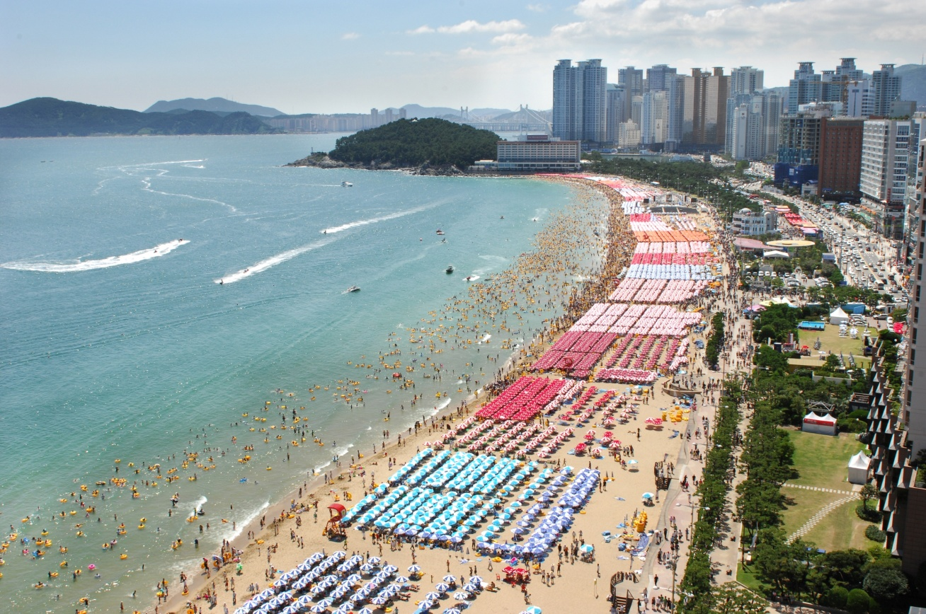
Do you know about Haeundae Beach?
It’s wet and dry.
It’s a famous beach.
It’s in Busan.

Slide 8
Do you know about Ice Cream?
It’s cold.
There are many different kinds
It tastes delicious.

Slide 9
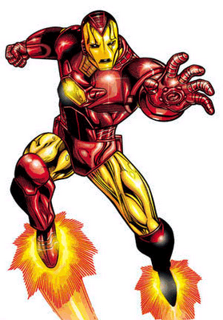
Do you know about Ironman?
He is a genius.
He helps people.
He is an inventor.
Sometimes he wears a metal suit.

Slide 10
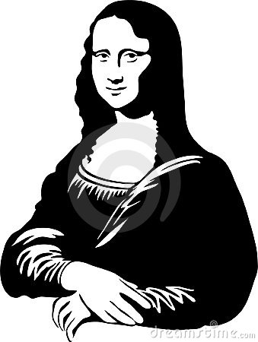
Do you know about Mona Lisa?
She has a famous face.
Many people look at her every year.
She is made of paint.
Leonardo Da Vinci painted her.

Slide 11
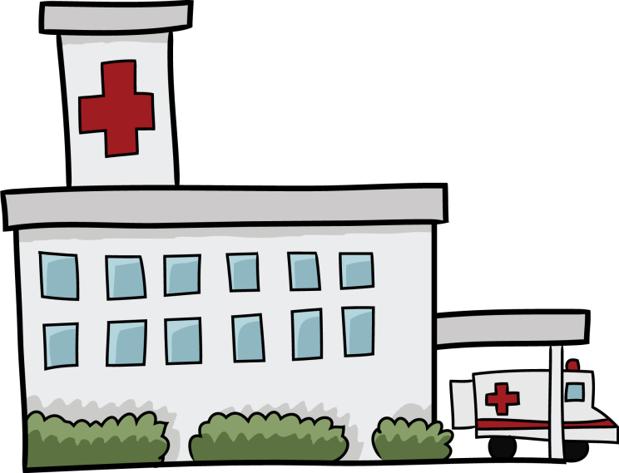
Do you know about hospitals?
This is not a fun place.
It is usually very big.
You go here when you are sick.

Slide 12
Do you know about smart phone?
It is fun and helpful.
It can be in your pocket.
You can play games or talk to friends with this.

Slide 13
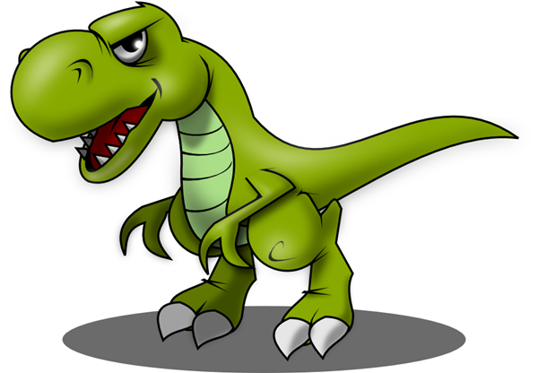
Do you know about T-Rex?
It has big teeth.
It lived a long time ago.
It has short arms and big legs.

Slide 14
Do you know about balloons?
They are made from rubber.
They can grow and shrink.
They get bigger when you blow in them.

Slide 15
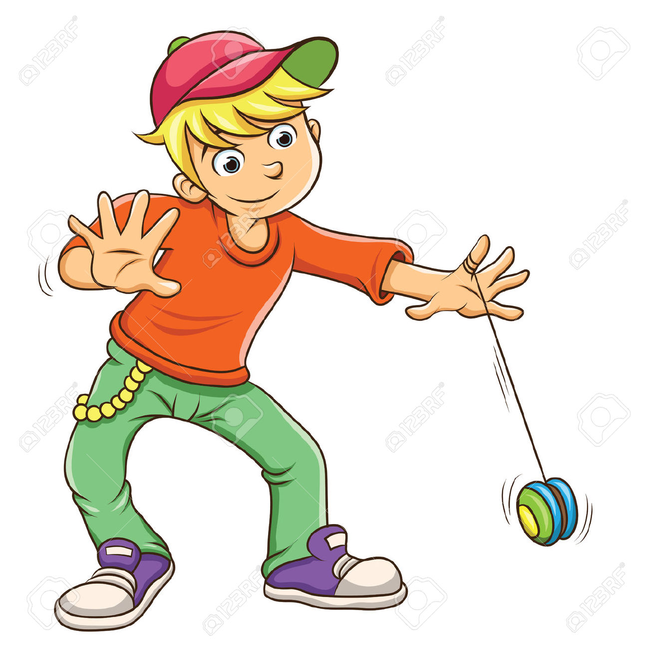
Do you know about yo-yo?
It is round.
It has string.
It goes up and down.

Slide 16
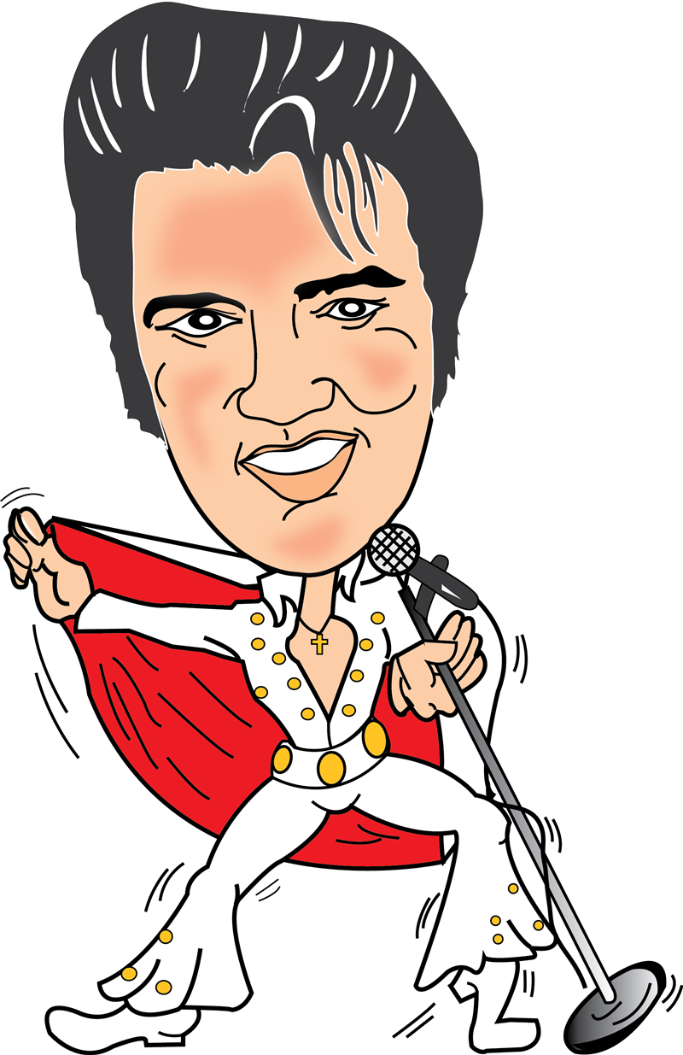
Do you know about Elvis?
He was a very famous singer.
He was called the “King of Rock and Roll.”
He had large sideburns.

Slide 17
Do you know about water?
It’s clear.
It’s wet.
It’s something you drink.

Slide 18
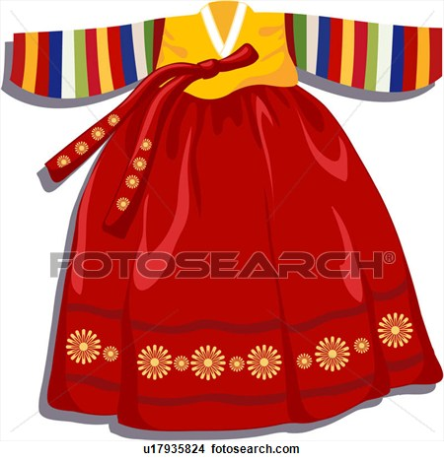
Do you know about Hanbok
It’s colorful.
It’s worn on special occasions.
It’s a Korean traditional dress.

Slide 19
Do you know about school?
It’s somewhere everybody goes to in their life.
It is usually a big building with children in it.
It is where you study.

Slide 20
Do you know about tulips?
It’s colorful but always green.
They are from the Netherlands.
You can see them in springtime.
Maybe you can give them as a gift.

Slide 21
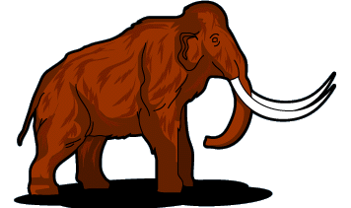
Do you know about wooly mammoths?
It lived a long time ago.
It was very hairy and big.
It lived where it was very cold.

Slide 22
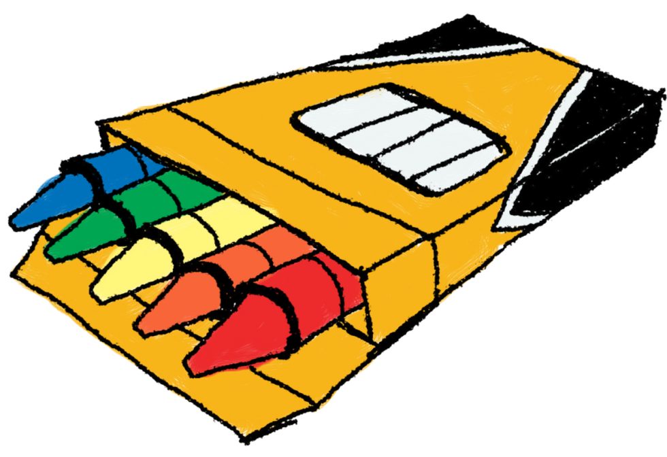
Do you know about crayons?
They are colorful.
You use them at school.
You use them to make pictures.

Slide 23
Do you know about paper?
It is flat.
It is colorful, but usually white.
It is easy to rip.
It is rectangular.

Slide 24
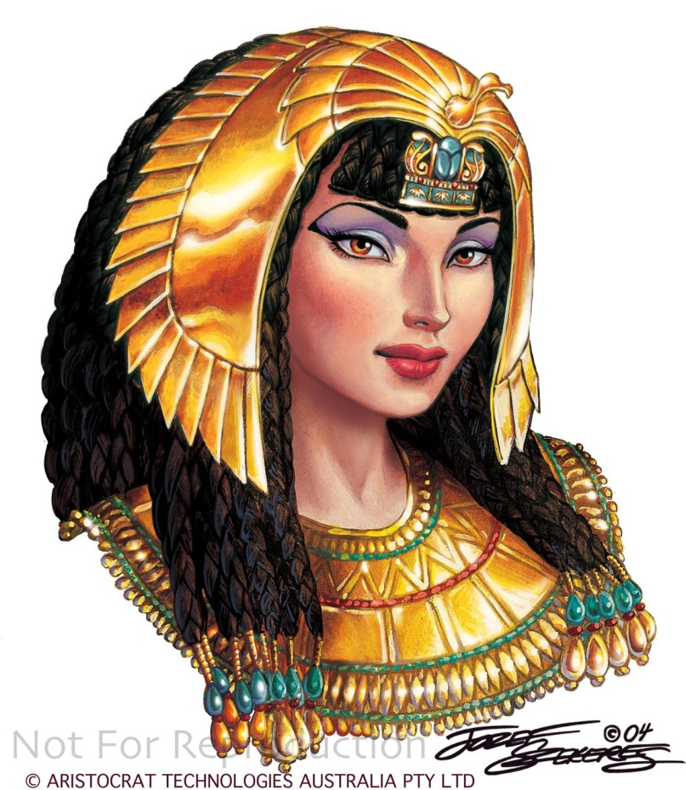
Do you know about Cleopatra?
She was considered beautiful.
She lived a long time ago.
She is from Egypt.

Slide 25
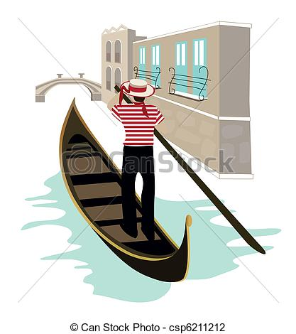
Do you know about Venice?
It is a city in Italy.
The taxis are boats.
The buildings are all on water.

Slide 26
Do you know about the Statue of Liberty?
It was a gift from France.
Now, you can see it in New York
It is a large statue.
It’s a girl holding a torch and book.

Slide 27
Do you know basketball?
It was invented by Canadians living in America.
It’s played by two teams on a rectangular court.
The ball is round and orange.

Slide 28
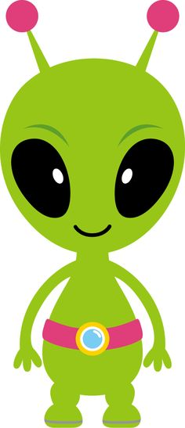
Do you know about aliens?
Some people have seen them.
Other people don’t believe they exist.
They come from far away.
Do they want to help or hurt us?

Slide 29
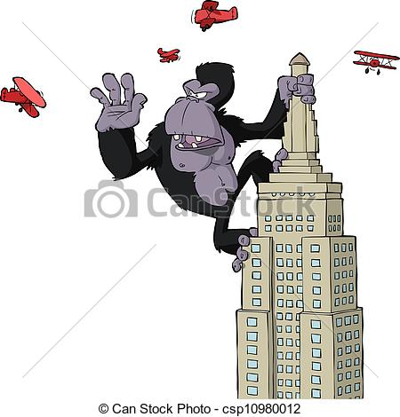
Do you know about King Kong?
He is a giant.
He came from far away.
He kidnapped a girl and climbed the Empire State Building.

Slide 30
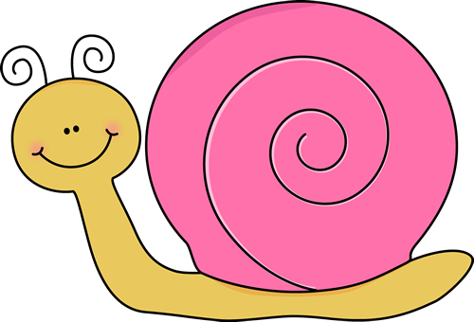
Do you know about snails?
They have no arms or legs
They carry their house with them.
They leave a slime behind.

Slide 31
Do you know about newspapers?
It’s black and white and read all over.

Slide 32
Do you know about mirrors?
It looks different most of the time, but it is always the same
If you see one in two places, it will look different.
If you see two in the same place, they will look the same.
.

Slide 33
Do you know about silence?
It is very delicate.
It breaks if you say it’s name.

Slide 34
Do you know about Postman?
Take away my first letter and I am the same.
Take away my second letter and I am the same.
Take away all my letters and I will be angry.

Slide 35
Do you know about blood?
It is red, but sometimes I look blue.
Without this, you will die.
Other people can use it too.

Slide 36
Do you know about stars?
They are always there, but half of the time you can’t see me.
They have a big, grey, round friend.
There is a famous painting of them.
They are very far away.

