Slide 1
Going to…
Make a Sentence

Slide 2
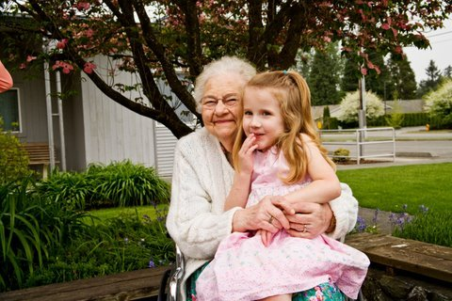
What is going to happen?

Slide 3
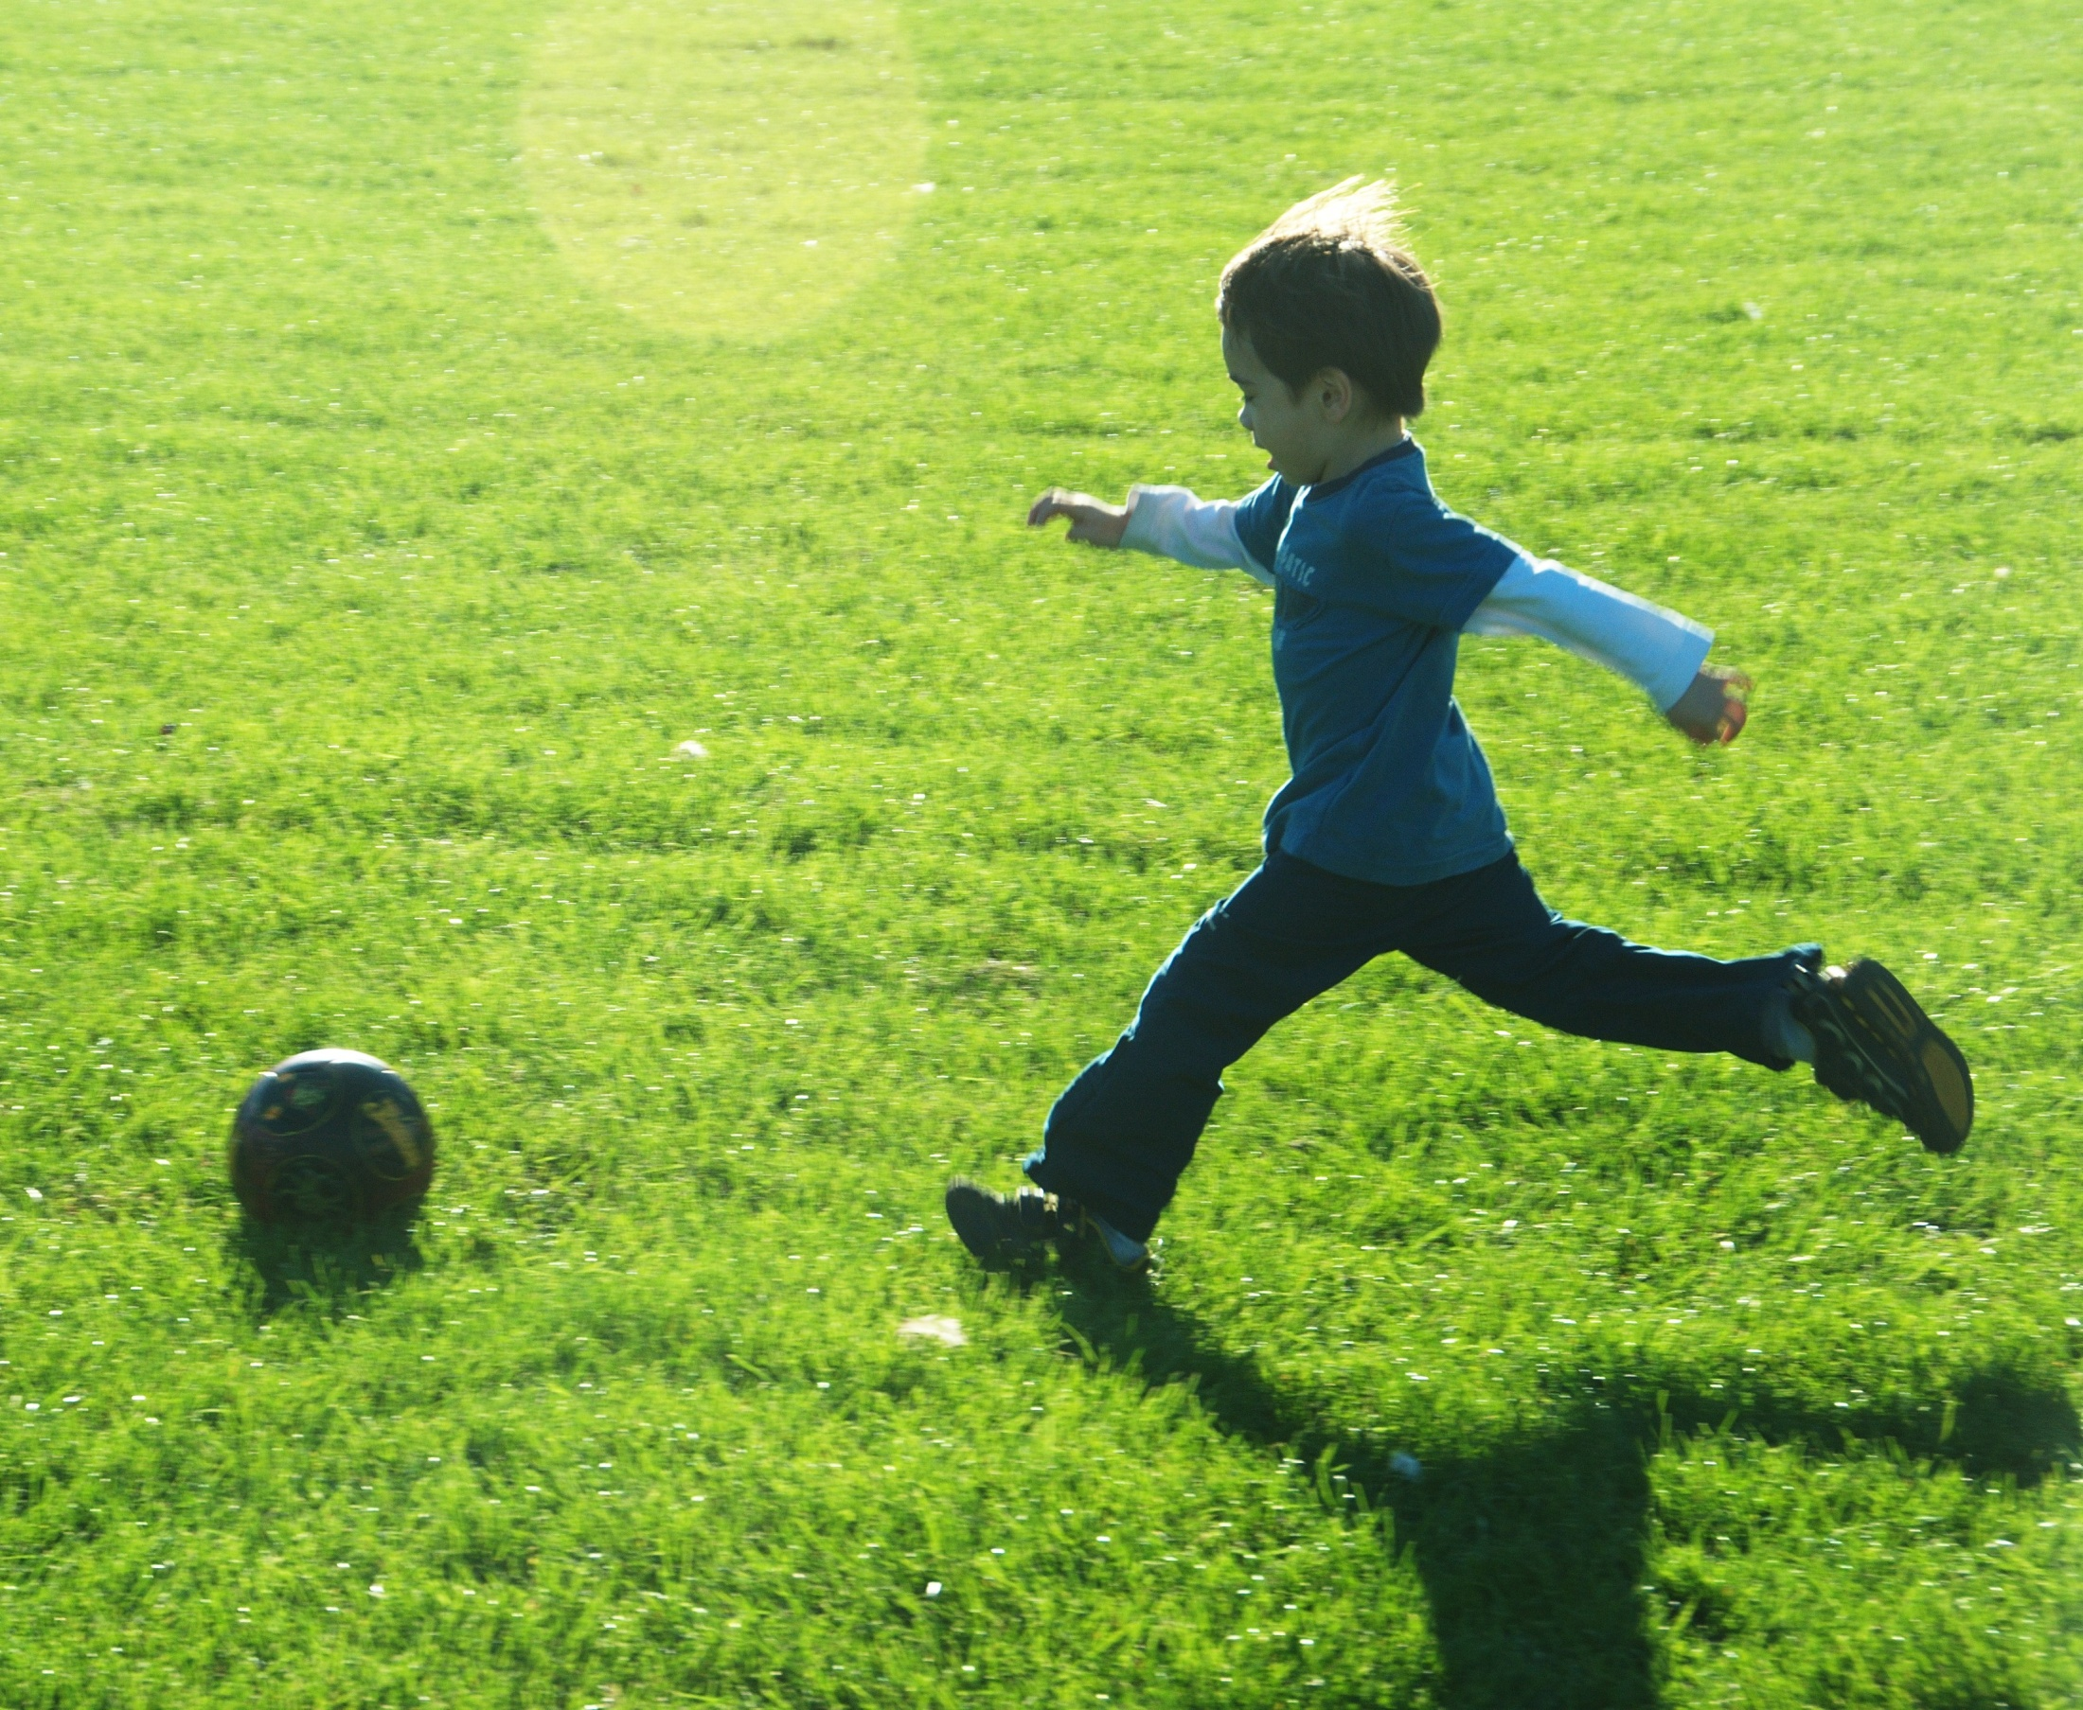

Slide 4


Slide 5


Slide 6
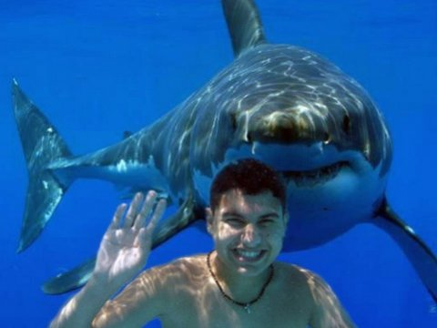

Slide 7
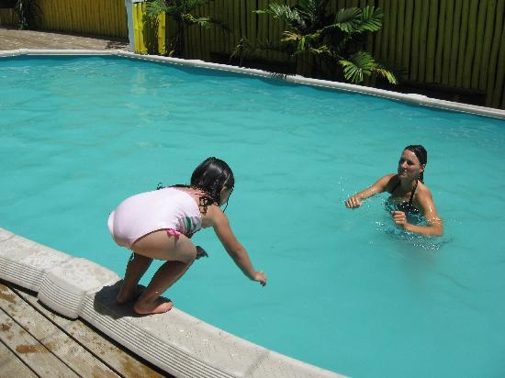

Slide 8
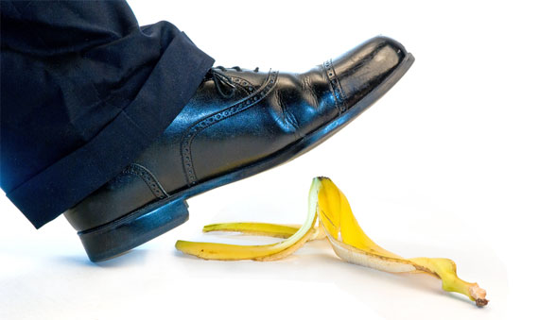

Slide 9


Slide 10
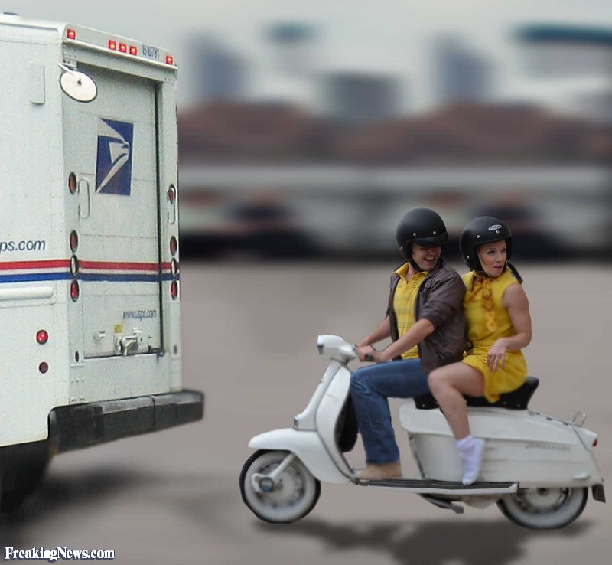

Slide 11
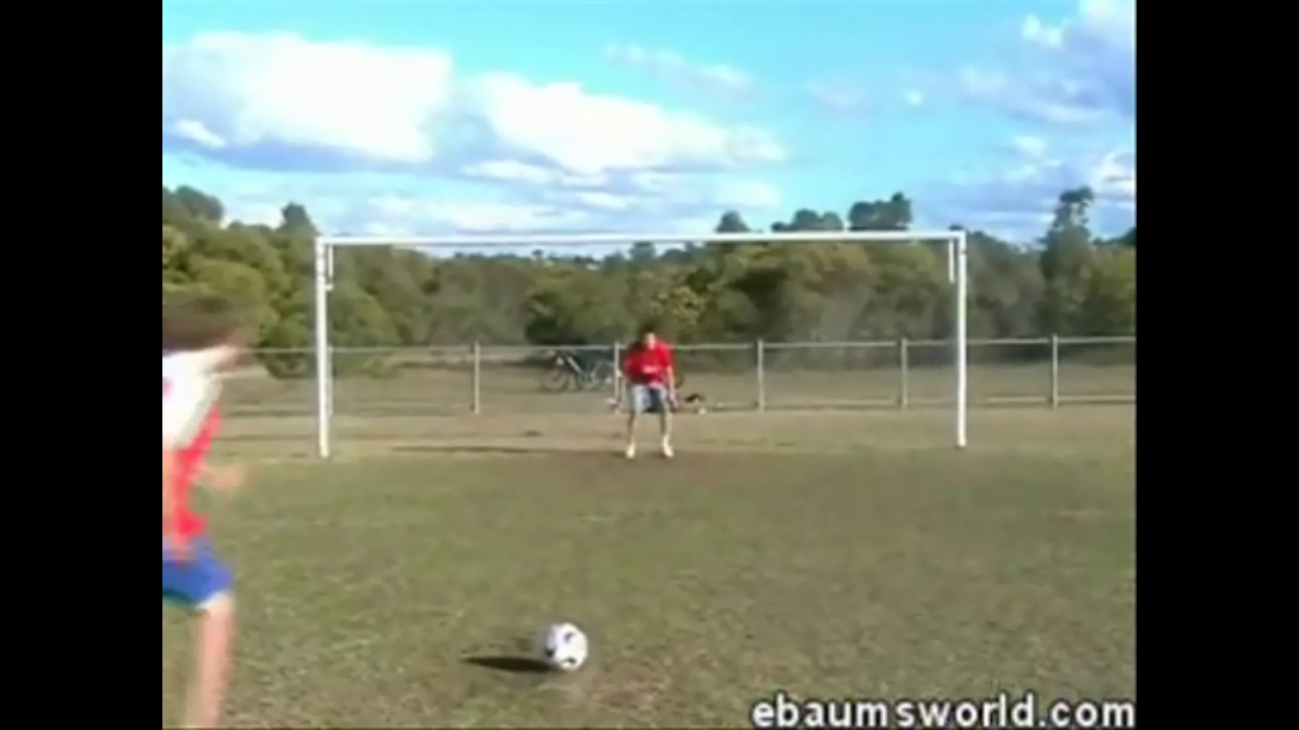
What is going to happen in the video?
Pause the video occasionally to let students guess what will happen.
Search for fail videos (the one I use is no longer onlie)
BUT – make sure you check for foul language and appropriate content before showing students.

Slide 12
What is going to happen?
http://eslgames.com/webapps/what_happened_next/index.html

Slide 13
What will happen #1
https://www.youtube.com/watch?v=ksLCgsnKOsQ

Slide 14
What will happen #2
https://www.youtube.com/watch?v=W5ExZGQ9heI

Slide 15
What will happen #3
https://www.youtube.com/watch?v=IfRKetONapU

Slide 16
Fortuneteller
http://eslgames.com/webapps/fortune/

Slide 17
http://eslgames.com/esl+apps/

