Slide 1
How tall is it?
Guessing Game

Slide 2
Rules
Each team will get a white board and markers.
Write your guess (how big) on the board and make a sentence.
Then, we will measure it and see which team is closest.
The closest one will get one point.

Slide 3
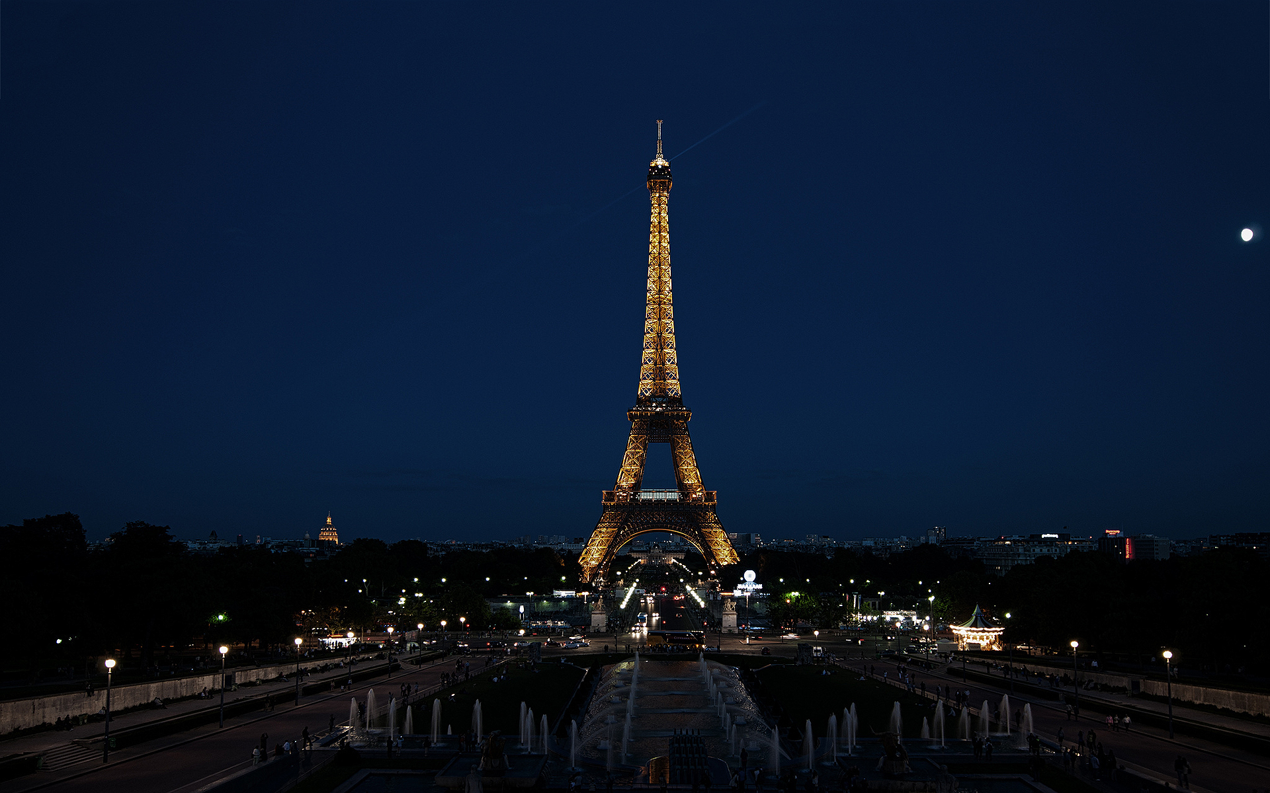
How tall is the Eiffel Tower?
It’s 300m tall.

Slide 4
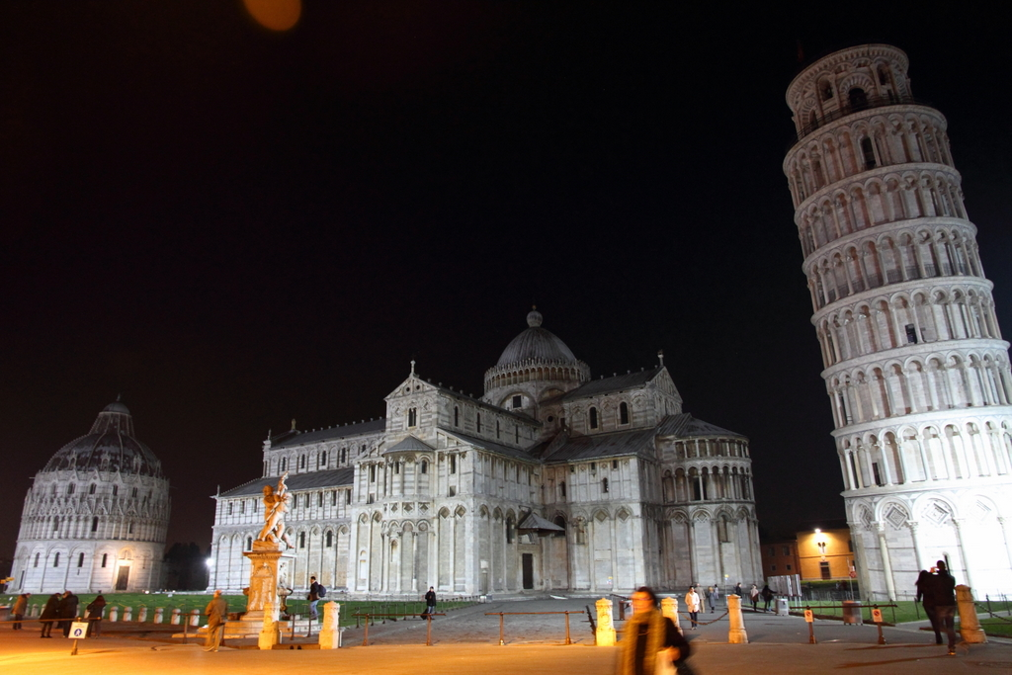
How tall is the Leaning Tower of Pisa?
It’s 56m tall.

Slide 5
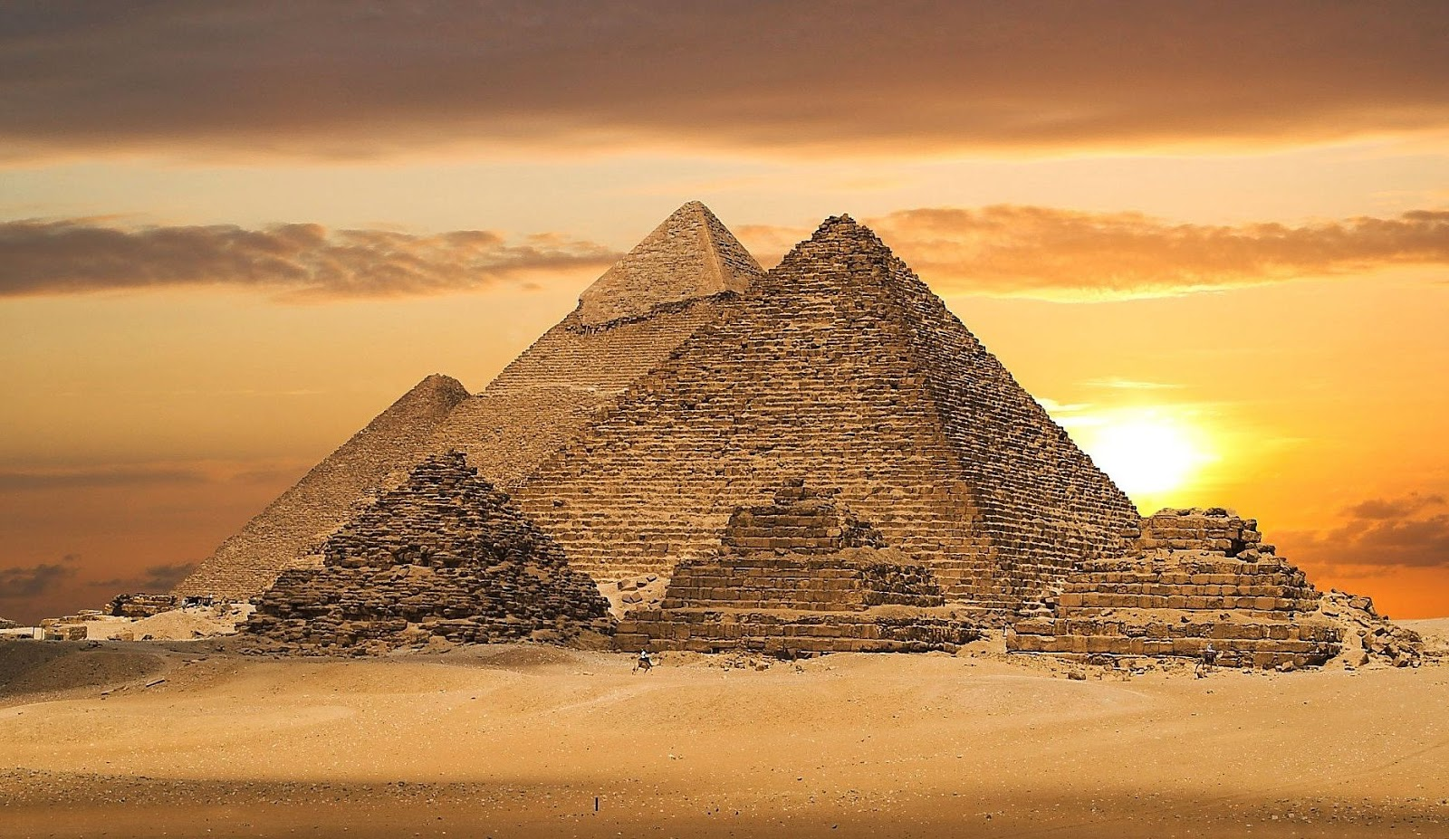
How wide is the great pyramid?
It’s 230m wide.

Slide 6
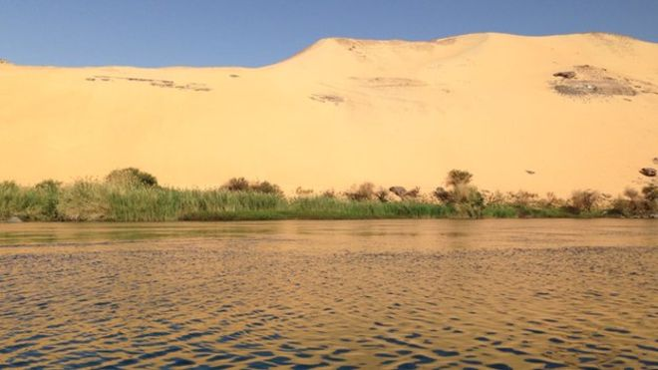
How long is the Nile River?
It’s 6853km long.

Slide 7
Do you know about Mr.S?
How tall is he?

Slide 8
Do you know about the TV?
How long is it?

Slide 9
Do you know about the table?
How long is it?

Slide 10
Do you know about the door?
How wide is it?

Slide 11
Do you know about the window?
How wide is it?

Slide 12
Do you know about Student ##?
How tall is he / she?

Slide 13
Do you know about the yellow chair?
How tall is it?

Slide 14
Do you know about Student ##?
How long is his / her arm?

Slide 15
Do you know about the pencil?
How long is it?

Slide 16
Do you know about the room?
How tall is it?

Slide 17
Do you know about the white board?
How long is it?

Slide 18
Do you know about the clock?
How wide is it?

Slide 19
Do you know about the _______?
How ______ is it?

