Slide 1
MASH

Slide 2
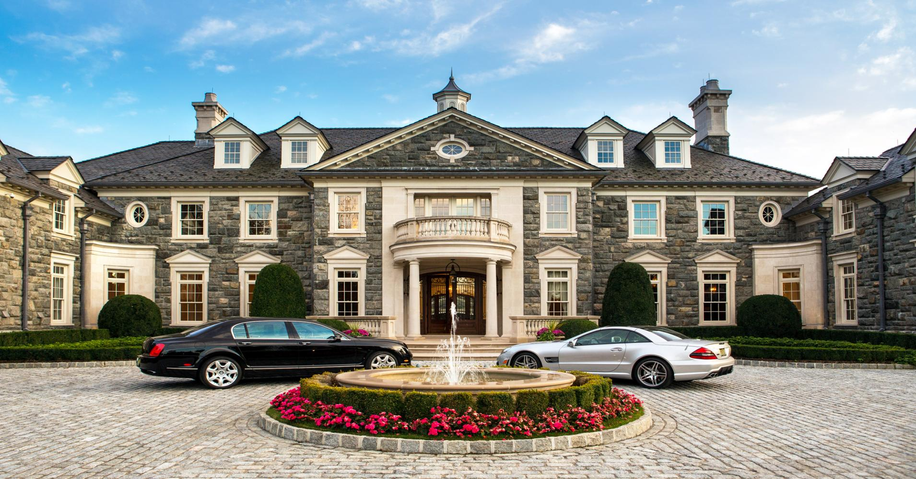
Mansion

Slide 3
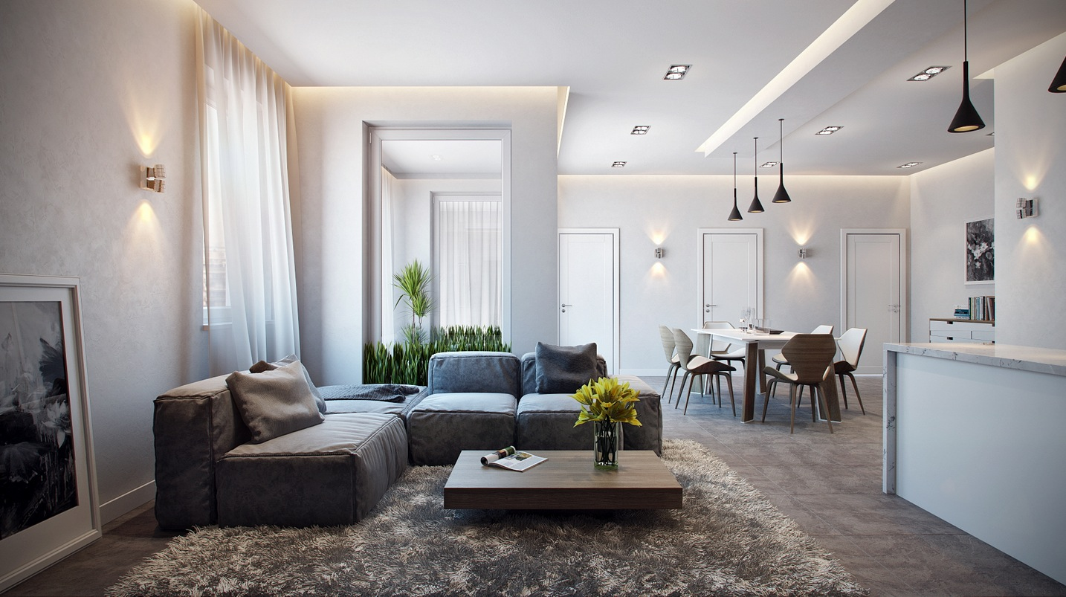
Apartment

Slide 4
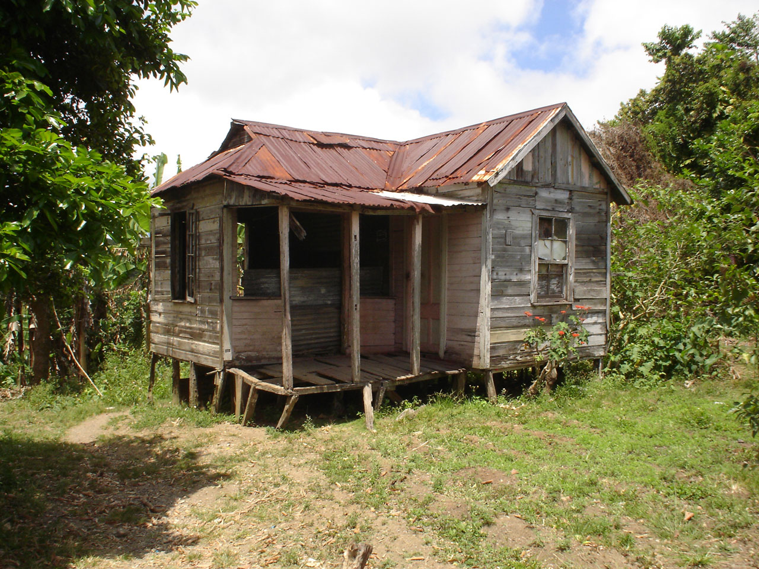
Shack

Slide 5
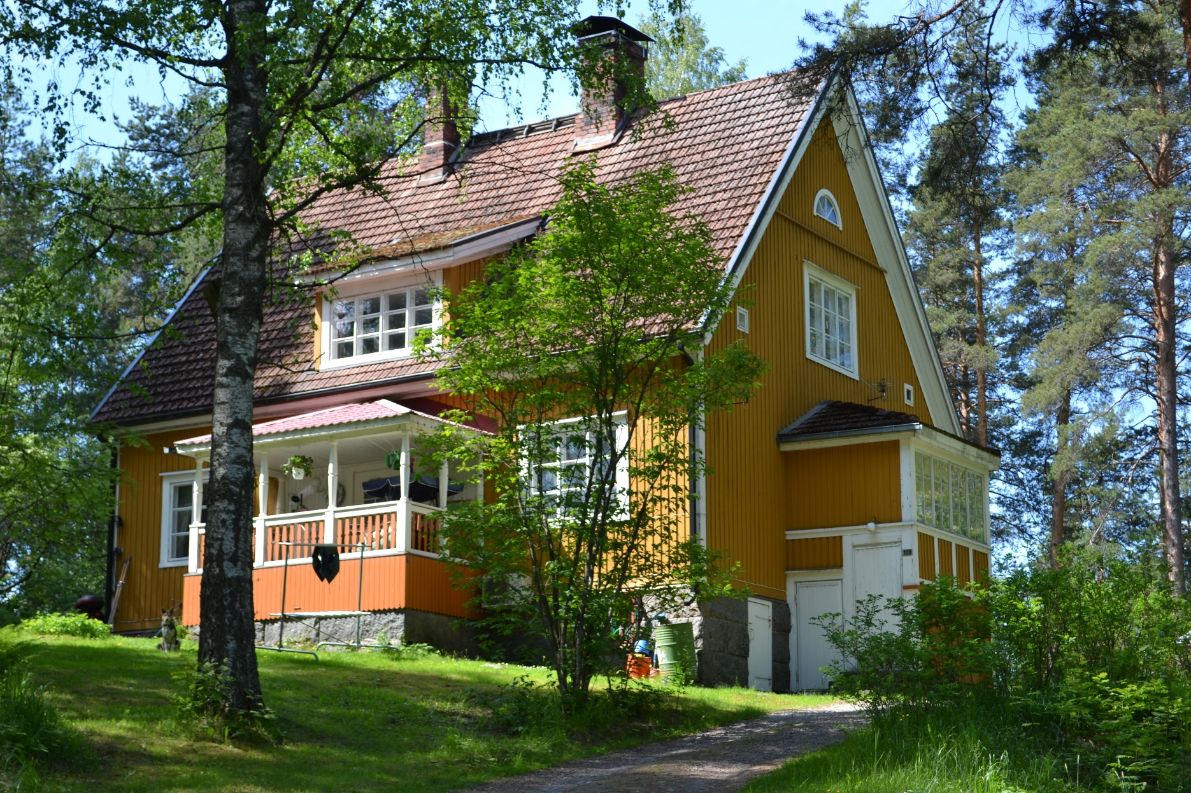
House

Slide 6
Who are you going to marry?
2 people you like.
The other student chooses 2 you don’t like.

Slide 7
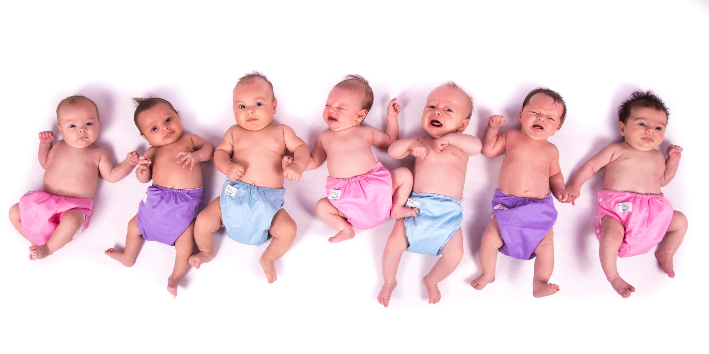
How many children?
2 people you like.
The other student chooses 2 you don’t like.

Slide 8
What car are you going to drive?
2 people you like.
The other student chooses 2 you don’t like.

Slide 9
What job are you going to have?
2 people you like.
The other student chooses 2 you don’t like.

Slide 10
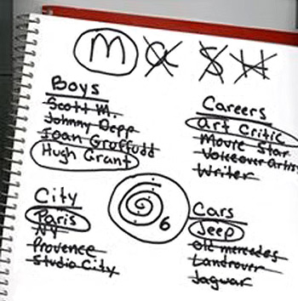
Choose a number between 5 and 10

