Slide 1
Hot Seat

Slide 2
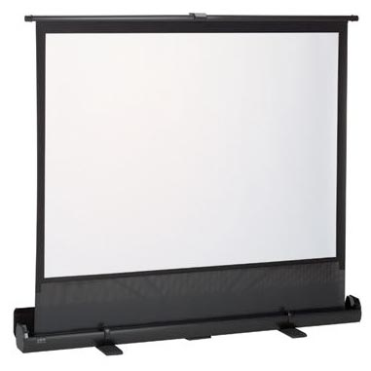
How to play
One student comes up to the front and sits in the hot seat.
The student faces away from the screen

Slide 3
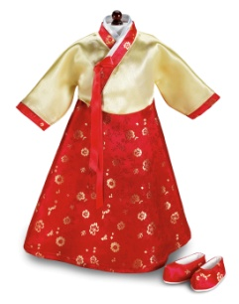
It’s colorful!
It’s a Korean dress!
Help your team guess the word by giving them clues! But you can’t use the word.

Slide 4
The student in the hot seat must answer by saying
Do you know about ______?

Slide 5
Do you know about hanbok?

Slide 6
If you guess the right word with the - 1st clue, your team gets 5 points. - 2nd clue, your team gets 3 points. - 3rd clue, your team gets 1 points. Or you can pass by saying, “I don’t know/I have no idea”

Slide 7
Raise your hand to tell a clue.

Slide 8
Don’t say the word!
Don’t speak Korean!

Slide 9
Understand?

Slide 10
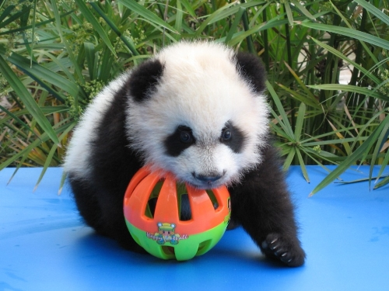
Do you know about pandas?

Slide 11
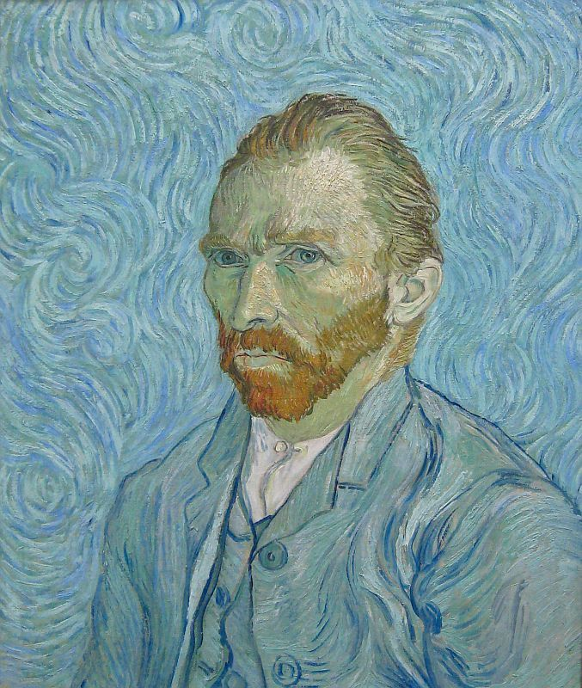
Do you know about Van Gogh?

Slide 12
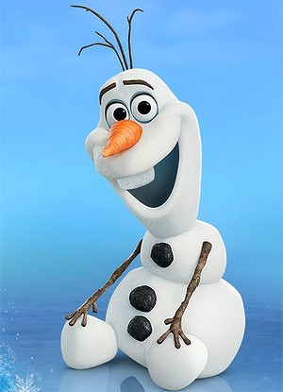
Do you know about Olaf?

Slide 13
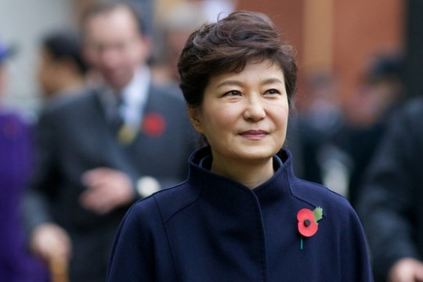
Do you know about Park Keun Hye?

Slide 14
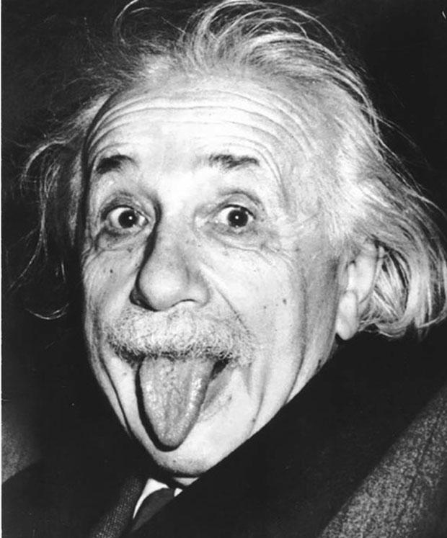
Do you know about Einstein?

Slide 15
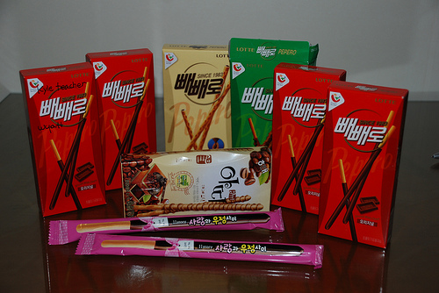
Do you know about ppeppero(빼빼로)?

Slide 16
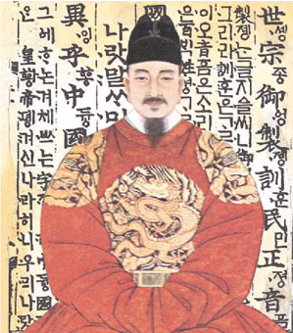
Do you know about King Sejong?

Slide 17
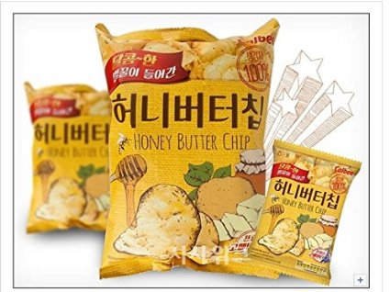
Do you know about honey butter chips?

Slide 18
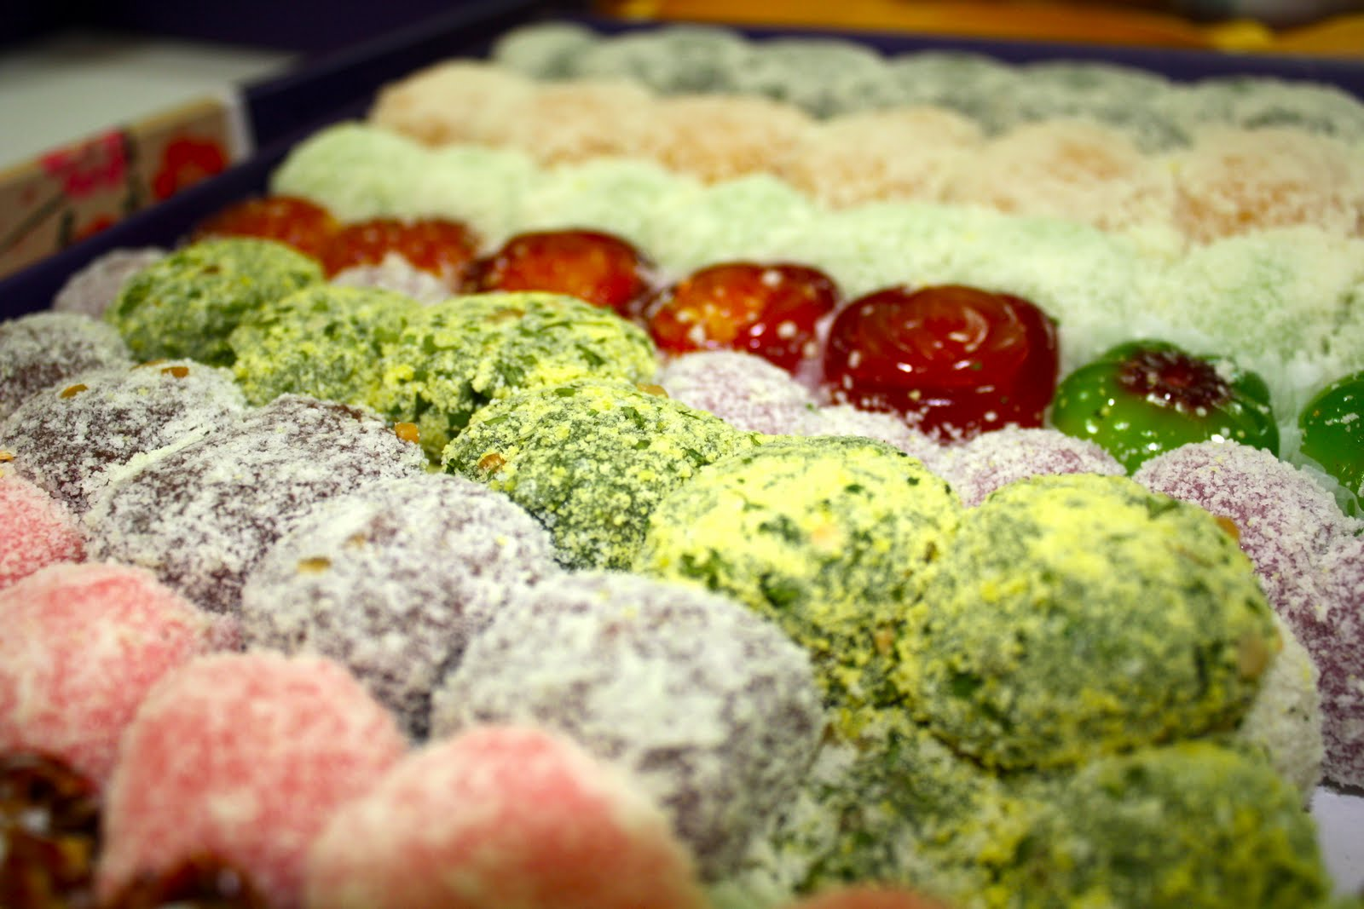
Do you know about tteok (떡)?

Slide 19
Do you know about Cinderella?

Slide 20
Do you know about Pororo (뽀로로)?

Slide 21
Do you know about League of Legends (LOL)?

Slide 22
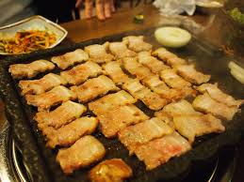
Do you know about grilled pork (삼겹살)?

Slide 23
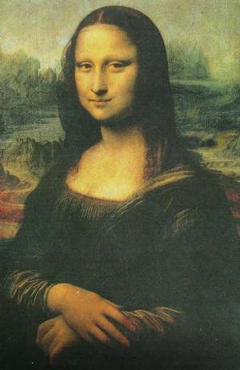
Do you know about the Mona Lisa?

Slide 24
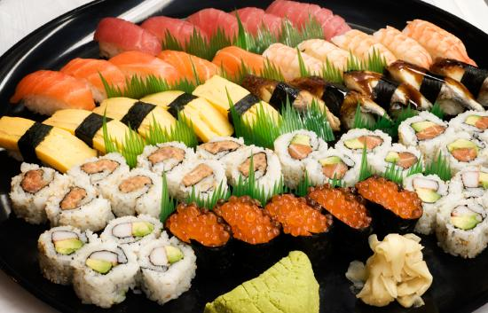
Do you know about sushi?

Slide 25
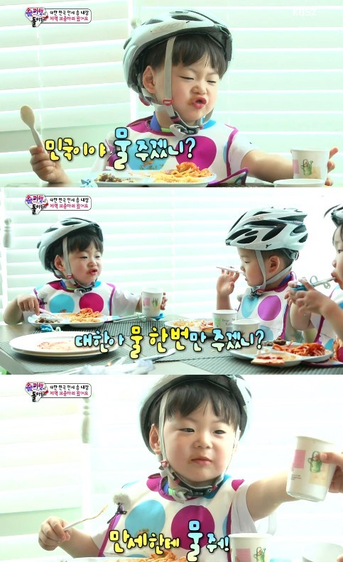
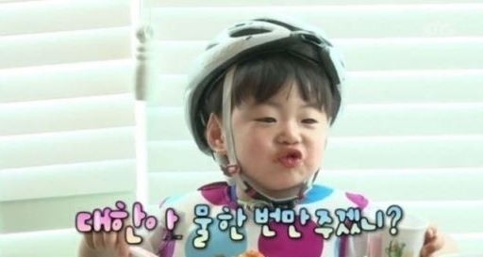
Do you know about Manse?

Slide 26
Do you know about Kakao?

Slide 27
Do you know about Steve Jobs?

Slide 28
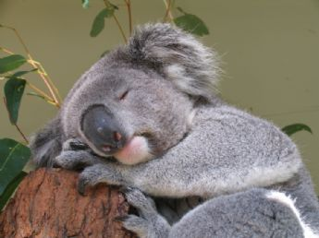
Do you know about koalas?

Slide 29
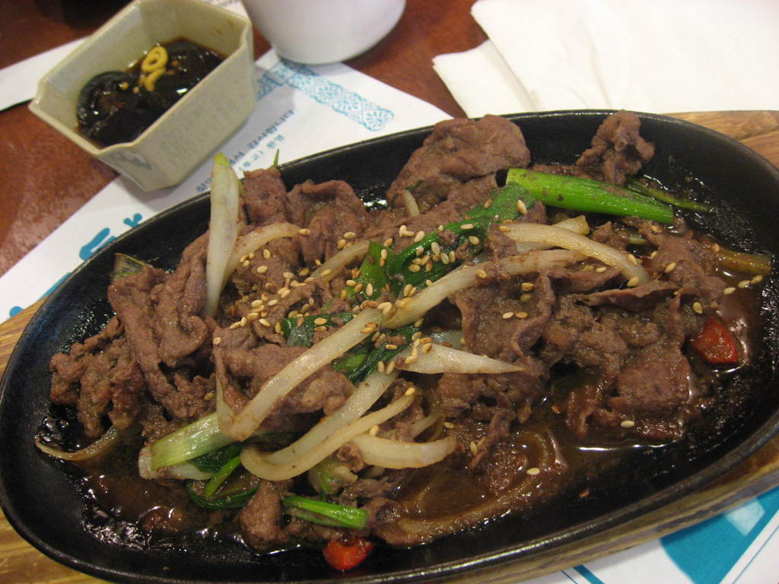
Do you know about bulgogi(불고기)?

Slide 30
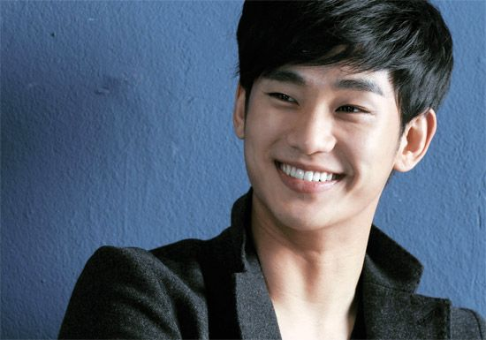
Do you know about 김수현?

Slide 31
Do you know about shooting stars?

Slide 32
Do you know about coke?

