Slide 1
A Maze Zing Lesson
Left / Right / Forwards / Backwards

Slide 2
How to Play
One student will come to the front
Turn off the monitor or blindfold the student
This student will use the keyboard to play the game.
The other students shout directions to front
Try to get to the end
Then the next student can try

Slide 3
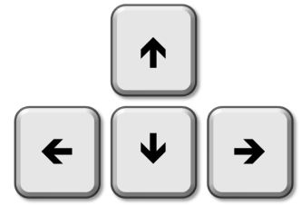
Left
Forwards
Right
Backwards

Slide 4
Rolling Maze
http://www.allmazegames.com/play/labyrink.htm

Slide 5
Maze Runner
http://www.allmazegames.com/play/maze-runner-missions.htm

Slide 6
3D Maze
https://scratch.mit.edu/projects/14777574/

Slide 7
Pumpkin Maze
http://www.xygames.com/flash/3d-maze

